Slide 1
empathicLLM – patient study
Can an LLM answer patients' questions about PSMA therapy well?
Pia Koller · 28 October 2026

Slide 2
The idea in short
– Patients before a PSMA therapy have many questions: side effects, radiation, how long they stay in hospital
– A large language model (LLM, like ChatGPT) could answer these questions
– A good answer must be correct and easy to understand – and ideally also kind
– We let the LLM write answers in three different ways and ask patients and doctors which answers they like
What we want to find out
– Do patients like the answers of the two-step method best (first the facts, then friendly wording)?
– And are these answers still correct?
– And do the answers change patients' decisions – do they feel more or less certain about the therapy?
empathicLLM patient study · 28.10.2026
2
Notes:
Project title at the ethics committee: Uncertainty-Aware Large Language Models in Nuclear Medicine.

Slide 3
Three ways to write an answer
Clinical Only
LLM writes the answer
instruction: facts only
Check
readable, no jargon, answers the question in the first sentence
→ shown in the study
Patient question
e.g. “Will I feel sick?”
Sources
Insel patient information, guidelines
Direct Empathy
LLM writes the answer
instruction: facts, warm and empathic
Two-Stage
Step 1: LLM lists the facts
no wording yet
Step 2: LLM rewrites them warmly
no new facts allowed
Same LLM, same sources, same writing rules – only the instruction differs.
empathicLLM patient study · 28.10.2026
3
Notes:
The three arms. Everything is the same except the instruction to the LLM: same model (MedGemma 27B, a medical language model from Google, running on our own server), same sources, same writing rules (short, simple words, answer in the first sentence). Direct Empathy uses the NURSE model of empathic communication in its instruction. Two-Stage: step 1 lists the facts, step 2 may only reword them, not add new facts.

Slide 4
The LLM also tells us how sure it is
While writing, we measure:
This gives two numbers per answer
– Does the LLM hesitate between words?
– Do 5 drafts of the same answer say the same thing?
– Do the sources fit the question?
– How emotional is the tone?
– How sure does the LLM say it is?
Uncertainty about the facts
0 = sure, 1 = unsure
Uncertainty about the tone
0 = sure, 1 = unsure
Currently about 0.3 in all three ways of writing; the questions differ more than the three ways.
empathicLLM patient study · 28.10.2026
4
Notes:
Technical names: token log-probabilities, perplexity, token entropy, top-1/top-2 gap (model); TF-IDF and NLI agreement between 5 sampled candidates (consistency); similarity of the retrieved passages (sources); emotion classifier; verbalised confidence. Combined with weights into U_clinical and U_empathy. They are computed from the 5 drafts per question; the answer shown is written separately with the same instruction and sources.

Slide 5
Why we measure this
LLM's uncertainty
two numbers per answer
Study results
ratings by patients and doctors, medical check
Do they match?
is the LLM unsure where people see problems?
– Example: the LLM is unsure about the facts → do the doctors find a mistake in this answer?
– Example: the LLM is unsure about the tone → do patients find this answer cold or worrying?
– If yes, a future chatbot could use these numbers to warn, be more careful, or pass the question to the care team
empathicLLM patient study · 28.10.2026
5
Notes:
Exploratory: 60 answers in total, so these are first indications. Each rating is stored with the answer, so the numbers can be joined afterwards.

Slide 6
Where we are
– The LLM uses the Insel patient information and guidelines as sources
– The answers are short and in plain language
– The study app is ready for a test run
– Ethics committee Bern: no approval needed
empathicLLM patient study · 28.10.2026
6
Notes:
Insel patient information added to the sources, unrelated text sections filtered out, better ranking of sources: the right source passages are found for 71 % of the questions.

Slide 7
How readable are the answers?
 | Readability (Flesch) | Words | Passed the check
Clinical Only | 42 | 59 | 19 of 20
Direct Empathy | 41 | 73 | 17 of 20
Two-Stage | 40 | 83 | 18 of 20
What is Flesch?
A score from 0 to 100 for how easy a text is to read
Short sentences and short words = higher score
Over 60: easy
50–60: medium
30–50: difficult (like a newspaper)
Under 30: very difficult (scientific text)
– All three ways are now similar in readability and length – so if patients prefer one, it is because of the way of writing, not the length
– 6 answers did not pass the check and Q14 (danger to others after discharge) differs between the three: the doctors look at these first
empathicLLM patient study · 28.10.2026
7
Notes:
Flesch reading ease, German version by Amstad: 180 − average sentence length − 58.5 × average syllables per word. Screening: answer in the first sentence, at most 150 words, no drug names, no talk about sources, no letter phrases.

Slide 8
Why the sources matter
 | With sources | Without sources
Key facts correct (5 checked, per way of writing) | 4–5 | 0–1
Uncertainty about the facts (0 = sure) | 0.30–0.32 | 0.30–0.34
Examples without sources
– Visitors? – “Yes, you may have visitors” (Insel: no visitors)
– Cure? – “Yes, a cure is possible” (in this situation a cure is not expected)
– It even writes “the Insel patient information says …”, although it never saw it
→ The study only uses answers with sources
→ The uncertainty numbers barely changed – they did not warn about these errors. The study will show whether they are useful at all
empathicLLM patient study · 28.10.2026
8
Notes:
Benchmark only, not shown to patients. Same LLM, instructions and settings, runs of 27 Oct 2026; 'without sources' means the LLM answers from what it learned in training (no retrieval). Key facts checked by text search in 5 questions: no cure (Q1), 3 days in hospital (Q9), no visitors (Q10, Q13), cycles every 6-8 weeks (Q20). Uncertainty about the facts: 0.30-0.32 with sources, 0.30-0.34 without. Note: the shared writing rules mention the Insel patient information even when no sources are given, which is why the LLM refers to it without sources.

Slide 9
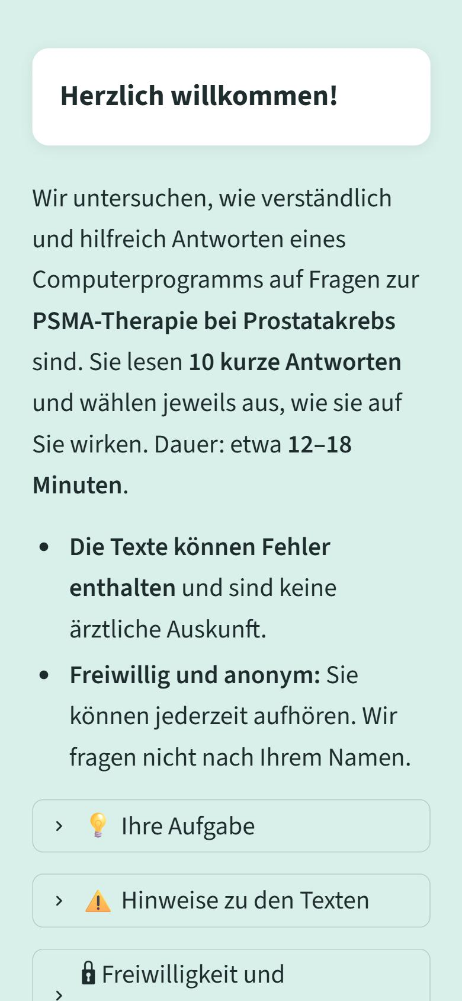
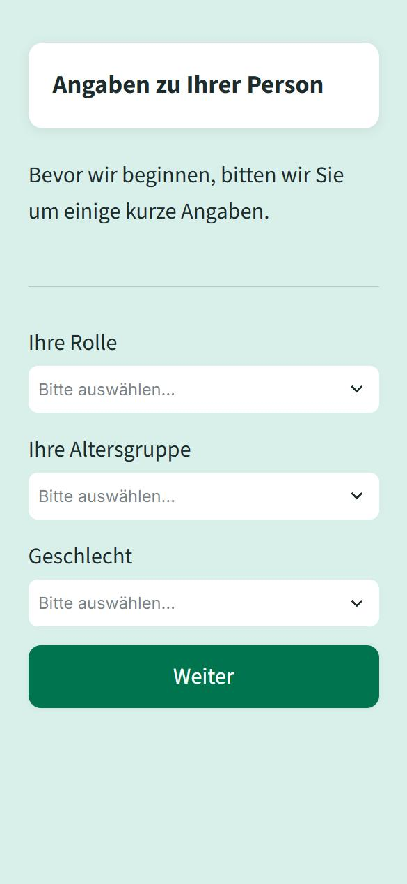
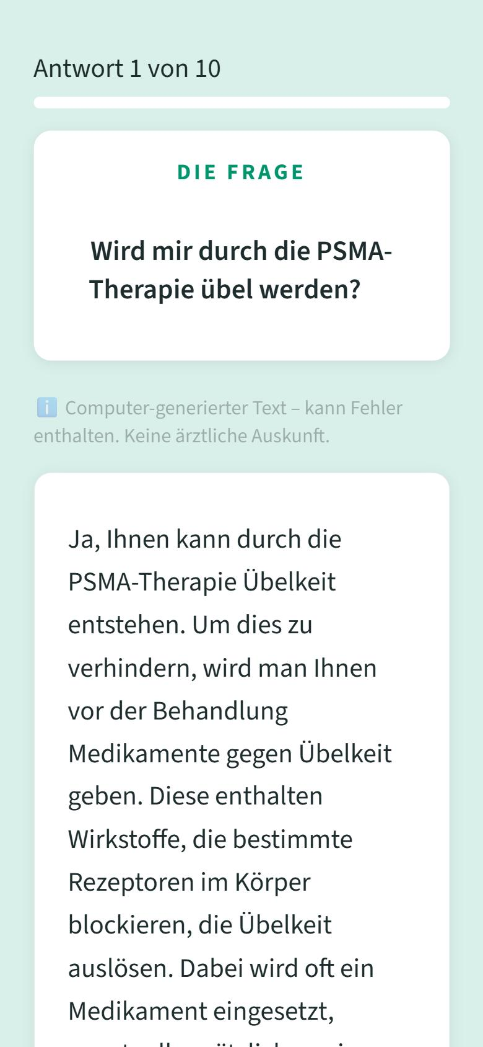
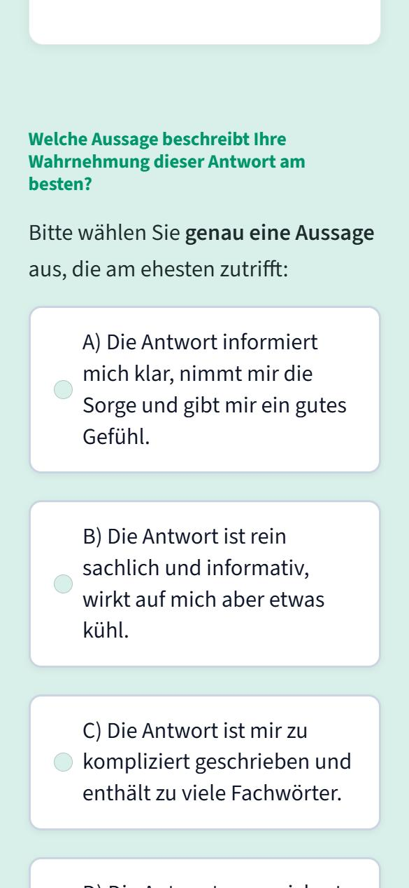
The study app
1 Start page
2 Role and age group
3 Question and answer
4 Rating
empathicLLM patient study · 28.10.2026
9
Notes:
Real screenshots of the app on a phone (local test with demo data).

Slide 10
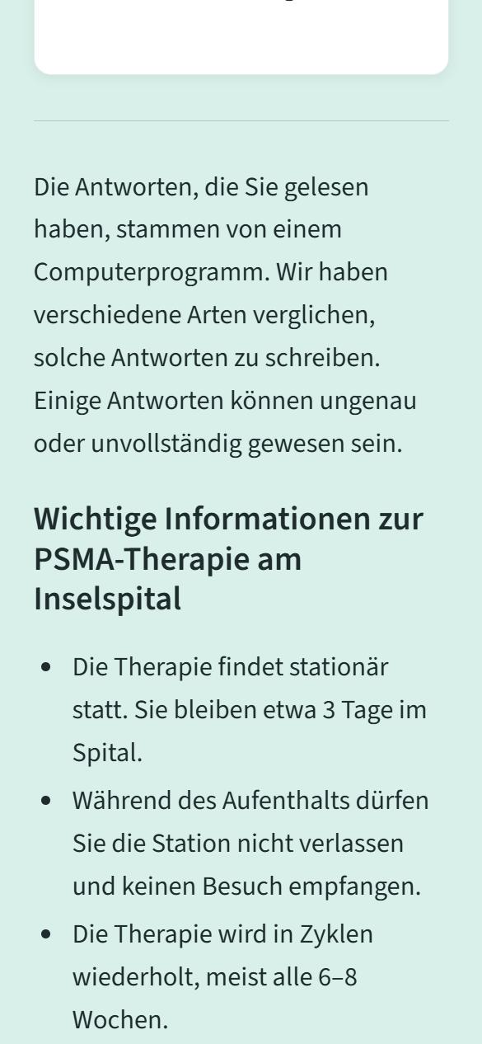
How a participant takes part
– Patients scan a QR code, doctors get a link; both use their own phone
– Each person reads 10 answers (out of 20 questions), about 15 minutes
– For each answer they choose one of four statements, e.g. “clear and reassuring” or “too complicated”
– They do not know which of the three ways wrote the answer
– Every question is rated equally often, by patients and by doctors
– Anonymous: no name, only age group and gender
– At the end: a sheet with the correct key facts about the therapy
5 End: information sheet
empathicLLM patient study · 28.10.2026
10
Notes:
Screenshot: end of the study with the information sheet.

Slide 11
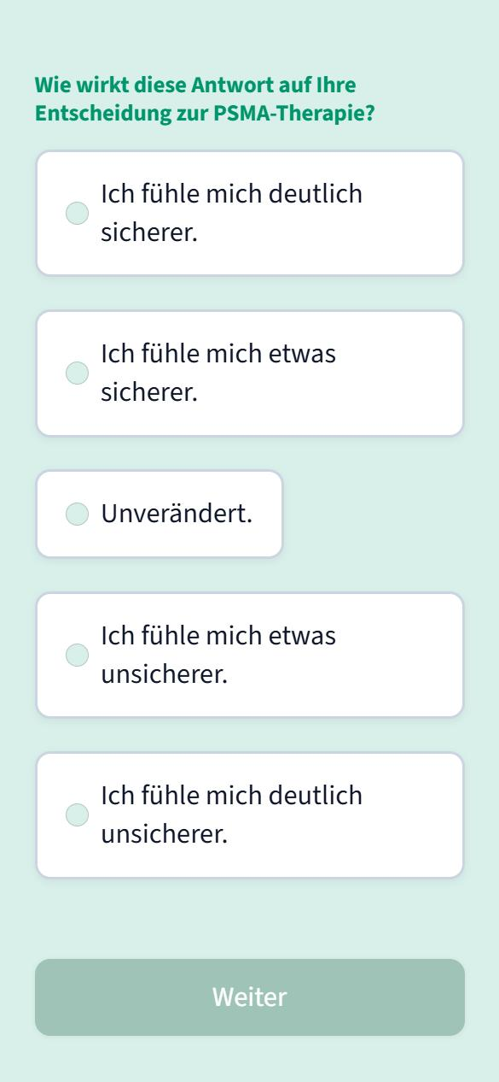
New: does the answer change the decision?
Added on 28 Oct: not only whether an answer is empathic, but whether it changes patients' decisions.
Patients, after each answer: more certain … less certain about their decision on the PSMA therapy (+2 to −2)
Doctors, after each answer: would you give this answer to a patient – as is / with changes / no
Patients, before and after: SURE test, 4 yes/no questions on decisional conflict
Main comparison: do Two-Stage answers make patients more certain than Clinical Only answers?
Safety: patients who end the study less certain see a note to talk to their care team; the ethics committee will be informed.
Second question after each answer
empathicLLM patient study · 28.10.2026
11
Notes:
Added after the meeting of 28 Oct at the supervisor's request. Certainty instead of for/against, because many patients are already in therapy. Dosimetry was dropped as an example because it is hardly done at Insel. No new answers are needed; the same 60 answers are used.

Slide 12
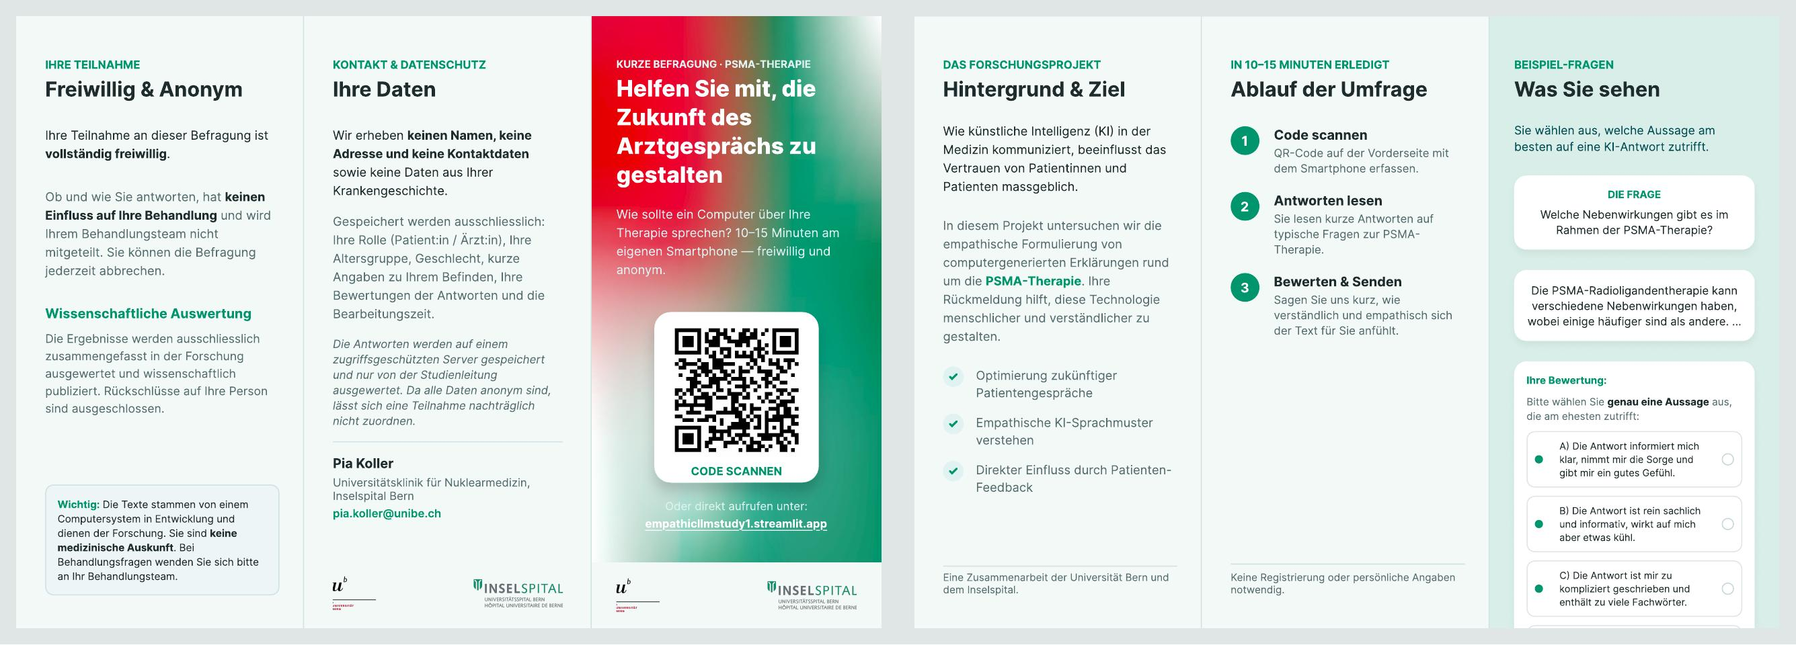
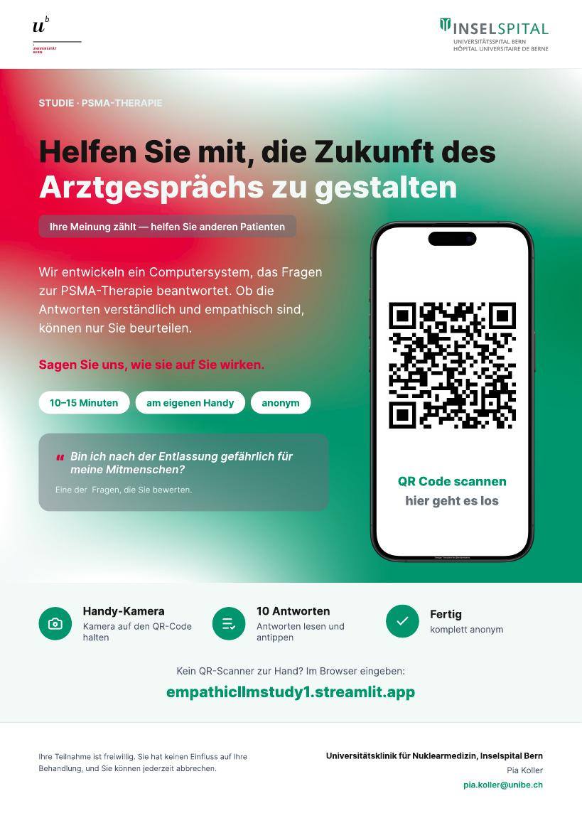
Flyer and poster
Flyer, A4 tri-fold (outside left, inside right)
Both lead to the app with a QR code (empathicllmstudy1.streamlit.app)
Poster, A3, waiting room
empathicLLM patient study · 28.10.2026
12
Notes:
Flyer and poster, Figma export of 27 Oct 2026: duration, 10 answers, patient rating options and data description updated; the line about an ethics approval was removed.

Slide 13
Ethics committee: three points differ
 | What we described to the ethics committee | The app today
Questions | 10 | 10 (out of 20)
Participants | patients and doctors | patients and doctors
Data | anonymous | anonymous
Rating | compare answer A with answer B | rate one answer at a time
Ways of writing | 2 (new method vs. standard) | 3
Health data | none | questions on worries and mood
For the last three rows: change the app, or tell the ethics committee.
empathicLLM patient study · 28.10.2026
13
Notes:
The ethics committee (KEK Bern, Req-2026-00886, 22 June 2026) decided that the project is outside the Human Research Act. That decision is based on our description; three points differ now.

Slide 14
We need about 60–70 participants
We use all three ways of writing
The line shows how likely the study finds a real difference between Two-Stage and Clinical Only (target: 80 %)
40 participants: 63 %; about 60–70 participants reach 80 %
Patients and doctors can be analysed together if the effect is similar in both groups; then nothing can be said about each group on its own
empathicLLM patient study · 28.10.2026
14
Notes:
Simulation: Clinical Only rated 'clear and reassuring' in 30 % of answers, Two-Stage 15 points higher. Three ways of writing (decided 27 Oct). Power = chance that the study shows the difference if it is real; 80 % is the usual target. 20 patients + 20 doctors analysed together give about the same as 40 patients, if the effect is the same in both groups.

Slide 15
What is still needed before a run
Task
Check all 60 answers for medical correctness – Excel rating sheet ready (one per doctor, arm hidden)
Check the facts on the final information sheet
Test run with 3–5 patients and 1–2 doctors
empathicLLM patient study · 28.10.2026
15
Notes:
Proposed; to be agreed in the meeting.

Slide 16
Timeline: study start 16 November
26.10.
2.11.
9.11.
16.11.
23.11.
30.11.
Meeting: go / decisions
28.10.
Medical check of the 60 answers and the information sheet
2 doctors, Excel sheets
Remove harmful questions; app final; inform clinic and data protection
Test run with colleagues; print flyer and poster
incl. 1–2 non-medical people; test data deleted
Study start
16.11.
First week: follow the first participants closely
Holiday (deputy: contact e-mail and data check)
Critical path: the medical check must be done by 6 November. Before the holiday: a deputy for the contact e-mail and for checking that data arrive.
empathicLLM patient study · 28.10.2026
16
Notes:
Start on Monday 16 November, one week before the holiday (from 24 November). The test run uses colleagues instead of patients: it checks the app, timing and wording; how patients react is watched in the first week of the study, which can be paused if something comes up. Test records are removed from MongoDB.

Slide 17
If we only get 20–30 patients
Chance to find a real difference (target 80 %)
Options
Patients | Answers per person | +15 points | +20 points
20 | 10 | 36 % | 60 %
30 | 10 | 52 % | 70 %
20 | 20 | 61 % | 84 %
30 | 20 | 76 % | 96 %
1. Report it as a pilot study: show the differences with confidence intervals, without claiming proof
2. Analyse patients and doctors together: 20–30 of each count like 40–60 participants – decide this before the study
3. 20 answers per person: much more power, but 20–30 minutes instead of 10–15
4. Recruit longer or add Munich: more patients, later results
Three ways of writing; difference between Two-Stage and Clinical Only in how often patients choose “clear and reassuring”.
Proposal: 1 as the main plan, 2 as a pre-planned additional analysis; keep 10 answers per person.
empathicLLM patient study · 28.10.2026
17
Notes:
Simulation with the app's assignment: Clinical Only rated 'clear and reassuring' in 30 % of answers, Two-Stage 15 or 20 points higher, 200 simulated studies per cell. Pooling patients and doctors assumes statement A counts as the same outcome in both groups and a similar effect.

Slide 18
Open questions
Go for a test run in Bern
Is recruiting 60–70 participants realistic?
Keep or drop the questions on worries and mood
Is hosting the app on Streamlit Cloud OK
Munich: now, or later as a second phase
Decision question: is the wording OK? (the ethics committee will be informed)
empathicLLM patient study · 28.10.2026
18
Notes:
Decision 1 is the main point; 2-5 decide whether the app changes before the test run.

