Slide 1
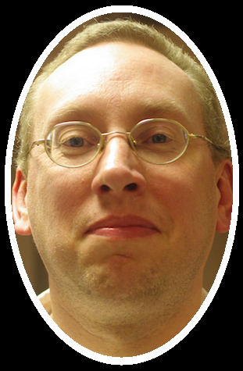
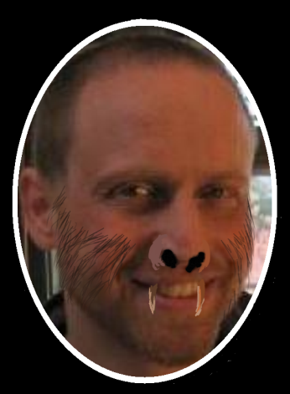
CS
Education Zoo
With your hosts:
Byrd
Wolfman

Slide 2
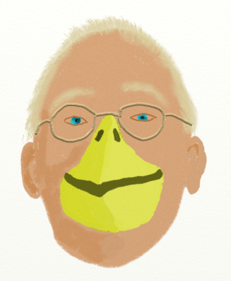
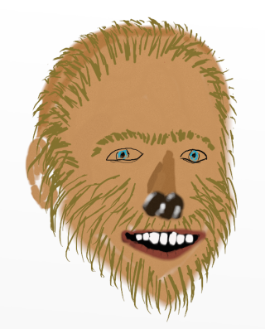
CS
Education Zoo
With your hosts:
Byrd
Wolfman

Slide 3
CS
Ed Zoo
The Bestiary

Slide 4
