Slide 1
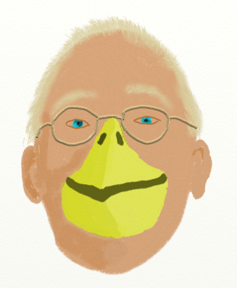
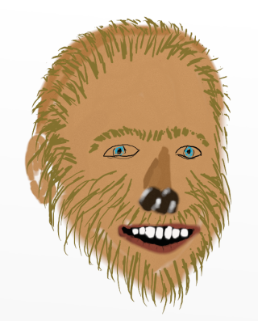
CS
Education Zoo
Byrd
webyrd.net/zoo.html
With your hosts:
Wolfman
Watch Jeff Forbes explain why “rapid feedback is better than good feedback,” and much more!
The Zoo is your lunchtime CS Education interview show,
now supported by the SIGCSE Special Projects Grant Program!

