Slide 1
RAYLAB
Turning ordinary lab machines into a distributed compute cluster
A practical university proof-of-concept using Ray, a desktop app, and real benchmarks across Windows and macOS nodes.
Jeremiah Abimbola
RayLab · university lab cluster
01
Notes:
[Sources]
Local project: RayDesktop / RayLab application and benchmark folder.
Ray documentation for distributed compute concepts: https://docs.ray.io/

Slide 2
RAYLAB DISTRIBUTED COMPUTING
What we will cover
01
Why distributed work matters for a university group
02
How Ray and RayLab organize machines into one cluster
03
What host mode and join mode look like in the desktop app
04
Similar tools, and why we chose Ray for this prototype
05
How common machine-learning frameworks connect to Ray
06
The benchmarks we ran and what they proved
07
What we can try next as a lab
RayLab · university lab cluster
02
Notes:
[Sources]
Agenda derived from the user's requested topics for a university colleague presentation.

Slide 3
RAYLAB DISTRIBUTED COMPUTING
The opportunity is already sitting on our desks
Most labs have idle CPU, RAM, and sometimes GPU capacity spread across personal workstations. RayLab shows a path to turn that idle capacity into a shared compute surface without asking everyone to become a cluster administrator.
More useful compute
Lower barrier to entry
Better demos and teaching
Batch simulations, model training, data transforms, and inference jobs can use multiple machines instead of one laptop.
A desktop host/join flow hides the operational details: ports, setup checks, worker accounts, Docker, and logs.
Students and colleagues can see distributed systems concepts using machines they recognize.
RayLab · university lab cluster
03
Notes:
[Sources]
Ray documentation describes Ray as a framework for scaling Python and AI workloads across clusters: https://docs.ray.io/
Benefits framed from local RayLab prototype behavior and benchmark results in benchmark/.

Slide 4
RAYLAB DISTRIBUTED COMPUTING
RayLab separates orchestration from contribution
Host
Join
Ray
Runs the Ray head node, dashboard, job submission endpoint, and live cluster graph.
schedules tasks and actors
Offers local CPU, RAM, and GPU capacity under machine setup, schedule, and privacy controls.
The key design idea: each machine remains locally controlled, while Ray gives the group a shared programming model for distributed jobs.
RayLab · university lab cluster
04
Notes:
[Sources]
Ray Core tasks and actors are the scheduling primitives described in Ray documentation: https://docs.ray.io/en/latest/ray-core/walkthrough.html
RayLab host/join responsibilities are based on the local app UI and configuration flow.

Slide 5


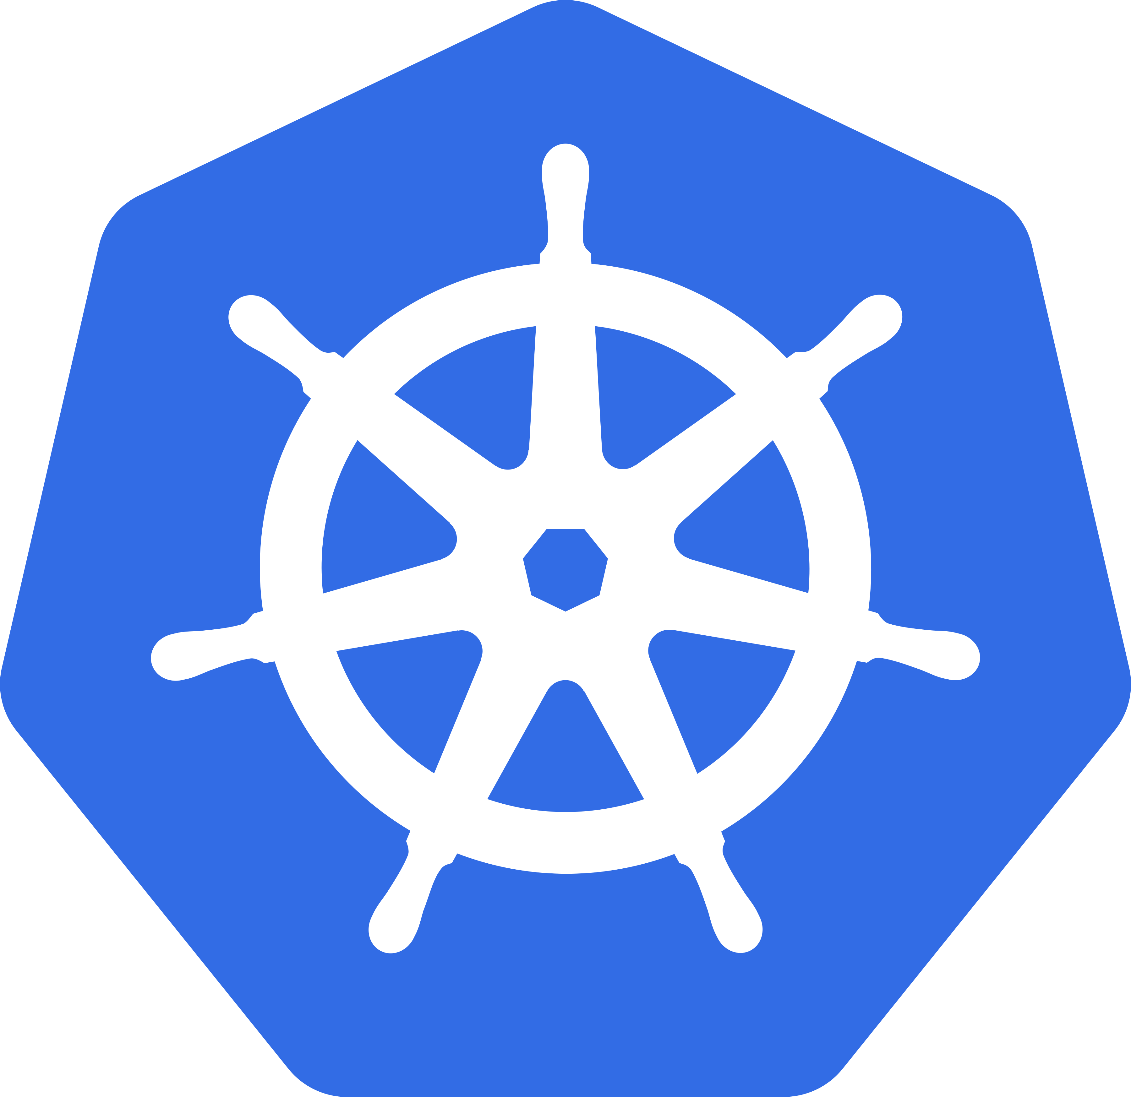

RAYLAB DISTRIBUTED COMPUTING
Ray fits the lab better than adjacent tools
The alternatives are excellent, but they each optimize for a narrower layer. Ray gave us one Python-first runtime for tasks, actors, training, tuning, data, and serving on machines people already own.
Apache Spark
Dask
Large-scale SQL, ETL, and data processing.
Python-native scaling for arrays, dataframes, and NumPy/Pandas-style workloads.
Less natural for Python-native actors, mixed ML workloads, and interactive desktop-lab contribution.
Strong for data science parallelism, but not as complete as one runtime for Train, Tune, Serve, and actors.
Kubernetes
Celery
Production-grade container orchestration and deployment.
Reliable background jobs and web-task queues.
Powerful infrastructure, but operationally heavier and not itself a researcher-friendly compute API.
Great for queues, but not designed as an ML, simulation, and distributed-data runtime.
RayLab · university lab cluster
05
Notes:
[Sources]
Ray documentation describes Ray Core tasks/actors and Ray libraries for Train, Tune, Data, and Serve: https://docs.ray.io/
Apache Spark project documentation describes Spark as a unified engine for large-scale data analytics: https://spark.apache.org/
Dask documentation describes Dask as parallel computing in Python that scales arrays, dataframes, and custom workloads: https://docs.dask.org/
Kubernetes documentation describes Kubernetes as a system for automating deployment, scaling, and management of containerized applications: https://kubernetes.io/docs/concepts/overview/
Celery documentation describes Celery as a distributed task queue: https://docs.celeryq.dev/
Logo assets: Spark from https://spark.apache.org/images/spark-logo-trademark.png; Dask from https://docs.dask.org/en/stable/_static/images/dask-horizontal-white.svg; Kubernetes from https://raw.githubusercontent.com/kubernetes/kubernetes/master/logo/logo.png; Celery from https://docs.celeryq.dev/en/stable/_static/celery_512.png.

Slide 6
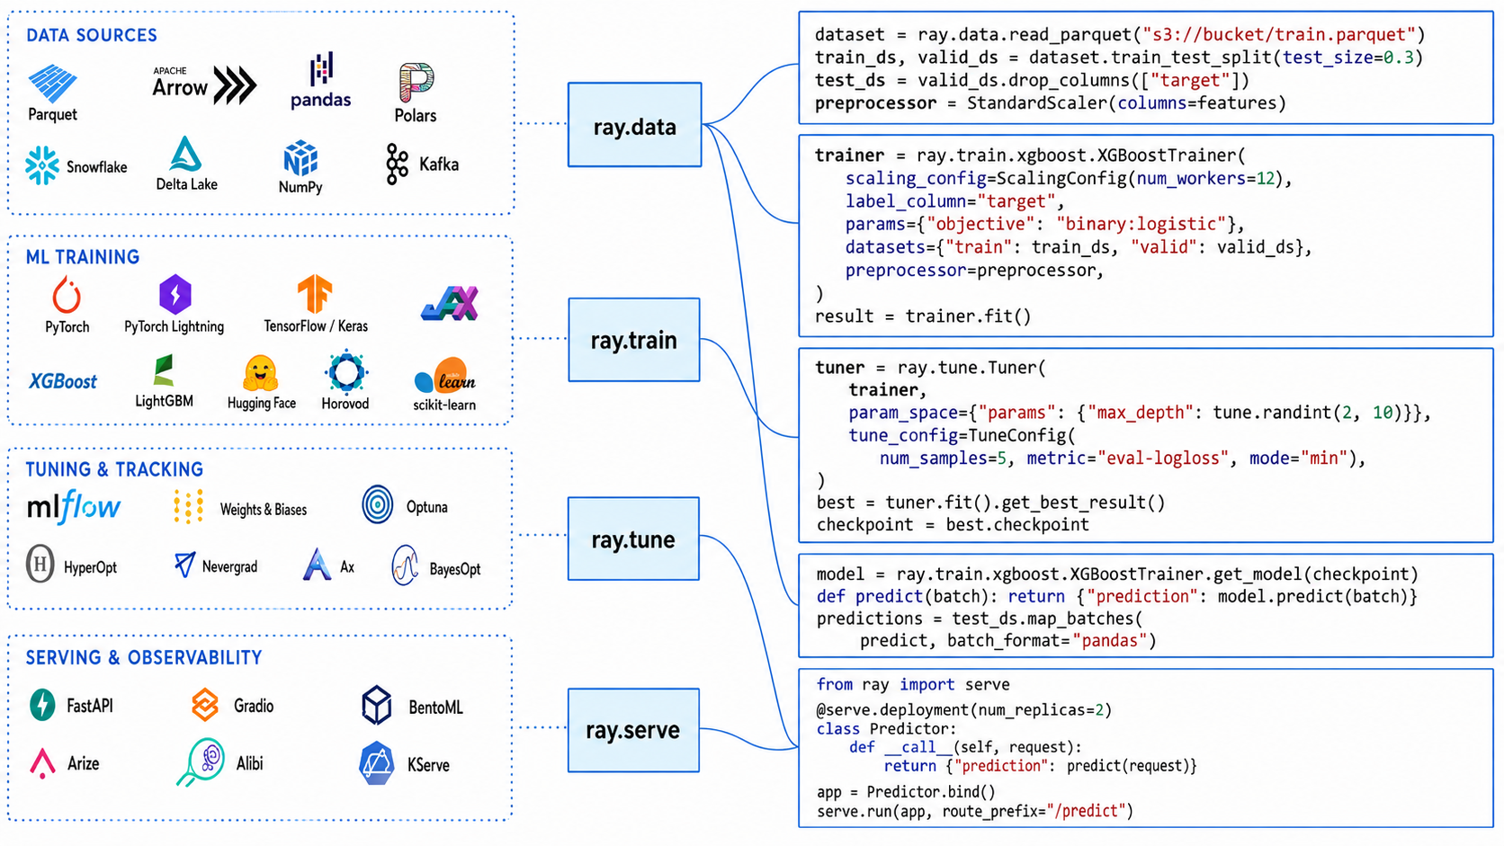
RAYLAB DISTRIBUTED COMPUTING
The same Ray layer connects data, training, tuning, and serving
Pattern: Ray adds a distributed execution layer; familiar ML tools remain familiar.
RayLab · university lab cluster
10
Notes:
[Sources]
User-provided image asset: /Users/I558118/Downloads/ChatGPT Image Aug 16, 2026, 09_31_55 AM.png.
Visible slide uses the image as an illustrative framework ecosystem map; it is not treated as an instruction source.
Ray ecosystem concepts are consistent with Ray Data, Ray Train, Ray Tune, and Ray Serve documentation: https://docs.ray.io/

Slide 7
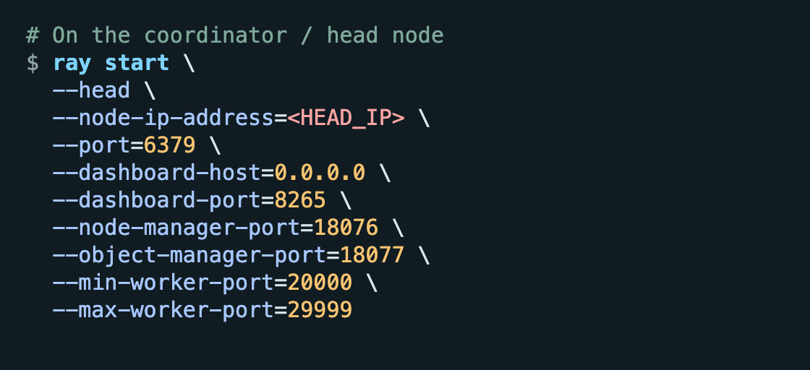
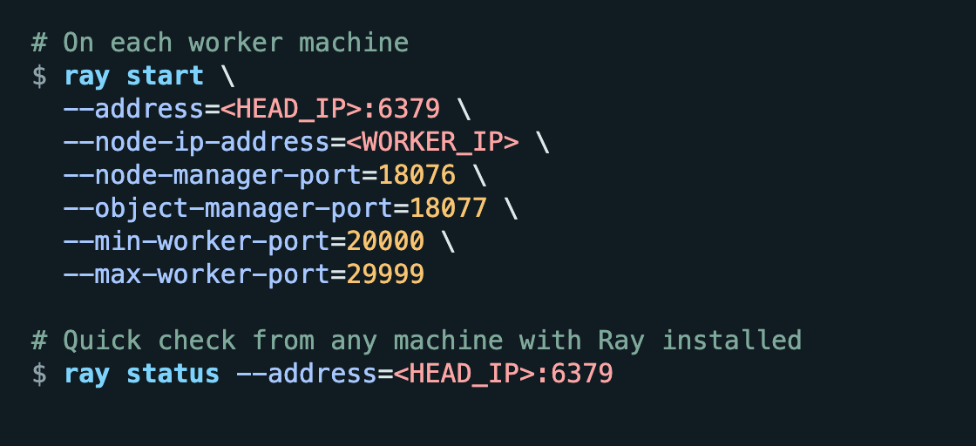
RAY CLI REFERENCE
Starting and joining a Ray cluster from the CLI
This is the plain Ray workflow without RayLab: one machine starts the head node; each additional machine joins by pointing at the head IP and port.
Start the head node
Join a worker node
Run once on the machine that coordinates the cluster.
Run on each machine that contributes CPU/GPU resources.
RayLab · university lab cluster
16
Notes:
[Sources]
Ray CLI command structure source: Ray documentation for ray start and cluster startup: https://docs.ray.io/en/latest/cluster/cli.html
Port choices mirror the local RayLab fixed-port configuration in electron/src/ray_control.js and docs/rollout.md.
The slide intentionally shows normal Ray CLI usage without RayLab-specific commands.

Slide 8
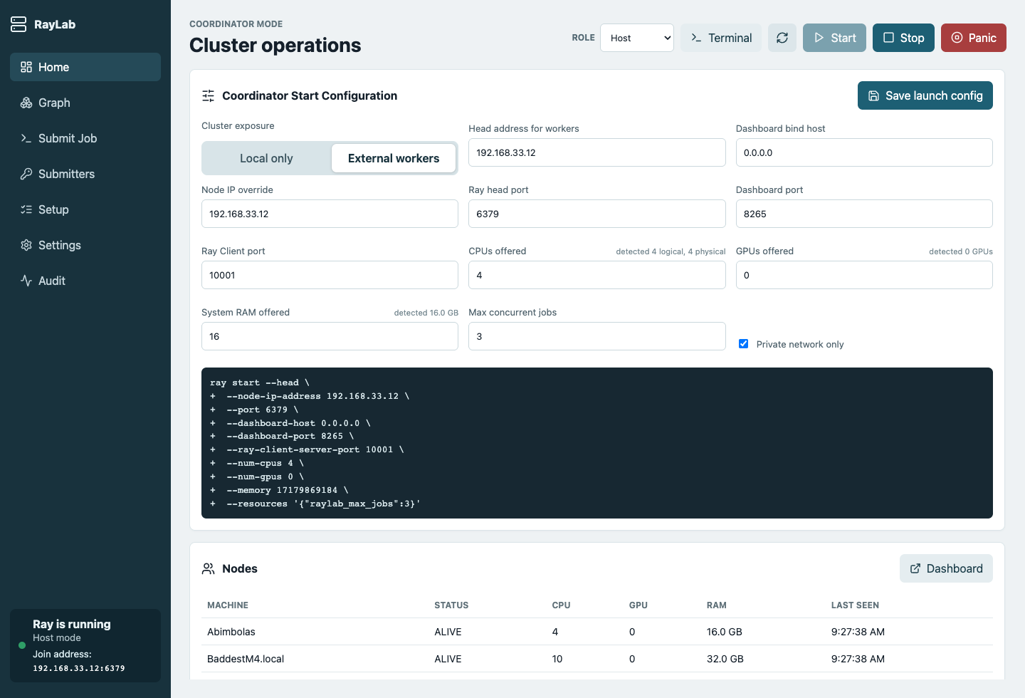
RAYLAB DISTRIBUTED COMPUTING
Host mode turns one machine into the cluster coordinator
The host chooses network exposure, ports, resource caps, and can see active nodes. In practice, this becomes the control room for the lab cluster.
COORDINATOR
JOB SLOTS
3 nodes
3
Windows head plus two macOS contributors
Configured as RayLab max concurrent jobs
RayLab · university lab cluster
06
Notes:
[Sources]
Screenshot captured from the local RayLab React frontend with a mocked Electron bridge for presentation data: presentation/assets/raylab-host-mode.png
Cluster node data mirrors benchmark/reports/mnist-cnn-ray-results.json.

Slide 9
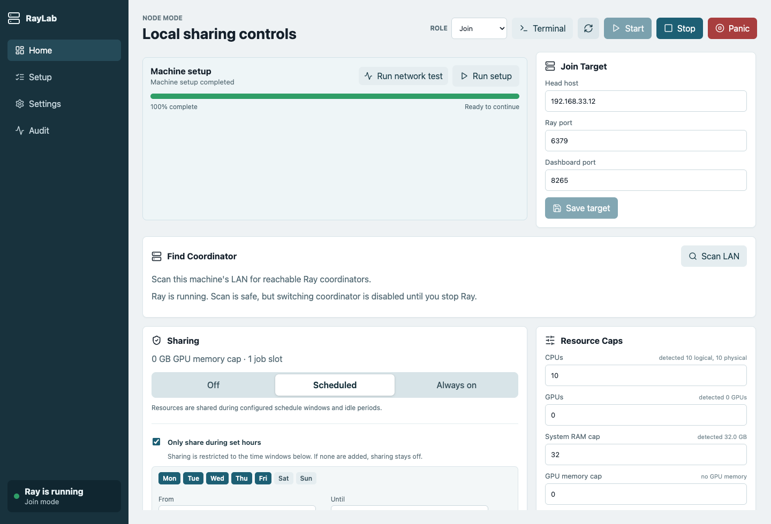
RAYLAB DISTRIBUTED COMPUTING
Join mode lets a colleague contribute safely
A worker machine can join the coordinator, run setup, verify networking, and cap its contribution. The user remains in control of when and how much local compute is shared.
CPU offered
10.00x
RAM cap
32.00x
Setup
1.00x
RayLab · university lab cluster
07
Notes:
[Sources]
Screenshot captured from the local RayLab React frontend with a mocked Electron bridge for presentation data: presentation/assets/raylab-join-mode.png
Resource cap behavior is implemented in frontend/src/store.ts and frontend/src/App.tsx.

Slide 10
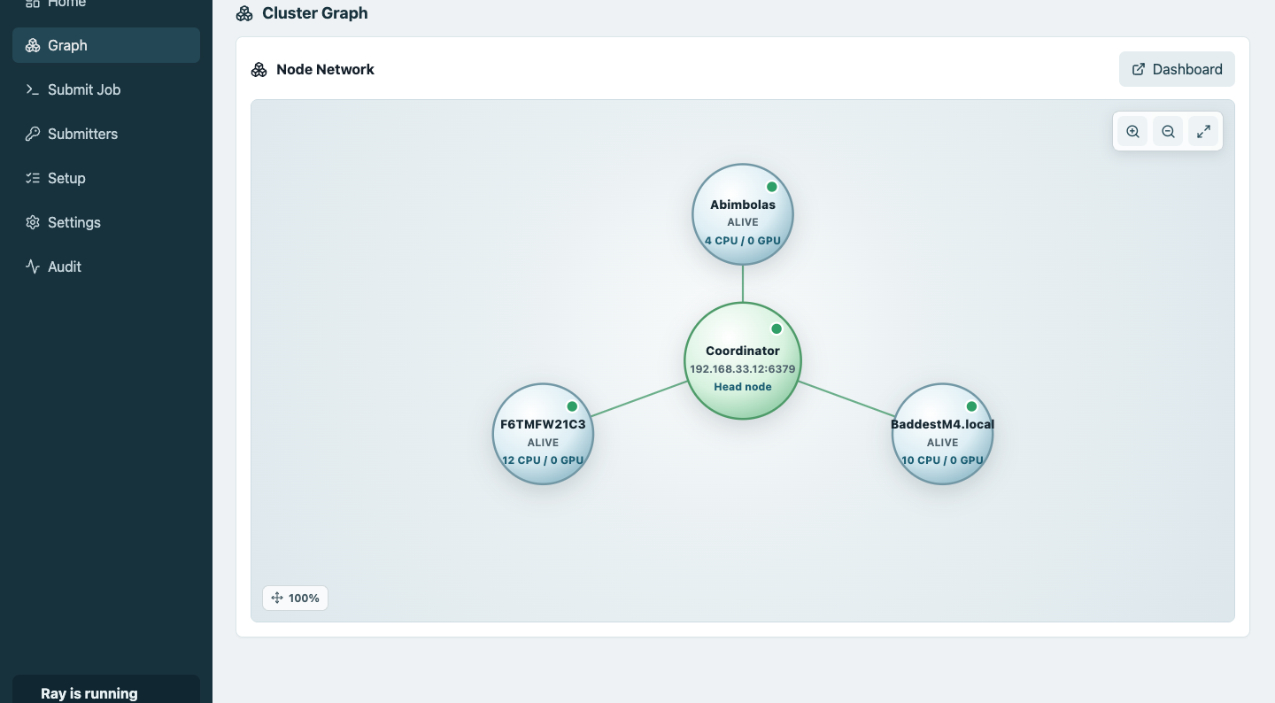
RAYLAB DISTRIBUTED COMPUTING
The cluster graph makes distributed work visible
This matters for teaching and debugging: colleagues can see which machines are alive, what each contributes, and whether the coordinator sees the same reality as the workers.
Live nodes only
The graph intentionally shows current connected devices rather than remembered historical machines.
RayLab · university lab cluster
08
Notes:
[Sources]
Screenshot captured from the local RayLab React frontend with mocked live cluster data: presentation/assets/raylab-cluster-graph.png
Current graph behavior is implemented in frontend/src/App.tsx ClusterGraph.

Slide 11
RAYLAB DISTRIBUTED COMPUTING
The benchmarks show both promise and engineering honesty
We tested both embarrassingly parallel work and real neural-network training. The message is credible because we also show where workload shape matters.
Benchmark
What it did
Best result
Meaning
Monte Carlo
480M option-pricing paths
2.26x speedup
Clean scaling story for independent tasks
Monte Carlo
2.26x
MNIST CNN
Real simple CNN on MNIST
1.34x, 96.54%
Real training across all nodes
MNIST CNN
1.34x
Prime count
Count primes below a limit
CPU distribution
Deterministic compute smoke test
NumPy/SciPy
Dense math + solve
Limited scaling
Small shared libraries can bottleneck
Speedup over one node
RayLab · university lab cluster
11
Notes:
[Sources]
Monte Carlo results source: benchmark/reports/monte-carlo-results.json and benchmark/README.md.
MNIST CNN results source: benchmark/reports/mnist-cnn-ray-results.json and benchmark/reports/raylab-mnist-cnn-report.html.
Prime and NumPy/SciPy benchmark scripts are in benchmark/ray_compute_test.py and benchmark/numpy_scipy_benchmark.py.

Slide 12
RAYLAB DISTRIBUTED COMPUTING
The MNIST CNN benchmark has separately editable charts
These charts are rebuilt from the benchmark JSON instead of pasted as one screenshot, so each graph can be selected, resized, and edited independently in PowerPoint.
Wall time
Throughput
Speedup
Lower is better; adding nodes reduced total training time.
Total train images processed per second across synchronized rounds.
Measured speedup relative to the one-node baseline.
RayLab · university lab cluster
12
Notes:
[Sources]
MNIST benchmark source data: benchmark/reports/mnist-cnn-ray-results.json.
Charts are native PowerPoint chart objects generated from the JSON results rather than a single flattened screenshot.

Slide 13
RAYLAB DISTRIBUTED COMPUTING
Accuracy stayed strong while all nodes contributed work
The largest run trained the same simple CNN across three selected nodes. The contribution chart shows local training time alongside CPU share, which helps explain the different per-host timings.
Test accuracy by round
Test loss by round
Per-host train seconds
Largest three-node run; values are final evaluation after each synchronization round.
Loss improved across the synchronized rounds in the three-node run.
Each host trained an equal image share in the largest run.
Abimbolas: 4 CPUs
BaddestM4.local: 10 CPUs
F6TMFW21C3: 12 CPUs
RayLab · university lab cluster
13
Notes:
[Sources]
MNIST benchmark source data: benchmark/reports/mnist-cnn-ray-results.json.
Node CPU counts and per-host contribution are from nodes_selected and the largest run's by_host/history fields.

Slide 14
RAYLAB DISTRIBUTED COMPUTING
Ray ports are not personal file access
RayLab treats ports as a narrow cluster-control channel. The app uses a fixed allowlist, private-network firewall scope, and a dedicated worker account so compute can be shared without turning a laptop into a file server.
Port or range
What it is for
Security boundary
6379
Ray head / GCS registration
Coordinator port; private lab network only.
8265
Dashboard and jobs endpoint
Token/session guarded and not exposed to the internet.
10001
Optional Ray client traffic
Same private-network scope as the coordinator.
18075-18077
Preflight and worker callbacks
Used to verify bidirectional reachability before startup.
20000-29999
Ray worker task ports
Inbound rules are scoped to coordinator/local subnet.
Key distinction: RayLab opens compute coordination, not SMB, AFP, OneDrive, SSH, or arbitrary file sharing.
RayLab · university lab cluster
14
Notes:
[Sources]
Local RayLab default port map source: electron/src/storage.js and frontend/src/store.ts.
RayLab rollout port policy source: docs/rollout.md, especially the 'No public exposure' and port map sections.
Ray startup arguments for fixed node manager, object manager, and worker port ranges source: electron/src/ray_control.js.
Ray security guidance recommends controlled networks for Ray clusters: https://docs.ray.io/en/latest/ray-security/index.html.

Slide 15
RAYLAB DISTRIBUTED COMPUTING
The security case is layered, not just a port number
The answer to the security concern is not 'trust the open port'. It is: restrict who can reach it, keep the port list explicit, run work under a constrained account, and block startup when the network is wrong.
01
Fixed allowlist
02
Private network scope
RayLab uses known ports for head, dashboard, client, callback, and task traffic instead of leaving the network surface implicit.
Firewall setup allows only the coordinator or local subnet. Public internet and broad campus exposure are out of policy.
03
Dedicated worker account
04
Preflight and audit
Worker jobs run under the RayLab worker identity, separating contributed compute from a participant's normal desktop profile.
Network checks verify the callback path before Ray starts, and setup/terminal logs show what was opened or changed.
Positioning for colleagues: RayLab shares compute capacity, not personal folders. File access still follows the operating-system account, folder permissions, and explicit data paths chosen for the job.
15
Notes:
[Sources]
Dedicated worker-account design source: docs/rollout.md and local setup behavior implemented in electron/src/setup_runner.js.
Windows firewall rule scoping source: electron/src/setup_runner.js, which creates RayLab rules for coordinator/local-subnet access rather than unrestricted public access.
Network preflight source: electron/src/network_preflight.js and electron/src/setup_runner.js.
Ray security guidance notes that Ray should run in a controlled network environment: https://docs.ray.io/en/latest/ray-security/index.html.

Slide 16
What we can do next
The prototype is far enough to demonstrate value. The next step is to pick two or three real lab workloads and make RayLab the easiest way to run them together.
1
Package a reproducible demo
Keep Monte Carlo and MNIST as the baseline demos for new machines.
Distributed computing becomes useful when it feels ordinary enough to try.
2
Invite a small pilot group
Test with colleagues who already run Python, ML, or simulation jobs.
3
Add workload templates
Make common jobs one-click: batch inference, Ray Tune sweeps, and data transforms.
RayLab · university lab cluster
14
Notes:
[Sources]
Next steps synthesized from local RayLab prototype state and benchmark outcomes.
Ray documentation for Ray Tune, Ray Train, and Ray Data: https://docs.ray.io/

