Slide 1
Graph isomorphism
By:
Akasnhu Gupta (iwm2014501)
Anshul Anand(icm2014501)
Amit Khanna(iim2014004)

Slide 2
Problem:
Given the adjacency matrix of two graphs , we have to find whether the two graphs are isomorphic in nature or not.

Slide 3
Keywords:
Isomorphism :Two graphs are said to be isomorphic if they contain same number of vertices connected in the same way as in the other one.

Slide 4
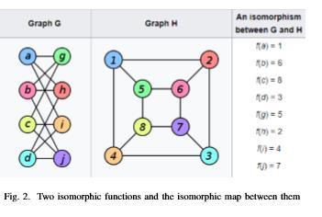
Example:

Slide 5
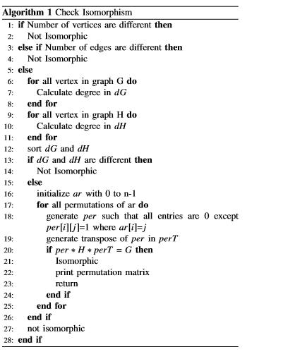
Algorithm:

Slide 6
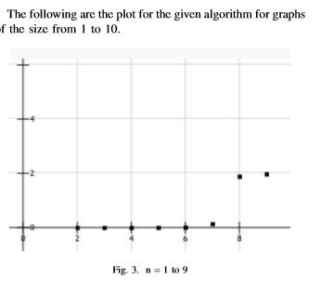
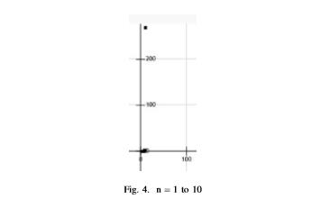
Results:

Slide 7
Conclusion:
For a graph with N number of nodes, time complexity to ﬁnd parallel edges is
O(N!*N³ ).

