Slide 1
Towards Reliable Rootkit Detection in Live Response
IMF, Stuttgart, September 2007
Felix C. Freiling
University of Mannheim, Germany
Bastian Schwittay
Symantec (Deutschland) GmbH, Germany

Slide 2
Motivation
Traditional forensics use dead analysis
Live Response captures data from live systems
Rootkits change the behaviour of live systems
Goal: Increase credibility of live response
Subgoal: Sound methods for reliable rootkit detection during Live Reponse

Slide 3
Agenda
Motivation
Background
Live Response
Windows Rootkits
Detection Experiments
Results and Recommendations
Summary and Discussion

Slide 4
Live Response
Volatile data is lost when powering down a computer
Running processes
Open network ports
Kernel modules loaded
RAM contents
– …
Live Response includes all techniques that capture data from running systems

Slide 5
Live Response Dilemma
Dilemma: Live Response techniques alter the running system‘s state
Acceptable only if alterations are well- understood
Tradeoff between value of captured information and integrity of the evidence

Slide 6
Windows Rootkits
“a set of programs and code that allows a permanent and undetectable presence on a computer” [Hoglund and Butler]
Ultimate attacker‘s tool
Stealth techniques to alter a running system:
Hide processes, files, drivers, ports etc.
Optionally include backdoors or keyloggers

Slide 7
Windows Internals
user programs
Ring 3
Ring 2
Ring 1
Ring 0 software has full system priviliges
Kernel rootkits run in Ring 0
Live Response tools mostly run in Ring 3
In the presence of a rootkit, Live Response tools can not capture accurate data!
Ring 0 kernel programs

Slide 8
Rootkit Techniques: Hooking
„Hooking“ – alter the execution path of applications
Example: SSDT Hooking
System Service Dispatch Table
system_call_x | 0x10002000
system_call_y | 0x10003000
system_call_z | 0x10004000
function_x()
Hooked System Service Dispatch Table
system_call_x | 0x10002000
system_call_y | 0xdeadbeef
system_call_z | 0x10004000
function_x()
function_y()
function_y()
function_z()
function_z()
rkfunction_y()

Slide 9
Rootkit Techniques: DKOM
„Direct Kernel Object Manipulation“
Alter in-memory list of processes
EPROCESS
EPROCESS
EPROCESS
...
...
...
LIST_ENTRY{
LIST_ENTRY{
LIST_ENTRY{
FLINK
BLINK }
FLINK
FLINK
BLINK }
BLINK }
EPROCESS
EPROCESS
HIDDEN
EPROCESS
...
...
...
LIST_ENTRY{
LIST_ENTRY{
LIST_ENTRY{
FLINK_modified
FLINK
FLINK
BLINK }
BLINK }
BLINK_modified }

Slide 10
Detection Tools
Use heuristics to discover inconsistencies in kernel
Discover hooks
Discover hidden kernel objects
Some tools use cross view detection:
Compare output of API functions with results from parsing internal data structures

Slide 11
Agenda
Motivation
Background
Live Response
Windows Rootkits
Detection Experiments
Results and Recommendations
Summary and Discussion

Slide 12
Experimental Setup (1/2)
11 different publicly available rootkits
Available from rootkit.org
12 different rootkit detectors
Using different heuristics
6 well-known Live Response tools
pslist, fport, netstat, psservice, find, regdmp
4 different flavors of Windows
Windows 2000 SP4
Windows XP (no updates)
Windows XP SP2
Windows 2003 Server SP1

Slide 13
Experimental Setup (2/2)
For each flavor of Windows do
For each rootkit do
If the rootkit offers file hiding capabilities create a hidden file
If the rootkit offers process hiding capabilities create a hidden process
If the rootkit ...
For each rootkit detector do
Check what hidden objects are detected
Revert system into original (infected) state
Possible detection results:
No hidden objects detected
Some but not all hidden objects detected
All hidden objects detected

Slide 14
Results (1/3)
Severe compatibility problems with rootkits
– “Best” platform was Windows XP SP2
Also some compatibility problems with detectors

Slide 15
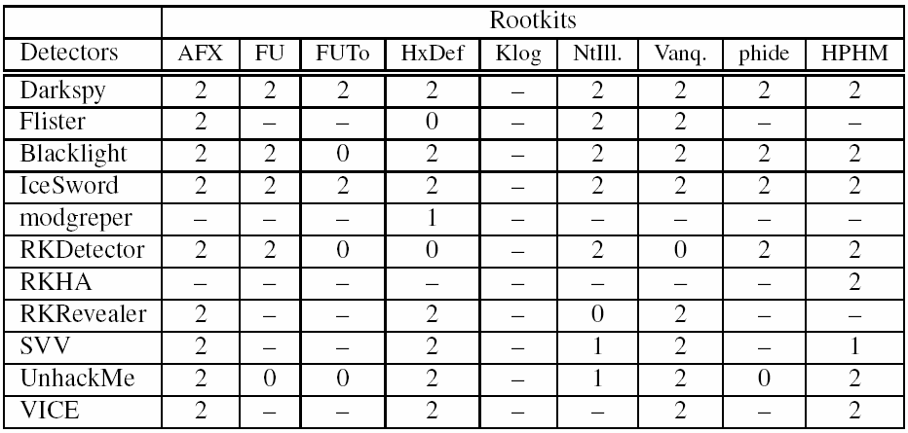
Results (2/3)
0 = no detection, 1 = partial detection, 2 = complete detection, - = incompatible

Slide 16
Results (3/3)
Using the live reponse tools none of the hidden objects (files, processes, ports etc.) were detected
Rootkit detection is necessary in live response!

Slide 17
Recommendations
As of June 2006, the combination of the following three rootkit detectors offers complete detection:
Blacklight
IceSword
System Virginity Verifier (SVV)
Good individual detection rate
Redundancy in detection
Different approaches result in resilience against implementation-specific attacks

Slide 18
Methodology
Experiments should be repeated and documented regularly
Result in recommendation of rootkit detectors
Examiners use this combination of rootkit detectors
If no rootkit is found, hypothesis that a known rootkit was installed during live response can be refuted

Slide 19
Summary
Live response is becoming an integral part of incident response and digital forensics
Rootkits subvert systems at a very low level, fooling classic live response tools
Reliable rootkit detection is needed
Proposed methodology combines different detection tools to achieve reliability
What about Virtualization rootkits like Rutkowska‘s BluePill?

Slide 20
谢谢^ㅁ^

