Slide 1
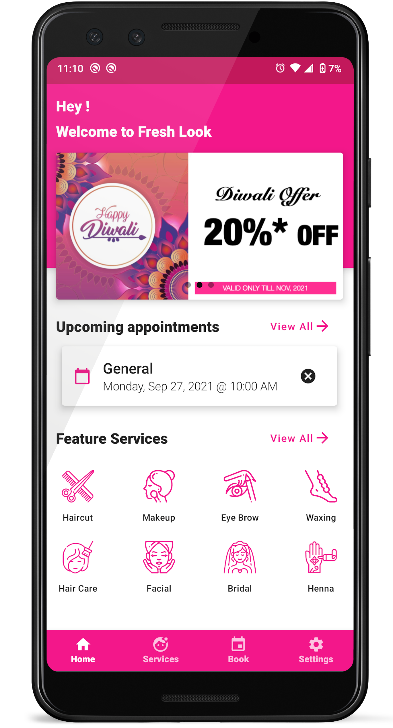
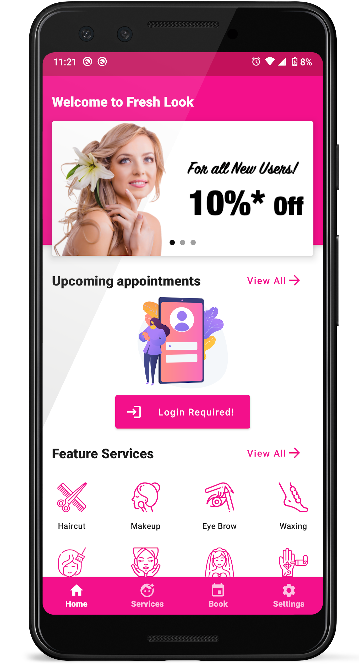

INTUITIVE DESIGN
Fresh Look
Beauty Parlor

Slide 2
INTUITIVE DESIGN
Elegant Dashboard
Dashboard For All
Special Offers to ALL
Fresh Look
Beauty Parlor

Slide 3
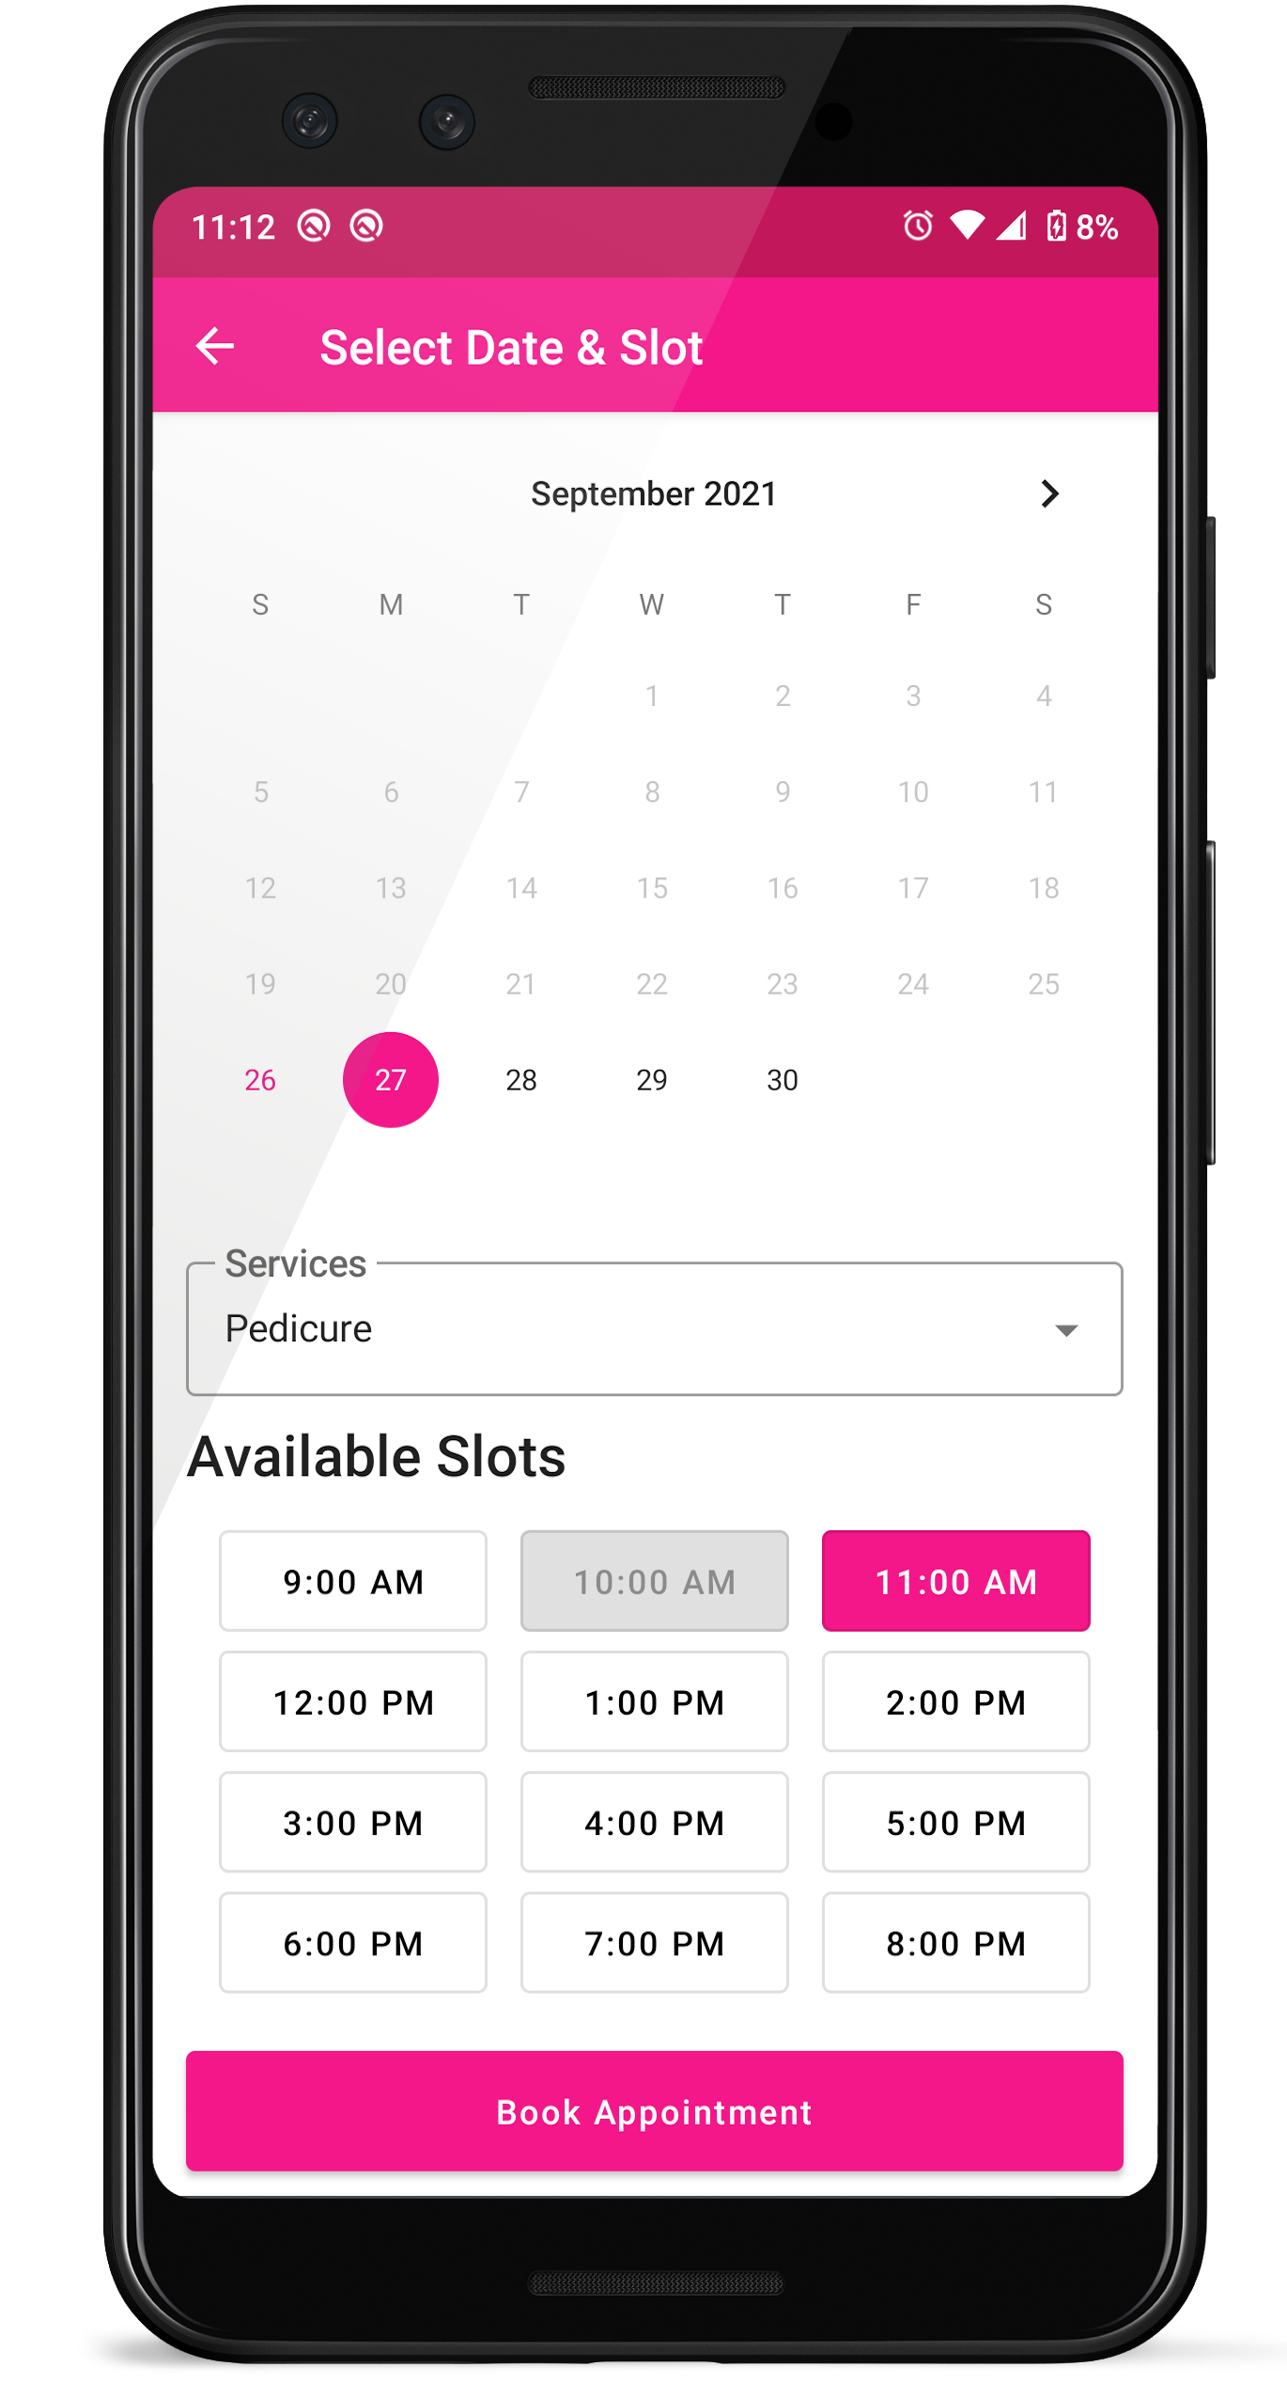
INTUITIVE DESIGN
Elegant Dashboard
Dashboard For All
Special Offers to ALL
Fresh Look
Beauty Parlor

