Slide 1
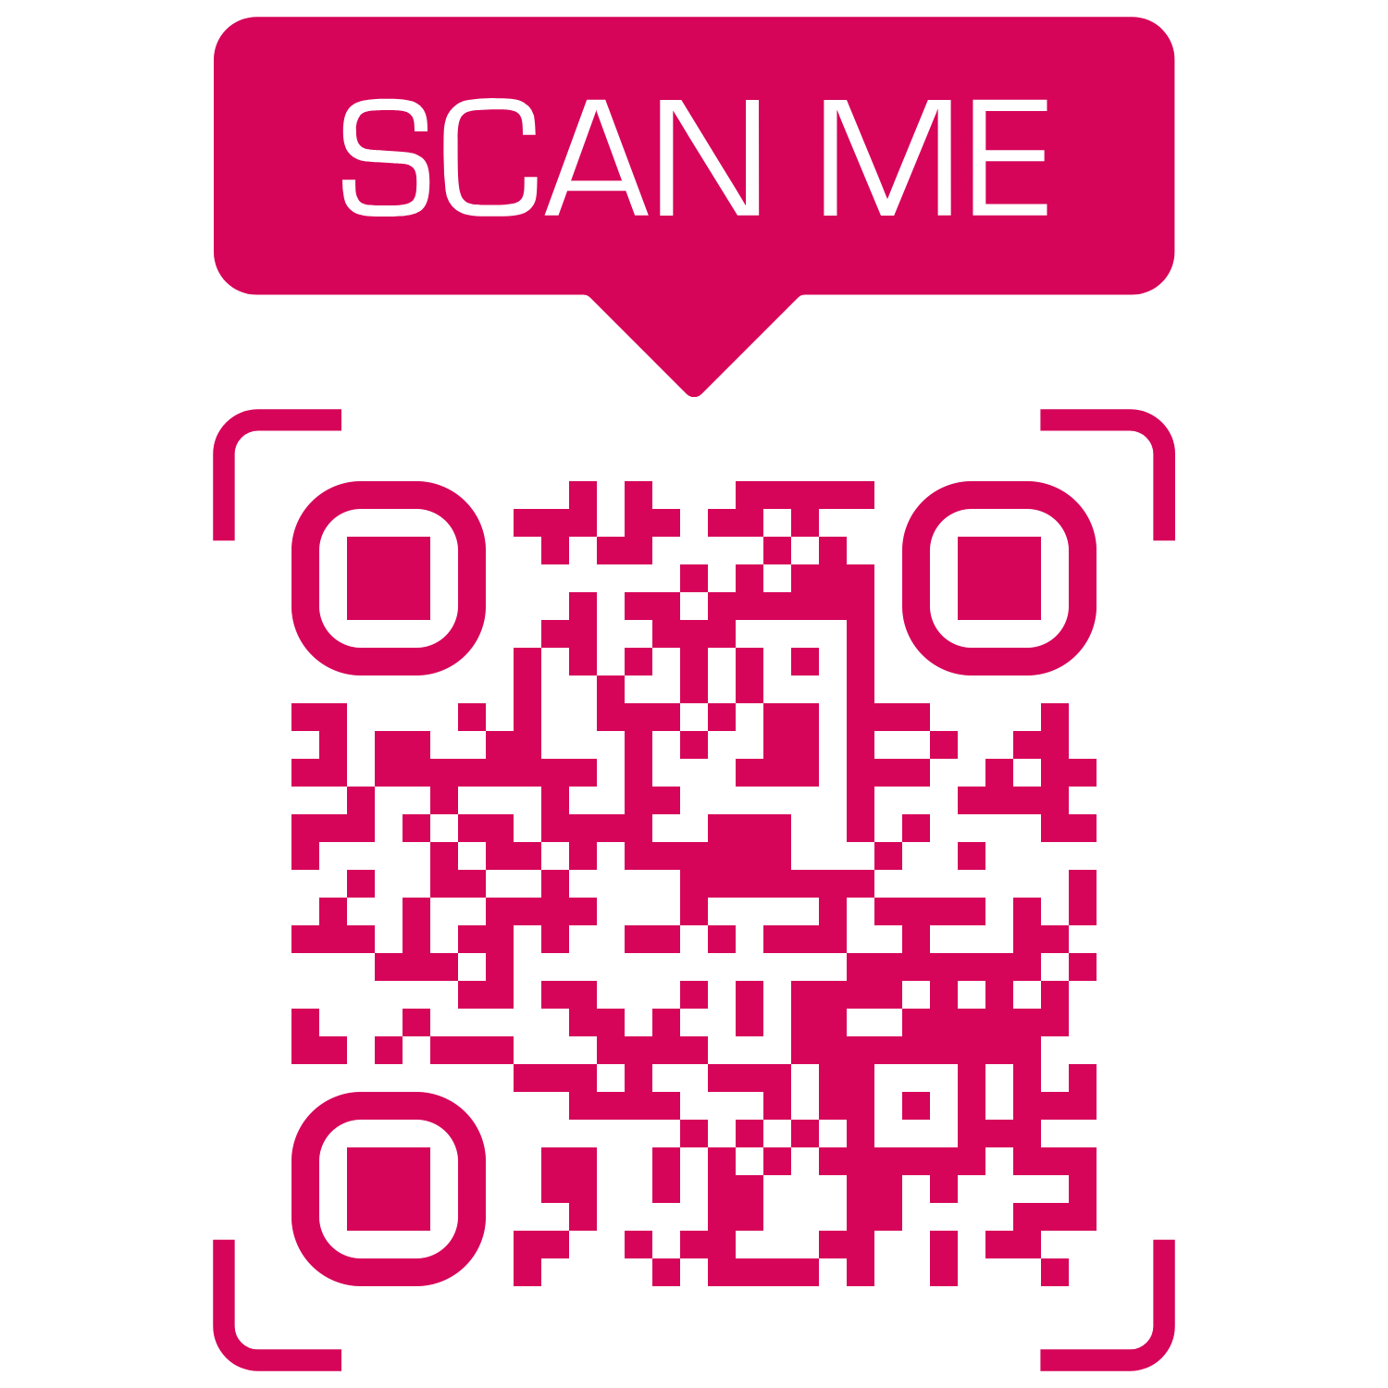

Offer!
Save your time!
Don’t wait in queue
Download
Fresh Look
Beauty Parlor Android App from Google Play Store and Book ONLINE Appointment to
GET
10% OFF
_{Fresh Look}
_{Beauty Parlor}
_{No 39/A, New Street,}
_{Arakkonam - Ocheri Rd,}
_{Nagavedu, Arakkonam}
₊₉₁ ₍₈₂₂₎₋₀₀₆₋₁₀₀₁
₊₉₁ ₍₈₀₉₎₋₈₈₈₋₉₄₉₄
*Ladies & Kids only

