Slide 1
Fake News Classification Using MACHINE LEARNING

Slide 2
COMPLEX ENGINEERING PROBLEM

Slide 3
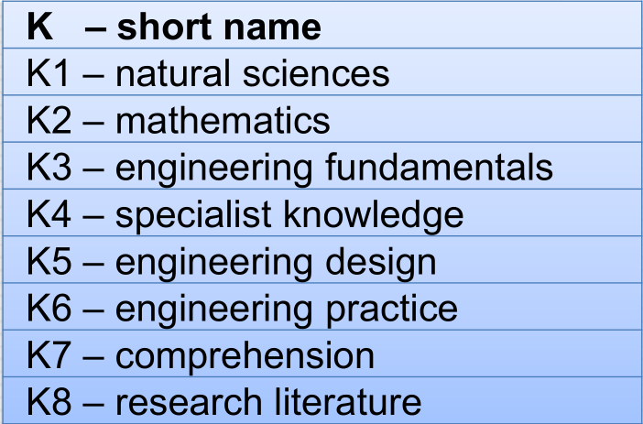
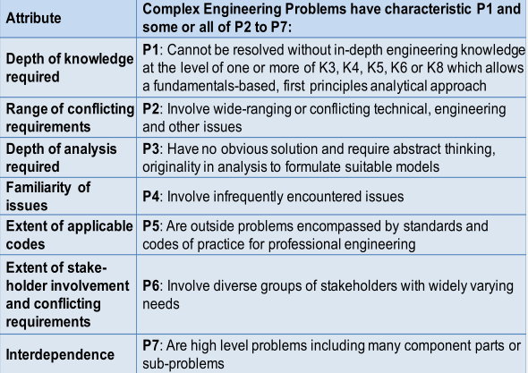
P’s that are addressed through this project
P1 : Depth of knowledge required
P2 : Range of conflicting requirements
P3 : Depth of analysis required
P4 : Familiarity of issues
P7 : Interdependence

Slide 4
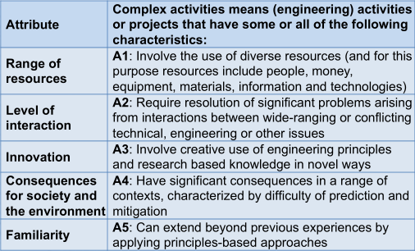
A’s that are addressed through this project
A1 : Range of resources
A2 : Level of interaction
A4 : Consequences for society and the environment
A5 : Familiarity

Slide 5
Thank You

Slide 6
Final Year Design Project - I
Course Title : CSE 4000A
Sec : B
Submitted To
Dr. Salekul Islam
Professor & Head of the Dept
Dept. Of CSE,
United International University
Supervised By
Dr. Mohammad Nurul Huda
Professor & Director - MSCSE
Dept. Of CSE,
United International University

