Slide 1
Document Image Tampering Localization with DWS U-Net: RGB, ELA and DCT Features
Submitted to
Dr. Kaushik Deb
Professor
Department of CSE, CUET
Submitted By
Md Piash Islam
ID:2104051

Slide 2
Content
Motivation and Dataset
Error Level Analysis (ELA)
Discrete Cosine Transform (DCT)
DWS U-Net Experiments
Experiment 1: RGB512
Experiment 2: RGB + ELA 512
Experiment 3: RGB + DCT 512
Comparison and Conclusion

Slide 3
Motivation
Documents such as IDs, certificates, receipts and invoices are easy to edit with common software
Typical tampering: text or number replacement, copy-move, splicing and inpainting
Edits are often visually seamless, so they are hard to spot by eye
Detecting a forgery is not enough: we need to localize the tampered pixels
Applications: document verification, digital forensics and fraud prevention

Slide 4
Motivation (Contd..)
Challenges of tampering localization
  Tampered regions are tiny: most pixels are untampered
  RGB-only baseline: 97.1% accuracy but only 0.194 Dice, so accuracy is misleading
  Resizing (e.g. 512 → 256) can weaken fine forensic traces
  The model must stay lightweight (below 2.5M parameters)
Idea: add forensic features that expose compression traces: ELA and DCT

Slide 5
Dataset and Task Setup
Dataset: DocTamperV1-TrainingSet
Subset: fixed 25K images, never re-split
  18,750 train / 2,500 validation / 3,750 test
Data: 512 × 512 images stored as JPEG; PNG ground-truth masks (non-zero = tampered)
Task: binary pixel-wise segmentation of tampered regions
Metrics: Dice, IoU, Precision, Recall, F1, Accuracy

Slide 6
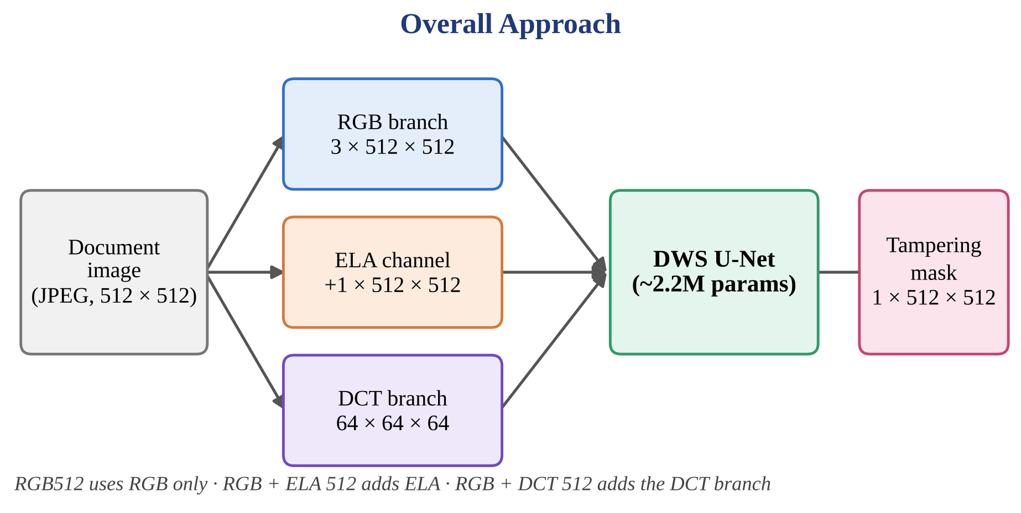
Overall Approach

Slide 7
Error Level Analysis (ELA)
What is ELA? Compares an image with its own JPEG re-compressed copy
JPEG is lossy: re-saving changes every region by a small amount
Regions with the same compression history change similarly; edited or pasted regions respond differently
The ELA map highlights these inconsistent error levels
Here ELA is used as an extra pixel-aligned input channel

Slide 8
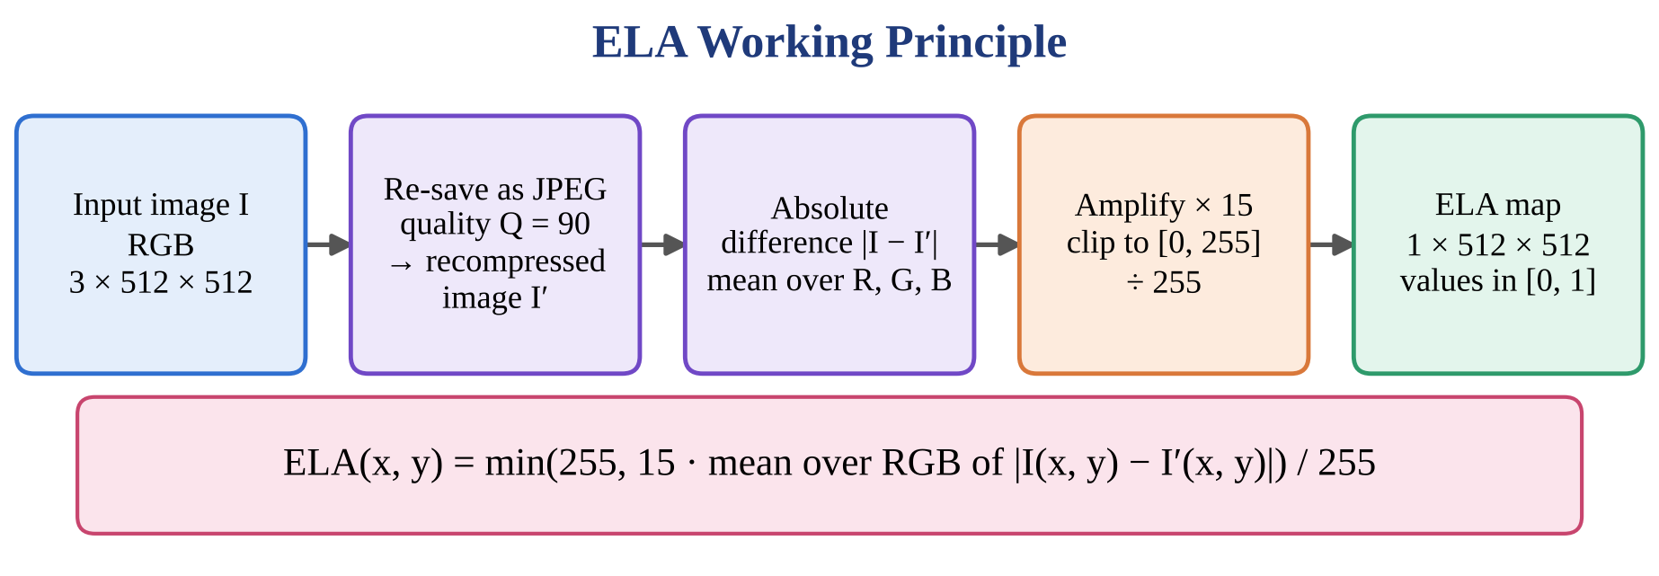
ELA (Contd..): Working Principle

Slide 9
ELA (Contd..): How It Is Applied
1. Take the native 512 × 512 RGB image (no resizing before ELA)
2. Re-save as JPEG at quality 90 and reload it
3. Mean absolute difference over R, G, B; × 15, clip to [0, 255], ÷ 255 → 1 channel
4. Stack with RGB → model input 4 × 512 × 512
5. Only the first convolution changes (3 → 4 channels): +75 parameters (2,162,658 → 2,162,733)

Slide 10
Advantages of ELA
Simple and fast — computed on the fly, no training needed
Pixel-aligned with RGB — concatenates directly as a channel
Reveals compression inconsistencies invisible in RGB
Almost free — only 75 extra parameters
Keeps the full 512 × 512 resolution
Caution: depends on the chosen quality and the image's JPEG history

Slide 11
Discrete Cosine Transform (DCT)
JPEG splits the image into 8 × 8 blocks and applies the DCT
Each block gives 64 coefficients: 1 DC (block mean) + 63 AC (frequency detail)
Coefficients are quantized, then entropy coded into the file
Editing and re-saving leaves traces in the quantized coefficients (e.g. double compression)
We read the coefficients directly from the stored JPEG: no decoding, no re-compression error

Slide 12
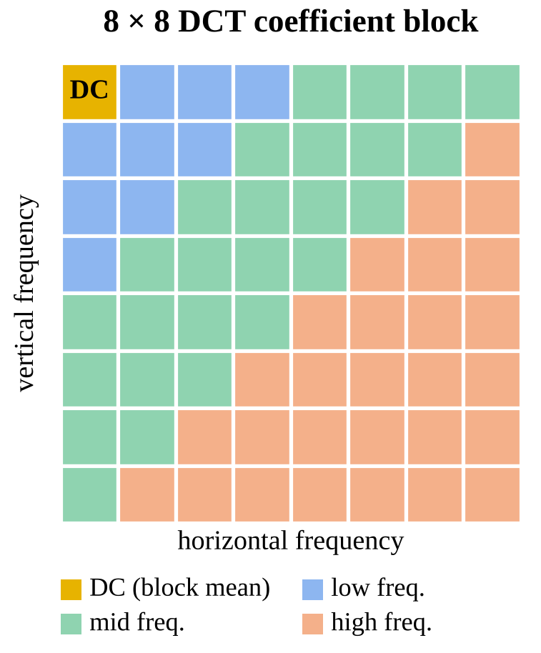
DCT (Contd..): Coefficient Block
DC: average intensity of the block
Low frequencies: coarse structure
High frequencies: fine detail and noise
AC coefficients carry the forgery traces, so each of the 64 coefficient channels is standardised separately

Slide 13
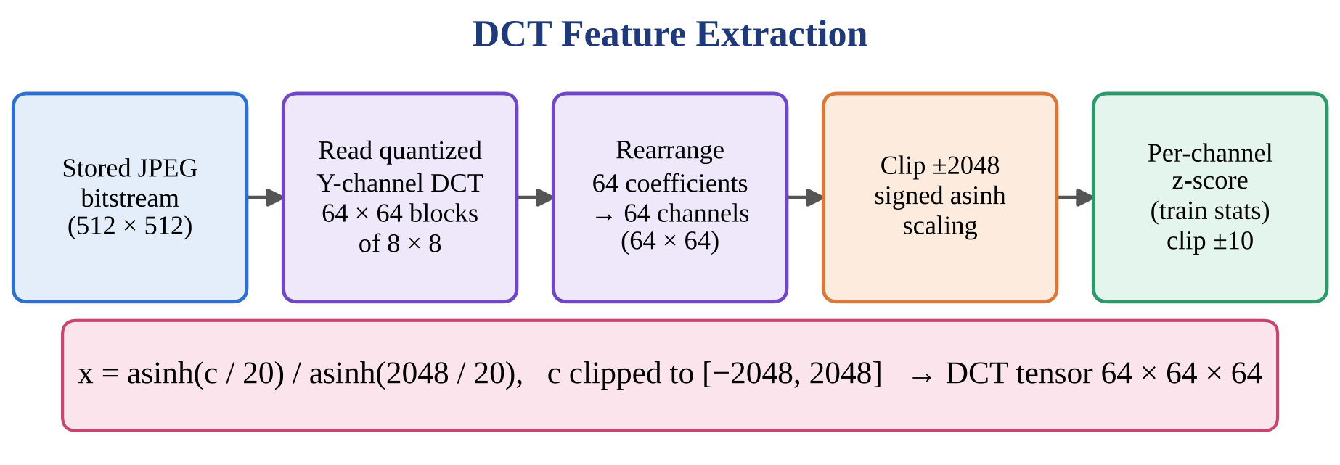
DCT (Contd..): Working Principle

Slide 14
DCT (Contd..): How It Is Applied
Y-channel quantized coefficients → 64 × 64 grid of 8 × 8 blocks → tensor 64 × 64 × 64
One block covers 8 × 8 pixels, so the grid is at 1/8 resolution, not pixel-aligned
Processed by a separate DCT stem: 1×1 Conv 64 → 128, BatchNorm, ReLU, DWSConv 128
Fusion: concatenated with pooled Enc 3 features (256 + 128 = 384 channels) before Enc 4
Parameters: 2,256,098 (+93,440 over RGB512)
Non-JPEG samples fall back to a Q90 re-encode

Slide 15
Advantages of DCT
Works in the compression domain: sees traces that pixel features can miss
Uses the original stored coefficients: no re-compression error
Compact: 64 × 64 × 64 at 1/8 resolution is cheap to process
Frequency-separated: the network can weight each coefficient channel
Complements RGB (appearance) and ELA (error level)
Caution: needs a JPEG source; non-JPEG images use a fallback

Slide 16
DWS U-Net Experiments
Experiment | Input | Extra branch | Parameters
RGB512 | RGB 3 × 512 × 512 | None (baseline) | 2,162,658
RGB + ELA 512 | RGB + ELA 4 × 512 × 512 | ELA as 4th channel | 2,162,733
RGB + DCT 512 | RGB 3 × 512 × 512 + DCT 64 × 64 × 64 | DCT stem fused at 1/8 | 2,256,098
Same backbone, same 25K split, same loss, optimizer and batch size
Only the input features differ, so differences in results come from the features

Slide 17
DWS U-Net Backbone
Encoder: 64 → 128 → 256 → 512, two DWSConv blocks per stage, 2×2 MaxPool
Bottleneck: 512 channels, two DWSConv blocks (32 × 32)
Decoder: ConvTranspose2d upsampling with concatenation skips
DWSConv: depthwise 3×3 → BN → ReLU → pointwise 1×1 → BN → ReLU
Output: 1 × 512 × 512 raw logits (no sigmoid inside the model)

Slide 18
Shared Training Pipeline Configuration
Component | Configuration
Dataset | DocTamperV1-TrainingSet
Subset | Fixed 25K images
Split | 18,750 / 2,500 / 3,750
Augmentation | None
Loss | BCE + Dice (1.0 / 1.0)
Optimizer | AdamW
Learning rate | 1 × 10⁻⁴
Weight decay | 1 × 10⁻⁴
Batch size | 8
Component | Configuration
Scheduler | ReduceLROnPlateau (val Dice, ×0.5, patience 4)
Grad. clipping | Max norm 1.0
EMA | Decay 0.999 (used for validation)
Epochs | 30 per run (cap 300)
AMP | Enabled on CUDA
Seed | 42
Threshold | 0.5
Model selection | Best validation Dice (top-5 kept)
Input / params | See each experiment

Slide 19
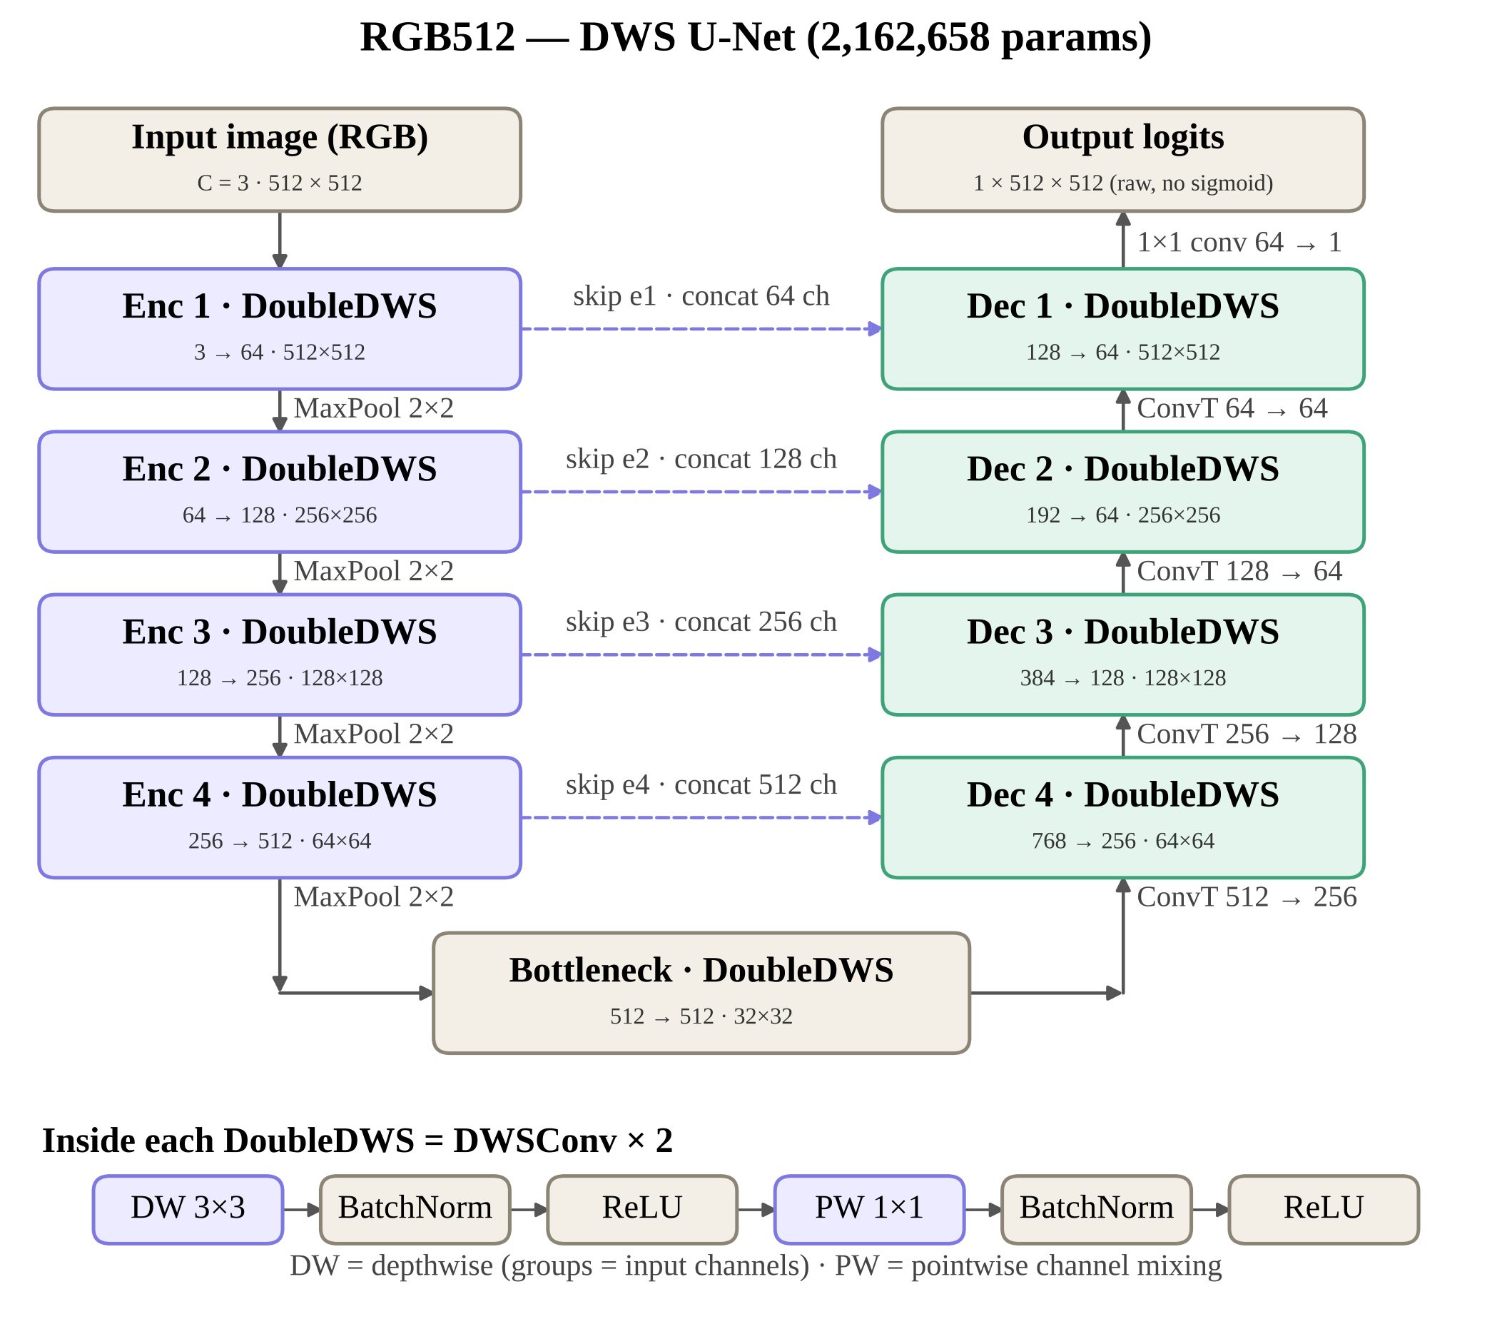
Experiment 1: RGB512: Architecture

Slide 20
Experiment 1: RGB512: Preprocessing
Image branch
Ground-truth mask
Original DocTamper image
(stored JPEG, 512 × 512)
Ground-truth mask
(PNG, 512 × 512)
↓
↓
RGB conversion
Grayscale (L)
↓
↓
Pixel normalization
[0,255] → [0,1]
Binarize: pixel ≠ 0 → 1
({0,1} and {0,255} both handled)
↓
↓
DWS U-Net
(3 × 512 × 512)
No resizing (native 512)
↓
Binary mask {0,1}
1 × 512 × 512

Slide 21
Experiment 1: RGB512 Results
Metric | Best Validation | Epoch
Dice | 0.802726 | 29
IoU | 0.670461 | 29
Precision | 0.894267 | 29
Recall | 0.728185 | 29
F1 | 0.802726 | 29
Accuracy | 0.993201 | 29
Validation Loss | 0.380392 | 29
Metric | Test Result
Dice | 0.791852
IoU | 0.655427
Precision | 0.884246
Recall | 0.716940
F1 | 0.791852
Accuracy | 0.993060
Test Loss | Not computed
TEST METRICS: Global pixel-level (micro) scores at threshold 0.50. Mean per-image (macro) scores: Dice/F1 0.637696, IoU 0.569287, Precision 0.720386, Recall 0.616201. Test loss was not calculated from the per-image metrics. The test split contains 3,750 tampered images and 0 authentic images; authentic-image false-alarm rate cannot be estimated from this split.

Slide 22
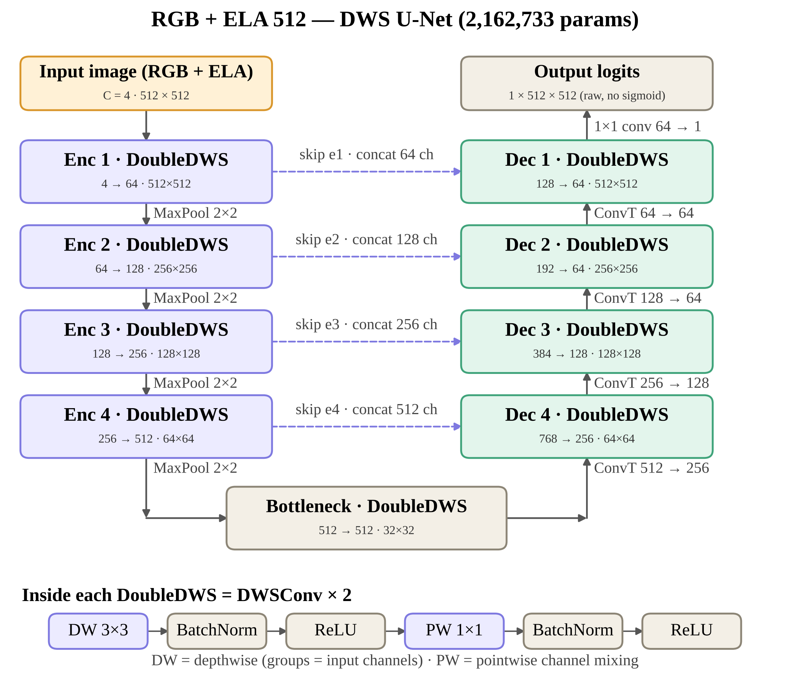
Experiment 2: RGB + ELA 512: Architecture

Slide 23
Experiment 2: RGB + ELA 512: Preprocessing
Image branch
Ground-truth mask
Original DocTamper image
(stored JPEG, 512 × 512)
Ground-truth mask
(PNG, 512 × 512)
↓
↓
RGB conversion
Grayscale (L)
↓
↓
RGB: normalize [0,255] → [0,1]
ELA: JPEG Q90 re-save,
|diff| × 15, clip, ÷ 255
Binarize: pixel ≠ 0 → 1
({0,1} and {0,255} both handled)
↓
↓
No resizing (native 512)
Concatenate RGB + ELA
(4 × 512 × 512)
↓
↓
Binary mask {0,1}
1 × 512 × 512
DWS U-Net

Slide 24
Experiment 2: RGB + ELA 512 Results
Macro (per-image mean): Dice 0.77705 | IoU 0.71170 | Precision 0.82852 | Recall 0.76065 | Boundary F1 0.75224. Full-test rerun cell separately reports loss 0.245788, Dice 0.883784, IoU 0.791767, Precision 0.918516, Recall 0.851582, Accuracy 0.995876; the notebook contains this small discrepancy between evaluation paths.
Metric | Best Validation | Epoch
Dice | 0.884033 | 30
IoU | 0.792168 | 30
Precision | 0.919580 | 30
Recall | 0.851133 | 30
F1 | 0.884033 | 30
Accuracy | 0.995760 | 30
Validation Loss | 0.242980 | 30
Metric | Test Result
Dice | 0.883600
IoU | 0.791480
Precision | 0.918240
Recall | 0.851490
F1 | 0.883600
Accuracy | 0.995870
Test Loss | NaN in saved table

Slide 25
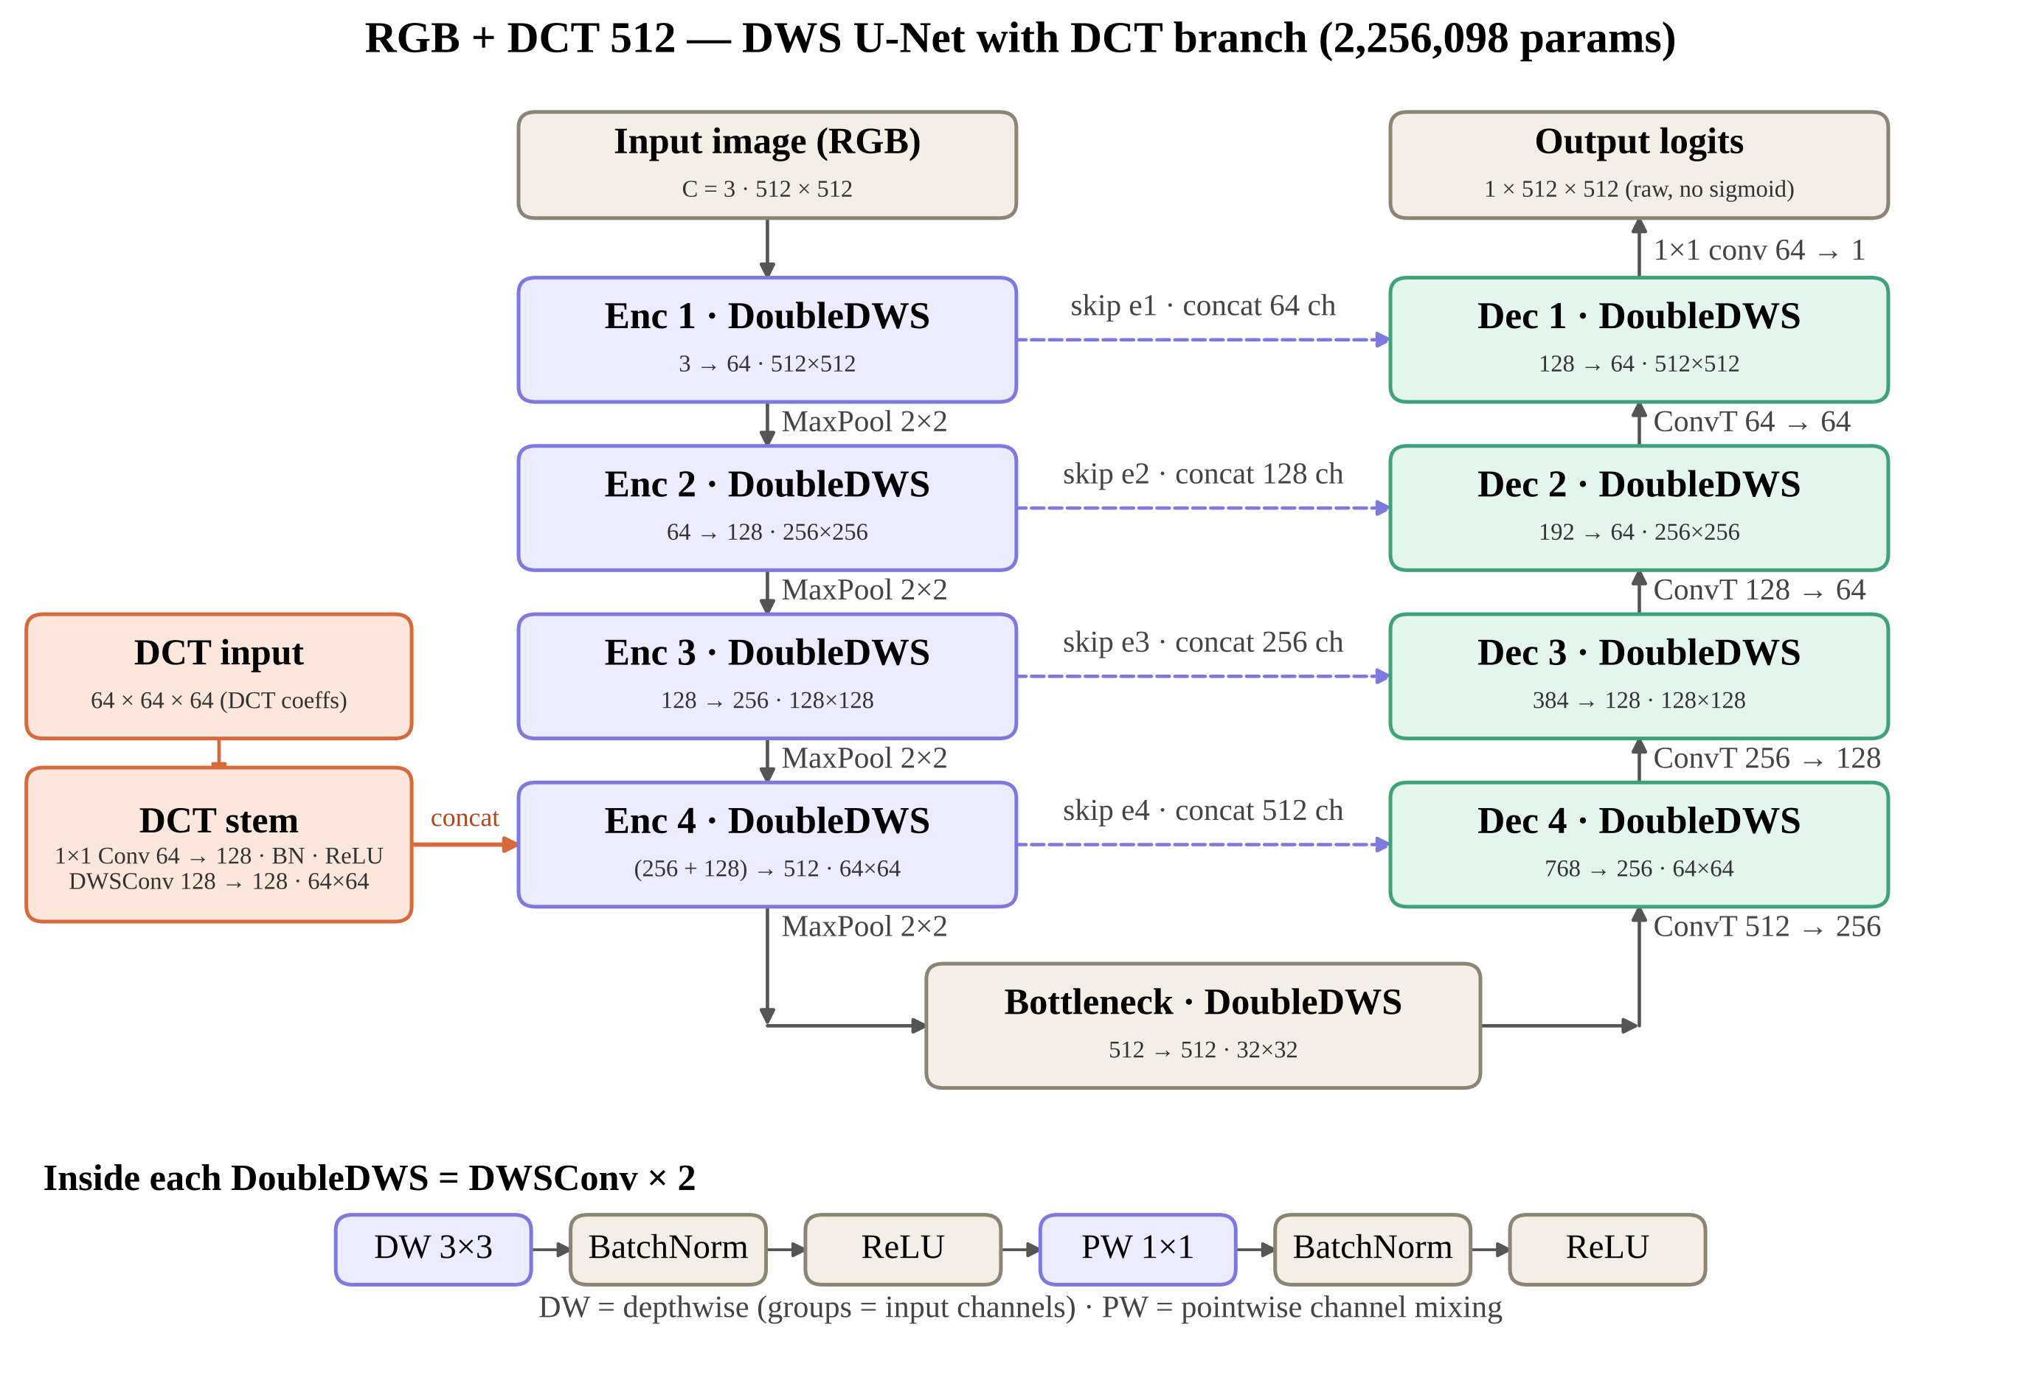
Experiment 3: RGB + DCT 512: Architecture

Slide 26
Experiment 3: RGB + DCT 512: Preprocessing
RGB branch
DCT branch
Ground-truth mask
Original DocTamper image
(stored JPEG, 512 × 512)
Stored JPEG bitstream
(non-JPEG: re-encode Q90)
Ground-truth mask
(PNG, 512 × 512)
↓
↓
↓
RGB conversion
Read quantized Y-channel DCT
(64 × 64 blocks of 8 × 8)
Grayscale (L)
↓
↓
↓
Pixel normalization
[0,255] → [0,1]
Rearrange to 64 channels
(64 × 64 × 64)
Binarize: > 0 if max ≤ 1,
else > 127
↓
↓
↓
RGB branch
(3 × 512 × 512)
Clip ±2048, signed asinh
asinh(x/20) / asinh(2048/20)
No resizing (native 512)
↓
↓
Binary mask {0,1}
1 × 512 × 512
Per-channel z-score, clip ±10
↓
DCT stem → fuse at 1/8

Slide 27
Experiment 3: RGB + DCT 512 Results
Metric | Best Validation | Epoch
Dice
IoU
Precision
Recall
F1
Accuracy
Validation Loss
Metric | Test Result
Dice
IoU
Precision
Recall
F1
Accuracy
Test Loss

Slide 28
Summary of Results
Experiment | Input | Params | Best Val Dice | Epoch | Test Dice | Test IoU
RGB512 | RGB | 2.16M | 0.8027 | 29 | 0.7919 | 0.6554
RGB + ELA 512 | RGB + ELA | 2.16M | 0.8840 | 30 | 0.8836 | 0.7915
RGB + DCT 512 | RGB + DCT | 2.26M
RGB512 values are from the native RGB-only notebook; RGB + ELA 512 values are from rgb-ela-512-eval.ipynb. Test Dice/IoU are global pixel-level (micro) metrics. ELA macro test metrics: Dice 0.77705, IoU 0.71170. RGB + DCT remains unfilled pending its own evaluation.

Slide 29
Conclusion
ELA adds a pixel-aligned error-level channel at almost no cost (+75 parameters)
DCT exposes compression-domain traces through a separate branch fused at 1/8 resolution
Same backbone, split, loss and optimizer isolate the effect of each feature
Results: to be filled after training and testing

Slide 30
Thank you

Slide 31
Native RGB512: Results & Reproducibility Notes
EXPERIMENT CONFIGURATION
• Input: RGB, 3 × 512 × 512; no resizing
• DWS U-Net, 2,162,658 trainable parameters
• Fixed split: 18,750 train / 2,500 validation / 3,750 test
• BCE + Dice; AdamW, lr 1e−4, weight decay 1e−4
• Batch size 8; seed 42; threshold 0.50
BEST VALIDATION — EPOCH 29
• Dice/F1 0.802726; IoU 0.670461
• Precision 0.894267; Recall 0.728185
• Accuracy 0.993201; validation loss 0.380392
RGB512 — HELD-OUT TEST RESULTS
• Micro Dice/F1 0.791852; IoU 0.655427
• Micro precision 0.884246; recall 0.716940; accuracy 0.993060
• Macro Dice/F1 0.637696; IoU 0.569287
RGB + ELA 512 — HELD-OUT TEST RESULTS
• Best validation epoch 30; Dice 0.884033; IoU 0.792168
• Test micro Dice/F1 0.883600; IoU 0.791480
• Test micro precision 0.918240; recall 0.851490; accuracy 0.995870
• Test macro Dice/F1 0.777050; IoU 0.711700; precision 0.828520; recall 0.760650
NOTE: RGB + ELA figures are from rgb-ela-512-eval.ipynb. Its main saved test table differs slightly from a later full-test evaluation cell (Dice 0.883784, IoU 0.791767). Keep the chosen reporting path consistent. RGB + DCT remains pending.

