Slide 1


CHARACTERISTICS OF SUCCESSFUL OPINION LEADERS IN A BOUNDED CONFIDENCE MODEL
NETWORKED CONTROL SYSTEM
MSC MECHATRONIC ENGINEERING
PROF: ANTON PROSKURNIKOV
GROUP:
PIERLUIGI SACCONE , 355355
MICHELE GAZZILLI, 360623
CESARE MESSA, 361616
GOFFREDO PIAZZA, 360031
PERCENTAGE OF WORK: 25% EACH
A.Y 2025/26

Slide 2
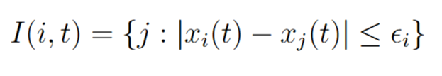
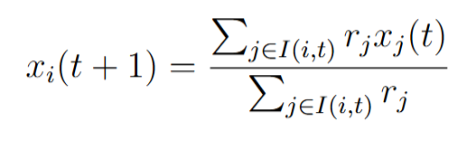
INTRODUCTION
We adopt the extended Hegselmann-Krause model formulation as described in Chen et al. (2016).
Consider a society of 200 agents, with two competing opinion leaders L1 and L2. The opinion of agents at time t
is represented by a random real value xi(t) generated between 0 and 1, while for the two Leaders is fixed at
0.2 and at 0.8, respectively. In the classic HK model, at each time step t, agents i updates its opinion by
averaging the opinions of all agents within its confidence set I(i, t), defined as:
where ∈_{i} = T is the bound of confidence.
For every agents we assaign value named Reputation (r), which reflect the solcial power of each agents.
The new rule is given by the weighted average:

Slide 3
CHARACTERISTICS OF OPINION LEADERS
1. Reputation (R): This eflects the social power. Leaders are assigned a weight Ri ≫ 1, whereas normal agents typically have a weight R= 1.
2. Stubbornness (S): This measures the leader’s resistance to been influenced by normal agents. It is related to the leader’s confidence bound TL by the relation:
Si = 1 − TLi
3. Appeal (A): this is the specific confidence bound of normal agents towards leader Li, allowing the leader to influence distant agents.
4. Extremeness (E): This quantifies how far the leader's opinion is relative to the extreme value 0 and 1. It is defined as:
Ei = 2 · |0.5 − xLi (t)|

Slide 4
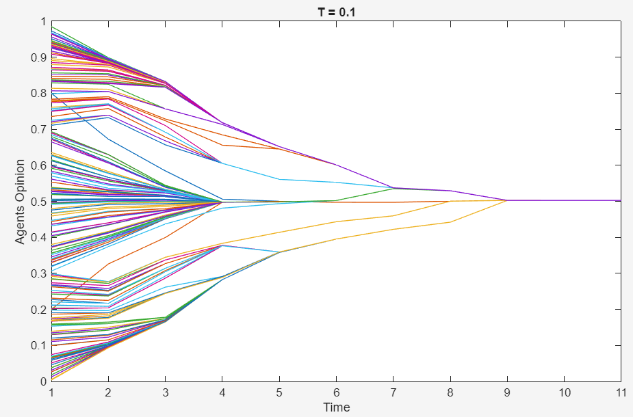
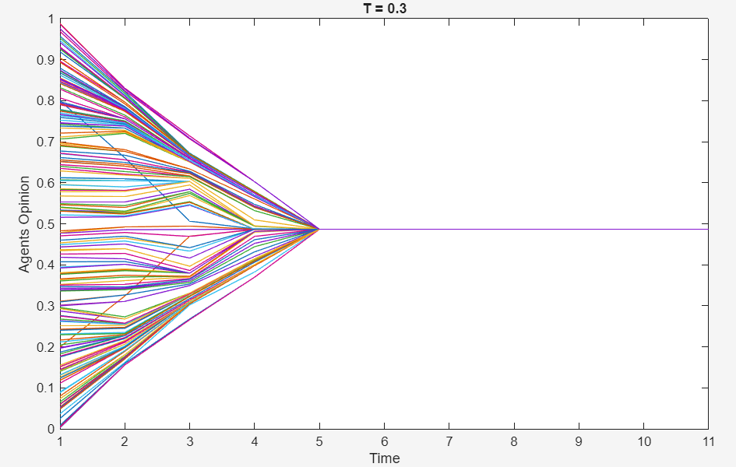
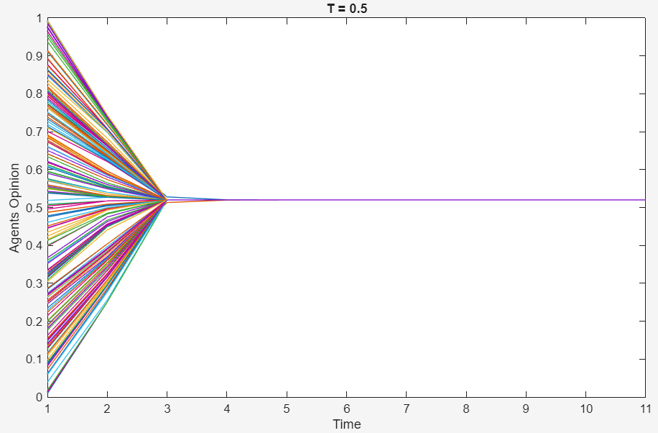
IMPACT OF GROUP BOUND OF CONFIDENCE
For each variable, we study the average number of groups formed for different values of the group bound of confidence T, at different value of the variable. This is because the higher T is, the faster consensus will be reached, as dimostrated from our simulations. Moreover we study the average number of followers for each leader's group.
Configuration of final opinions, for T=0.1, 0.3, 0.5. Ai = TLi = 0.5, Ri = 10.

Slide 5
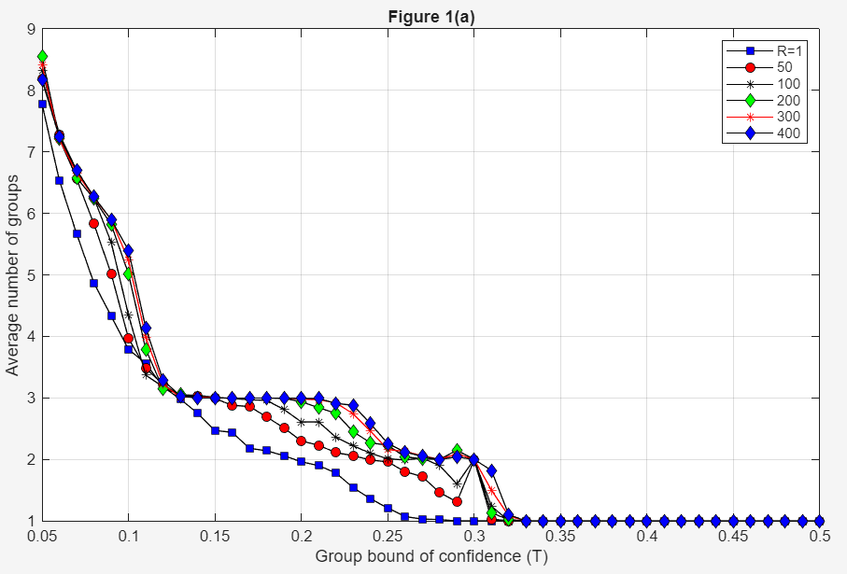
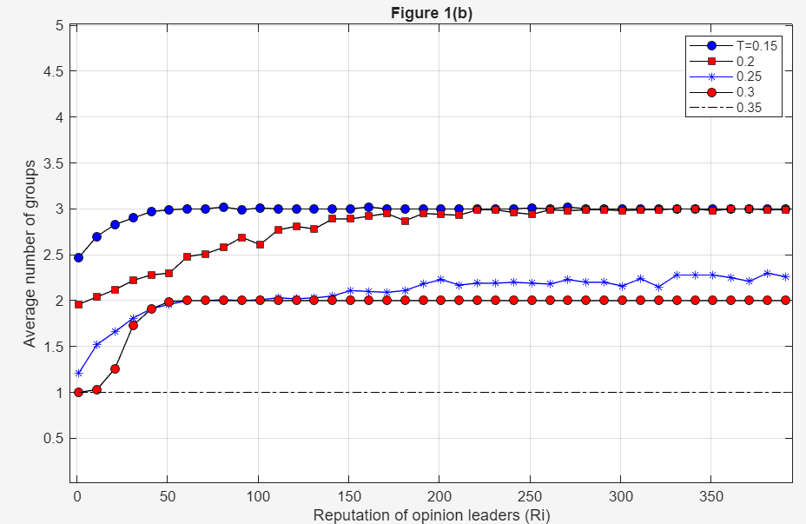
VALIDATION OF REPUTATION IMPACT
Average number of groups with respect to: (a) group bound of confidence T for different reputation values, and (b) reputation Ri with different bounds of confidence values.

Slide 6
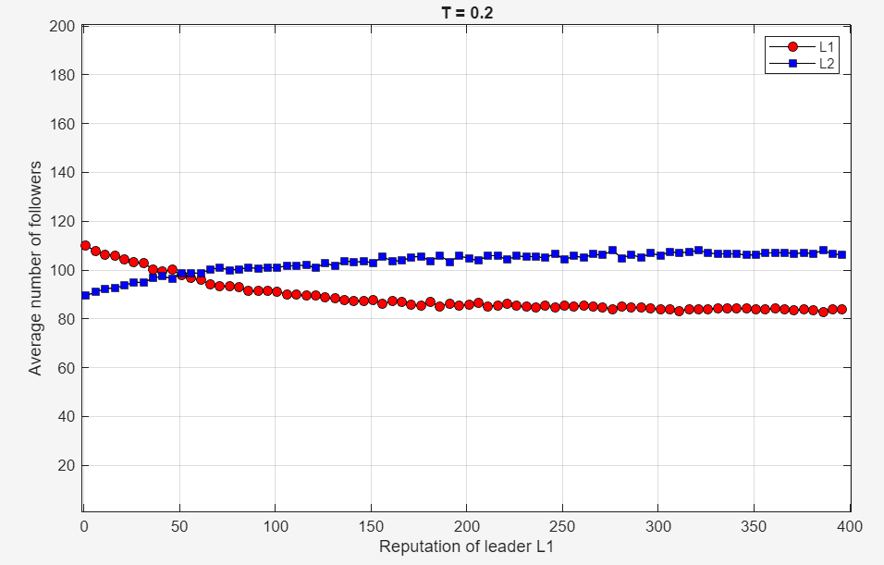
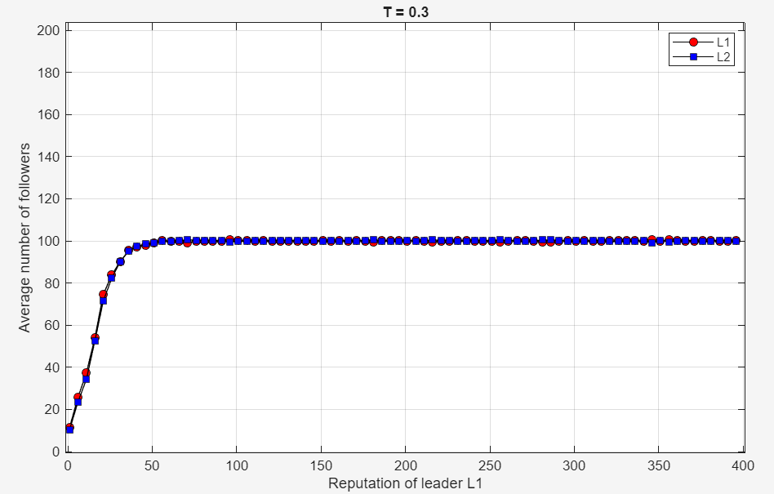
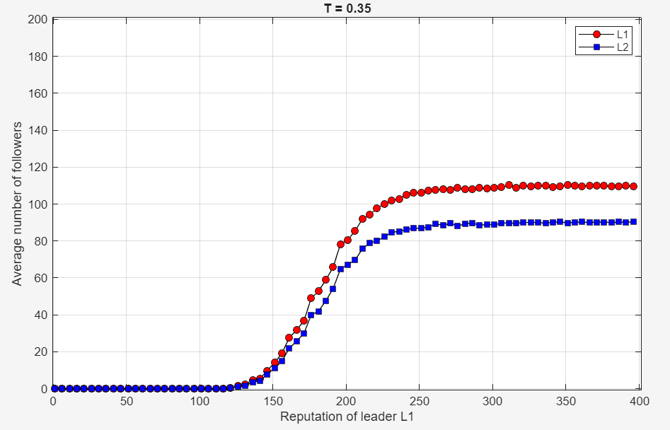
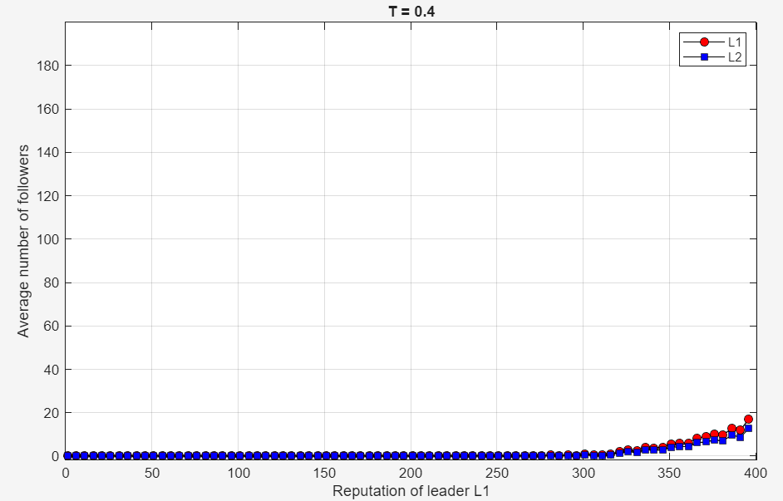
VALIDATION OF REPUTATION​ IMPACT
Average number of followers of opinion leaders L1 and L2 with respect to the reputation of leader L1, R1, where R2 = 50, for T = 0.2, 03, 0.35, 0.4.

Slide 7
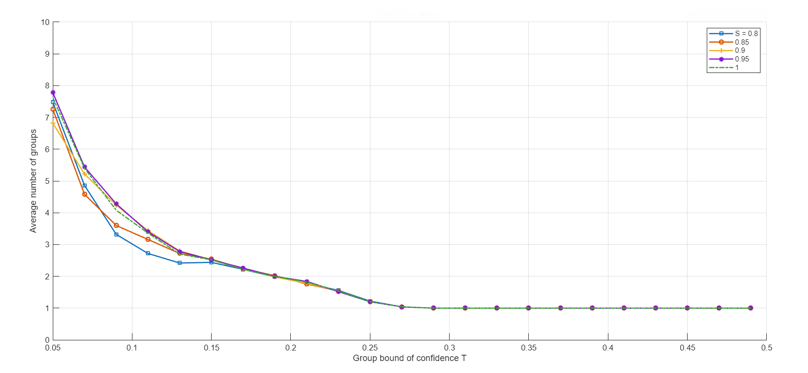
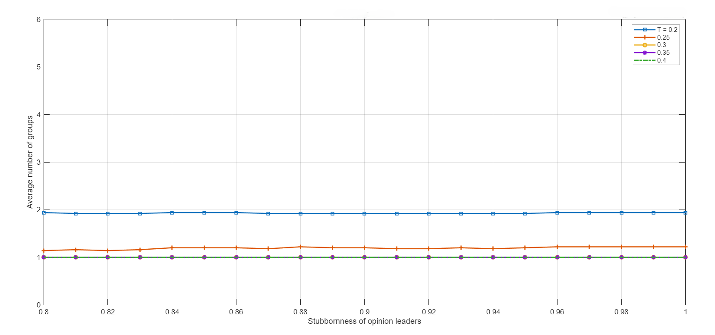
VALIDATION OF STUBBORNESS IMPACT
Average number of groups with respect to (a) group bound of confidence T with different stubborness values, and (b) stubborness Si with different bounds of confidence, where Ri = 1, Ai = T, Ei = 0.6. Averages taken over 50 runs.

Slide 8
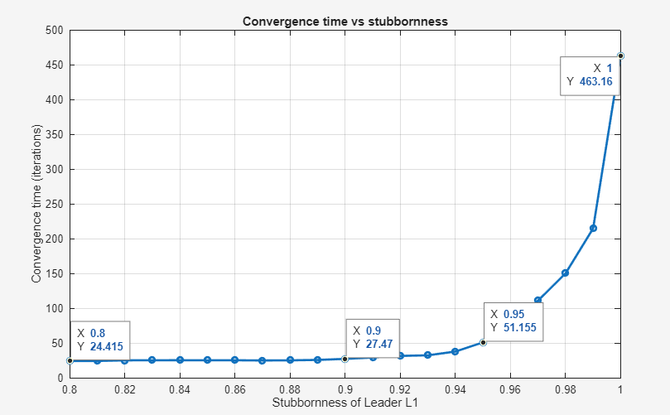

CONVERGENCE TIME VS STUBBORNESS
Number of iterations required to reach the steady state as the stubbornness S1 of leader L1 varies in the range [0.8, 1.0] with a step of 0.01 and T = 0.2.
The reported plot represents the scenario in which the stubbornness of leader L2 is fixed to 0.95, while the stubbornness of leader L1 is varied from 0.8 to 1 with a step of 0.01.
The plot can be divided into three distinct regions:
1) 0.8 < S1 < 0.9
2) 0.9 < S1 < 0.95
3) 0.95 < S1 < 1.0

Slide 9
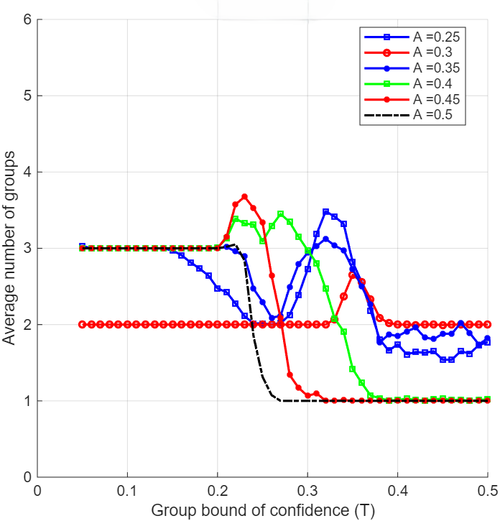
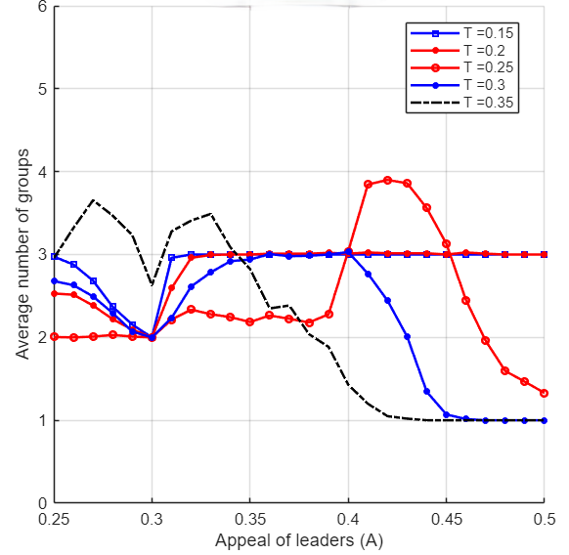
VALIDATION OF APPEAL IMPACT
Fixed Extremeness (Ei) = 0.6 with leaders’ opinions L1 = 0.2 and L2 = 0.8. The analysis focused on simultaneous variation of both the leaders from 0.25 to 0.5 in steps of 0.01 and the group bound of confidence T from 0.05 to 0.5 in steps of 0.01, while Ri = 50 and Si = 1 (i = 1, 2).

Slide 10
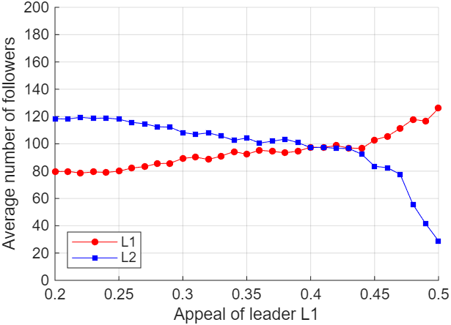
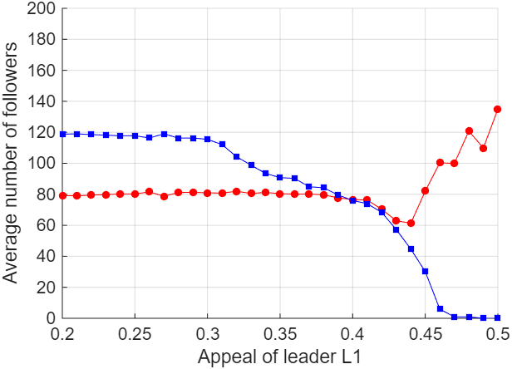
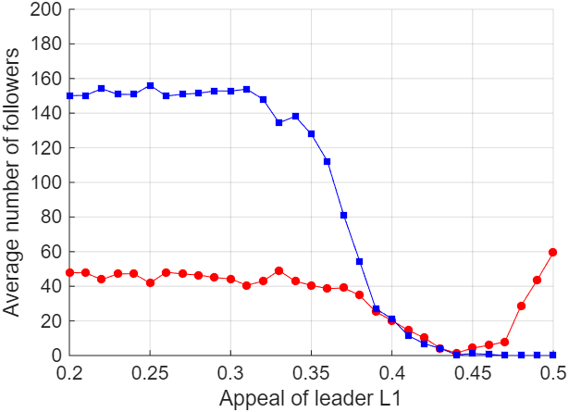
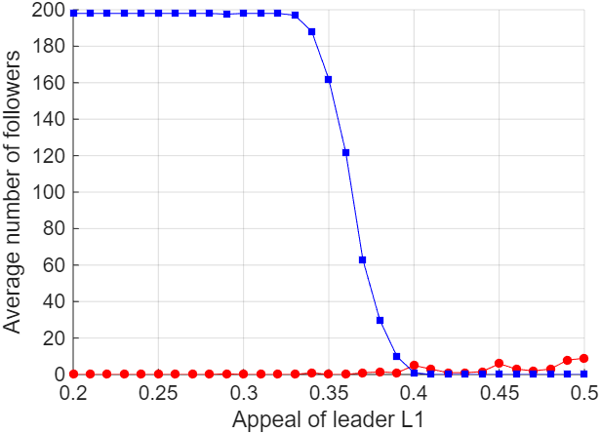
VALIDATION OF APPEAL IMPACT
The second analysis is focused on the key role of Appeal on attracting follower while the group bound of confidence T vary from 0.2 (1° image) to 0.4 (4° image) . Moreover, we have introduced a fixed A2 = 0.4 and a variation of A1 from 0.2 to 0.5 (in steps of 0.05).

Slide 11
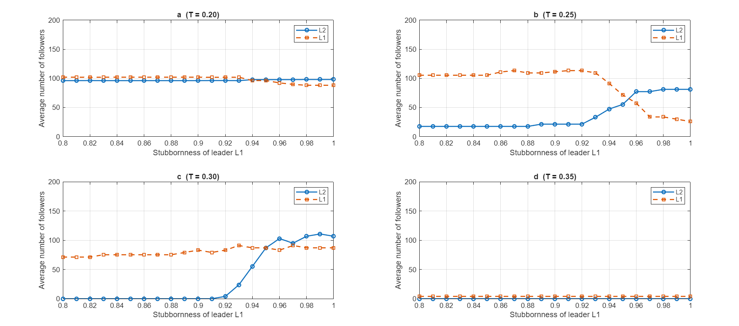
VALIDATION OF STUBBORNESS IMPACT
Average number of followers of opinion leaders L1 and L2 with respect to stubborness of leader L1, where Ri = 1, S2 = 0.95, Ai = T, Ei=0.6 and group bound of confidence T is (a) 0.2, (b) 0.25, (c) 0.30 and (d) 0.35. Averages taken over 50 runs.

Slide 12
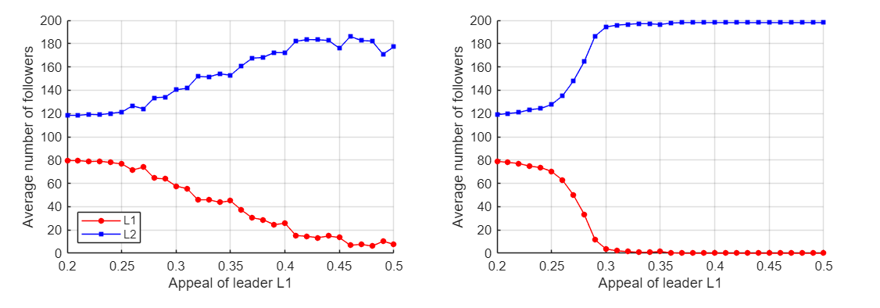
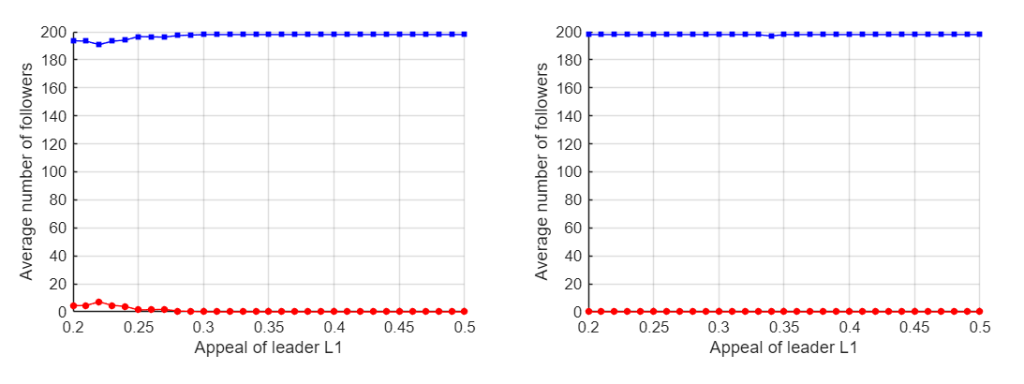
ANALYSIS OF STUBBORNESS’ EFFECTS ON APPEAL
To simulate this context the "stubbornness" constraint was relaxed for Leader 1 (TL1 = 0.2) whereas TL2 = 0. The objective was to create a scenario of a Flexible "Democratic“ Leader (L1) versus a Rigid Leader (L2) using a symmetric reputation (RL1=RL2=50)

Slide 13
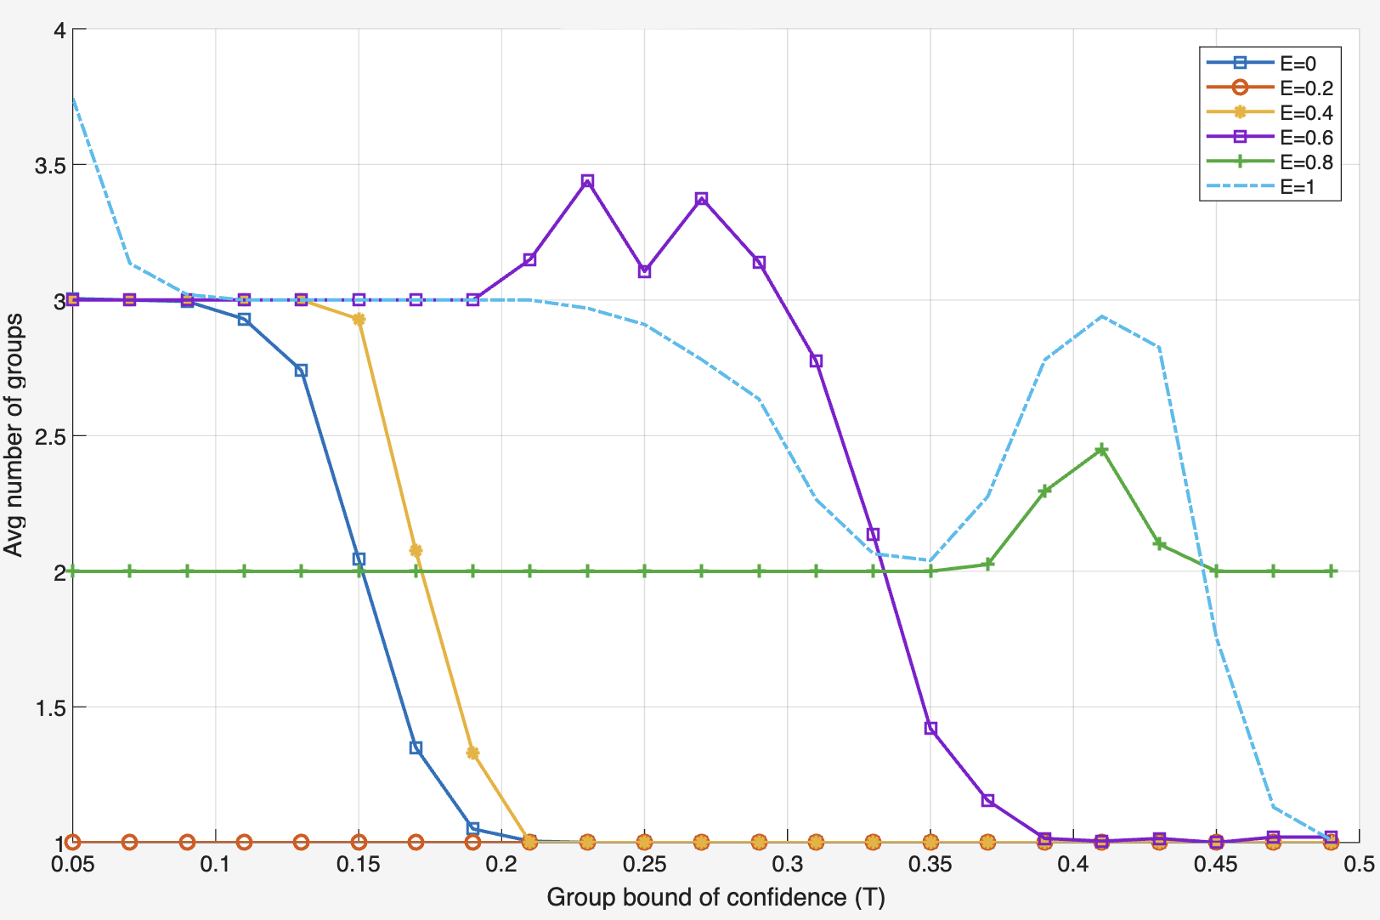
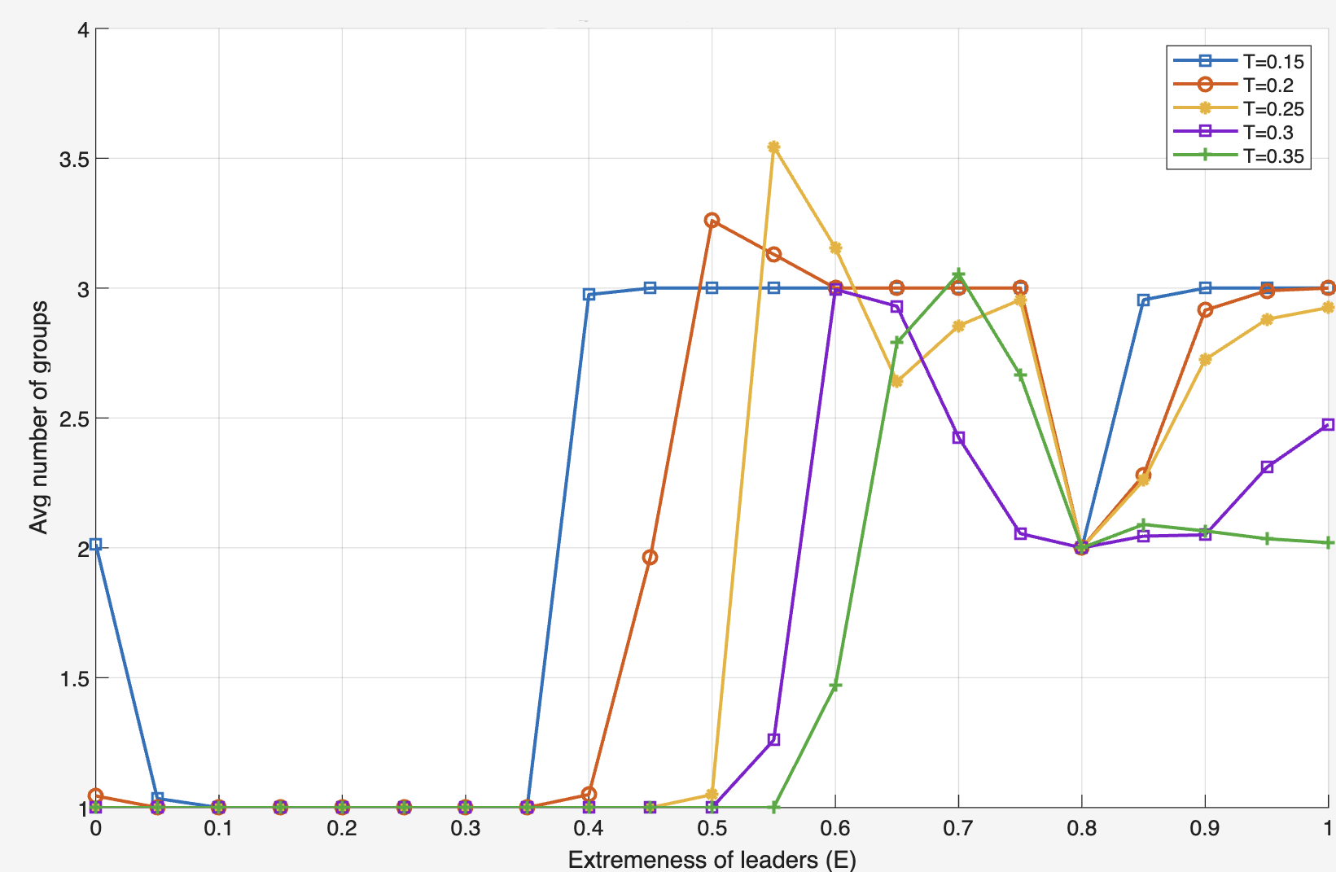
VALIDATION OF EXTREMENESS IMPACT
According with the paper of Chen et al. we simulated a system of n = 200 agents with two competing leaders, L1 and L2, positioned symmetrically with respect to the center of the opinion space. The leaders’ extremeness was varied from E = 0 to E = 1 , while keeping other characteristics constant (R = 50 S = 1, A = 0.4).
These pictures show the impact of leader extremeness on group fragmentation

Slide 14
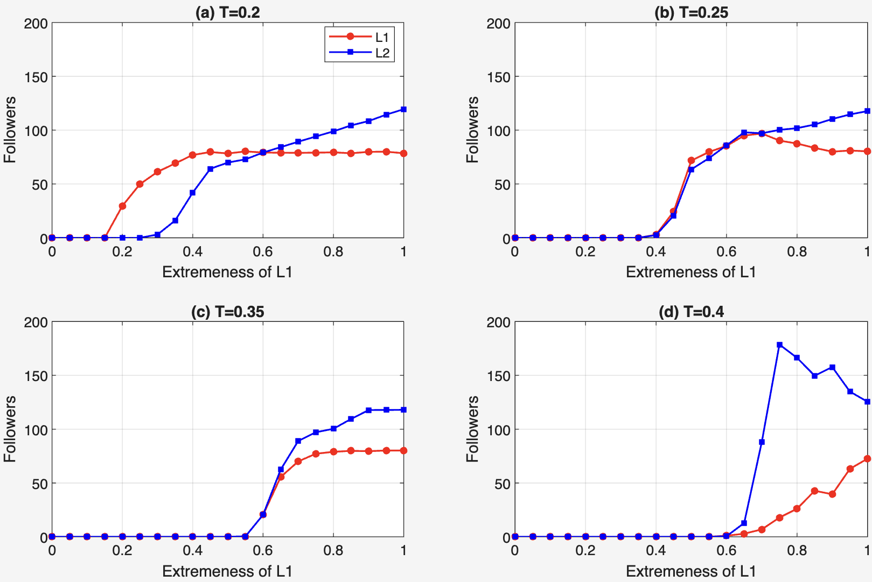
VALIDATION OF EXTREMENESS IMPACT
These pictures show the average number of followers for Leader 1 and Leader 2 as a function of E1, with E2 fixed at 0.6

Slide 15
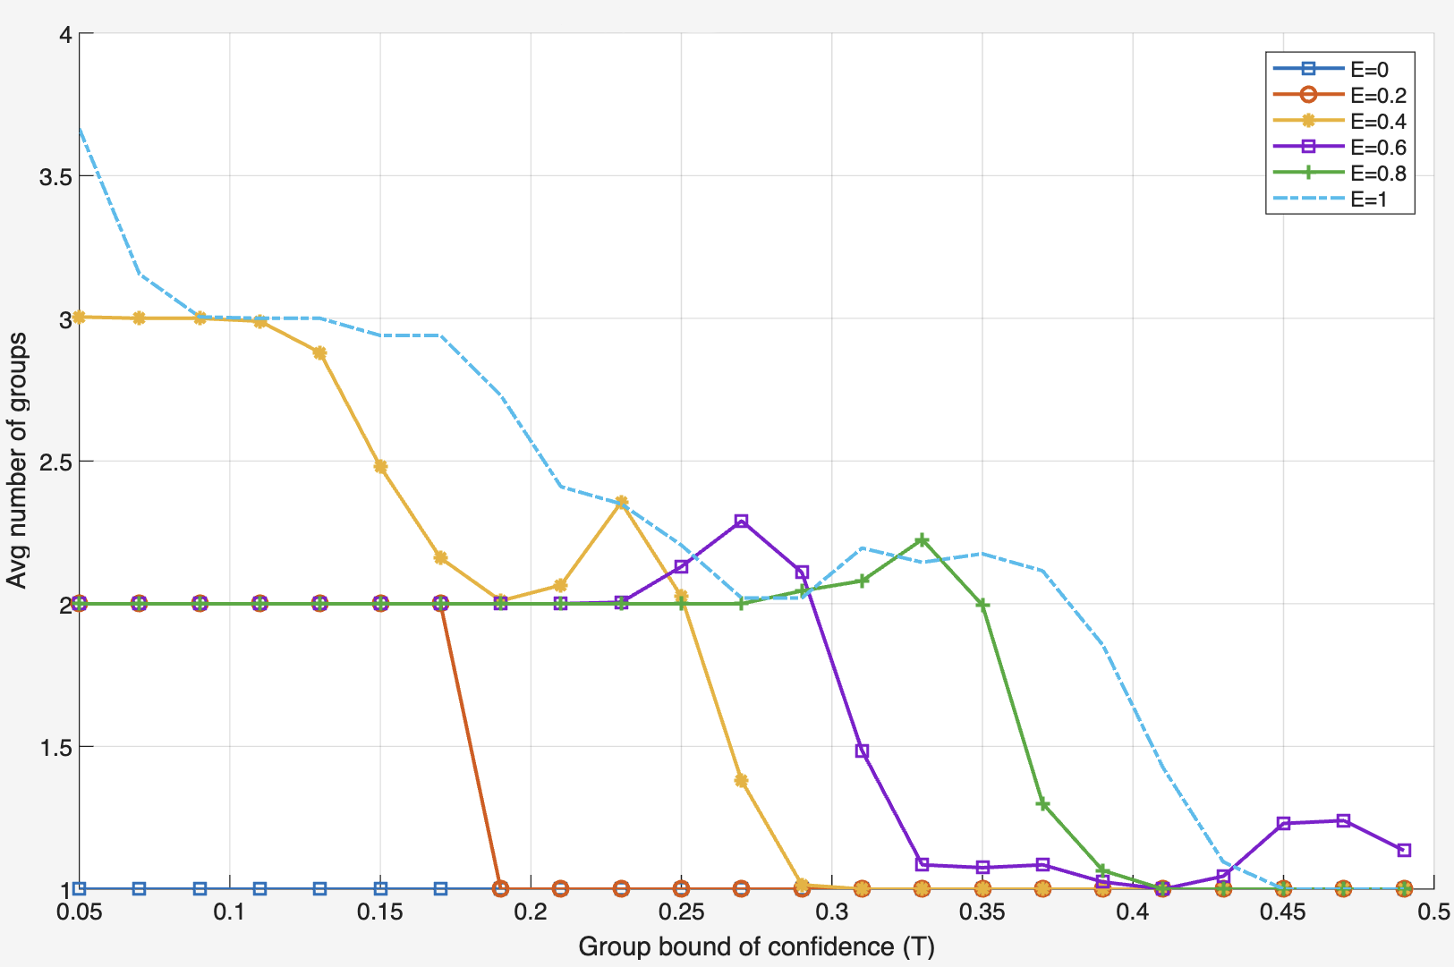
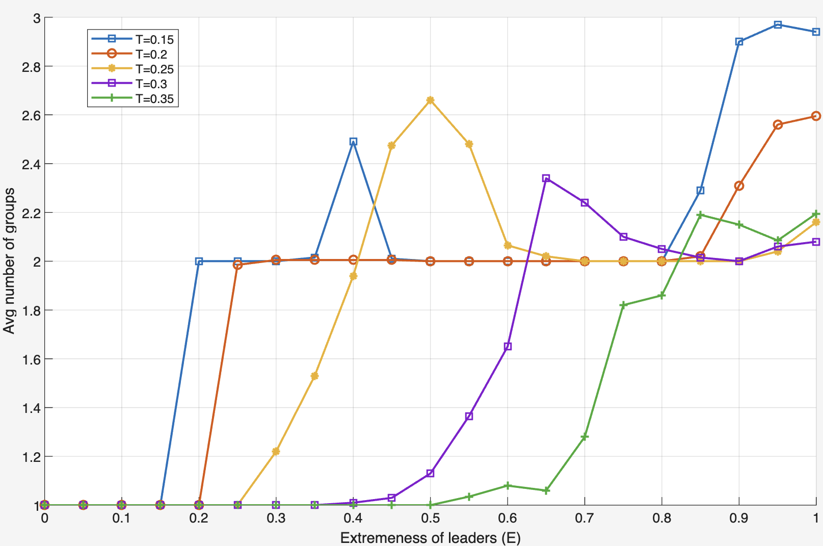
ASYMMETRIC LEADERSHIP
In this experiment, we simulate a scenario often observed in political dynamics:
Leader 1 ("The Populist"): Low Reputation (R1 = 10) but High Appeal (A1 = 0.6).
Leader 2 ("The Institution"): High Reputation (R2 = 100) but Low Appeal (A2 = 0.2).
We fixed E2 = 0.6 and varied (E1) from 0 to 1.
Fragmentation analysis in the Asymmetric Scenario

Slide 16
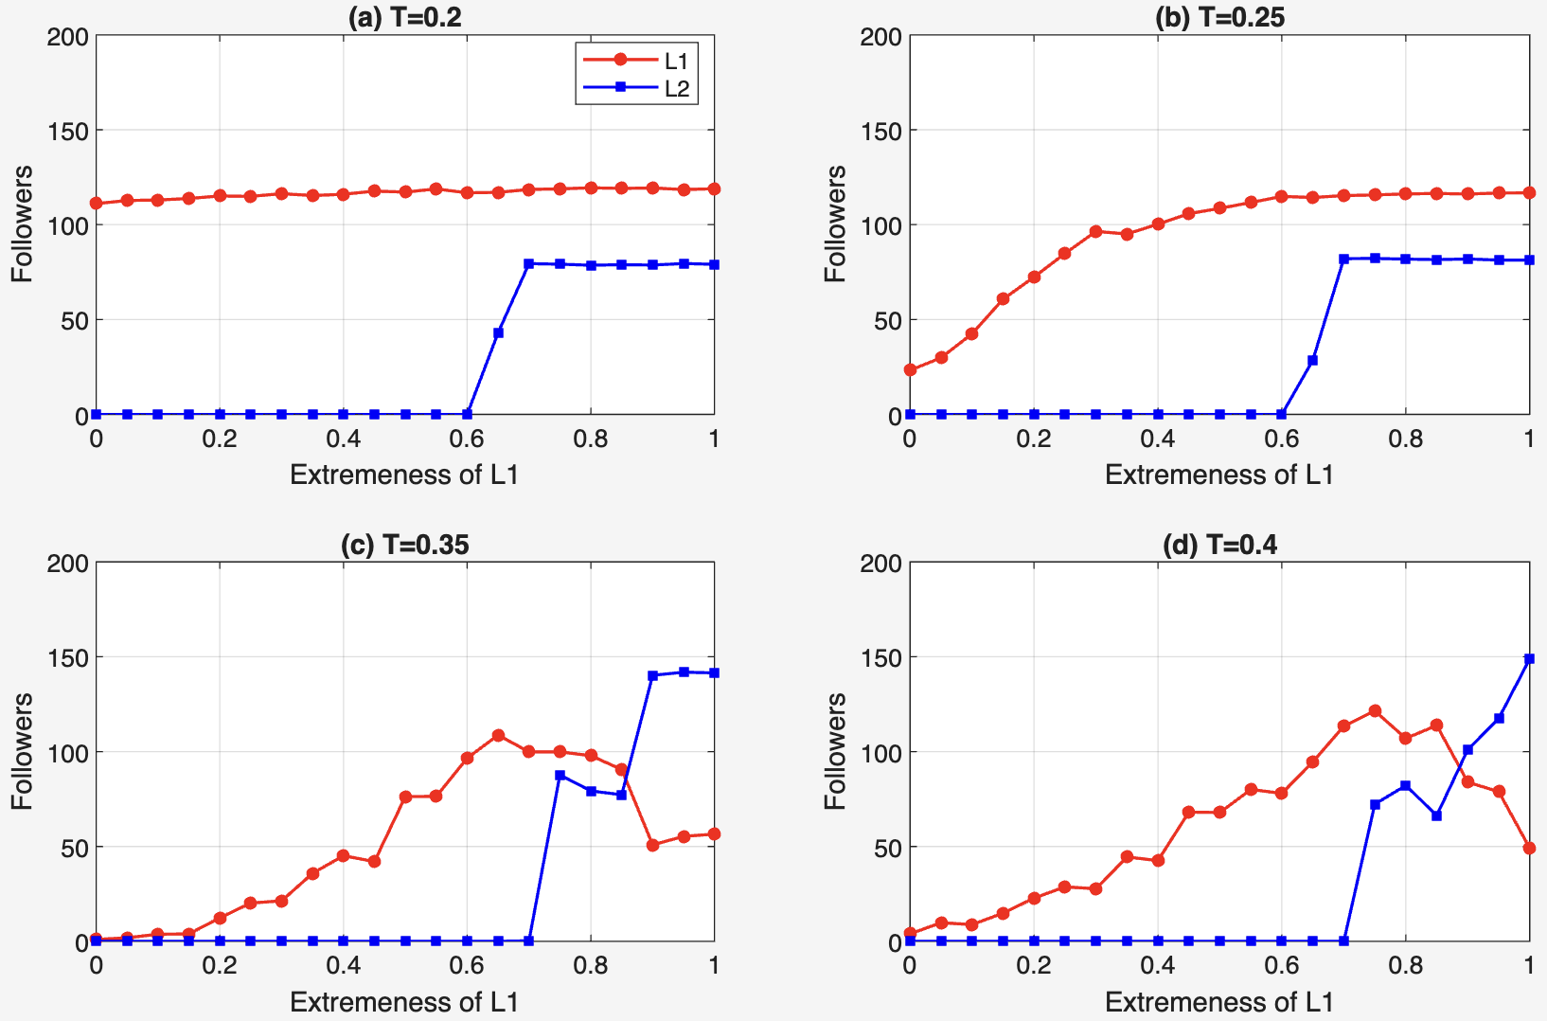
ASYMMETRIC LEADERSHIP
Follower counts in the Asymmetric Scenario

