Slide 1

MattockFS
Computer-Forensics File-System

Slide 2
A family tree
2002: OCFA Anycast
2006: CarvFS
2006: Sealed Digital Evidence Bag
2008: MinorFS

Slide 3

The OCFA Anycast
Message bus solution
Based on the workers concept
Part of Open Computer forensics Architecture
Persistent Priority Queues
Virtually infinite size queues

Slide 4
Issues with AnyCast
Infinite size queues
Multiple tools in tool-chain access same data
Result: Many page-cache misses

Slide 5
Spurious reads in OCFA
Page-cache misses
Early hashing and Content Addressed Storage
No locality of data design
Server-side data entry

Slide 6
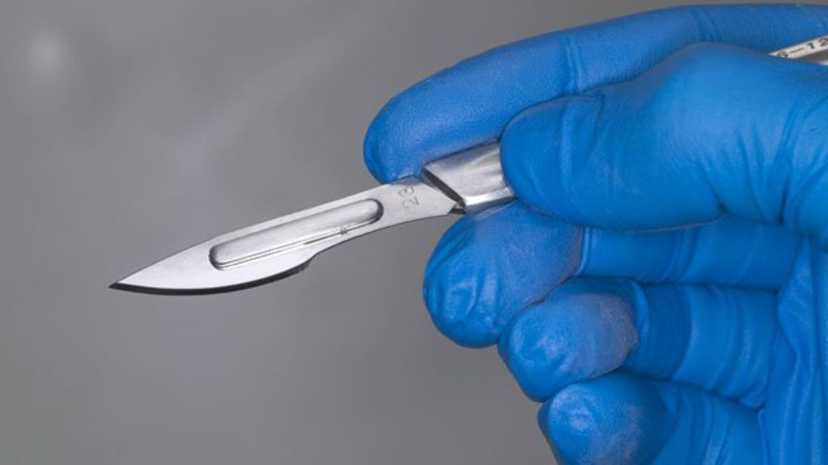
CarvFS
Storage requirements traditional file carving
CarvFS allows for zero-storage carving
Carved files not copied our but designated
CarvPath dessignations
  /mnt/carvfs/mp3/18400+4096_S4096_47912+975.crv

Slide 7
Issues with CarvFS
Read-only access to forensic disk image
In large cases hundreds of mounted image files
OCFA hacks
  Bypass CarvFS to write to underlying growing archive
  Inefficient hybrid CarvFS/CAS storage

Slide 8

Shared mutable data
Meta-data
Evidence data
Derived evidence data
Provenance logs

Slide 9
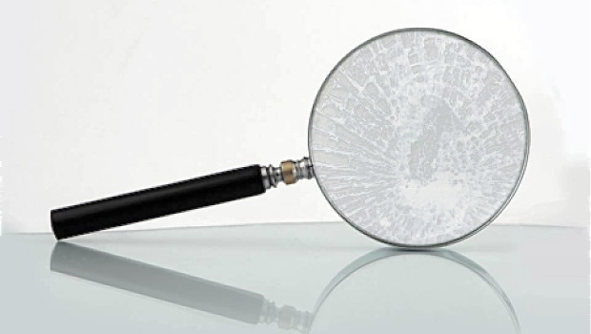
Shared mutable data
Meta-data
Evidence data
Derived evidence data
Provenance logs
Anti forensics ?
Forensic process integrity ?

Slide 10
Integrity measures
Trusted immutable data and meta-data
  Lab side sealed digital evidence bags.
Trusted provenance logging
Capability based access control
  Sparse capabilities
  Mandatory Access Controls

Slide 11
Spurious reads measures
Opportunistic hashing
Linux fadvise API
Integration of message-bus and data-archive
Priority queues → Sortable sets
Provide pressure data for throttling purposes

Slide 12
MattockFS
User space file-system for forensic frameworks
Zero-storage carving
Hybrid data-archive/message-bus solution
Helps minimize spurious read induced performance degradation.
Provides write-once (meta) data
Provides safe capability based API
Provides trusted provenance logs

Slide 13
MattockFS: Hooks
Hooks for forensic frameworks
  Framework based routing functionality
  Pressure data for throttling new-data input
  Queue size for throttling
Hooks for multi-server setup
  Geared to locality of data
  Migrating CPU intensive jobs

Slide 14
MattockFS
Combining a zero-storage carving-capable high-integrity data-storage archive with trusted forensic logging, a capability secure API and a local page-cache friendly message bus solution.

