Slide 1

Deep-Underground Neutrons:
An (almost) simulation-free review

Slide 2
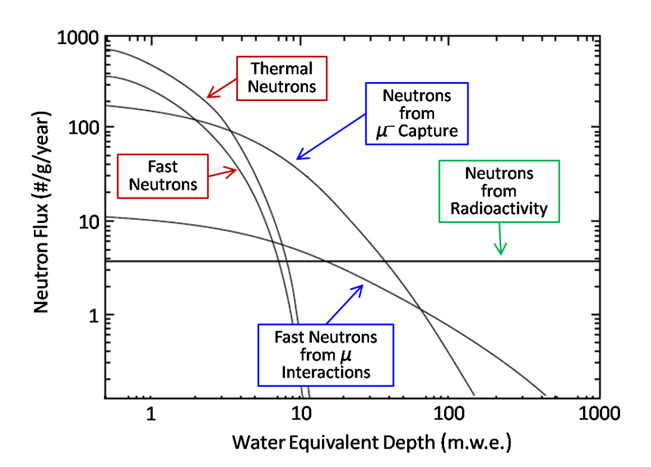
A Complete Description:
Rate + Energy Spectrum
Deep underground, there are two significant neutron sources:
Neutrons from radioactive elements in the rock
Neutrons from muon-induced spallation
R. Bunker (2011). A Low-threshold Analysis of Data from the Cryogenic Dark Matter Search Experiment. Ph.D. Thesis, UCSB

Slide 3
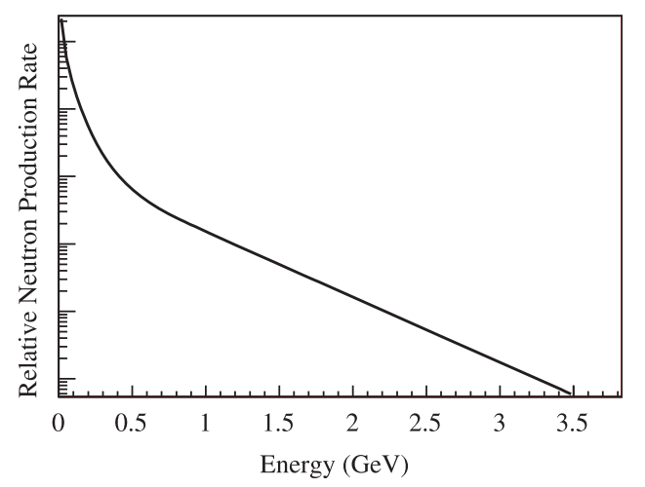
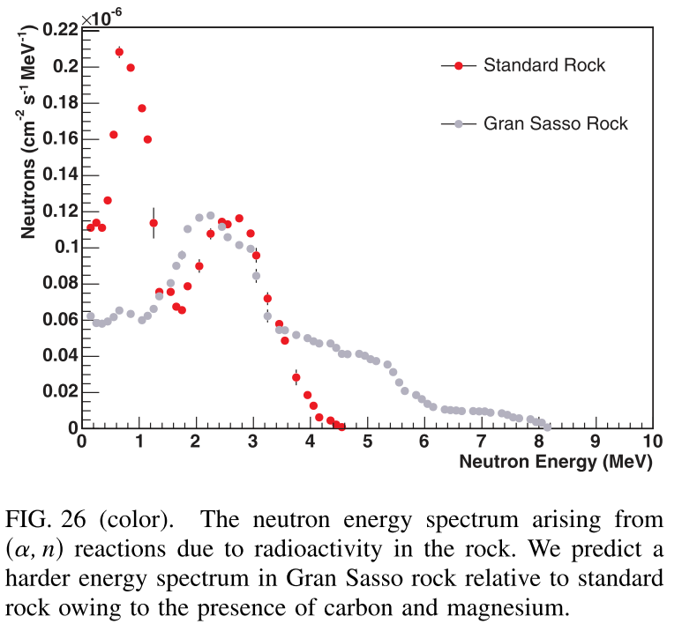
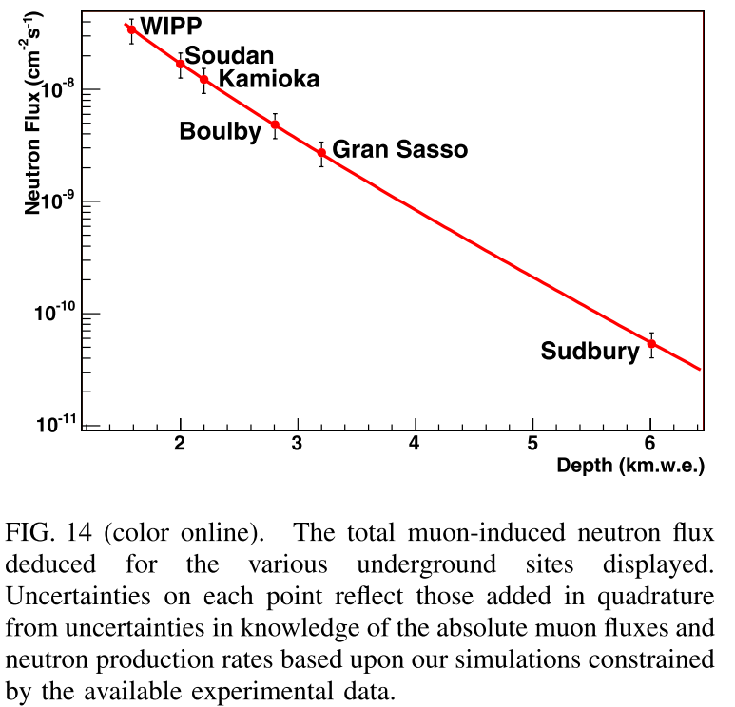
Neutron Rate + Energy Spectrum
The neutron spectrum due to radioactive decay is well understood, but only a few datasets exist for the energy spectrum of muon-induced neutrons (e.g. LVD). Several collaborations are working to take more data (e.g. DCTPC).
Wright et al., NIMA 644: 18-26, 2011
Mei and Hime, PRD 73: 153004, 2006

Slide 4
Neutron Interactions: Strongly Energy-Dependent
Lezione, INFN Lecture

Slide 5
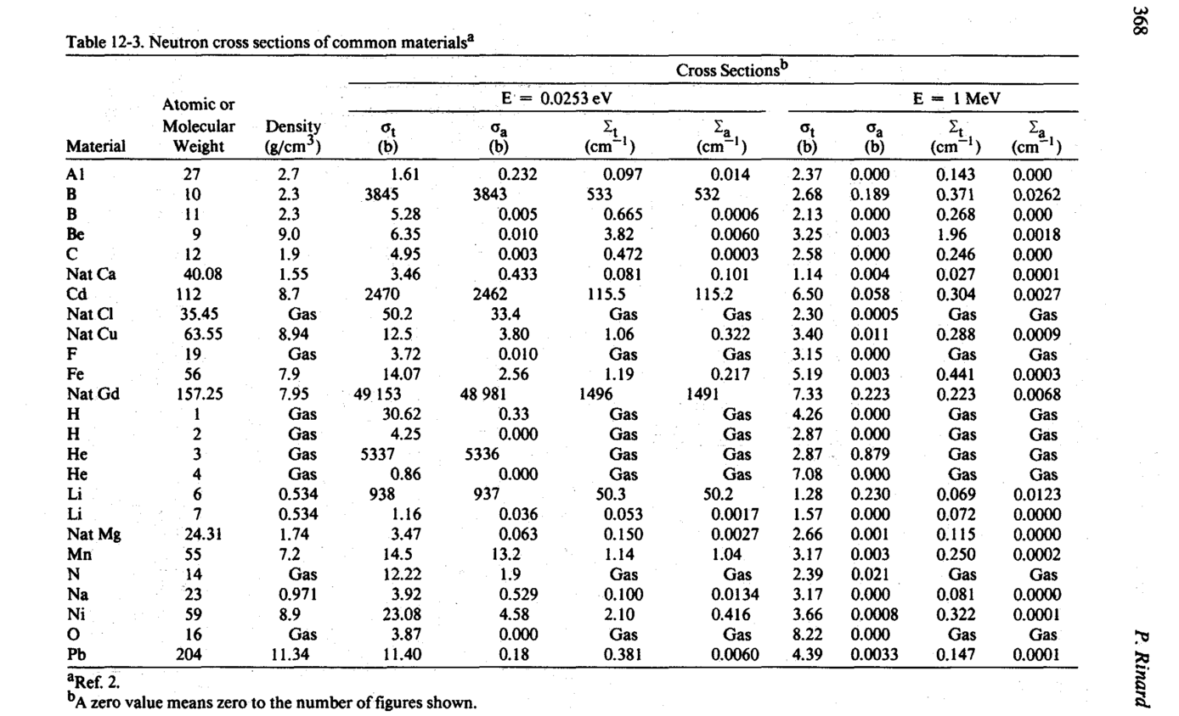
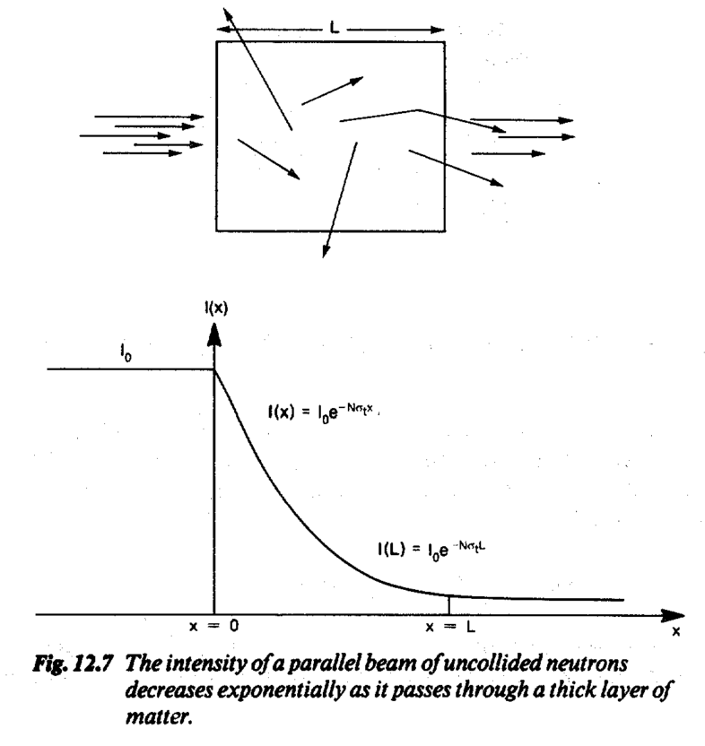
The Scale of Neutron Interactions
Rinard, Chapter 12, Passive Nondestructive Assay of Nuclear Materials, 1991

Slide 6
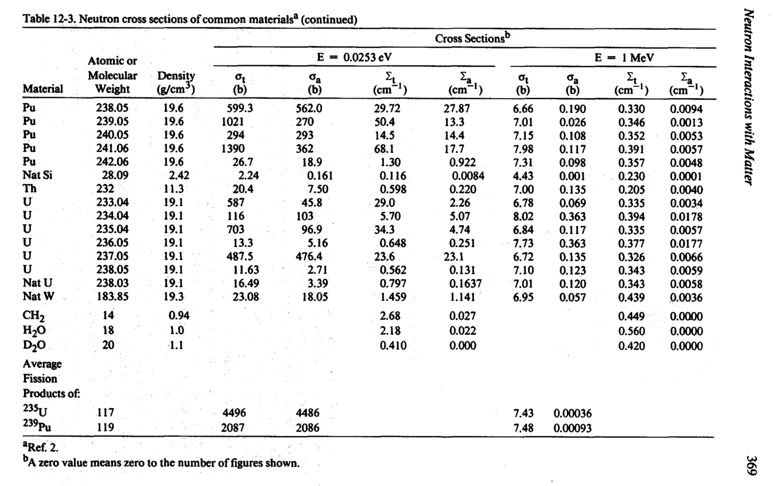
The Scale of Neutron Interactions: Molecules
The mean free path of a neutron in a non-isotopically pure medium (e.g. concrete) can be approximated as
Rinard, Chapter 12, Passive Nondestructive Assay of Nuclear Materials, 1991

Slide 7
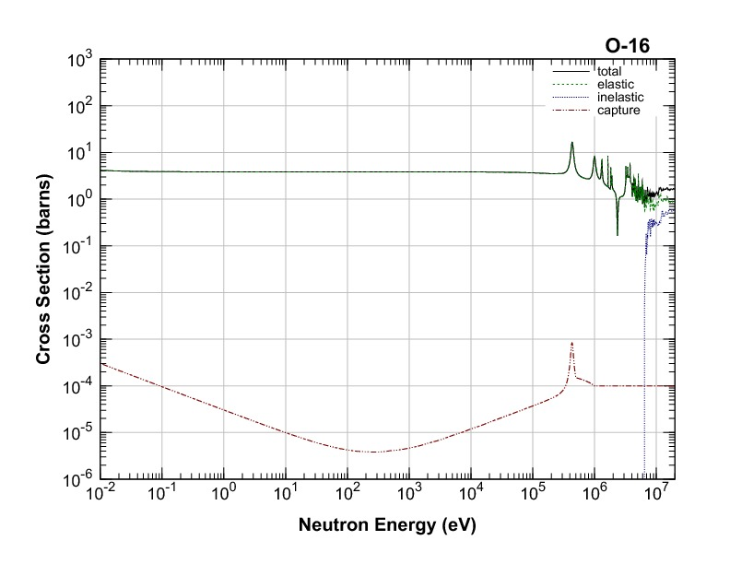
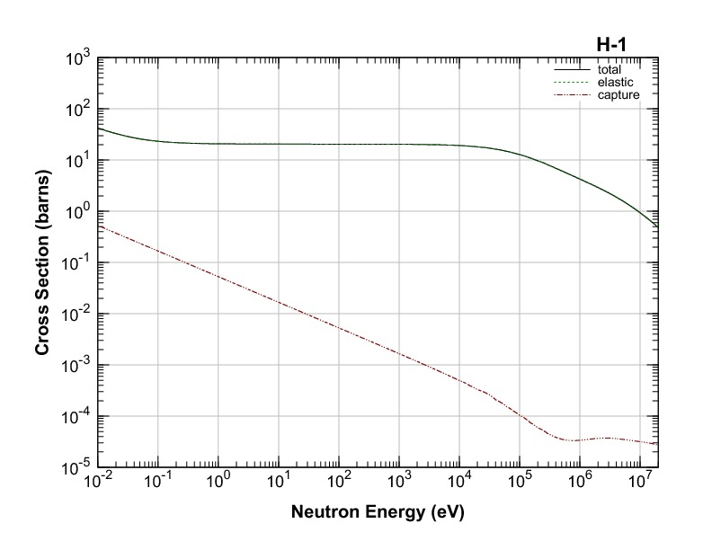
Using Neutron Cross Sections to Understand Low-Energy Shielding
Mean free path of 5 MeV neutron in water?
At 5 MeV, a rough estimate:
These cross sections give a mean free path of (0.25/cm + 0.1/cm)^-1 ~ 3 cm.
Note that a thickness of one mean free path reduces the number of neutrons by half.
JENDL, J. Nucl. Sci. Technol.. 48(1), 1-30 (2011)

Slide 8
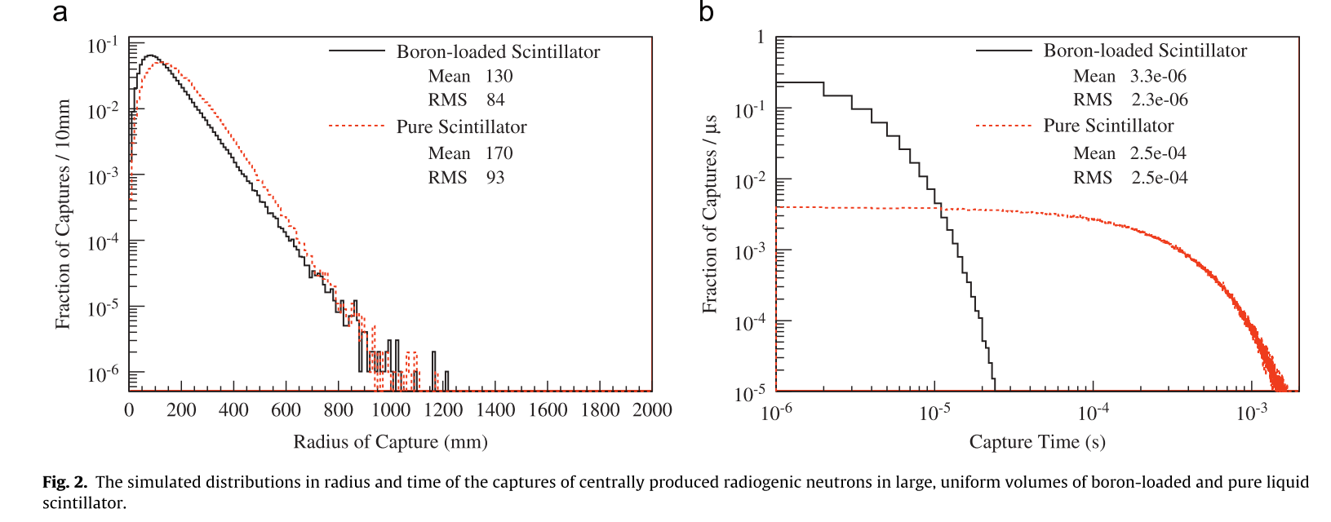
Low-Energy Neutron Shielding: Monte Carlo
Adding Boron has a noticeable but un-dramatic effect on the extent of the neutron travel.
But the time until capture is reduced by nearly two orders of magnitude because the hydrogen effectively slows the neutrons into the region where the boron-capture cross section is large.
Wright et al., NIMA 644: 18-26, 2011

Slide 9
What about High-Energy Neutrons?
High-energy neutrons have a longer mean free path and are therefore more likely to penetrate shielding
At Soudan, neutron flux for En > 10 MeV ~ 5*10^(-9) cm⁻²s⁻¹
Can ask
  Angular distribution of neutrons?
  How likely to penetrate shielding?
  How likely to generate additional neutrons – and how many neutrons, at what energies?
  How likely to leave a signal in the WIMP signal region?
  …
Not as much cross-section data
Wright et al., NIMA 644: 18-26, 2011
Mei and Hime, PRD 73: 153004, 2006

Slide 10
High-Energy Neutrons:
Evaluating a Scenario in Germanium
To understand a ~ 20 GeV neutron incident on Ge, we'll need the total cross section and the elastic cross-section for Ge (ideally, for each isotope of Ge!).
But for Ge, data is scarce.

Slide 11
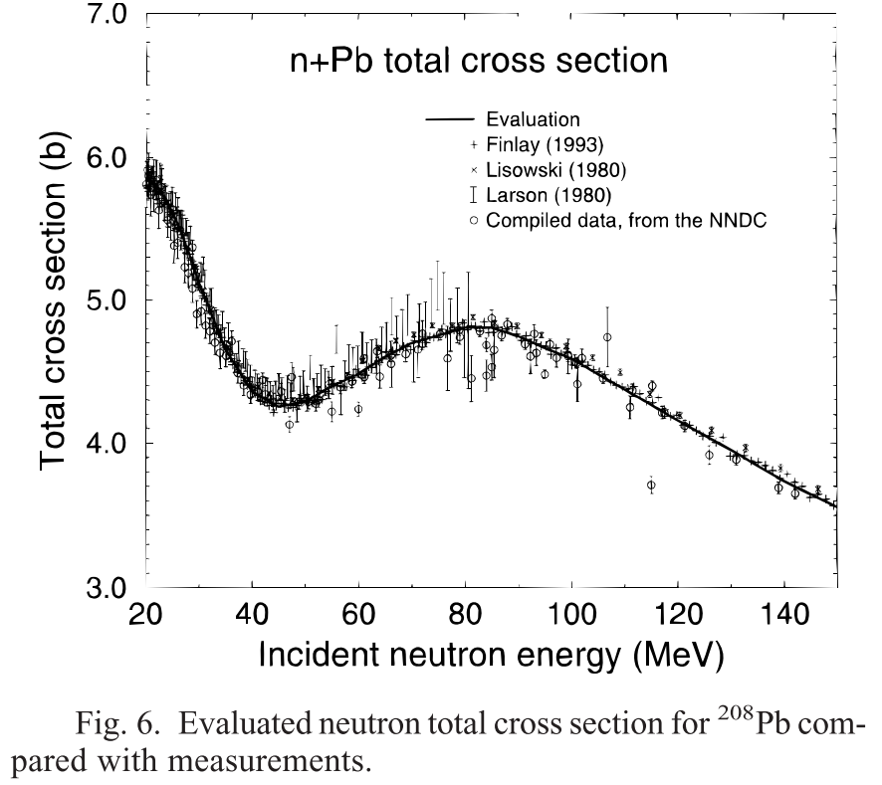
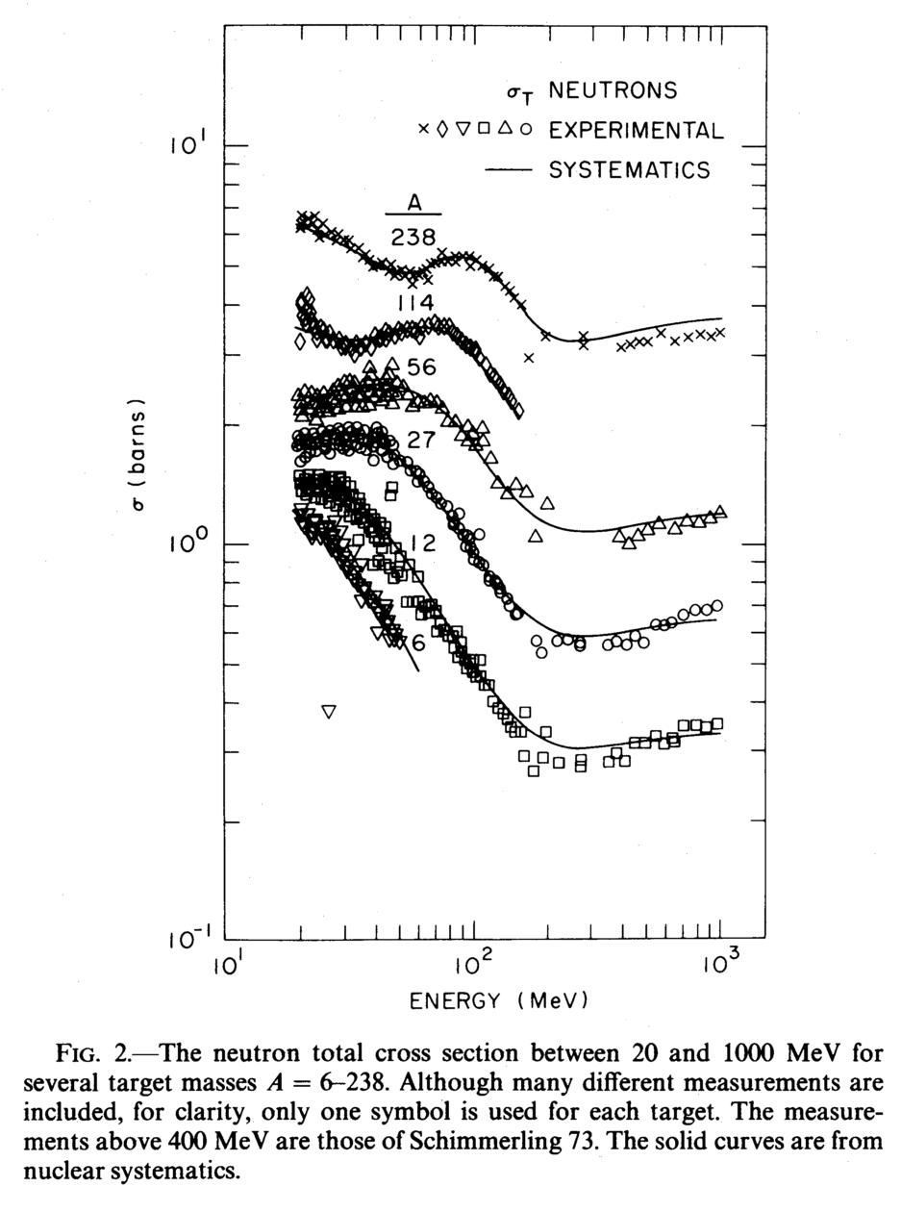
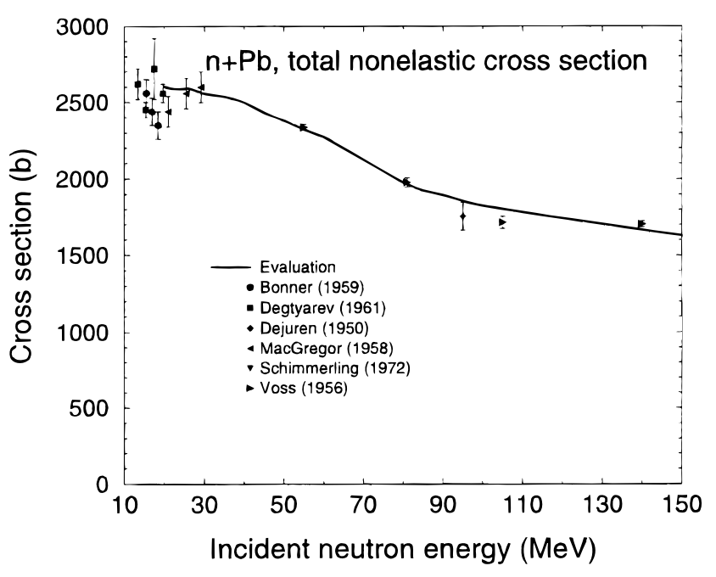
Who needs germanium? Lead has data!
Some isotopes (208Pb, below) have abundant data (see Chadwick).
Other isotopes have little to no data (Ge) in the fast-neutron regime. In this case, simulations often use evaluated nuclear data files (ENDF) or interpolated fits to data (see Pearlman).
Chadwick et al., Nuclear Science and Engineering, 131: 293-328, 1999 (super awesome paper)
mb
Pearlstein et al., The Astrophysical Journal, 346: 1049-1060, 1989

Slide 12
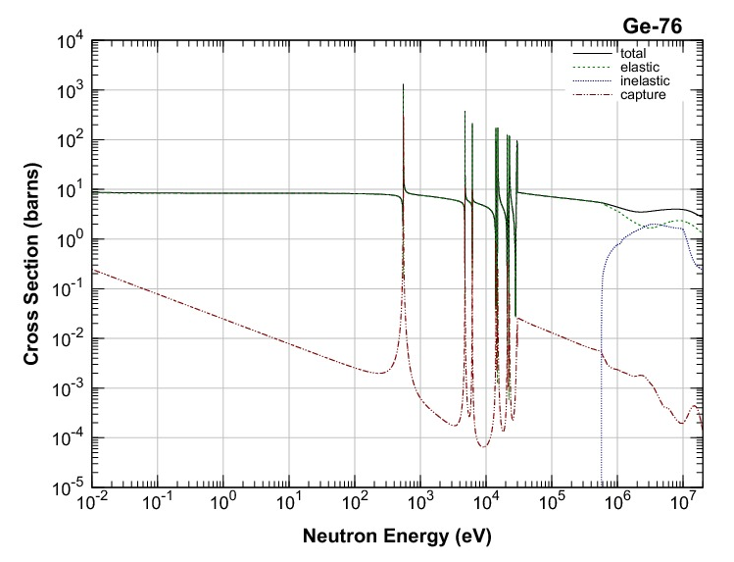
Evaluated Nuclear Data Files
Several nuclear committees (NNDC, JENDL, etc.) provide evaluated nuclear data files.
These files have an agreed-upon format (ENDF-VI) and give fit results based on:
DATA
17)N. Yamamuro JAERI-M 88-140(1988) 18)S. Raman et al. AND 42,1(1989)
19)R.H. Spear AND 42,55(1989)
...
MODEL
Model often some form of an optical potential
Potential V(r) is a complex number whose real part scatters incoming nuclei and whose imaginary part captures nuclei
Potential depth V(r_0) scaled to match ground-state binding energy
Nuclear-matter radius and charge radius fit to data
Final optical model parameters typically based on large datasets with many reactions and angular-dependence of cross sections
RESULT
JENDL, J. Nucl. Sci. Technol.. 48(1), 1-30 (2011)

Slide 13
High-Energy Neutrons in Germanium
A ~ 20 GeV neutron incident on Ge has an elastic cross section of ~ 1.5 barns (1.5 * 10^(-24) cm^2, so its mean free path is
So the probability of the 20 GeV neutron elastically scattering while traversing 3 cm of a Ge crystal is
Can use kinematics to determine the probability of nuclear recoil between E_0, E_threshold

Slide 14
Neutron Resources
Data
  ENDF format: http://t2.lanl.gov/nis/endf/title.html, https://www.oecd-nea.org/dbdata/data/manual-endf/endf102.pdf
  JENDL, NNDC
Monte-Carlo Software
  FLUKA, Geant4 (+ neutron libraries), MCNPX
Books
  An excellent, introductory overview (features real numbers!): Passive Nondestructive Assay of Nuclear Materials. Published by the US Nuclear Regulatory Commission and available in full as .pdf.
  Rigorous treatment of nearly every nuclear physics concept: From Nucleons to Nucleus, J. Suhonen
Papers
  Overview of neutron flux, spectrum parametrizations: Mei and Hime
  Detailed description of neutron cross section evaluation for ENDF: Chadwick
  Recent cross-section measurements for dark-matter search: MacMullin et al., http://arxiv.org/abs/1212.2992

Slide 15
Thank You!

Slide 16
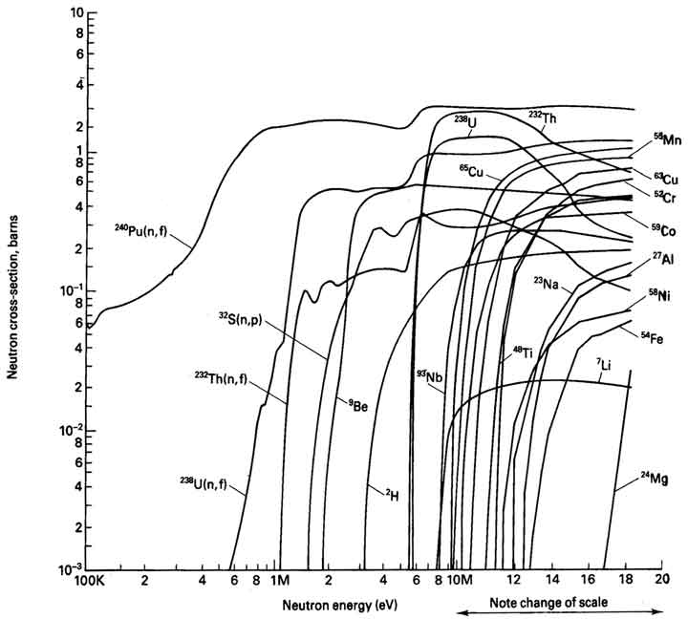
Neutron-Induced Spallation
Tables of Physical & Chemical Constants. 2.1.2 Barometry. Kaye & Laby Online. Version 1.1 (2008) www.kayelaby.npl.co.uk

