Slide 1
Exploring New York City and its Housing Prices
Data Science Capstone Project
Rui Huang

Slide 2
New York City
New York City, a.k.a. the Big Apple, is situated in northeastern U.S.
It is the financial capital of the country
It hosts many neighborhoods within its five boroughs - Manhattan, Brooklyn, the Bronx, Queens, and Staten Island - and each of these boroughs exhibits its own lifestyle
New York City is heavily populated and ethnically diverse
It is one of the most international cities in the country.

Slide 3
Business Problem
New York City boosts tremendous business opportunities, and is a global hub of business and commerce
Much of New York's business success is due to the real estate market
The highly competitive business market in New York City has driven up its cost of living
New comers who wish to move into the city need to carefully analyze the costs and benefits associated with living in New York before making a serious financial commitment
Particularly, people who are interested in moving to New York City should understand the culturally diverse neighborhoods and their identifying characteristics, as well as the housing prices in each neighborhood

Slide 4
Research Questions
How could we cluster neighborhoods in New York City using surrounding venues?
Is there a relationship between the characterized clusters and housing prices in New York City?
Is there a relationship between the surrounding venues and housing prices in New York City? If yes, which aspects of the venues are most likely to influence housing prices, and whether we can use venues to predict housing prices in NYC?

Slide 5
Target Audience
The objective of this study is to understand how neighborhood venues may impact housing prices in New York City
Real estate professional may be interested in our findings
People who plan to move to New York would find the findings useful too
The study would also interest anyone who is taking the data science course

Slide 6
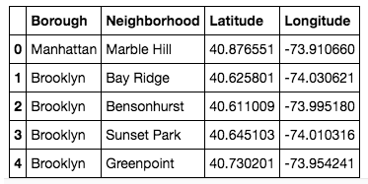
Data Description – 1
Coordinates data for each borough and neighborhood from Geocoder (https://geocoder.readthedocs.io/index.html) - coordinates data will allow us to locate venues on FourSquare API and map the neighborhood segments on a map

Slide 7
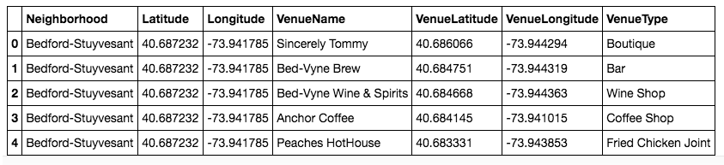
Data Description – 2
Venues in each neighborhood from FourSquare API - venue data from FourSquare can be used to explore and segment neighborhoods in NYC
For example, FourSquare APIs offer rich location-based experiences and enable access to places data in real time and venue-related tips, tastes, photos & attributes from the Foursquare community

Slide 8
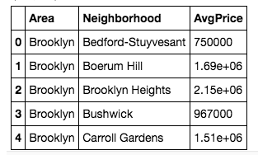
Data Description – 3
Average NYC condo prices by neighborhoods from CITYREALTY (https://en.wikipedia.org/wiki/New_York_City#Population_density) - data retrieved from CityRealty lists average prices for different types of condos (ranging from studio to 3-bedroom) aggregated by neighborhoods in NYC
This project will use the average price of 2-bedroom condos, which is a common type selected by an average family

Slide 9
Data Collection
For each neighborhood, call Geocoder Python to get its coordinate.
Based on each neighborhood's coordinate, call FourSquare API to get the surrounding venues.
We will scrap the average price of 2-bedroom condos for each neighborhood from the CityRealty website

Slide 10
Methodology
Cluster Analysis - used to explore and segment NYC neighborhoods
Visualization – used to display data on map
Correlation and linear regression analysis - used to identify the impacts of neighborhood clusters and venue types on 2-bedroom condo prices
Machine learning techniques - used to determine how well independent variables can be used to predict condo prices

Slide 11
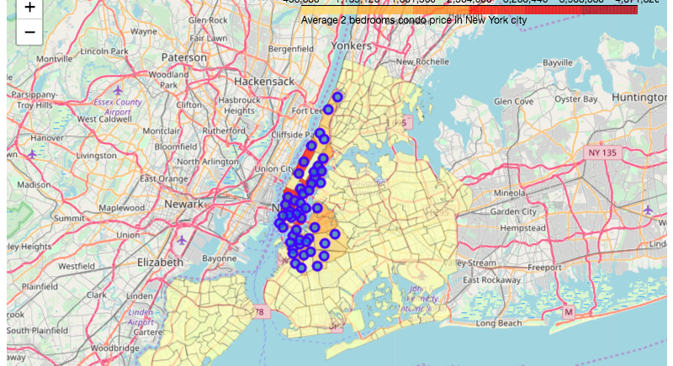
New York City Geographical Coordinates Data

Slide 12
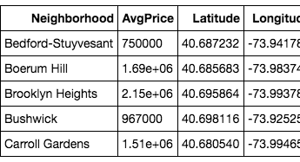
Average 2-bedroom Condo Price Data

Slide 13
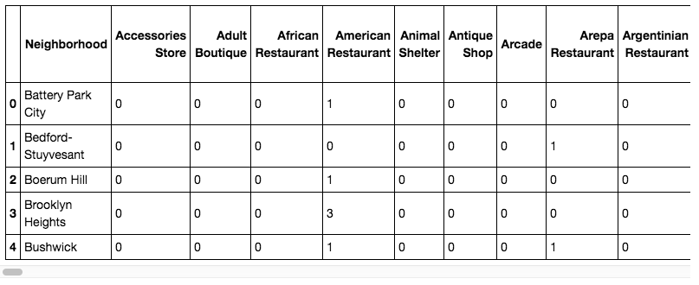
FourSquare APIs Data

Slide 14
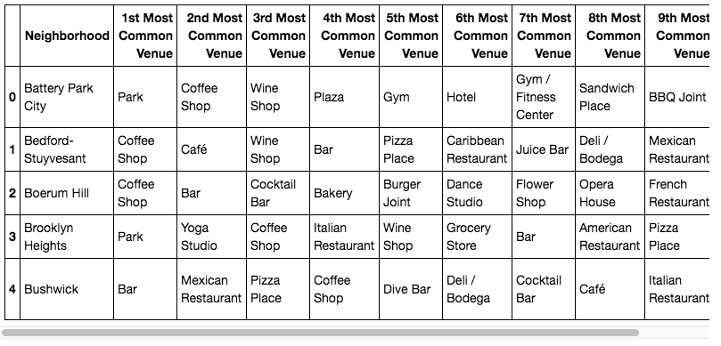
FourSquare Data - Continued

Slide 15
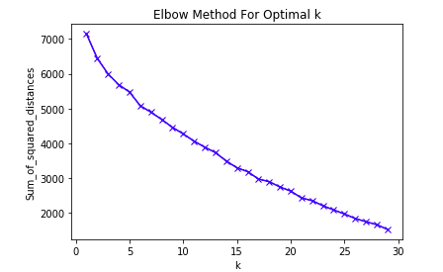
Cluster Results

Slide 16
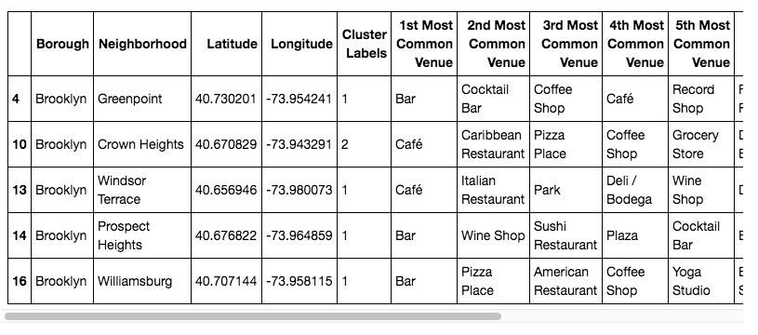
Cluster Results - Continued

Slide 17
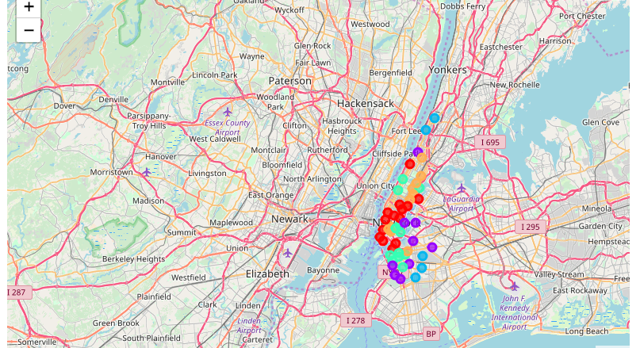
Cluster Visualization

Slide 18
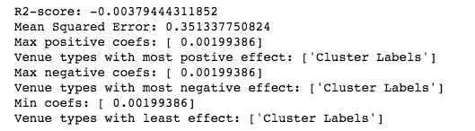
Linear Regression – Clusters as the IV

Slide 19
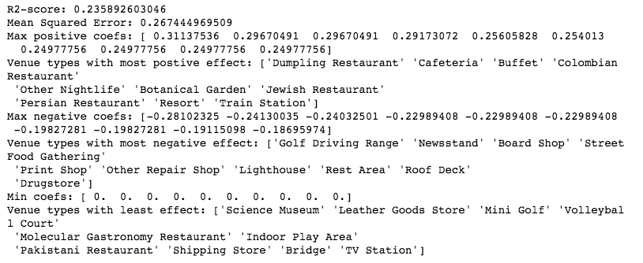
Linear Regression – Venue Types as the IV

Slide 20

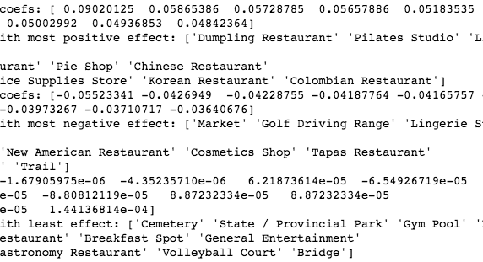
Principal Component Regression (PCR)

Slide 21
Discussions
NYC neighborhoods may be segmented into five clusters.
Regression results, seems consistent and logical.
Neighborhoods with interesting restaurants may be more expensive to live in.
Despite the variables identified in this study, the real estate price can be hard to predict.
The machine learning techniques applied in this study may not accurately predict future housing prices in NYC.
Future studies may be needed to better understand the factors that would help explain housing prices in NYC.

Slide 22
Conclusion
Based on the analysis, neighborhoods with interesting restaurants seem to boost housing values the most
There may be a logical endogeneity in this observation though, as neighborhoods with a lot of eateries tend to be those with highly population density and it might simply be the housing demands that drive up the living prices
To make a more accurate conclusion about how features of neighborhoods may impact housing prices, future studies are needed to explore additional variables

