Slide 2
Sample
Analyze
Monitor
Sample
Analyze
Monitor

Slide 3
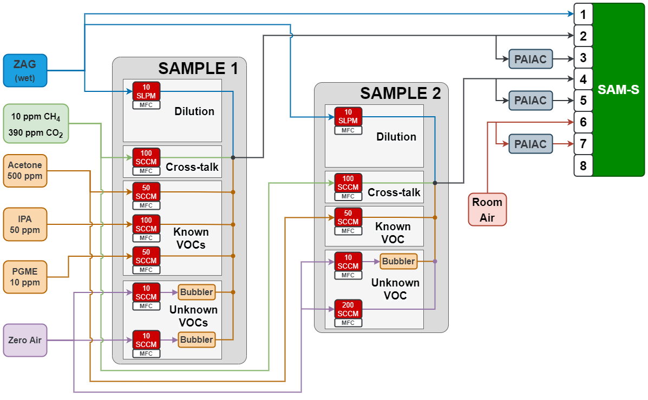
1
7
2
3
8
4
9
5
10
6

