Slide 1
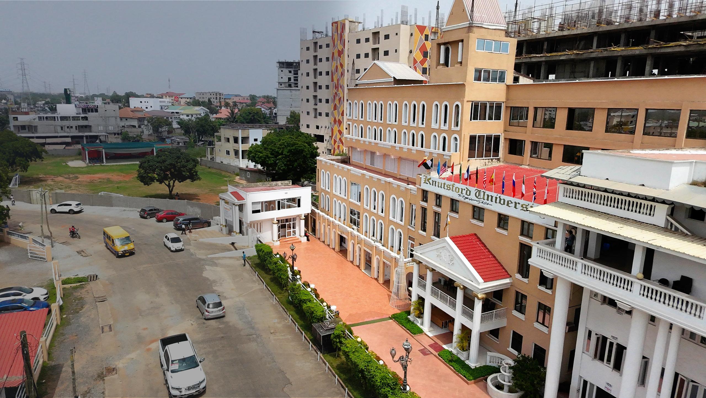

FINAL YEAR PROJECT
NFC-Based Student Permit
Verification and Governance
Management System
One connected platform for permits, verified payments, SRC operations, and student verification.
Daud Abdul-Rahim • Kwuatsenu Divine • M’Bangot-Menard Naeem Latif Dieudonne
Supervisor: Mr. Bryan Laryea
Faster services · stronger accountability · safer verification

Slide 2



THE PROBLEM
Disconnected processes created delays and weak accountability
The challenge was not just a paper form — it was the missing connection between each decision.
A fragmented journey
Students
01
Request
Could wait while eligibility and payment were confirmed.
02
Payment
Administrators
Had to coordinate records across separate activities.
03
Approval
04
Verification
Verification staff
Needed a current, auditable permit decision.
Result: slower service and limited audit visibility
KNUTSFORD UNIVERSITY · NFC PERMIT & GOVERNANCE SYSTEM
02

Slide 3




THE SOLUTION
One backend connects the website, mobile app, and verification decisions
Different interfaces. One controlled source of truth.
Website
Mobile App
Public information and administrative operations
Student services and authorized staff verification
SHARED BACKEND
Laravel rules + one database
Current decision
The same permit, payment, role, and audit state — everywhere
KNUTSFORD UNIVERSITY · NFC PERMIT & GOVERNANCE SYSTEM
03

Slide 4

ARCHITECTURE
Laravel enforces the business rules for every channel
Web and mobile remain independent interfaces, while permissions, payments, permits, and verification stay centralized.
Website
Inertia • React • TypeScript
Laravel 13
PostgreSQL
Application + API
Sanctum authentication
Production data store
Mobile app
Expo React Native
Central rule: clients display the backend’s current decision
Paystack
NFC + staff device
Server-side payment verification
Identifier initiates an authenticated lookup
KNUTSFORD UNIVERSITY · NFC PERMIT & GOVERNANCE SYSTEM
04

Slide 5


CONTROLLED WORKFLOW
A permit is issued only after eligibility and verified payment
A browser redirect is not accepted as proof of payment; the backend verifies the transaction first.
1
2
3
4
Request
Eligibility
Verify payment
Issue permit
Student submits the permit request.
Backend applies the required checks.
Paystack result is confirmed server-side.
Receipt, history, renewal, and verification use the same record.
Outcome
The permit is created only from a verified backend state; duplicate processing is controlled.
KNUTSFORD UNIVERSITY · NFC PERMIT & GOVERNANCE SYSTEM
05

Slide 6
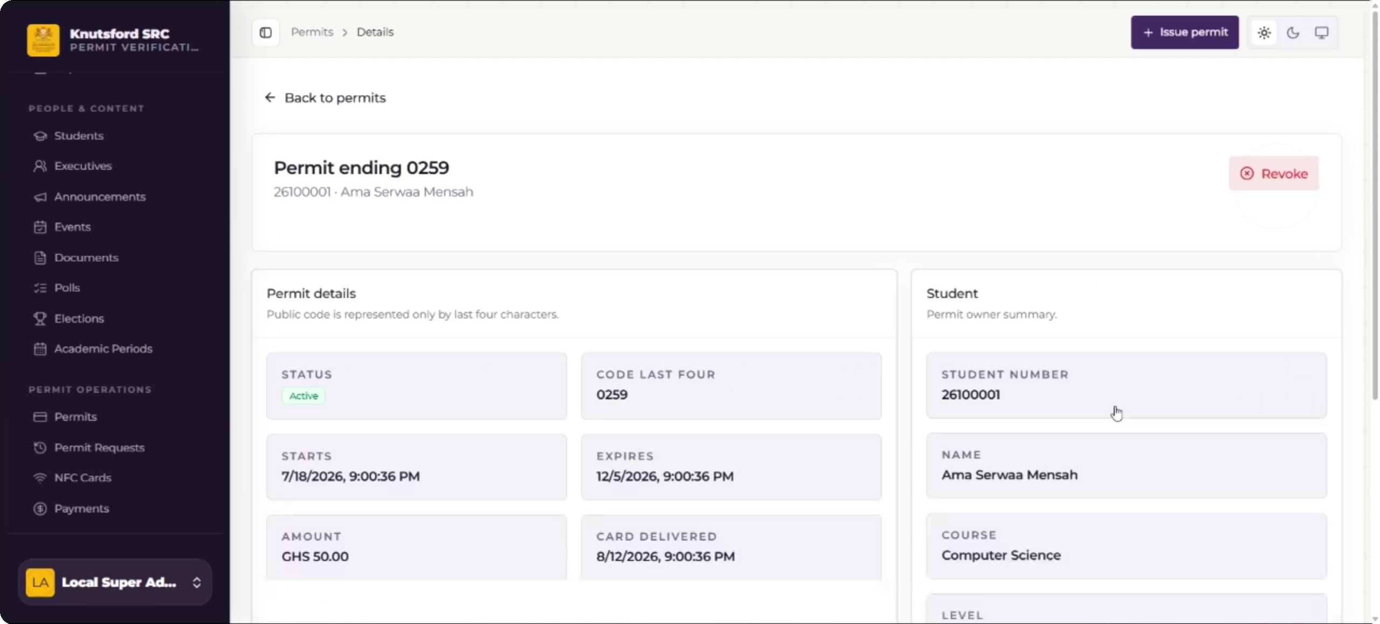
WEBSITE EXPERIENCE
The website centralizes daily SRC operations
Authorized workspace
Review permit activity and payment records
Issue receipts and monitor status history
Manage complaints, announcements, budgets, reports, and elections
Separate public information from restricted administrative records
Live screenshot — Knutsford SRC Permit Verification Portal
Role permissions control access
KNUTSFORD UNIVERSITY · NFC PERMIT & GOVERNANCE SYSTEM
06

Slide 7
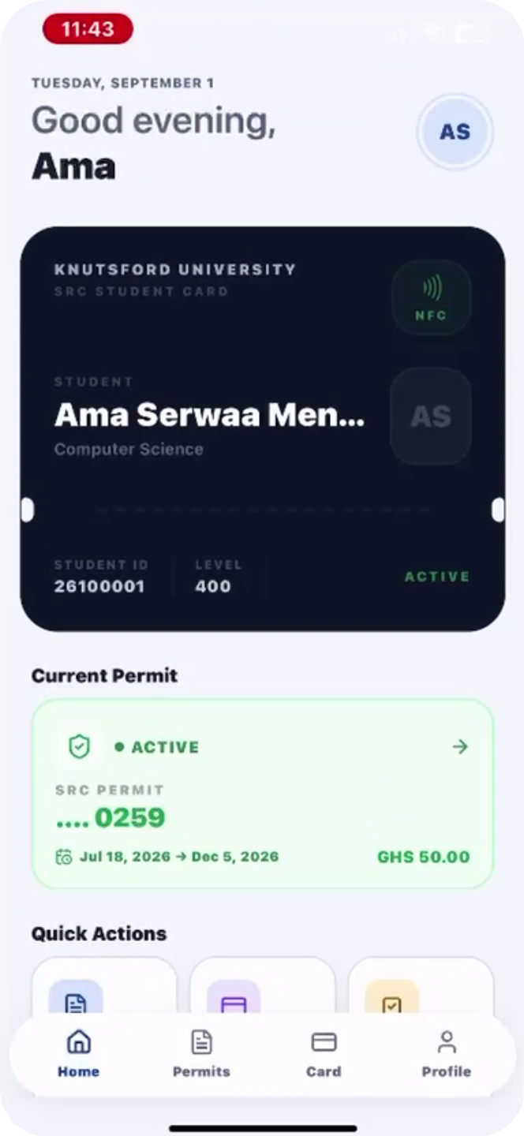
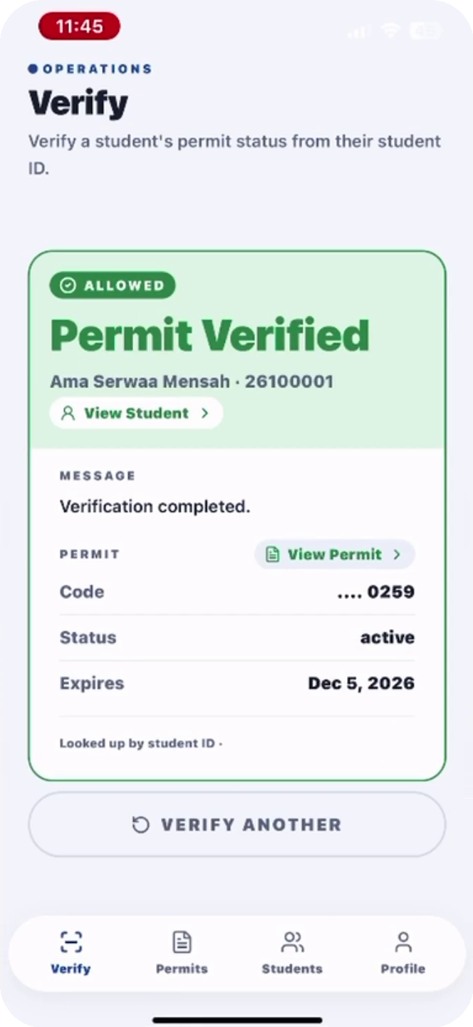
MOBILE EXPERIENCE
One mobile app presents different workflows by role
The app displays the backend’s decision; it does not independently decide whether a permit is valid.
Student
Authorized staff
Permit requests
Payments and receipts
Current permit status
Announcements and elections
Focused verification workflow
Student-number fallback
Current backend result
Verification audit record
KNUTSFORD UNIVERSITY · NFC PERMIT & GOVERNANCE SYSTEM
07

Slide 8

VERIFICATION AND SECURITY
NFC starts the lookup; the backend decides
The card carries an identifier — not a complete student profile or a permanent permit decision.
1 Tap
2 Check
3 Return
The phone reads the registered NFC identifier.
The backend confirms the verifier, linked record, and current permit state.
Only the authorized verification result is displayed and logged.
CONTROLS AROUND THE LOOKUP
Role-based access
Server validation
Audit logs
Rate limits
Verified payments
Limitation: copied identifiers remain a risk; stronger deployments can add cryptographic tags or controlled devices.
KNUTSFORD UNIVERSITY · NFC PERMIT & GOVERNANCE SYSTEM
08

Slide 9
PILOT EVIDENCE
The pilot exercised the digital permit and payment workflow at scale
These figures validate permit and payment operations — not a completed campus-wide NFC rollout.
2,021
2,769
GHS 276,900
registered student records
permit records linked to successful payments
value of successful pilot transactions
Why permits exceed students
The figures count different things: 2,021 registered students versus 2,769 processed permit/payment records. Some students have repeated records across permit periods.
KNUTSFORD UNIVERSITY · NFC PERMIT & GOVERNANCE SYSTEM
09

Slide 10

POST-SUBMISSION VALIDATION
The latest verified build passed 337 automated tests
Development and validation continued after the report was submitted.
Verified checks
Laravel feature and API tests
TypeScript checks passed
Mobile lint passed
No failed checks in the verified run
337
automated tests passed
1,657 assertions
The report contains the submission-time count; this slide reports the newer current-build validation.
KNUTSFORD UNIVERSITY · NFC PERMIT & GOVERNANCE SYSTEM
10

Slide 11

IMPLEMENTATION PATH
A phased GHS 32,450 rollout keeps adoption realistic
Controlled stages reduce operational risk and create room for training, monitoring, and improvement.
1
Phase 1 — Prepare
Confirm accounts, training, and controlled verification points.
SUBMITTED BUDGET
2
Phase 2 — Expand
GHS
32,450
Widen permit use and authorized staff coverage.
3
Phase 3 — Improve
Implementation envelope
Monitor adoption, support users, and refine the system.
KNUTSFORD UNIVERSITY · NFC PERMIT & GOVERNANCE SYSTEM
11

Slide 12
DEMONSTRATION
One record connects every channel
Student 26100001 • permit ending 0259 • active status
ADMINISTRATOR
STUDENT
STAFF VERIFICATION
What the demonstration proves
The website, student app, and authorized staff workflow return the same backend-controlled record.
KNUTSFORD UNIVERSITY · NFC PERMIT & GOVERNANCE SYSTEM
12

Slide 13


CONCLUSION
One accountable system replaces
fragmented decisions
The project connects:
A shared backend across web and mobile
Verified payment before permit issuance
Questions
Backend-controlled verification with an honest phased rollout
Evidence supports continued, controlled institutional adoption.
KNUTSFORD UNIVERSITY · NFC PERMIT & GOVERNANCE SYSTEM
13

