Slide 1
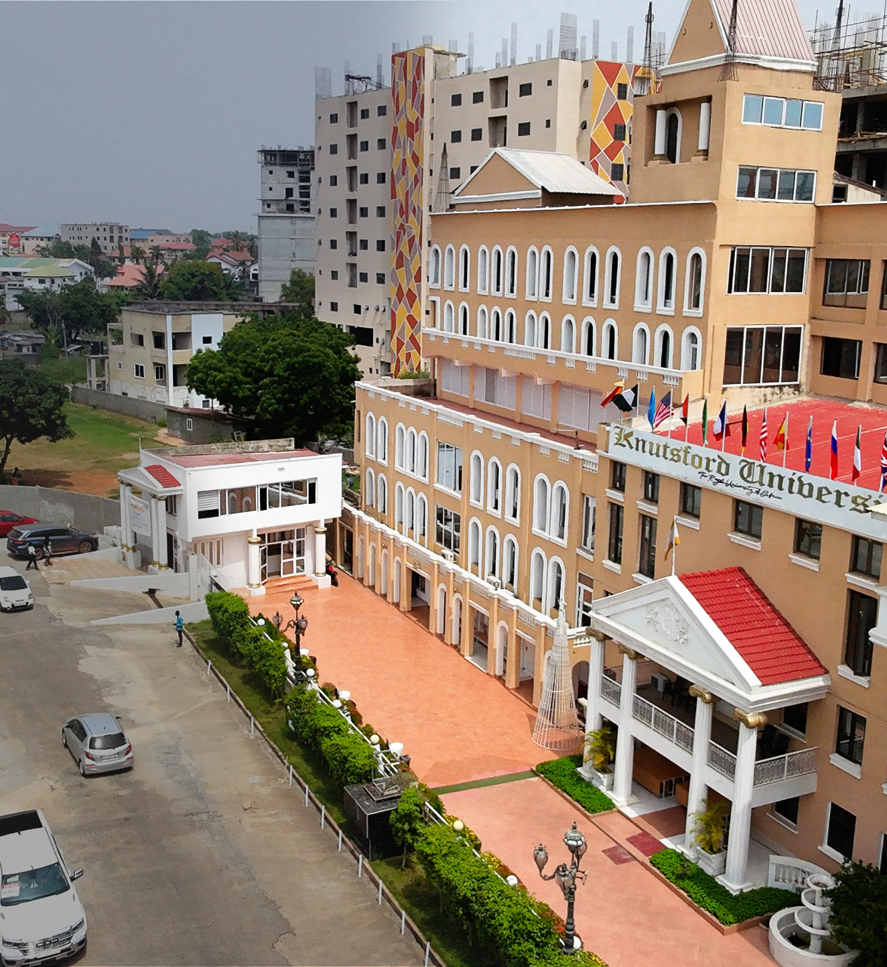

FINAL YEAR PROJECT
NFC-Based Student Permit Verification and Governance Management System
One connected platform for permits, verified payments, SRC operations, and student verification.
Daud Abdul-Rahim • Kwuatsenu Divine • M'Bangot-Menard Naeem Latif Dieudonne
Faster services • stronger accountability • safer verification
Supervisor: Mr. Bryan Laryea
Notes:
Speaker: Divine
Main point: Introduce the project as one connected platform and preview the proof points.
Example wording — adapt; do not read verbatim:
Good morning. Our project is an NFC-based student permit verification and governance management system for Knutsford University. We developed it to connect permit requests, verified payments, SRC activities, and student verification in one platform. We will explain the problem, show how the system works, present our evidence, and demonstrate the connected workflow.
Internal presenter note — do not say aloud:
Keep the opening under 25 seconds. Do not list every feature. Move directly into the problem.
[Sources]
- KNTSF_PRESENTATION_STORYBOARD_SPEAKING_GUIDE.md
- KNTSF_REPORT_UPDATED_WITH_PILOT_RESULTS_AND_BUDGET.docx
- kntsf-core/public/images/campus-hero.jpg
- kntsf-core/public/images/kntsf-logo.png

Slide 2
THE PROBLEM
Disconnected processes created delays and weak accountability
The challenge was not just a paper form. It was the missing connection between each decision.
A fragmented journey
01 Request
Students could wait while eligibility and payment were confirmed.
Administrators had to coordinate records across separate activities.
Verification staff needed a current, auditable permit decision.
break
02 Payment
break
03 Approval
break
04 Verification
Result: slower service and limited audit visibility
KNTSF
02
Notes:
Speaker: Divine
Main point: Explain that the real problem was the disconnected end-to-end workflow.
Example wording — adapt; do not read verbatim:
Previously, the permit process involved several separate activities. A request could be submitted, but eligibility, payment confirmation, permit issuance, and later verification still had to be coordinated. When those records are disconnected, students may wait longer and administrators have less visibility. We therefore focused on connecting the complete workflow.
Internal presenter note — do not say aloud:
Avoid saying every old activity completely failed or was entirely manual. Transition by saying the solution was designed around the full journey.
[Sources]
- KNTSF_REPORT_UPDATED_WITH_PILOT_RESULTS_AND_BUDGET.docx
- KNTSF_PRESENTATION_STORYBOARD_SPEAKING_GUIDE.md

Slide 3
THE SOLUTION
One backend connects the website, mobile app, and verification decisions
Different interfaces. One controlled source of truth.
Website
Mobile app
Public information and administrative operations
Student services and authorized staff verification
SHARED BACKEND
Laravel rules + one database
Current decision
The same permit, payment, role, and audit state everywhere
KNTSF
03
Notes:
Speaker: Divine
Main point: Show that the website and mobile application are channels into the same controlled system.
Example wording — adapt; do not read verbatim:
Our solution has a website and a mobile application, but they are not separate systems. They use the same backend rules and the same source of data. The website supports public information and administrative work, while the mobile application supports students and authorized verification staff. A permit should therefore not appear valid in one channel and invalid in another.
Internal presenter note — do not say aloud:
After the shared-backend point, hand over to Daud for the architecture.
[Sources]
- SYSTEM_ARCHITECTURE.md
- KNTSF_PRESENTATION_STORYBOARD_SPEAKING_GUIDE.md

Slide 4
ARCHITECTURE
Laravel enforces the business rules for every channel
Web and mobile remain independent interfaces, while permissions, payments, permits, and verification stay centralized.
Website
Laravel 13
PostgreSQL
Inertia • React • TypeScript
Application + API
Sanctum authentication
Production data store
Mobile app
Central rule: clients display the backend's current decision
Expo React Native
Paystack
NFC + staff device
Server-side payment verification
Identifier initiates an authenticated lookup
KNTSF
04
Notes:
Speaker: Daud
Main point: Explain the responsibility of each technical layer without turning the slide into a framework inventory.
Example wording — adapt; do not read verbatim:
Technically, Laravel is the central application and API layer. The website uses Inertia, React, and TypeScript, while the mobile application is built with Expo React Native. Both clients communicate with the same backend and database. Sanctum protects authenticated API requests, and PostgreSQL is used for production data. Keeping the main rules in one backend applies the same permission, payment, permit, and verification decisions everywhere.
Internal presenter note — do not say aloud:
Keep this to about one minute. Paystack and NFC are integrations, not databases.
[Sources]
- SYSTEM_ARCHITECTURE.md
- kntsf-core/docs/MOBILE_API.md
- KNTSF_PRESENTATION_STORYBOARD_SPEAKING_GUIDE.md

Slide 5
CONTROLLED WORKFLOW
A permit is issued only after eligibility and verified payment
A browser redirect is not accepted as proof of payment; the backend verifies the transaction first.
01
02
03
04
Request
Eligibility
Verify payment
Issue permit
Student submits the permit request.
Backend applies the required checks.
Paystack result is confirmed server-side.
Receipt, history, renewal, and verification use the same record.
Outcome
The permit is created only from a verified backend state; duplicate processing is controlled.
KNTSF
05
Notes:
Speaker: Daud
Main point: Explain why server-side payment verification controls permit issuance.
Example wording — adapt; do not read verbatim:
A student first submits a permit request. After the required checks, the student can begin payment through Paystack. Returning from the payment page is not enough for the system to assume that payment succeeded. The backend verifies the transaction and records the result. The permit is issued only after that verified state is confirmed.
Internal presenter note — do not say aloud:
If asked, explain server-side verification and idempotent processing. Do not claim that every payment failure is impossible.
[Sources]
- kntsf-core/docs/PAYSTACK_INTEGRATION.md
- KNTSF_PRESENTATION_STORYBOARD_SPEAKING_GUIDE.md

Slide 6
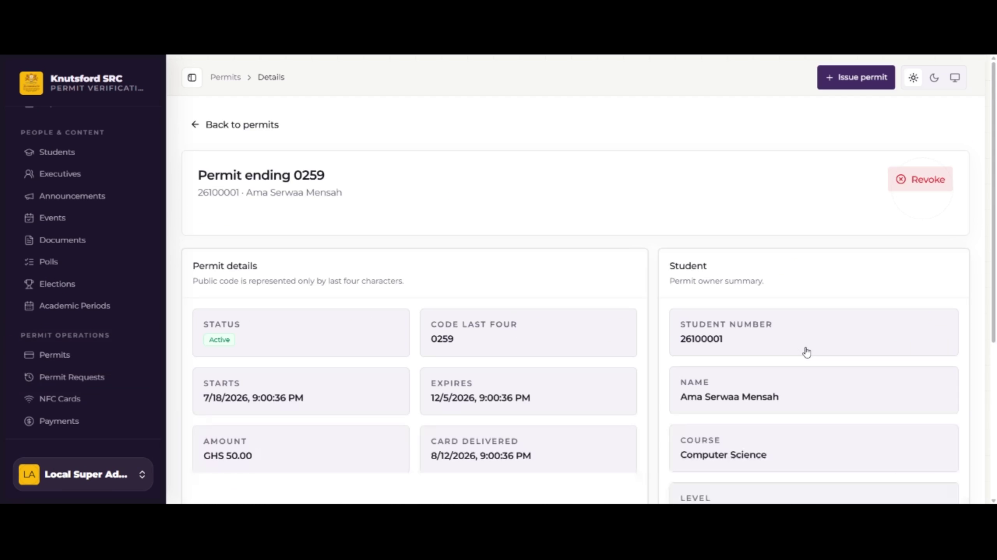
WEBSITE EXPERIENCE
The website centralizes daily SRC operations
Authorized workspace
Review permit activity and payment records
Issue receipts and monitor status history
Manage complaints, announcements, budgets, reports, and elections
Separate public information from restricted administrative records
Role permissions control access
KNTSF
06
Notes:
Speaker: Naeem
Main point: Explain the practical value of a single administrative workspace and the public/private boundary.
Example wording — adapt; do not read verbatim:
The website gives authorized administrators one place to review permit activity, monitor payments, issue receipts, manage complaints, publish announcements, track budgets, and administer elections. A separate public-facing area exposes only approved SRC information. Private administrative records remain restricted through role permissions.
Internal presenter note — do not say aloud:
Focus on usefulness. Do not read every menu item. The screenshot uses prepared demonstration data.
[Sources]
- recording/combined video.mp4
- kntsf-core/docs/PUBLIC_PORTAL.md
- KNTSF_PRESENTATION_STORYBOARD_SPEAKING_GUIDE.md

Slide 7
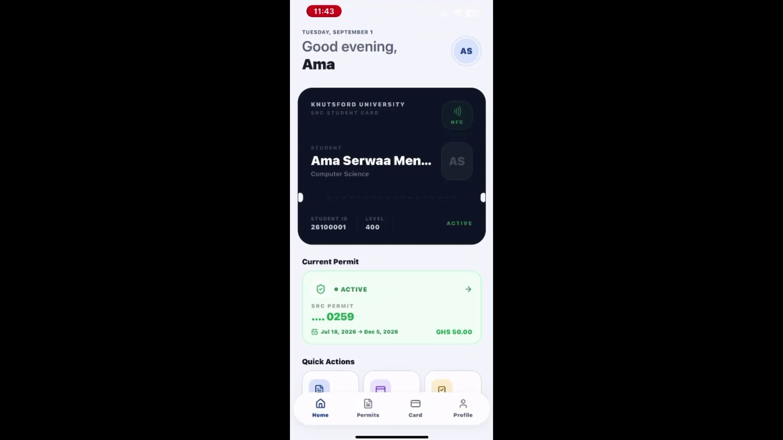
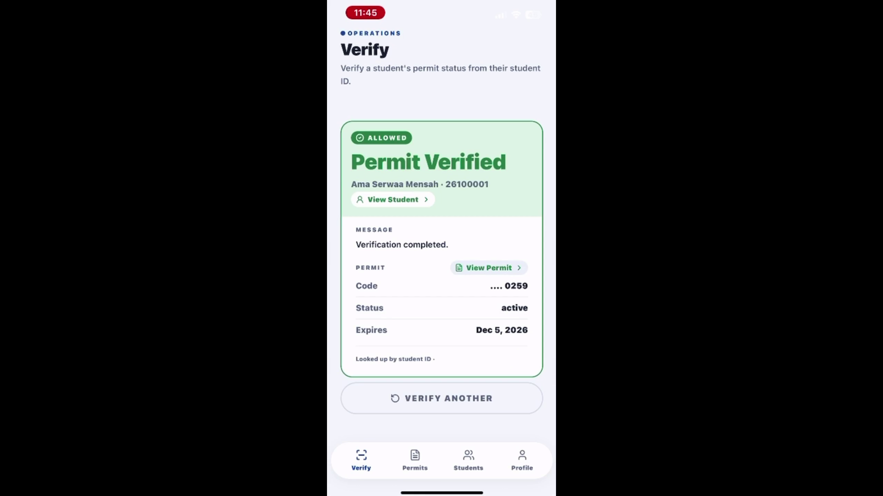
MOBILE EXPERIENCE
One mobile app presents different workflows by role
The app displays the backend's decision; it does not independently decide whether a permit is valid.
Student
Authorized staff
Permit requests
Payments and receipts
Current permit status
Announcements and elections
Focused verification workflow
Student-number fallback
Current backend result
Verification audit record
KNTSF
07
Notes:
Speaker: Naeem
Main point: Explain that students and staff use the same app for different authorized tasks.
Example wording — adapt; do not read verbatim:
The mobile application presents different functions depending on the user's role. Students can submit requests, complete payments, view permits and receipts, follow announcements, and participate in elections when eligible. Authorized staff use a focused verification workflow. The application displays the current result returned by the backend rather than deciding validity by itself.
Internal presenter note — do not say aloud:
Avoid touring every screen. The recording demonstrates the student-number fallback path, not an NFC tap.
[Sources]
- recording/combined video.mp4
- kntsf-core/docs/MOBILE_API.md
- KNTSF_PRESENTATION_FACT_LOCK_AND_DEMO_PLAN.md

Slide 8
VERIFICATION AND SECURITY
NFC starts the lookup; the backend decides
The card carries an identifier—not a complete student profile or a permanent permit decision.
1 Tap
2 Check
3 Return
The phone reads the registered NFC identifier.
The backend confirms the verifier, linked record, and current permit state.
Only the authorized verification result is displayed and logged.
Controls around the lookup
Role-based access
Server validation
Audit logs
Rate limits
Verified payments
Limitation: copied identifiers remain a risk; stronger deployments can add cryptographic tags or controlled devices.
KNTSF
08
Notes:
Speaker: Daud
Main point: Explain the privacy boundary and why the server, not the card, determines validity.
Example wording — adapt; do not read verbatim:
During verification, the phone reads the NFC identifier and sends an authenticated request to the backend. The backend checks whether the staff member is authorized, finds the linked permit, and returns the current result. The card does not need to store the student's complete profile. We also use role-based access, validation, audit logs, rate limits, and secure payment verification around sensitive actions.
Internal presenter note — do not say aloud:
Do not say NFC completely prevents copying. Acknowledge the limitation and the stronger future options if asked.
[Sources]
- kntsf-core/docs/VERIFICATION_MODULE.md
- KNTSF_PRESENTATION_FACT_LOCK_AND_DEMO_PLAN.md
- KNTSF_REPORT_UPDATED_WITH_PILOT_RESULTS_AND_BUDGET.docx

Slide 9
PILOT EVIDENCE
The pilot exercised the digital permit and payment workflow at scale
These figures validate permit and payment operations—not a completed campus-wide NFC rollout.
2,021
2,769
GHS 276,900
registered student records
permit records linked to successful payments
value of successful pilot transactions
Why permits exceed students
The figures count different things: 2,021 registered students versus 2,769 processed permit/payment records. Some students have repeated records across permit periods.
KNTSF
09
Notes:
Speaker: Divine
Main point: Present the four pilot figures and clearly limit what they prove.
Example wording — adapt; do not read verbatim:
During the pilot, the system captured 2,021 registered student records and processed 2,769 permit and successful payment records, representing GHS 276,900. These figures show meaningful use of the digital permit and payment workflow. NFC was not fully deployed during that pilot, so we do not present these numbers as proof of a completed campus-wide NFC rollout.
Internal presenter note — do not say aloud:
If asked why permits exceed students, use the agreed explanation about repeated permit records across periods. Do not call every repeated record a renewal.
[Sources]
- KNTSF_REPORT_UPDATED_WITH_PILOT_RESULTS_AND_BUDGET.docx
- KNTSF_PRESENTATION_FACT_LOCK_AND_DEMO_PLAN.md

Slide 10
POST-SUBMISSION VALIDATION
The latest verified build passed 337 automated tests
Development and validation continued after the report was submitted.
337
Verified checks
Laravel feature and API tests
TypeScript checks passed
Mobile lint passed
No failed checks in the verified run
automated tests passed
1,657 assertions
The report contains the submission-time count; this slide reports the newer current-build validation.
KNTSF
10
Notes:
Speaker: Daud
Main point: Present the current validation evidence without implying the submitted report was changed.
Example wording — adapt; do not read verbatim:
Validation continued after the report was submitted. In the latest verified build, 337 automated tests passed with 1,657 assertions. The TypeScript checks and mobile lint also passed. If this count differs from the report, it is because the report contains the submission-time result while this slide shows the current build.
Internal presenter note — do not say aloud:
Keep this to about 40 seconds. Be ready to name the main test groups if asked.
[Sources]
- KNTSF_PRESENTATION_FACT_LOCK_AND_DEMO_PLAN.md
- KNTSF_PRESENTATION_STORYBOARD_SPEAKING_GUIDE.md

Slide 11
IMPLEMENTATION PATH
A phased GHS 32,450 rollout keeps adoption realistic
Controlled stages reduce operational risk and create room for training, monitoring, and improvement.
SUBMITTED BUDGET
GHS
32,450
PHASE 1
PHASE 2
PHASE 3
Prepare
Expand
Improve
Confirm accounts, training, and controlled verification points.
Widen permit use and authorized staff coverage.
Monitor adoption, support users, and refine the system.
Implementation envelope
KNTSF
11
Notes:
Speaker: Naeem
Main point: Connect the submitted budget to a controlled three-phase implementation approach.
Example wording — adapt; do not read verbatim:
The submitted implementation budget is GHS 32,450. We recommend using a phased rollout rather than switching the whole institution at once. The first phase confirms accounts, training, and controlled verification points. The second expands permit use and staff coverage. The third focuses on monitoring, support, and improvements based on actual use.
Internal presenter note — do not say aloud:
Do not invent or revise budget line items. Do not imply the rollout has already happened.
[Sources]
- KNTSF_REPORT_UPDATED_WITH_PILOT_RESULTS_AND_BUDGET.docx
- KNTSF_PRESENTATION_STORYBOARD_SPEAKING_GUIDE.md

Slide 12
DEMONSTRATION
One record connects every channel
Student 26100001 • permit ending 0259 • active status
Administrator
Student
Staff verification
→
→
What the demonstration proves
The website, student app, and authorized staff workflow return the same backend-controlled record.
KNTSF
12
Notes:
Speaker: Naeem narrates; Divine and Daud operate
Main point: Demonstrate one record across administrator, student, and staff views.
Example wording — adapt; do not read verbatim:
We will now follow one record through the system. Divine will show the active permit from the administrator's view. We will then open the same permit in the student's mobile application. Finally, Daud will use the authorized staff workflow to retrieve the current result from the backend. The recording demonstrates the student-number fallback path.
Internal presenter note — do not say aloud:
Use recording/combined video.mp4 as the 32-second fallback. If the live NFC tap is not available, say clearly that the student-number fallback uses the same authenticated verification service. Do not claim the recording shows NFC scanning.
[Sources]
- recording/combined video.mp4
- KNTSF_PRESENTATION_FACT_LOCK_AND_DEMO_PLAN.md

Slide 13
CONCLUSION
One accountable system replaces fragmented decisions
The project connects:
a shared backend across web and mobile
verified payment before permit issuance
backend-controlled verification with an honest phased rollout
Questions
Evidence supports continued, controlled institutional adoption.
Notes:
Speaker: Divine
Main point: Resolve the opening by restating the integrated achievement and the phased recommendation.
Example wording — adapt; do not read verbatim:
In conclusion, our project brings permit, payment, governance, and verification activities into one system. The website and mobile application use the same backend rules, payments are verified before permit issuance, and verification returns the current backend result. The pilot provides meaningful evidence for the digital permit and payment workflow. We therefore recommend a controlled, phased rollout with training, monitoring, and continued improvement. Thank you. We are ready for your questions.
Internal presenter note — do not say aloud:
Pause after inviting questions. Divine receives the first question and routes technical questions to Daud and workflow or rollout questions to Naeem.
[Sources]
- KNTSF_REPORT_UPDATED_WITH_PILOT_RESULTS_AND_BUDGET.docx
- KNTSF_PRESENTATION_STORYBOARD_SPEAKING_GUIDE.md

