Slide 1
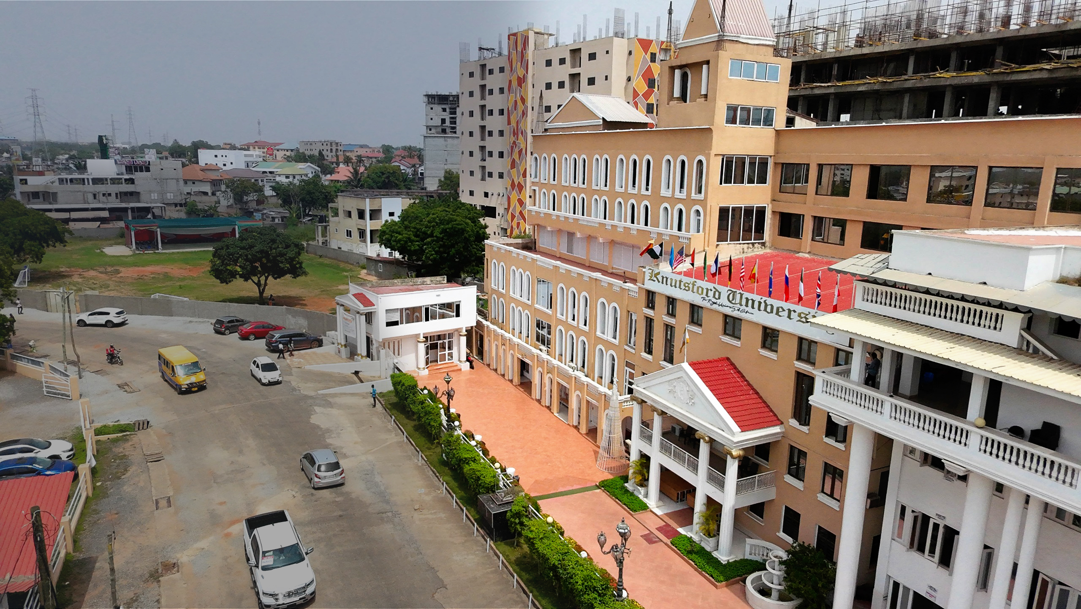

FINAL YEAR PROJECT
NFC-Based Student
Permit Verification
and Governance
Management System
One backend. Two channels. One trusted decision.
Daud Abdul-Rahim • Kwuatsenu Divine
M'Bangot-Menard Naeem Latif Dieudonne
Supervisor / Mr. Bryan Laryea
Notes:
Speaker: Divine
Main point: Introduce the project as one connected platform and preview the proof points.
Example wording — adapt; do not read verbatim:
Good morning. Our project is an NFC-based student permit verification and governance management system for Knutsford University. We developed it to connect permit requests, verified payments, SRC activities, and student verification in one platform. We will explain the problem, show how the system works, present our evidence, and demonstrate the connected workflow.
Internal presenter note — do not say aloud:
Keep the opening under 25 seconds. Do not list every feature. Move directly into the problem.
[Sources]
- KNTSF_PRESENTATION_STORYBOARD_SPEAKING_GUIDE.md
- KNTSF_REPORT_UPDATED_WITH_PILOT_RESULTS_AND_BUDGET.docx
- kntsf-core/public/images/campus-hero.jpg
- kntsf-core/public/images/kntsf-logo.png

Slide 2
02 / 13
THE PROBLEM
The gaps between decisions caused the real delay
The process broke into four separate moments:
01
02
03
04
REQUEST
//
PAYMENT
//
APPROVAL
//
VERIFY
Students waited
Administrators searched
Staff needed certainty
while eligibility and payment were reconciled.
across records with limited shared visibility.
from a current and auditable permit decision.
The design target was a connected journey—not simply a digital form.
KNTSF • FINAL YEAR PROJECT
Notes:
Speaker: Divine
Main point: Explain that the real problem was the disconnected end-to-end workflow.
Example wording — adapt; do not read verbatim:
Previously, the permit process involved several separate activities. A request could be submitted, but eligibility, payment confirmation, permit issuance, and later verification still had to be coordinated. When those records are disconnected, students may wait longer and administrators have less visibility. We therefore focused on connecting the complete workflow.
Internal presenter note — do not say aloud:
Avoid saying every old activity completely failed or was entirely manual. Transition by saying the solution was designed around the full journey.
[Sources]
- KNTSF_REPORT_UPDATED_WITH_PILOT_RESULTS_AND_BUDGET.docx
- KNTSF_PRESENTATION_STORYBOARD_SPEAKING_GUIDE.md

Slide 3
03 / 13
THE SOLUTION
Different interfaces now share one controlled source of truth
ONE
system
SHARED BACKEND
Laravel rules
+ one database
WEBSITE
MOBILE APP
Public information and administrative operations
Student services and authorized staff verification
CURRENT DECISION
Same permit • payment • role • audit state
KNTSF • FINAL YEAR PROJECT
Notes:
Speaker: Divine
Main point: Show that the website and mobile application are channels into the same controlled system.
Example wording — adapt; do not read verbatim:
Our solution has a website and a mobile application, but they are not separate systems. They use the same backend rules and the same source of data. The website supports public information and administrative work, while the mobile application supports students and authorized verification staff. A permit should therefore not appear valid in one channel and invalid in another.
Internal presenter note — do not say aloud:
After the shared-backend point, hand over to Daud for the architecture.
[Sources]
- SYSTEM_ARCHITECTURE.md
- KNTSF_PRESENTATION_STORYBOARD_SPEAKING_GUIDE.md

Slide 4
04 / 13
ARCHITECTURE
Laravel is the control layer for every channel
The interfaces stay independent; the business rules stay centralized.
Laravel 13
Website
Application + API
Sanctum authentication
PostgreSQL
Inertia • React • TypeScript
Production data store
Mobile app
PERMISSIONS / PAYMENTS / PERMITS / VERIFICATION
Expo React Native
Paystack
NFC + staff device
Server-side payment verification
Authenticated lookup begins here
KNTSF • FINAL YEAR PROJECT
Notes:
Speaker: Daud
Main point: Explain the responsibility of each technical layer without turning the slide into a framework inventory.
Example wording — adapt; do not read verbatim:
Technically, Laravel is the central application and API layer. The website uses Inertia, React, and TypeScript, while the mobile application is built with Expo React Native. Both clients communicate with the same backend and database. Sanctum protects authenticated API requests, and PostgreSQL is used for production data. Keeping the main rules in one backend applies the same permission, payment, permit, and verification decisions everywhere.
Internal presenter note — do not say aloud:
Keep this to about one minute. Paystack and NFC are integrations, not databases.
[Sources]
- SYSTEM_ARCHITECTURE.md
- kntsf-core/docs/MOBILE_API.md
- KNTSF_PRESENTATION_STORYBOARD_SPEAKING_GUIDE.md

Slide 5
05 / 13
CONTROLLED WORKFLOW
Verified payment is the gate before permit issuance
A browser redirect never becomes proof of payment by itself.
01
02
03
04
Request
Eligibility
Verify
Issue
Student submits the permit request.
Backend applies the required checks.
Paystack is confirmed server-side.
One record powers the receipt and later verification.
ISSUE CONDITION
A verified backend state exists—and duplicate processing is controlled.
KNTSF • FINAL YEAR PROJECT
Notes:
Speaker: Daud
Main point: Explain why server-side payment verification controls permit issuance.
Example wording — adapt; do not read verbatim:
A student first submits a permit request. After the required checks, the student can begin payment through Paystack. Returning from the payment page is not enough for the system to assume that payment succeeded. The backend verifies the transaction and records the result. The permit is issued only after that verified state is confirmed.
Internal presenter note — do not say aloud:
If asked, explain server-side verification and idempotent processing. Do not claim that every payment failure is impossible.
[Sources]
- kntsf-core/docs/PAYSTACK_INTEGRATION.md
- KNTSF_PRESENTATION_STORYBOARD_SPEAKING_GUIDE.md

Slide 6
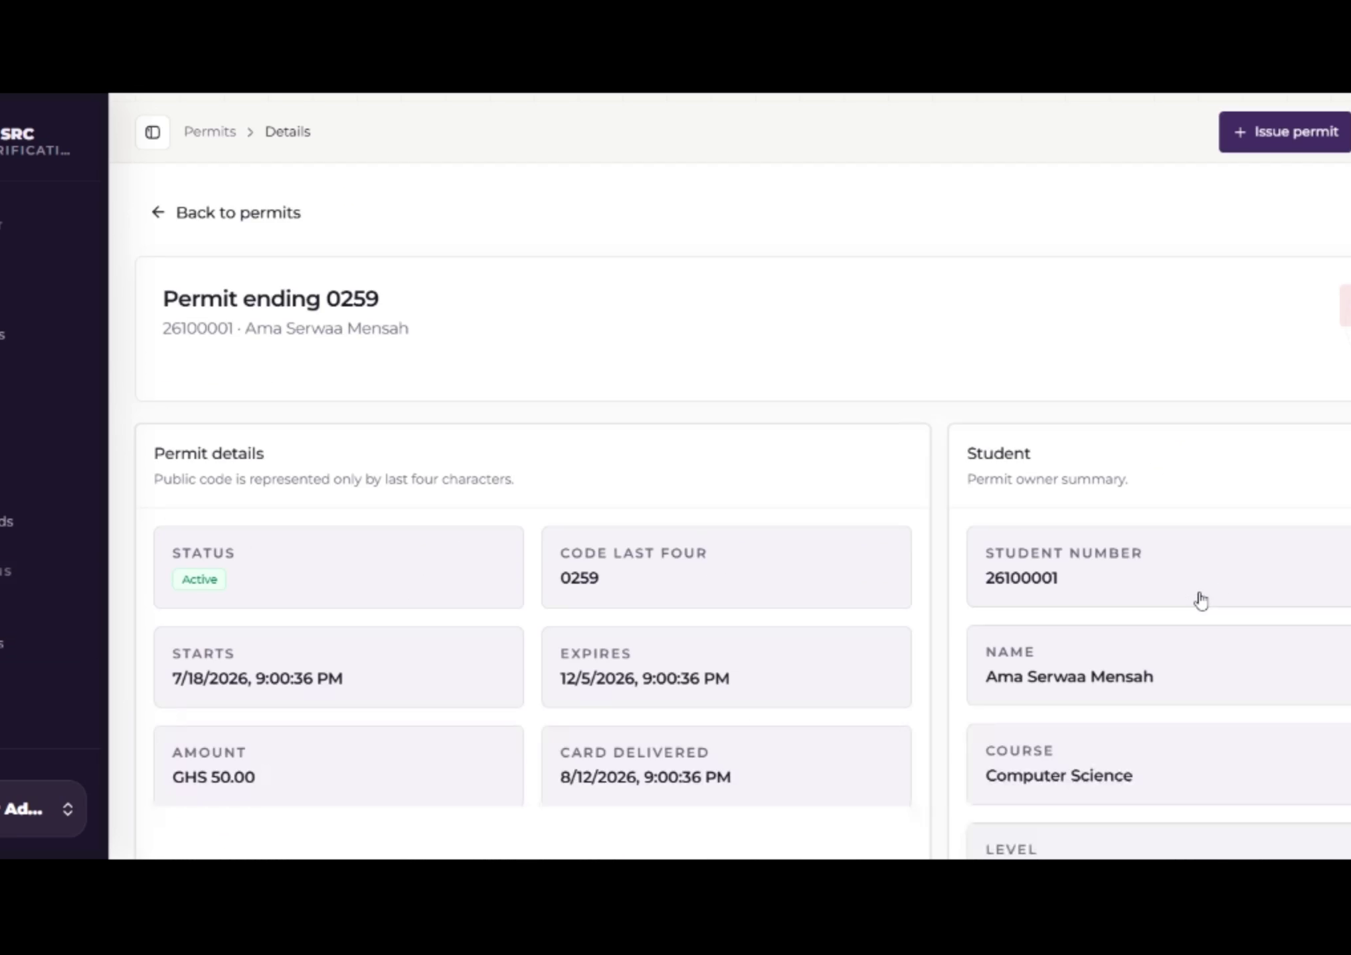
06 / 13
06 / 13
WEBSITE EXPERIENCE
WEBSITE EXPERIENCE
One workspace
for daily SRC
operations
Permit activity
Payment records
Complaints and reports
Announcements and elections
ROLE-CONTROLLED ACCESS
KNTSF • FINAL YEAR PROJECT
Notes:
Speaker: Naeem
Main point: Explain the practical value of a single administrative workspace and the public/private boundary.
Example wording — adapt; do not read verbatim:
The website gives authorized administrators one place to review permit activity, monitor payments, issue receipts, manage complaints, publish announcements, track budgets, and administer elections. A separate public-facing area exposes only approved SRC information. Private administrative records remain restricted through role permissions.
Internal presenter note — do not say aloud:
Focus on usefulness. Do not read every menu item. The screenshot uses prepared demonstration data.
[Sources]
- recording/combined video.mp4
- kntsf-core/docs/PUBLIC_PORTAL.md
- KNTSF_PRESENTATION_STORYBOARD_SPEAKING_GUIDE.md

Slide 7
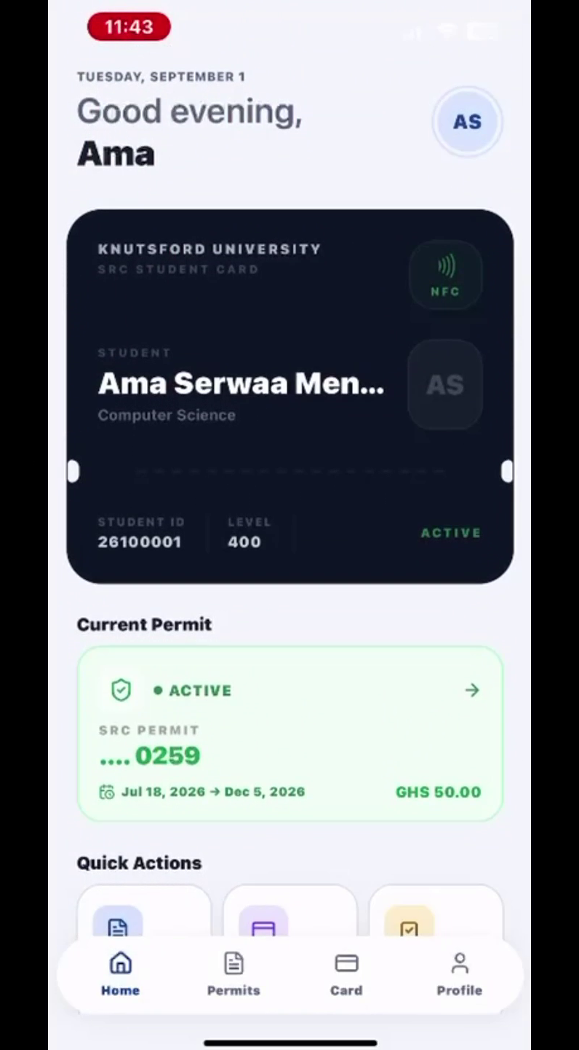
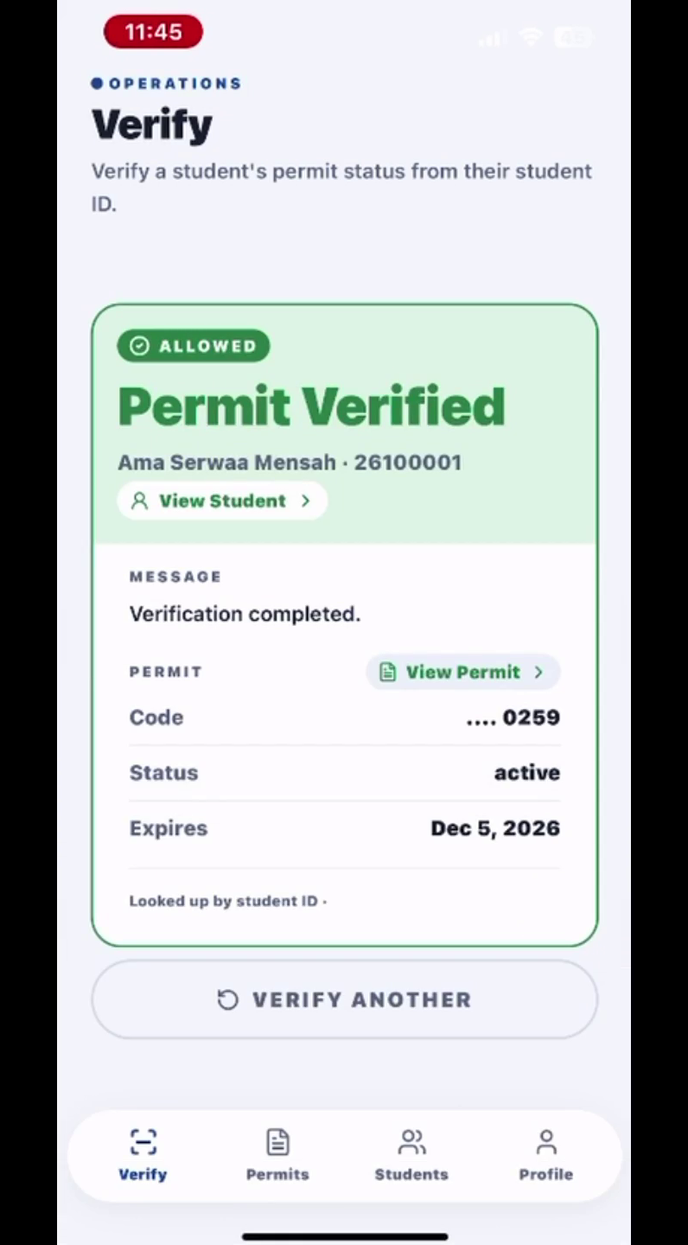
07 / 13
MOBILE EXPERIENCE
The same app changes with the user's role
Students access services. Authorized staff access verification.
STUDENT
AUTHORIZED STAFF
Requests
Payments
Permits
Receipts
Elections
Verify
Search
Read result
Create audit trail
BACKEND DECISION
The phone displays the result. It does not invent it.
KNTSF • FINAL YEAR PROJECT
Notes:
Speaker: Naeem
Main point: Explain that students and staff use the same app for different authorized tasks.
Example wording — adapt; do not read verbatim:
The mobile application presents different functions depending on the user's role. Students can submit requests, complete payments, view permits and receipts, follow announcements, and participate in elections when eligible. Authorized staff use a focused verification workflow. The application displays the current result returned by the backend rather than deciding validity by itself.
Internal presenter note — do not say aloud:
Avoid touring every screen. The recording demonstrates the student-number fallback path, not an NFC tap.
[Sources]
- recording/combined video.mp4
- kntsf-core/docs/MOBILE_API.md
- KNTSF_PRESENTATION_FACT_LOCK_AND_DEMO_PLAN.md

Slide 8
08 / 13
VERIFICATION AND SECURITY
NFC starts the lookup. The backend decides.
The card stores an identifier—not a complete student profile or permit decision.
1
2
3
TAP
CHECK
RETURN
→
→
Phone reads the registered identifier.
Backend confirms the verifier, linked record, and current status.
Authorized result is displayed and logged.
ROLE ACCESS • SERVER VALIDATION • AUDIT LOGS • RATE LIMITS • VERIFIED PAYMENTS
Copied identifiers remain a risk. Stronger deployments can add cryptographic tags or controlled devices.
KNTSF • FINAL YEAR PROJECT
Notes:
Speaker: Daud
Main point: Explain the privacy boundary and why the server, not the card, determines validity.
Example wording — adapt; do not read verbatim:
During verification, the phone reads the NFC identifier and sends an authenticated request to the backend. The backend checks whether the staff member is authorized, finds the linked permit, and returns the current result. The card does not need to store the student's complete profile. We also use role-based access, validation, audit logs, rate limits, and secure payment verification around sensitive actions.
Internal presenter note — do not say aloud:
Do not say NFC completely prevents copying. Acknowledge the limitation and the stronger future options if asked.
[Sources]
- kntsf-core/docs/VERIFICATION_MODULE.md
- KNTSF_PRESENTATION_FACT_LOCK_AND_DEMO_PLAN.md
- KNTSF_REPORT_UPDATED_WITH_PILOT_RESULTS_AND_BUDGET.docx

Slide 9
09 / 13
PILOT EVIDENCE
The pilot proved the permit and payment workflow
It did not prove a completed campus-wide NFC rollout.
2,021
2,769
GHS 276,900
registered student records
processed permit/payment records
successful pilot transaction value
WHY PERMITS EXCEED STUDENTS
The figures count different things. Some students have repeated permit records across recorded periods.
KNTSF • FINAL YEAR PROJECT
Notes:
Speaker: Divine
Main point: Present the four pilot figures and clearly limit what they prove.
Example wording — adapt; do not read verbatim:
During the pilot, the system captured 2,021 registered student records and processed 2,769 permit and successful payment records, representing GHS 276,900. These figures show meaningful use of the digital permit and payment workflow. NFC was not fully deployed during that pilot, so we do not present these numbers as proof of a completed campus-wide NFC rollout.
Internal presenter note — do not say aloud:
If asked why permits exceed students, use the agreed explanation about repeated permit records across periods. Do not call every repeated record a renewal.
[Sources]
- KNTSF_REPORT_UPDATED_WITH_PILOT_RESULTS_AND_BUDGET.docx
- KNTSF_PRESENTATION_FACT_LOCK_AND_DEMO_PLAN.md

Slide 10
10 / 13
POST-SUBMISSION VALIDATION
The current build has newer automated evidence
The report remains the submission-time record.
337
1,657
automated tests passed
assertions
Laravel feature + API tests
TypeScript checks
Mobile lint
NO FAILED CHECKS IN THE VERIFIED RUN
KNTSF • FINAL YEAR PROJECT
Notes:
Speaker: Daud
Main point: Present the current validation evidence without implying the submitted report was changed.
Example wording — adapt; do not read verbatim:
Validation continued after the report was submitted. In the latest verified build, 337 automated tests passed with 1,657 assertions. The TypeScript checks and mobile lint also passed. If this count differs from the report, it is because the report contains the submission-time result while this slide shows the current build.
Internal presenter note — do not say aloud:
Keep this to about 40 seconds. Be ready to name the main test groups if asked.
[Sources]
- KNTSF_PRESENTATION_FACT_LOCK_AND_DEMO_PLAN.md
- KNTSF_PRESENTATION_STORYBOARD_SPEAKING_GUIDE.md

Slide 11
11 / 13
IMPLEMENTATION PATH
A phased rollout keeps adoption realistic
SUBMITTED IMPLEMENTATION BUDGET
GHS 32,450
01
02
03
PREPARE
EXPAND
IMPROVE
One implementation envelope—introduced in controlled stages.
Accounts, training, controlled verification points
Wider permit use and authorized staff coverage
Monitoring, support, and refinement
TRAIN → DEPLOY → MONITOR → IMPROVE
KNTSF • FINAL YEAR PROJECT
Notes:
Speaker: Naeem
Main point: Connect the submitted budget to a controlled three-phase implementation approach.
Example wording — adapt; do not read verbatim:
The submitted implementation budget is GHS 32,450. We recommend using a phased rollout rather than switching the whole institution at once. The first phase confirms accounts, training, and controlled verification points. The second expands permit use and staff coverage. The third focuses on monitoring, support, and improvements based on actual use.
Internal presenter note — do not say aloud:
Do not invent or revise budget line items. Do not imply the rollout has already happened.
[Sources]
- KNTSF_REPORT_UPDATED_WITH_PILOT_RESULTS_AND_BUDGET.docx
- KNTSF_PRESENTATION_STORYBOARD_SPEAKING_GUIDE.md

Slide 12
12 / 13
DEMONSTRATION
One record. Three views. Thirty-two seconds.
Student 26100001 • permit 0259 • active
01
02
03
▶
ADMINISTRATOR
STUDENT
STAFF
Confirms the prepared permit record
Views the same permit in the app
Retrieves the current backend result
32 SEC
WHAT IT PROVES
Every channel returns the same backend-controlled record.
KNTSF • FINAL YEAR PROJECT
Notes:
Speaker: Naeem narrates; Divine and Daud operate
Main point: Demonstrate one record across administrator, student, and staff views.
Example wording — adapt; do not read verbatim:
We will now follow one record through the system. Divine will show the active permit from the administrator's view. We will then open the same permit in the student's mobile application. Finally, Daud will use the authorized staff workflow to retrieve the current result from the backend. The recording demonstrates the student-number fallback path.
Internal presenter note — do not say aloud:
Play recording/combined video.mp4 as the 32-second backup. If the live NFC tap is not available, say clearly that the student-number fallback uses the same authenticated verification service. Do not claim the recording shows NFC scanning.
[Sources]
- recording/combined video.mp4
- KNTSF_PRESENTATION_FACT_LOCK_AND_DEMO_PLAN.md

Slide 13
13 / 13
CONCLUSION
One accountable
system replaces
fragmented decisions.
Shared backend across web and mobile
Verified payment before permit issuance
Backend-controlled verification with phased adoption
Questions
Evidence supports continued, controlled institutional adoption.
Notes:
Speaker: Divine
Main point: Resolve the opening by restating the integrated achievement and the phased recommendation.
Example wording — adapt; do not read verbatim:
In conclusion, our project brings permit, payment, governance, and verification activities into one system. The website and mobile application use the same backend rules, payments are verified before permit issuance, and verification returns the current backend result. The pilot provides meaningful evidence for the digital permit and payment workflow. We therefore recommend a controlled, phased rollout with training, monitoring, and continued improvement. Thank you. We are ready for your questions.
Internal presenter note — do not say aloud:
Pause after inviting questions. Divine receives the first question and routes technical questions to Daud and workflow or rollout questions to Naeem.
[Sources]
- KNTSF_REPORT_UPDATED_WITH_PILOT_RESULTS_AND_BUDGET.docx
- KNTSF_PRESENTATION_STORYBOARD_SPEAKING_GUIDE.md
- kntsf-core/public/images/campus-hero.jpg

