Slide 1
Implementing a Recommendation Engine in Web Application
Chaloemphon Sirikayon Dhurakij Pundit University, Thailand

Slide 2

Recommender System

Slide 3
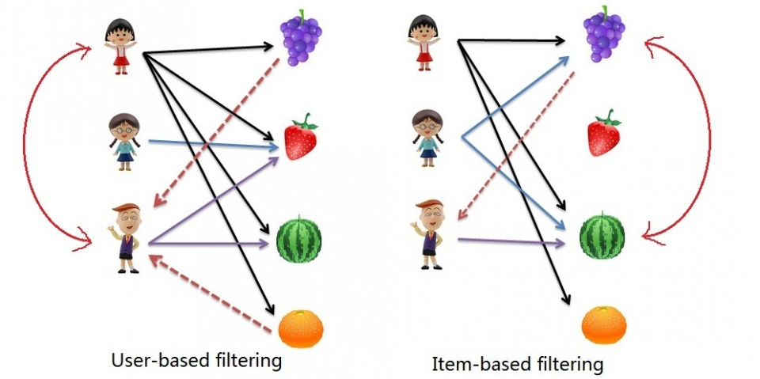
Collaborative Filtering (CF)
The main idea is
People have similar preferences and interests. We can find the nearest neighbors, and use them as guides for prediction.

Slide 4

Collaborative Filtering (CF)
How we know who are like-minded users?
 | Item A | Item B | Item C | Item D
User 1 | ⬇⬇⬇⬇ | ⬇ | ⬇⬇⬇ | ?
User 2 | ⬇⬇ | ⬇⬇⬇ | ⬇⬇ | ⬇⬇⬇⬇
User 3 | ⬇⬇⬇⬇ | ⬇⬇ | ⬇⬇⬇ | ⬇⬇⬇⬇

Slide 5
Similarity measurement
Various methods can be used to find similarity between users.
Pearson correlation
Cosine similarity
On the other hand, dissimilarity calculation can be converted to similarity.
Euclidean distance

Slide 6
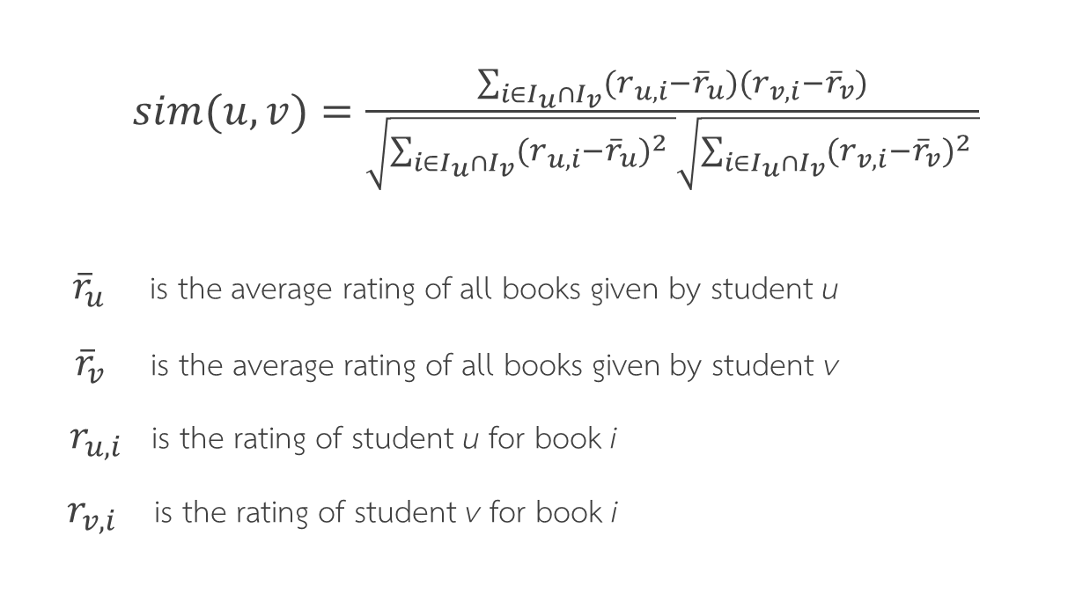
Pearson correlation
$sim(u,v)=\frac{\sum_{i∈I_{u}∩I_{v}}{(r_{u,i}−{\overline{r}}_{u})(r_{v,i}−{\overline{r}}_{v})}}{\sqrt{\sum_{i∈I_{u}∩I_{v}}{{(r_{u,i}−{\overline{r}}_{u})}^{2} }}\sqrt{\sum_{i∈I_{u}∩I_{v}}{{(r_{v,i}−{\overline{r}}_{v})}^{2} }}}$
${\overline{r}}_{u}$ is the average rating of all books given by student u
${\overline{r}}_{v}$ is the average rating of all books given by student v
$r_{u,i}$ is the rating of student u for book i
$r_{v,i}$is the rating of student v for book i

Slide 7

Cosine similarity
$sim\left(u,v\right)=\frac{r_{u}∙r_{v}}{{|\left|r_{u}\right||}^{2}{|\left|r_{v}\right||}^{2}}=\frac{\sum_{i}{r_{u,i}r_{v,i}}}{\sum_{i}{r_{u,i}^{2}\sum_{i}{r_{v,i}^{2}}}}$
$r_{u,i}$ is the rating of student u for book i
$r_{v,i}$ is the rating of student v for book i

Slide 8

Euclidean distance
$d\left(u,v\right)=\sqrt{\sum_{i∈I_{u}∩I_{v}}{{(r_{u,i}−r_{v,i})}^{2}}}$
$sim\left(u,v\right)=\frac{1}{1+d(u,v)}$
${ r}_{u,i}$ is the rating of student u for book i
$r_{v,i}$ is the rating of student v for book i

Slide 9
Prediction
A set of top-k students most similar to the active student u are selected and their ratings are used for the prediction.
is prediction of the specific book i for student u
is similarity between student u and v
is rating of student v for book i
is the average rating of all books given by student u
is the average rating of all books given by student v

Slide 10
Sparsity problem
Due to rapid growth of data, sparsity of rating matrix has become a challenge issue in recommender system.
 | Item1 | Item2 | Item3 | Item4 | Item5 | Item6 | Item7 | Item8 | Item9 | Item10
User1 |  | 4 |  |  |  |  | 4 |  |  | 2
User2 | 3 |  |  |  |  |  | 2 |  | 4
User3 |  |  | 2 |  |  | 3
User4 | 1 |  |  | 5 |  | 4 |  |  | 3

Slide 11
Matrix Factorization
 | Item 1 | Item 2 | Item 3 | Item 4
User 1 |  |  | 2.0
User 2 | 4.0 |  | 3.5
User 3 |  |  |  | 2.0
User 4 |  | 3.5 |  | 1.0
User 5 | 4.0 |  | 3.5
 | Item 1 | Item 2 | Item 3 | Item 4
User 1 | 2.22 | 1.83 | 1.93 | 0.80
User 2 | 3.90 | 3.32 | 3.39 | 1.46
User 3 | 3.18 | 3.28 | 2.75 | 1.47
User 4 | 3.19 | 3.19 | 2.76 | 1.43
User 5 | 3.90 | 3.60 | 3.38 | 1.59
Sparse Rating matrix
Rating matrix
 | Feature 1 | Feature 2
User 1 | 0.99 | 0.43
User 2 | 1.65 | 0.89
User 3 | 0.85 | 1.43
User 4 | 0.94 | 1.31
User 4 | 1.41 | 1.23
 | Item 1 | Item 2 | Item 3 | Item 4
Feature 1 | 1.72 | 1.14 | 1.50 | 0.48
Feature 2 | 1.20 | 1.61 | 1.03 | 0.74
x
User matrix
Item matrix

