Slide 1

Smart India Hackathon 2024
Team name: Coder Czars
Team Leader Name: Ishaan Singh Mahiyariya
Institute name: Shiv Nadar University
Theme Name: 𝙒𝙤𝙢𝙚𝙣 𝙎𝙖𝙛𝙚𝙩𝙮 𝘼𝙣𝙖𝙡𝙮𝙩𝙞𝙘𝙨 - 𝙋𝙧𝙤𝙩𝙚𝙘𝙩𝙞𝙣𝙜 𝙒𝙤𝙢𝙚𝙣 𝙛𝙧𝙤𝙢 𝙨𝙖𝙛𝙚𝙩𝙮 𝙩𝙝𝙧𝙚𝙖𝙩𝙨

Slide 2
Idea
जननी is a cutting-edge safety app designed to protect women by providing immediate assistance in emergencies. With a simple tap, it alerts your emergency contacts, local police, and hospitals with your exact location. At night, SafeStride guides you along the safest, well-lit routes, avoiding dark or isolated areas. It also features a sophisticated stalker detection system that monitors for unusual tracking patterns and sends alerts if suspicious activity is detected. All data is encrypted to ensure your privacy, and the app operates discreetly to maintain a low profile. SafeStride combines real-time safety measures with advanced technology to offer peace of mind and protection wherever you go.

Slide 3


Slide 4


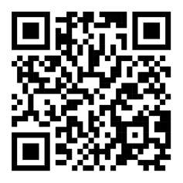
Problem Statement ID: 1605
𝙒𝙤𝙢𝙚𝙣 𝙎𝙖𝙛𝙚𝙩𝙮 𝘼𝙣𝙖𝙡𝙮𝙩𝙞𝙘𝙨 - 𝙋𝙧𝙤𝙩𝙚𝙘𝙩𝙞𝙣𝙜 𝙒𝙤𝙢𝙚𝙣 𝙛𝙧𝙤𝙢 𝙨𝙖𝙛𝙚𝙩𝙮 𝙩𝙝𝙧𝙚𝙖𝙩𝙨
जननी :
जननी creates safer environments for women and assist law enforcement in effectively addressing and preventing crimes against women. The proactive approach of detecting anomalies and generating alerts can play a crucial role in enhancing public safety and fostering a secure atmosphere for women.

Slide 5
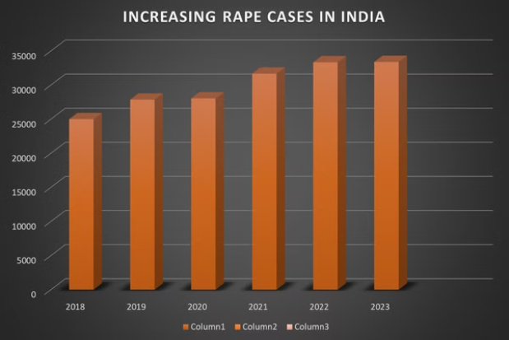
𝙈𝙖𝙟𝙤𝙧 𝙍𝙚𝙦𝙪𝙞𝙧𝙚𝙢𝙚𝙣𝙩𝙨 𝙊𝙛 𝙊𝙪𝙧 𝘼𝙥𝙥
India has seen a troubling rise in rape cases, exposing deep-rooted issues of gender violence and systemic failure. Despite reforms and awareness efforts, the increase highlights the urgent need for stronger law enforcement, victim support, and cultural change to effectively combat this crisis. In today’s world, a safety app for women is essential. It can offer real-time location tracking, emergency alerts, and direct links to authorities, helping women feel secure and empowered.
By providing immediate access to support and safety resources, our app जननी can significantly enhance personal
security and confidence.

Slide 6

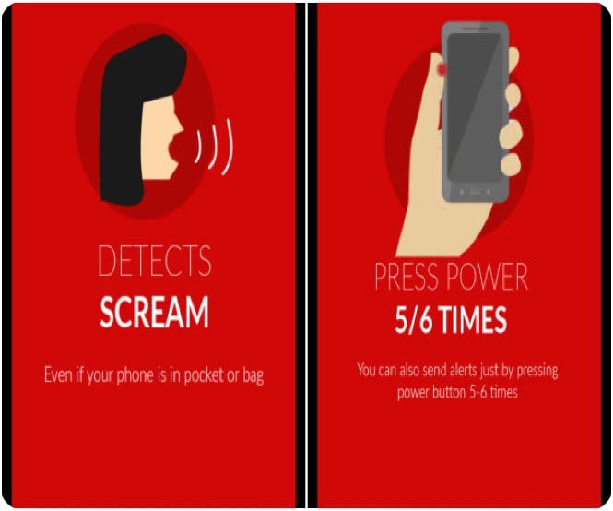
𝙆𝙚𝙮 𝙁𝙚𝙖𝙩𝙪𝙧𝙚𝙨 𝙖𝙣𝙙 𝙁𝙪𝙣𝙘𝙩𝙞𝙤𝙣𝙖𝙡𝙞𝙩𝙞𝙚𝙨
1
Emergency SOS
Allows users to send distress signals to emergency contacts with their location details.
2
Safe Route Navigation
Provides users with safe route options based on crime data and real-time traffic conditions.
3
Identifying a lone woman at night time
Monitors devices within a specified range and provides alerts if in an isolated location or when a device remains in proximity for an extended period.
4
Nearby police stations and hospitals
Provides you location and phone number of nearby police station and hospital.
5
Detects Scream
Activates the sos features with safe word screams, even if your phone is in
your pocket or bag.

Slide 7

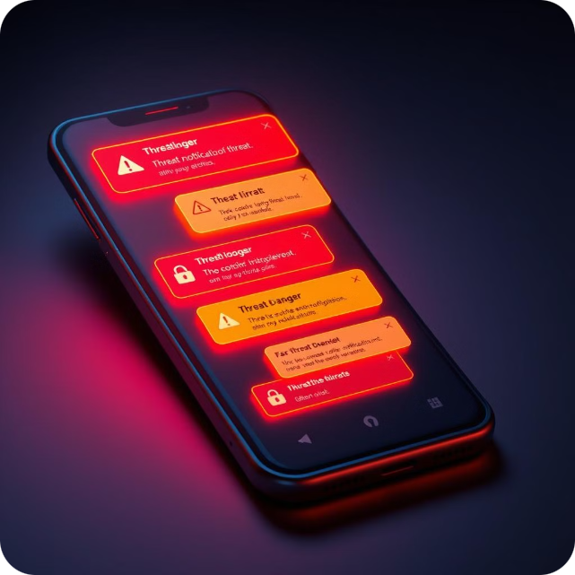


Notification and Alert System
Push Notifications
Real- time alerts are send to the emergency contacts, nearby police stations and hospitals on triggering the app.
Isolation and stalking alert
Notifies you when you're in a secluded area or if a device remains within range for an extended period, indicating potential tracking or prolonged proximity.

Slide 8

𝙋𝙧𝙤𝙟𝙚𝙘𝙩 𝙎𝙩𝙖𝙜𝙚𝙨
Phase 1: Ideation
Phase 5: Testing
Brainstorming and selecting a project idea based on the theme "Women safety" . Team discusses their goals, target users, and potential solutions.
Phase 3: Design
Evaluating the project for bugs, usability issues, and performance. Debugging, user testing, and refining the project based on feedback.
Sketching wireframes, creating mockups, and planning the overall look and feel of the project.
1
2
3
4
5
6
Phase 2: Planning
Phase 4: Development
Phase 6: Presentation
Preparing a demo and pitch for the final presentation. Showcasing the project, explain its features and benefits, and highlight its impact or
innovation.
Outlining the project scope, defining tasks, setting milestones, and assigning roles. Creating a timeline and deciding on the technologies and tools to use.
Writing code, building features, and integrating components. Focus on implementing core functionalities and ensuring the project meets the initial objectives.

Slide 9


Team Members
Group leader— Ishaan Singh Mahiyariya
Coded By— Hans James, Ramneek Singh, Rishika Gupta
PPT— Kashish, Archit Gupta

Slide 10
Thank You
We appreciate your time and look forward to your feedback on this exciting project.

