Slide 1

ClinicQ
A simplified clinic registration and queuing experience

Slide 2
Problem Statement
While polyclinics in Singapore have improved their appointment and registration experience by digitizing some services, more can be done in terms of easing the registration flow and managing patient queue numbers for an improved and seamless polyclinic experience. The current steps for a polyclinic experience are:
Register for an appointment via app / online portal, integrated with Singpass
Get a queue number on the day of appointment from the application
(During COVID-19 pandemic) Check in to the location via TraceTogether App or using a token
Patient manually checks polyclinic queue number panel to see if it is their turn
While there may not be many steps, to a patient seeking medical treatment it may be an additional hassle on top of their worries for their ailments. We can make this more intuitive and convenient for a better polyclinic experience.

Slide 3
Proposed Solution: ClinicQ
Similar in operation to the old-style mobile browser SafeEntry check-ins, ClinicQ combines the Singpass MyInfo API and SafeEntry API to provide an intuitive polyclinic walk-in experience for a patient registered under Singpass.
For patients, they get to enjoy:
Pre-filling of the clinic registration form using Singpass
Automated checking in for SafeEntry
Clinic queue status updates and queue number notifications
For clinics, they can easily on-board their existing queue / registration systems to make use of the ClinicQ web API to deliver this experience. This will be explained further in the ClinicQ Implementation section.
Source code: https://github.com/pickledbees/clinic_q_management

Slide 4
ClinicQ Usage (Patient)
A short storyboard on how using ClinicQ is used from a patient perspective

Slide 5

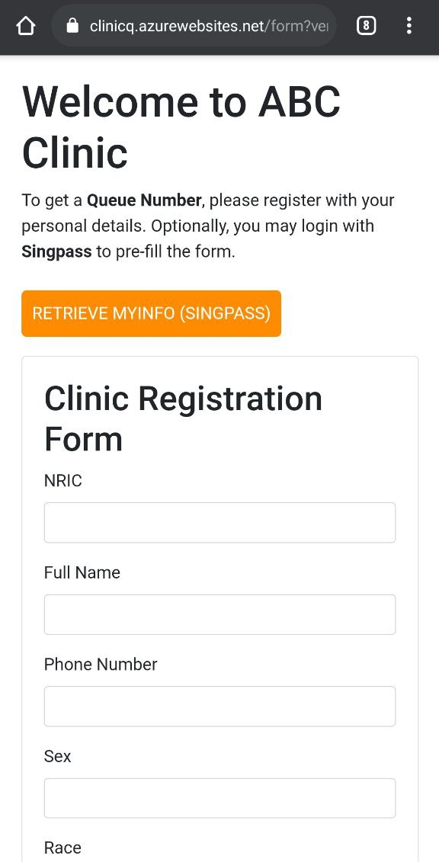
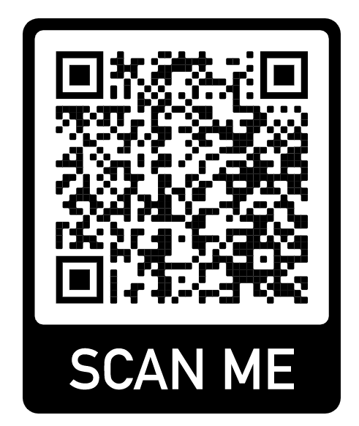
1. Form Page
When at the clinic, the patient will scan the QR code and get the registration form for the clinic. The patient may choose to fill in the form manually or use Singpass to pre-fill it.
Option to use Singpass available
QR code at clinic (scan to try out publicly deployed prototype)

Slide 6
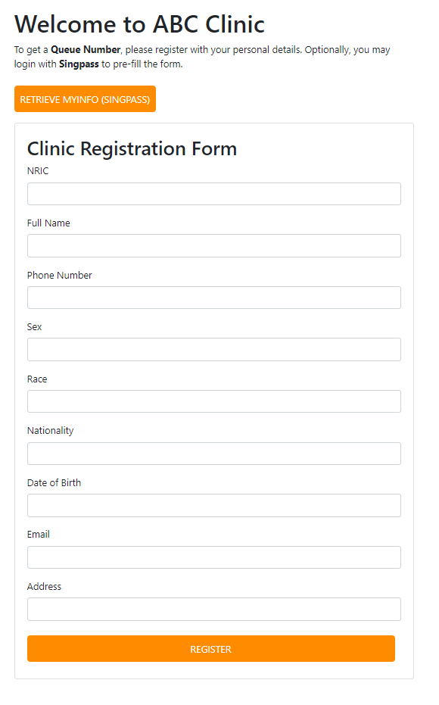
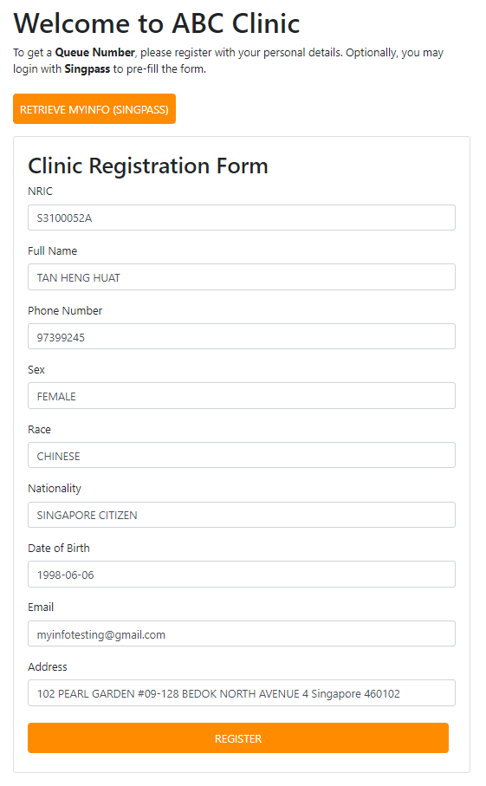
Fill form manually or with Singpass
Once done, register to get a queue number, data is sent to the clinic by ClinicQ

Slide 7

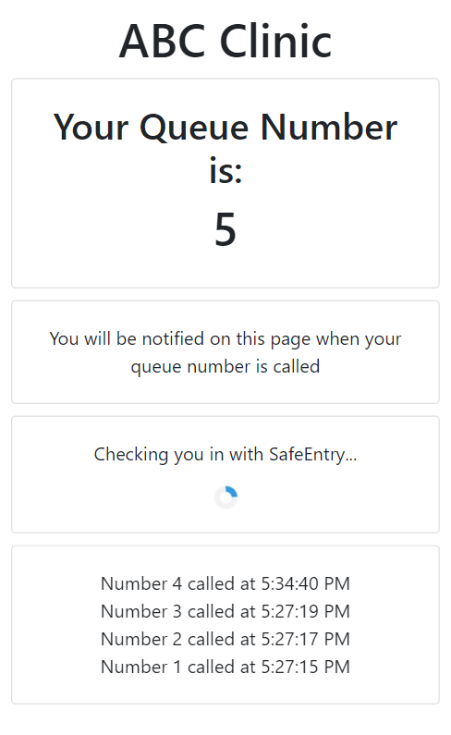
2. Queue Page
Once registered, the patient is presented with a queue page showing their assigned queue number. The page will also automatically attempt to perform a SafeEntry check in for the patient.
Once the patient gets the queue number, the patient is now free to roam without having to keep an eye on their queue number. They may do a SafeEntry check out to go for a meal and check in later, or they may take a toilet break without worrying about tracking their queue number.
Alert box showing patient status in queue
Display showing last few numbers that were called

Slide 8
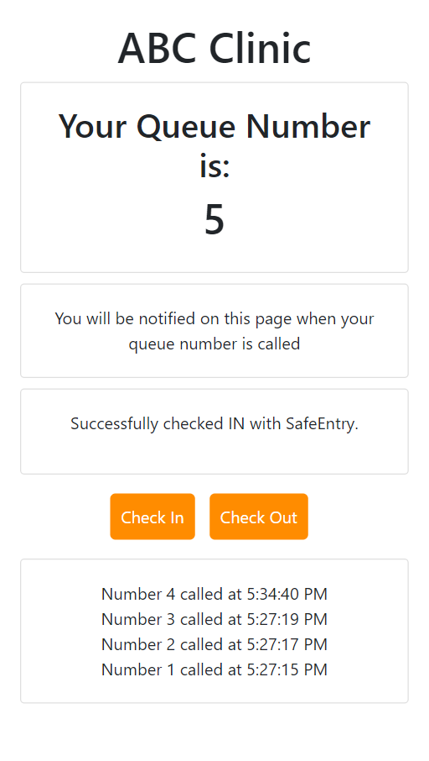
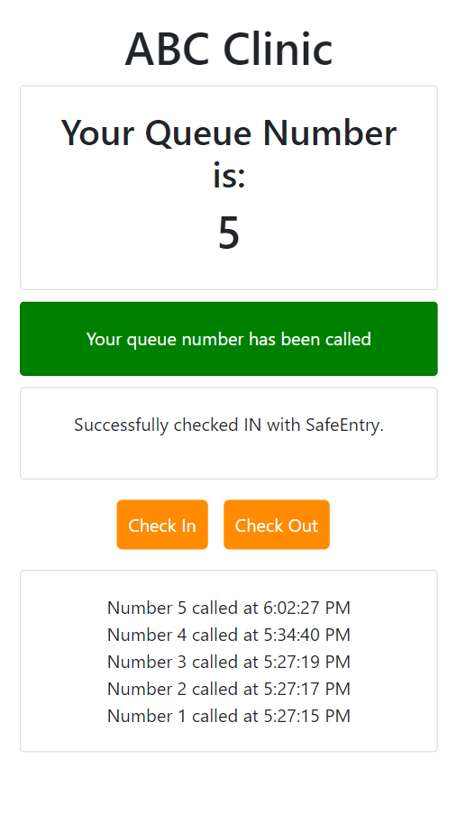
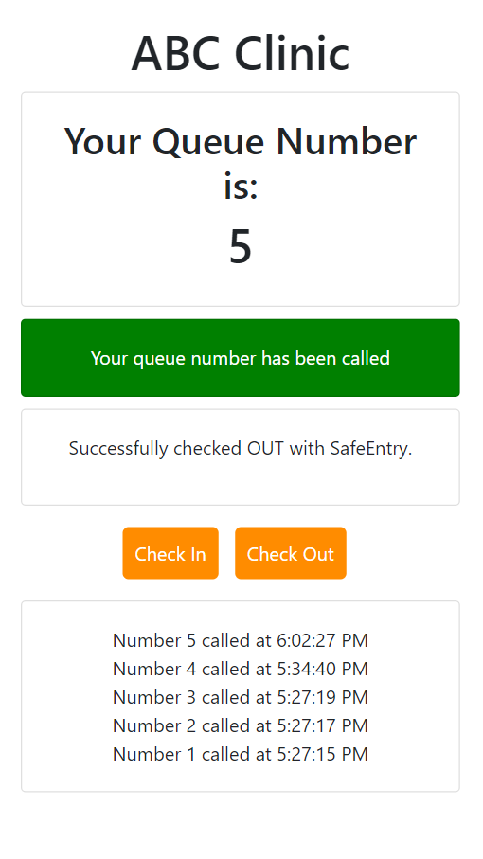
Queue Page Progression
b. Number called
a. Checked in
d. Checked out
Patient may check in and out whenever
c. Check out

Slide 9
ClinicQ Usage (Clinic)
A short storyboard on how using ClinicQ is used from the clinic’s perspective

Slide 10
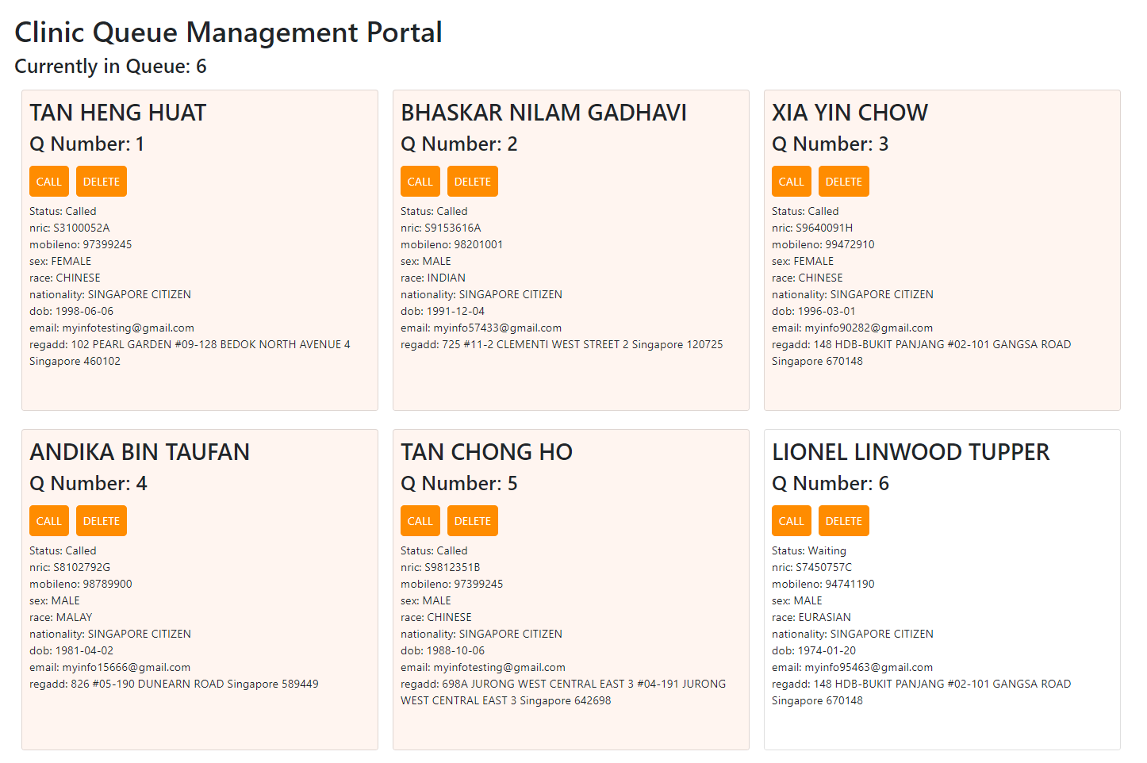
Clinic Queue Management (simulated)
Called patients are highlighted, while waiting ones are not
In real-life deployment, the clinic’s queue management system is onboarded with ClinicQ to use ClinicQ’s API. Thus visually, the clinic’s administration will not see a difference in their daily processes. For on-boarding and API interaction details, see the ClinicQ Implementation section.
For demonstration purposes, there is a simple simulated clinic queue management system portal set up (ABC clinic):
https://abcclinic.azurewebsites.net/
From the simulated queue management system portal, you can call patient numbers, and delete patients from the system.
Source code for sim: https://github.com/pickledbees/clinic_sim

Slide 11
ClinicQ Implementation
A look at ClinicQ’s system architecture, APIs and sequence diagrams and onboarding details

Slide 12



Overall Prototype Architecture
ClinicQ is designed to act as a patient-facing frontend service for clinic queue management systems.
The ClinicQ API Server is responsible for serving the relevant UI pages, as well as sending patient data submissions to the appropriate clinic queue management systems servers by calling their exposed web APIs. In turn, ClinicQ has exposed web APIs for clinics to call.
The exposed API information of each clinic is maintained in a noSQL database (MongoDB).
The implementation of ClinicQ API Server is stateless and can be replicated to scale up or down as needed.
Source code for ClinicQ:
https://github.com/pickledbees/clinic_q_management
API calls
Clinic ABC Queue System Server
Azure
ClinicQ API Server
Clinic DEF Queue System Server
ClinicQ frontend (browser)
Clinic GHI Queue System Server
ClinicQ DB

Slide 13
Clinic Onboarding to ClinicQ (part 1)
For clinics to use ClinicQ, they must expose the following APIs:
POST: /submit
Submission API: ClinicQ uses this API to submit person data required for clinic registration. The clinic API should respond with the patient’s allocated queue number.
GET: /checkStatus/<nric>/<queue_number>
Status Check API: ClinicQ will uses this API to check the status of a patient in the queue based on their NRIC and queue number. The clinic should respond with a status (integer) and a list of the most recent numbers called with their time of calling. The status (integer) indicates if the patient has been called, is waiting, or is not in queue. (0: waiting, 1: number called, 2: not-registered / appointment over)
Detailed API documentation can be found in the repository README.

Slide 14
Clinic Onboarding to ClinicQ (part 2)
ClinicQ exposes the following APIs for clinics to use:
POST: /callNumber
Number call API: Clinics will call this API to call a number, telling ClinicQ to inform the relevant patient. Clinics will send the number to be called, their registered Safe Entry venue ID, a secret and a list of the most recent numbers called with their time of calling.
Detailed API documentation can be found in the repository README.

Slide 15
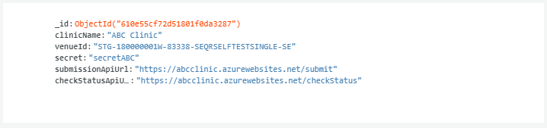
Clinic Onboarding to ClinicQ (part 3)
ClinicQ queries for API information and other clinic related information from a database during operation, thus the clinic will have to insert its API information (and other relevant details) into the database. The prototype uses MongoDB (noSQL document-based). Below is a sample clinic document stored in the database:
In the prototype, secret is used to “verify” a /callNumber request to ClinicQ from the clinic.
//MongoDB object ID

Slide 16
QR scan for Form Page Sequence
Browser
ClinicQ API Server
ClinicQ DB
QR code contains Form Page URL, browser calls server for page
GET /queue?venueId=<venueId>
getClinicDataFromDB(venueId)
Clinic Data (containing clinic name)
Serve rendered Form Page with clinic name

Slide 17
Patient Registration Sequence
Browser
ClinicQ API Server
Clinic Server
ClinicQ DB
Submit patient form data with venueId
POST /submit
getClinicDataFromDB(venueId)
Clinic Data (containing clinic Submission API URL)
Submit patient form data: POST /submit
Queue number for patient
Redirect URL containing
NRIC, mobileno, queue number and venueId in query
Redirect URL call
GET /queue
getClinicDataFromDB(venueId)
Clinic Data (containing clinic name)
Queue page

Slide 18
Check Status Sequence
Browser
ClinicQ API Server
Clinic Server
ClinicQ DB
Ask for status of patient
GET /checkStatus/<venueId>/<nric>/<number>
getClinicDataFromDB(venueId)
Clinic Data (containing clinic Status Check API URL)
Ask for status of patient
GET /checkStatus/<nric>/<number>
Status integer and list of recently called numbers
Status integer and list of recently called numbers

Slide 19
Call Number Sequence
Browser
ClinicQ API Server
Clinic Server
ClinicQ DB
Call number with queue number, venueId, secret and list of recently called numbers
POST /callNumber
getClinicDataFromDB(venueId)
Clinic Data (containing clinic secret)
Tell connected browsers for the venueId (clinic) that a number has been called by providing the called number and list of recently called numbers
Verify secret
(Sent through socket connection)
Respond with HTTP status code 200 (OK)

Slide 20
SafeEntry Check-in / Check-out Sequence
Browser
ClinicQ API Server
Check-in / check-out
POST /safeEntry
Call SafeEntry*
Respond with HTTP status code 201 (CREATED)
*SafeEntry API documentation: https://api.singpass.gov.sg/library/safeentry-api/developers/tutorial2

