Slide 1

WordPress File Structure

Slide 2
Why this is important?
Because we work with files.
We customize files.
We upload files.
We create files.
Override/replace files. (for our needs)
Delete files. (By mistakes)
We write on files. (.php, .js, .css)
We search for files. (Where is this come from)
Target files to hack(for hackers)

Slide 3
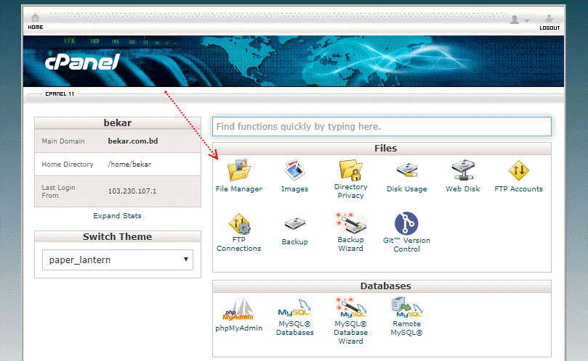
Where i can see the files?
Go to file manager from your hosting panels or Cpanel you will able to see files.

Slide 4
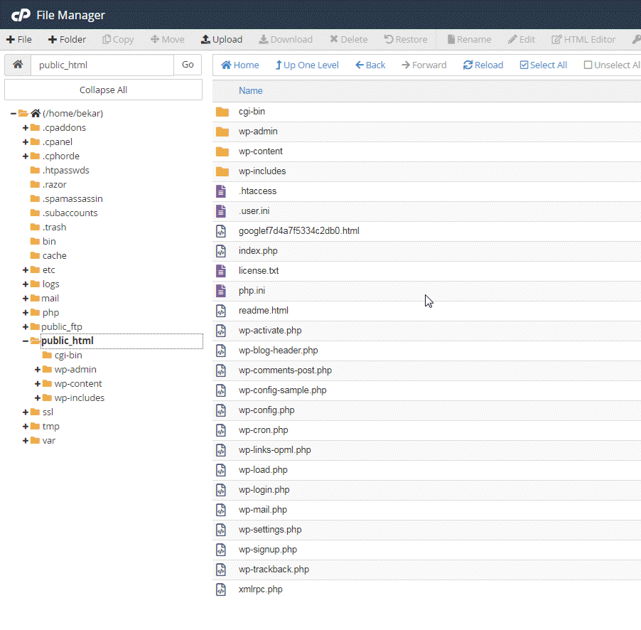
How to access files

Slide 5
Main directories
Special files
/wp-admin
/wp-content
/wp-includes
.htaccess
.maintenance
license
readme
/wp-content/debug.log
.po
.mo

Slide 6
Configuration files
Index file
wp-config
wp-config-sample
index.php
wp-blog-header.php
wp-load.php
template-loader.php

Slide 7
Login & Register files
Trackbacks and Pingbacks
https://make.wordpress.org/support/user-manual/building-your-wordpress-community/trackbacks-and-pingbacks/
wp-login.php (/wp-login.php)
wp-signup.php (wp-login.php?action=register)
wp-trackback.php

Slide 8
XML-RPC
Wp-content directories
https://www.hostinger.com/tutorials/xmlrpc-wordpress
xmlrpc.php
/languages
/plugins
/themes
/upgrade
/uploads

Slide 9
Do not edit these directories & files
Edit as needed
~wp-admin
~wp-includes
others .php file except wp-config.php
~wp-content
.htaccess
wp-config.php

