Slide 1
樹莓派與 Node-RED

Slide 2
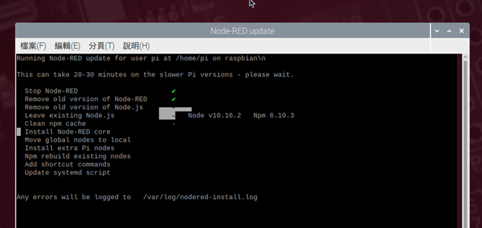
在 Raspberry Pi 上安裝
官網建議從他們的 github 上腳本進行安裝或是更新
bash <(curl -sL https://raw.githubusercontent.com/node-red/raspbian-deb-package/master/resources/update-nodejs-and-nodered)
也可使用 apt-get install nodered 直接安裝，但這樣不會安裝 npm

Slide 3
在 Raspberry Pi 上啟動 Node-RED
開機自動啟動
啟動檔 /lib/systemd/system/nodered.service 預設參數為 --max-old-space-size=256 如果太大要調小
sudo systemctl enable nodered.service
(sudo systemctl disable nodered.service)
終端啟動
node-red-start
(node-red-stop)
樹梅派記憶體比較小，可以使用
node-red-pi --max-old-space-size=128
限制使用量

Slide 4
Node-RED 改掉預設 Port 1880
預設 Port 為 1880 在終端下 node-red -p PORT_NUMBER 可以直接開在指定的 Port
可以透過變更 /home/username/.node-red 資料夾下 settings.js 的這一行
uiPort: process.env.PORT || 1880,
來改變預設的 Port
其他設定選項也是更改 settings.js 檔案，如果不小心改壞了可以從官方 github 載回來
https://github.com/node-red/node-red/blob/master/packages/node_modules/node-red/settings.js

Slide 5
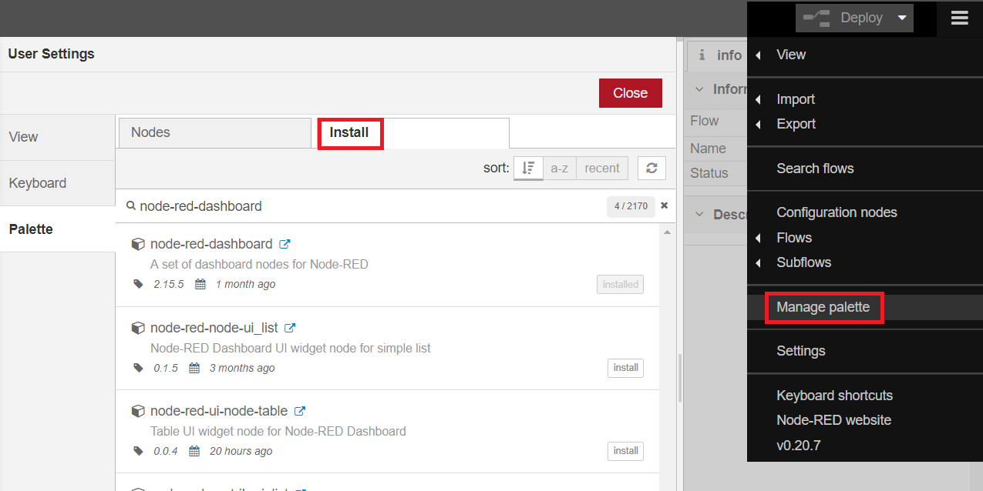
Node-RED 常用套件
除了 npm 之外也可以透過 manage palette 進行套件安裝與管理
MySQL 節點
npm i node-red-node-mysql
Dashboard 節點
npm install node-red-dashboard
Serial Port 節點
npm i node-red-node-serialport

Slide 6
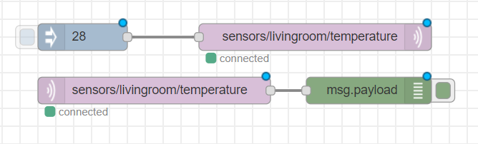
Node-RED 連接到 MQTT Server(Broker)
Node-Red 提供 MQTT input (subscribe) 與 MQTT output (publish) 兩種節點
通常是直接設定連接到如 Mosquitto 或其他地方的 MQTT Broker
也可直接在 Node-RED 上跑 MQTT Broker, 只需安裝套件 node-red-contrib-mqtt-broker
(npm install node-red-contrib-mqtt-broker)
MQTT output 節點(publisher)
MQTT input 節點(publisher)

Slide 7
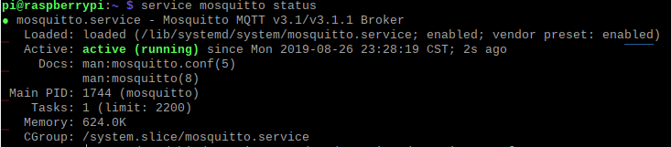
安裝 Mosquitto (MQTT Server)
可使用 apt-get install mosquitto 進行安裝，通常安裝後會啟動及開機自動啟動
如果沒有開啟可使用 sudo service mosquitto start 開啟
以及使用 sudo systemctl enable mosquitto 設定開機自動啟動
使用 service mosquitto status 檢查服務狀態，綠色表示服務正常

Slide 8

Mosquitto 身份驗證設定
Mosquitto 預設允許使用匿名身份，透過修改 mosquitto.conf 可以將其關閉
使用 mosquitto_passwd -c /etc/mosquitto/passwd admin
解壓範例設定檔案到 /etc/mosquitto/conf.d/ 目錄中
(sudo bash -c "gzip -d -k -c /usr/share/doc/mosquitto/examples/mosquitto.conf.gz > /etc/mosquitto/conf.d/mosquitto.conf")
並將 #allow_anonymous true 修改成 allow_anonymous false
且設定使用者設定檔之檔案位置找到 #password_file 改為
password_file /etc/mosquitto/passwd (假設為 /etc/mosquitto/passwd)
可以使用 mosquitto -c /etc/mosquitto/mosquitto.conf 執行看看有沒有錯誤訊息
或 sudo cat /var/log/mosquitto/mosquitto.log 看看

Slide 9
Mosquitto 身份驗證 (使用者與使用者權限)
使用 mosquitto_passwd -c /etc/mosquitto/passwd userA 創建使用者檔案與使用者 userA，並輸入使用者密碼
如果要在同個檔案新增使用者，就不要 –c 以免被覆蓋掉(如：mosquitto_passwd -c /etc/mosquitto/passwd userB)
若要針對使用者進行 topic 權限的設定，需修改 /etc/mosquitto/mosquitto.conf 將 #acl_file 改成 acl_file <路徑>
acl_file 範例(#表示所有):
user user1
topic read foo/bar
user user2
topic write foo/bar/#
user user3
topic readwrite foo/bar
user 使用者
topic 權限 主題
設定完後使用 sudo service mosquitto restart 重新啟動服務

Slide 10
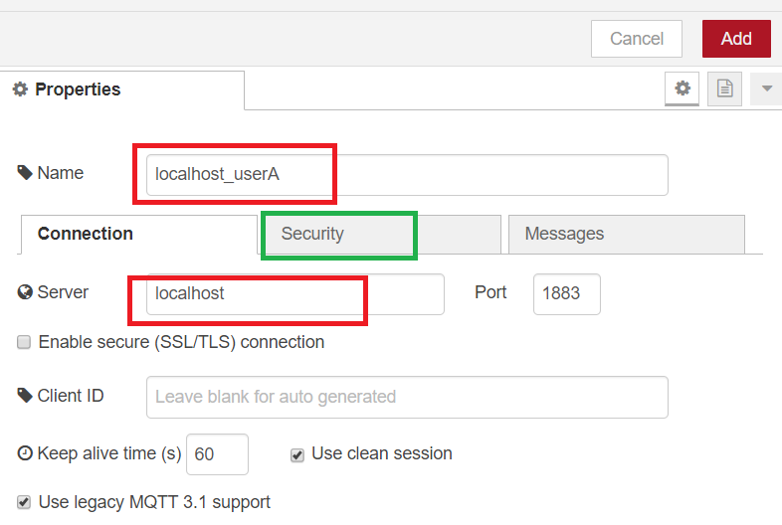
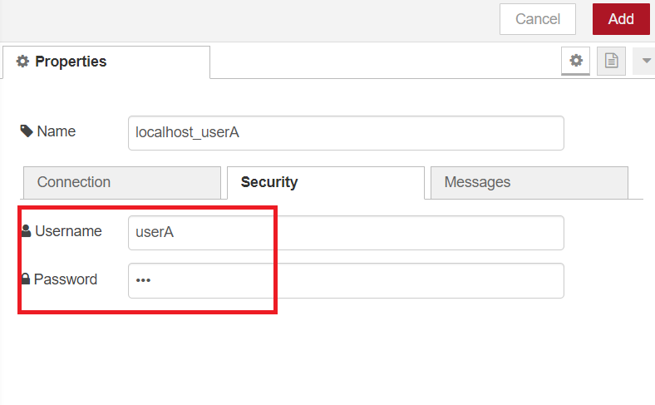
Node-RED 設定使用 MQTT 使用者帳密
編輯 MQTT 節點的 Server 選項，這邊是設定一個新的
輸入節點名稱以及 Server 位置後切到 SECURITY 頁面輸入使用者帳號及密碼
如果需要不同的使用者須設定多個 Server 選項

Slide 11
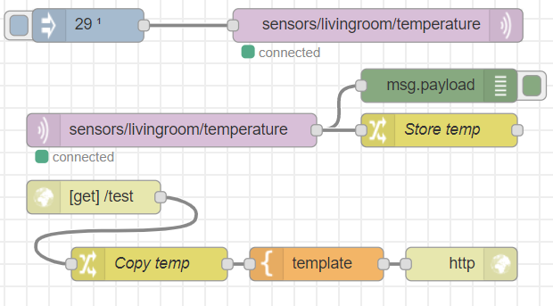
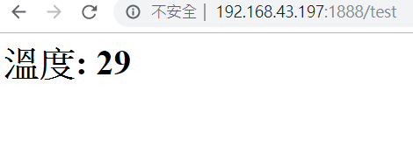
小測試一
這邊做了一個測試，把 29 publisher 到 sensors/livingroom/temperature 再透過 mqtt in 節點 subscriber 它
並把接收到的訊息存到 flow context 中，以便在 http 請求時顯示出接收到的溫度，下圖為執行結果
Node-red export:
[{"id":"5aa89b48.d791c4","type":"mqtt out","z":"b9f97446.e04d98","name":"","topic":"sensors/livingroom/temperature","qos":"2","retain":"true","broker":"8c3cf0b4.e003f","x":595,"y":206,"wires":[]},{"id":"8ca006b4.db6c18","type":"inject","z":"b9f97446.e04d98","name":"","topic":"","payload":"29","payloadType":"num","repeat":"","crontab":"","once":true,"onceDelay":"","x":335,"y":206,"wires":[["5aa89b48.d791c4"]]},{"id":"23675beb.bbf304","type":"mqtt in","z":"b9f97446.e04d98","name":"","topic":"sensors/livingroom/temperature","qos":"2","datatype":"auto","broker":"8acd6da7.eeb81","x":410,"y":300,"wires":[["64416797.a898d8","d35414ba.c9d7b8"]]},{"id":"64416797.a898d8","type":"debug","z":"b9f97446.e04d98","name":"","active":true,"tosidebar":true,"console":false,"tostatus":false,"complete":"payload","targetType":"msg","x":650,"y":260,"wires":[]},{"id":"c9c51166.d5e78","type":"http in","z":"b9f97446.e04d98","name":"","url":"/test","method":"get","upload":false,"swaggerDoc":"","x":340,"y":360,"wires":[["73dd4e9b.8327"]]},{"id":"4ce80e94.88f85","type":"template","z":"b9f97446.e04d98","name":"","field":"payload","fieldType":"msg","format":"handlebars","syntax":"mustache","template":"<html>\n <head></head>\n <body>\n <h1>溫度: {{ temp }}</h1>\n </body>\n</html>","output":"str","x":540,"y":420,"wires":[["4d776266.79c12c"]]},{"id":"4d776266.79c12c","type":"http response","z":"b9f97446.e04d98","name":"","statusCode":"","headers":{},"x":670,"y":420,"wires":[]},{"id":"d35414ba.c9d7b8","type":"change","z":"b9f97446.e04d98","name":"Store temp","rules":[{"t":"set","p":"temp","pt":"flow","to":"payload","tot":"msg"}],"action":"","property":"","from":"","to":"","reg":false,"x":650,"y":300,"wires":[[]]},{"id":"73dd4e9b.8327","type":"change","z":"b9f97446.e04d98","name":"Copy temp","rules":[{"t":"set","p":"temp","pt":"msg","to":"temp","tot":"flow"}],"action":"","property":"","from":"","to":"","reg":false,"x":390,"y":420,"wires":[["4ce80e94.88f85"]]},{"id":"8c3cf0b4.e003f","type":"mqtt-broker","z":"","name":"localhost_userA","broker":"localhost","port":"1883","clientid":"","usetls":false,"compatmode":true,"keepalive":"60","cleansession":true,"birthTopic":"","birthQos":"0","birthPayload":"","closeTopic":"","closePayload":"","willTopic":"","willQos":"0","willPayload":""},{"id":"8acd6da7.eeb81","type":"mqtt-broker","z":"","name":"localhost_userB","broker":"localhost","port":"1883","clientid":"","usetls":false,"compatmode":true,"keepalive":"60","cleansession":true,"birthTopic":"","birthQos":"0","birthPayload":"","closeTopic":"","closeQos":"0","closePayload":"","willTopic":"","willQos":"0","willPayload":""}]

Slide 12
Node-RED 與資料庫
常見的 Node-RED SQL 節點套件有
node-red-node-mysql
node-red-contrib-sqldbs (支援 mysql、mssql、postgresql、sqllite)
兩個用法差不多，都是將 SQL 語法放到 msg 中
還有嘗試安裝 node-red-contrib-sql 節點但是失敗，懷疑是他版本太老舊(4年前更新)或是其他問題
後面內容使用 node-red-contrib-sqldbs 節點與 MariaDB 資料庫
安裝 MariaDB sudo apt-get install mariadb-server
安裝節點 sudo npm i node-red-contrib-sqldbs
資料庫帳密等設定因非此處重點故省略

Slide 13

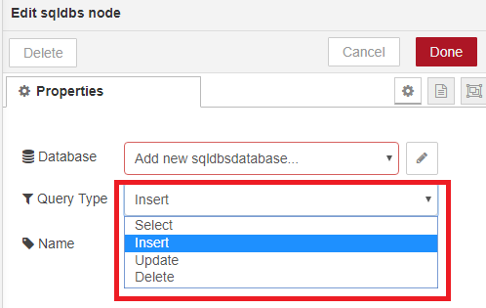
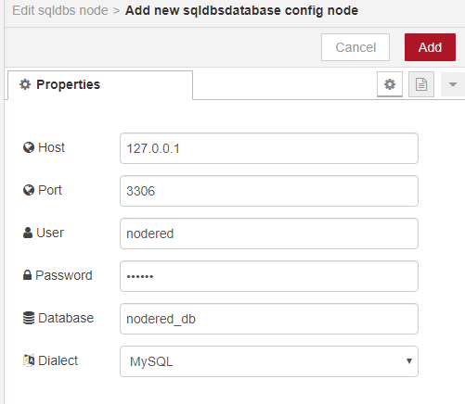
Node-RED 與資料庫
基本上都是一個 function 把 SQL 語句放到 msg.topic，讓 sqldbs 節點抓取且對資料庫操作
假設要新增一筆來自前面節點的 user 資料，那 function 可能會這樣寫
var insertuUser="INSERT INTO user(name, age) VALUES ('%s', %d)";
var newMsg = {
"topic": util.format(insertuUser, msg.payload.name, msg.payload.age)
}
return newMsg;
緊接著設定 sqldbs 節點，先選要做什麼操作，再根據需求設定 database 選項

Slide 14
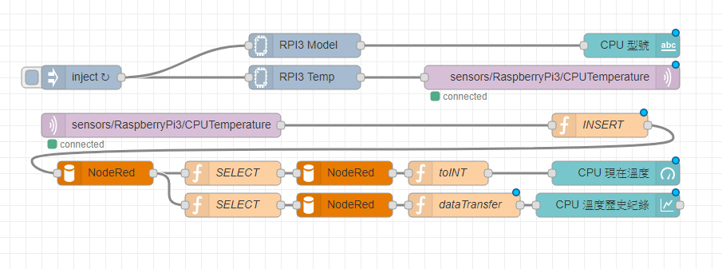
小測試二
延伸小測試一的內容，這邊透過 node-red-contrib-cpu 節點讀取 CPU 溫度，將溫度資料透過 MQTT 傳送。
收到 MQTT 的資料時，先將溫度寫到資料庫，再從資料庫讀出來到 ui_gauge 上面。
並且查詢最後 100 筆資料顯示到 ui_chart 上並設為折線圖。

Slide 15
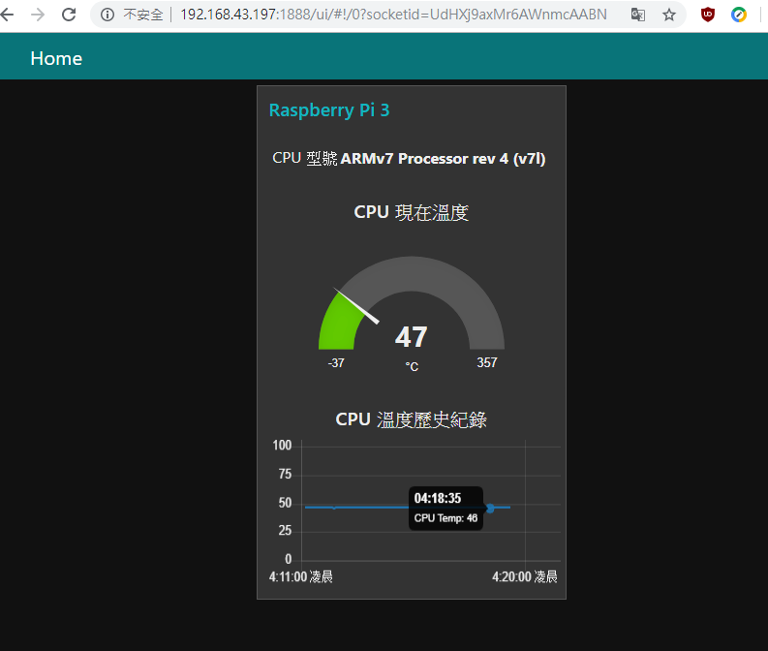
小測試二
結果圖
Node-red export:
[{"id":"5aa89b48.d791c4","type":"mqtt out","z":"b9f97446.e04d98","name":"","topic":"sensors/RaspberryPi3/CPUTemperature","qos":"2","retain":"true","broker":"8c3cf0b4.e003f","x":860,"y":100,"wires":[]},{"id":"8ca006b4.db6c18","type":"inject","z":"b9f97446.e04d98","name":"","topic":"","payload":"","payloadType":"num","repeat":"5","crontab":"","once":false,"onceDelay":"","x":270,"y":100,"wires":[["29fc5826.715b78","9b2004d6.40b128"]]},{"id":"23675beb.bbf304","type":"mqtt in","z":"b9f97446.e04d98","name":"","topic":"sensors/RaspberryPi3/CPUTemperature","qos":"2","datatype":"auto","broker":"8acd6da7.eeb81","x":370,"y":160,"wires":[["69b6f50b.1afc0c"]]},{"id":"e41115e1.53dc38","type":"sqldbs","z":"b9f97446.e04d98","mydb":"4aa24f91.847bf","querytype":"Insert","name":"","x":300,"y":220,"wires":[["9a95c9d6.b52c48","8c627e74.7d3eb"]]},{"id":"69b6f50b.1afc0c","type":"function","z":"b9f97446.e04d98","name":"INSERT","func":"var insertCpuTemp=\"INSERT INTO `cputemp` (`temp`) VALUES (%d)\";\nvar msg = {\n \"topic\": util.format(insertCpuTemp, parseInt(msg.payload))\n}\nreturn msg;","outputs":1,"noerr":0,"x":920,"y":160,"wires":[["e41115e1.53dc38"]]},{"id":"3fa02f29.692c3","type":"sqldbs","z":"b9f97446.e04d98","mydb":"4aa24f91.847bf","querytype":"Insert","name":"","x":600,"y":220,"wires":[["16effb4c.178515"]]},{"id":"9a95c9d6.b52c48","type":"function","z":"b9f97446.e04d98","name":"SELECT","func":"var msg = {\n \"topic\": 'SELECT * FROM `cputemp` ORDER BY sn DESC LIMIT 0 , 1'\n}\nreturn msg;","outputs":1,"noerr":0,"x":460,"y":220,"wires":[["3fa02f29.692c3"]]},{"id":"aad15836.a1baf8","type":"ui_gauge","z":"b9f97446.e04d98","name":"","group":"bc70ff2.e431a","order":2,"width":0,"height":0,"gtype":"gage","title":"CPU 現在溫度","label":"°C","format":"{{value}}","min":"-37","max":"357","colors":["#00b500","#e6e600","#ca3838"],"seg1":"","seg2":"","x":940,"y":220,"wires":[]},{"id":"16effb4c.178515","type":"function","z":"b9f97446.e04d98","name":"toINT","func":"var newMsg = {\n \"payload\": parseInt(msg.payload[0][0].temp)\n}\nreturn newMsg;","outputs":1,"noerr":0,"x":730,"y":220,"wires":[["aad15836.a1baf8"]]},{"id":"29fc5826.715b78","type":"cpu","z":"b9f97446.e04d98","name":"RPI3 Temp","msgCore":false,"msgOverall":false,"msgArray":false,"msgTemp":true,"x":550,"y":100,"wires":[["5aa89b48.d791c4"]]},{"id":"9b2004d6.40b128","type":"cpu","z":"b9f97446.e04d98","name":"RPI3 Model","msgCore":false,"msgOverall":false,"msgArray":true,"msgTemp":false,"x":550,"y":60,"wires":[["cae476cb.b6fda8"]]},{"id":"cae476cb.b6fda8","type":"ui_text","z":"b9f97446.e04d98","group":"bc70ff2.e431a","order":1,"width":0,"height":0,"name":"","label":"CPU 型號 ","format":"{{msg.payload[0].model}}","layout":"row-center","x":960,"y":60,"wires":[]},{"id":"1b12b026.8da84","type":"ui_chart","z":"b9f97446.e04d98","name":"","group":"bc70ff2.e431a","order":3,"width":0,"height":0,"label":"CPU 溫度歷史紀錄","chartType":"line","legend":"false","xformat":"auto","interpolate":"linear","nodata":"No Data","dot":false,"ymin":"0","ymax":"100","removeOlder":"10","removeOlderPoints":"120","removeOlderUnit":"60","cutout":0,"useOneColor":false,"colors":["#1f77b4","#aec7e8","#ff7f0e","#2ca02c","#98df8a","#d62728","#ff9896","#9467bd","#c5b0d5"],"useOldStyle":false,"outputs":1,"x":930,"y":260,"wires":[[]]},{"id":"811f9686.a0d458","type":"function","z":"b9f97446.e04d98","name":"dataTransfer","func":"data = msg.payload[0];\ndata_array = [];\n\nfor (i = 0; i < data.length; i++) {\n data_array.push({\"x\":Date.parse(data[i].date),\"y\":data[i].temp});\n}\n\nvar lineChart = [{\n \"series\":[\"CPU Temp\"],\n \"data\":[data_array],\n \"labels\":[\"\"]\n}];\n\nmsg.payload = lineChart;\nreturn msg;","outputs":1,"noerr":0,"x":750,"y":260,"wires":[["1b12b026.8da84"]]},{"id":"8c627e74.7d3eb","type":"function","z":"b9f97446.e04d98","name":"SELECT","func":"var newMsg = {\n \"topic\": 'SELECT * FROM `cputemp` ORDER BY sn DESC LIMIT 0 , 100'\n}\nreturn newMsg;","outputs":1,"noerr":0,"x":460,"y":260,"wires":[["621e92d5.925a1c"]]},{"id":"621e92d5.925a1c","type":"sqldbs","z":"b9f97446.e04d98","mydb":"4aa24f91.847bf","querytype":"Insert","name":"","x":600,"y":260,"wires":[["811f9686.a0d458"]]},{"id":"8c3cf0b4.e003f","type":"mqtt-broker","z":"","name":"localhost_userA","broker":"localhost","port":"1883","clientid":"","usetls":false,"compatmode":true,"keepalive":"60","cleansession":true,"birthTopic":"","birthQos":"0","birthPayload":"","closeTopic":"","closePayload":"","willTopic":"","willQos":"0","willPayload":""},{"id":"8acd6da7.eeb81","type":"mqtt-broker","z":"","name":"localhost_userB","broker":"localhost","port":"1883","clientid":"","usetls":false,"compatmode":true,"keepalive":"60","cleansession":true,"birthTopic":"","birthQos":"0","birthPayload":"","closeTopic":"","closeQos":"0","closePayload":"","willTopic":"","willQos":"0","willPayload":""},{"id":"4aa24f91.847bf","type":"sqldbsdatabase","z":"","host":"127.0.0.1","port":"3306","db":"NodeRed","dialect":"mysql"},{"id":"bc70ff2.e431a","type":"ui_group","z":"","name":"Raspberry Pi 3","tab":"b46e0872.12ca58","disp":true,"width":"6","collapse":false},{"id":"b46e0872.12ca58","type":"ui_tab","z":"","name":"Home","icon":"dashboard","disabled":false,"hidden":false}]

Slide 16
參考資料
https://nodered.org/docs/getting-started/raspberrypi
https://nodered.org/docs/user-guide/runtime/settings-file
http://www.steves-internet-guide.com/installing-node-red/
https://flows.nodered.org/node/node-red-contrib-mqtt-broker
https://oranwind.org/-aws-she-ding-node-red-lai-shi-jue-hua-xian-shi-gan-ce-zi-liao-jiao-xue/
https://cookbook.nodered.org/mqtt/connect-to-broker
http://www.steves-internet-guide.com/configuring-the-mqtt-publish-node/
http://misccp3.cnu.edu.tw/myblog/blogMessage.aspx?blog_id=300
https://mosquitto.org/man/mosquitto_passwd-1.html
https://www.cnblogs.com/saryli/p/9820532.html
https://cookbook.nodered.org/http/include-data-from-another-flow
https://segmentfault.com/a/1190000019595776

