Slide 1
PH電極檢測研究
戴

Slide 2
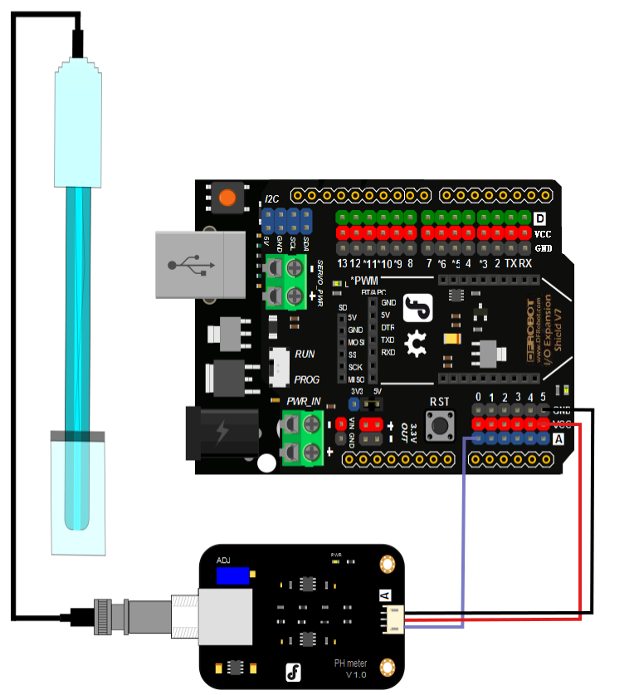
電路連接

Slide 3
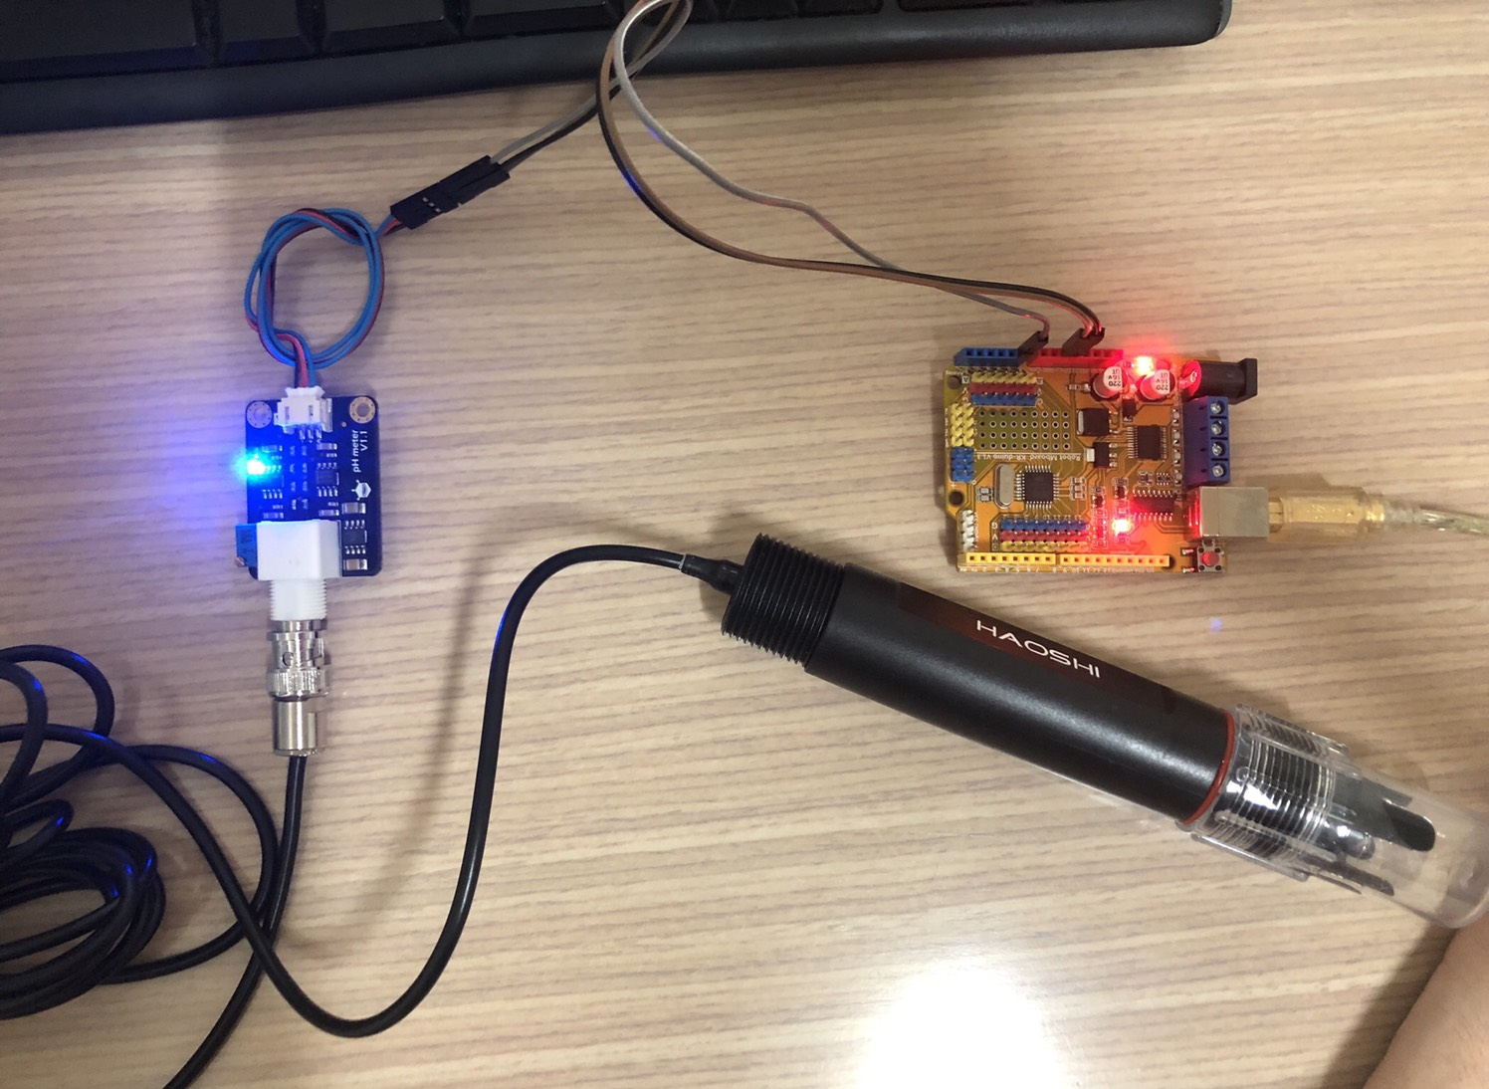
實際線路

Slide 4
程式碼1
#define SensorPin A0
#define Offset 0.00
#define LED 13
#define samplingInterval 20
#define printInterval 800
#define ArrayLenth 40
int pHArray[ArrayLenth];
int pHArrayIndex=0;
void setup(void)
{
pinMode(LED,OUTPUT);
Serial.begin(9600);
Serial.println("pH meter experiment!");
}

Slide 5
程式碼2
void loop(void)
{
static unsigned long samplingTime = millis();
static unsigned long printTime = millis();
static float pHValue,voltage;
if(millis()-samplingTime > samplingInterval)
{
pHArray[pHArrayIndex++]=analogRead(SensorPin);
if(pHArrayIndex==ArrayLenth)pHArrayIndex=0;
voltage = avergearray(pHArray, ArrayLenth)*5.0/1024;
pHValue = 3.5*voltage+Offset;
samplingTime=millis();
}

Slide 6
if(millis() - printTime > printInterval)
{
Serial.print("Voltage:");
Serial.print(voltage,2);
Serial.print(" pH value: ");
Serial.println(pHValue,2);
digitalWrite(LED,digitalRead(LED)^1);
printTime=millis();
}
}

Slide 7
double avergearray(int* arr, int number){
int i;
int max,min;
double avg;
long amount=0;
if(number<=0){
Serial.println("Error number for the array to avraging!/n");
return 0;
}
if(number<5){
for(i=0;i<number;i++){
amount+=arr[i];
}
avg = amount/number;
return avg;
}

Slide 8
else{
if(arr[0]<arr[1]){
min = arr[0];max=arr[1];
}
else{
min=arr[1];max=arr[0];
}
for(i=2;i<number;i++){
if(arr[i]<min){
amount+=min;
min=arr[i];
}else {
if(arr[i]>max){
amount+=max;
max=arr[i];
}else{
amount+=arr[i];
}
}
}
avg = (double)amount/(number-2);
}
return avg;
}

Slide 9
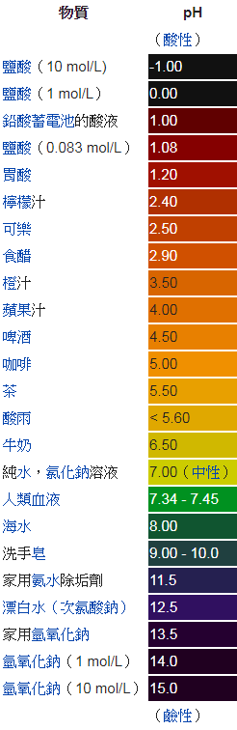
常用酸鹼性對照表

Slide 10
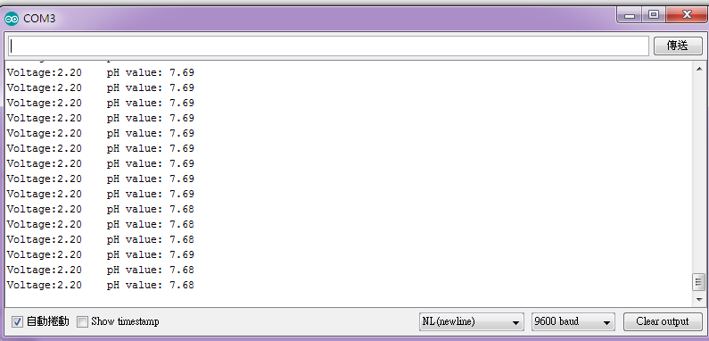
實際操作
檢測項目：弱鹼性水

Slide 11

實際操作
檢測項目：碳酸飲料

Slide 12
Reference-
https://zh.wikipedia.org/wiki/PH%E5%80%BC
https://wiki.dfrobot.com/Analog_pH_Meter_Pro_SKU_SEN0169

