Slide 1
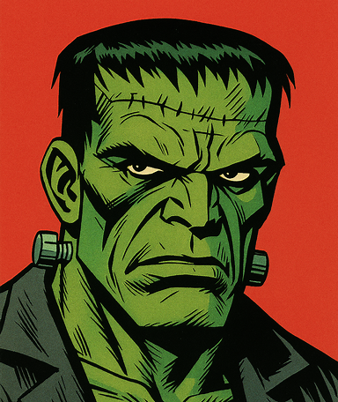
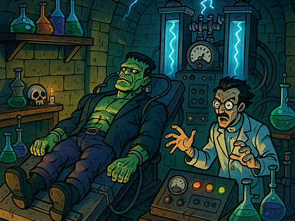
Images would depict key scenes from the novel
Visual Elements from Frankenstein

