Slide 1
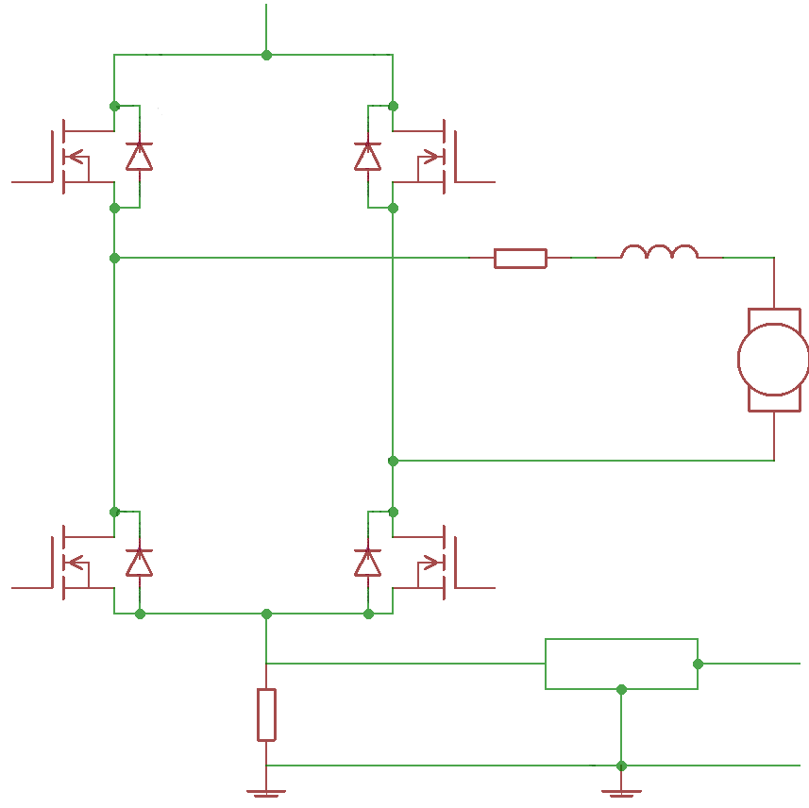










$$V_{cc}$$
$$Q_{11}$$
$$Q_{21}$$
$$R_{1}$$
$$L$$
$$e_{motor}(t)$$
$$Q_{21}$$
$$Q_{12}$$
$$Filtro$$
$$R_{2}$$

