Slide 1
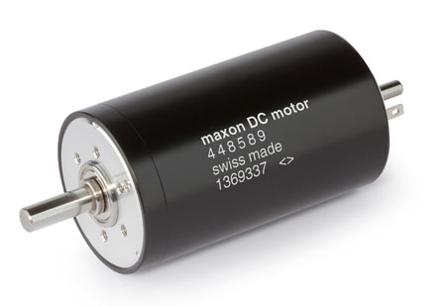
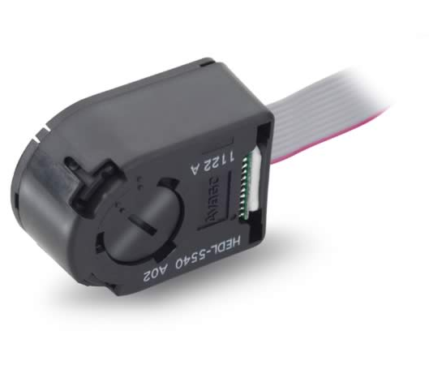


PWM
Pololu High-Power Motor Driver 36v20 CS
V
$$θ$$
$$θ$$

