Slide 1
Dialog Relation Extraction
picokatx

Slide 2
Dialog Relation Extraction
The Learning experience

Slide 3
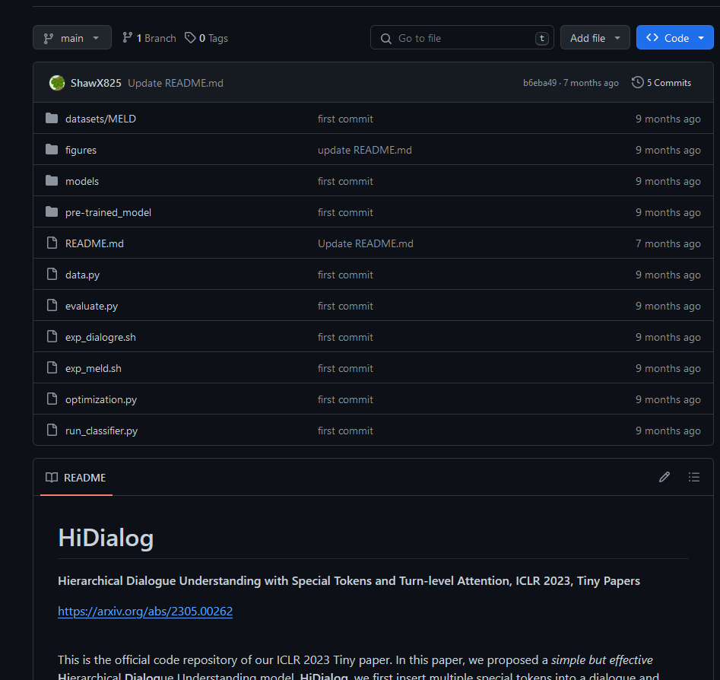
Why no pip install ☹

Slide 4
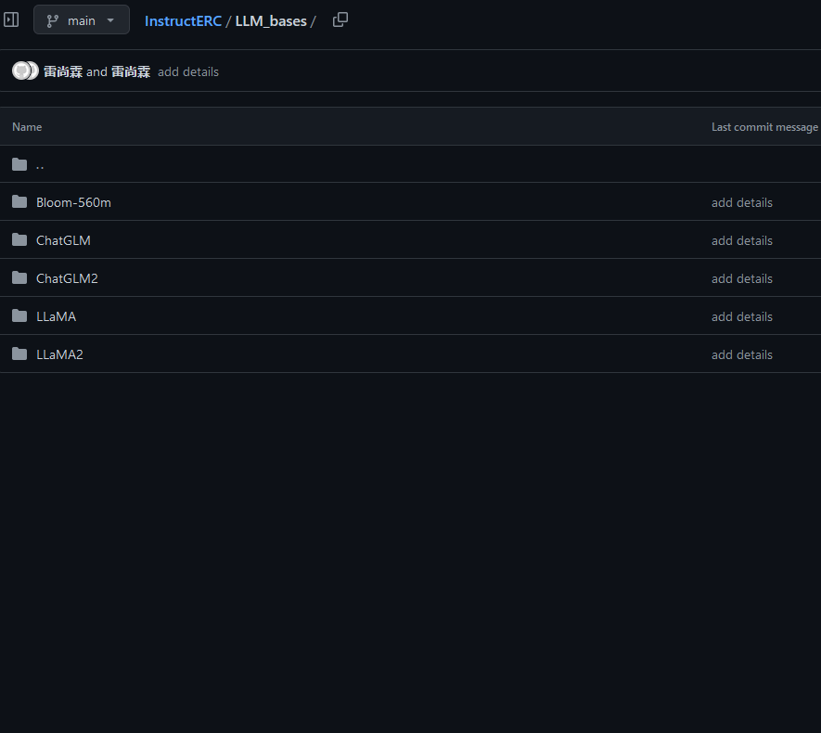
How download model???!?!?!?

Slide 5
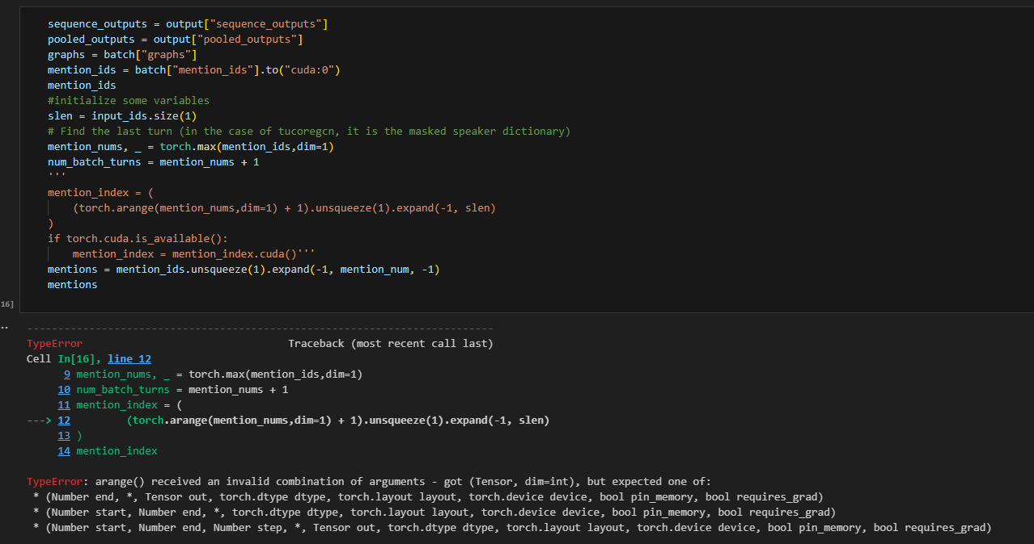
this repo’s code crash????

Slide 6
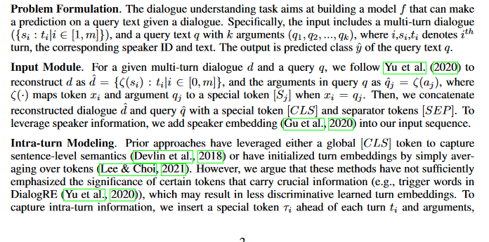
School of Math and

Slide 7
Overview
The release of DialogRE dataset in 2021 has greatly accelerated progress on Conversational Modelling.
Conversational Modelling has potential to improve social media algorithms among other stuff ig
However, most capabilities attained remains in academia, walled off from actual application as code released (if at all) fails to meet minimal standards for inclusion in libraries like huggingface transformers, pytorch, tensorflow, etc.

Slide 8
goal
Build a developer toolchain that streamlines the development of dialog relation extraction tasks.

Slide 9
Goal subgoal
Rewrite tucore-gcn in huggingface transformers.
Fix the 1 trillion bugs I have since found in their data processing pipeline (but replicate for parity)
Solve token context limit (explore huggingface transformers, I saw some models using methods to do so)
Upgrade to HiDialog
Can expand beyond dialog relation extraction to other dialog tasks as specified by tucore-gcn’s researchers

Slide 10
"Speaker 1: 'Okay. Okay, daddy we'll see you tomorrow night. Okay bye-bye.'",
"Speaker 2: We?",
"Speaker 1: Are ah, having dinner with my Dad tomorrow night, I hope that's okay.",
"Speaker 2: Oh shoot, tomorrow's not so good, I'm supposed to um, fall off the Empire State building and land on a bicycle with no seat. Sorry.",
"Speaker 1: Ross, my father doesn't hate you.",
"Speaker 2: Please, he refers to me as 'wethead'.",
"Speaker 1: But honey he calls everybody by a nickname! Okay, look, I know, all right, just one dinner, please, just one night for me, please. I just want him to love you like I do."
"x": "Speaker 2",
"y": "wethead",
"r": ["per:alternate_names"],
"x": "Speaker 2",
"y": "honey",
"r": ["per:alternate_names"],
"x": "Speaker 2",
"y": "Speaker 1",
"r": ["per:girl/boyfriend"],
"x": "Speaker 2",
"y": "daddy",
"r": ["unanswerable"],
D: ["Speaker X: <dialog>“]
"x": Entity 1,
"y": Entity 2,
"r": relation
"x": "Speaker 1",
"y": "Speaker 2",
"r": ["per:positive_impression", "per:girl/boyfriend"],
"x": "Speaker 1",
"y": "honey",
"r": ["unanswerable"]

Slide 11
Given D, x and y
Predict r
"x": Entity 1,
"y": Entity 2,
"r": relation
D: ["Speaker X: <dialog>“]

Slide 12
self,
input_ids: Optional[torch.Tensor] = None,
attention_mask: Optional[torch.Tensor] = None,
token_type_ids: Optional[torch.Tensor] = None,
position_ids: Optional[torch.Tensor] = None,
speaker_ids: Optional[torch.Tensor] = None,
head_mask: Optional[torch.Tensor] = None,
Speaker_1: Howdy! I’m Flowey, Flowey the Flower!
Speaker_2: Hello Flowey!
Speaker_1: You’re new to the underground, aren’tcha?
Speaker_3:
Input Embeddings
input
position
speaker
segment
768
Softmax
Position Embeddings
Linear
BERT
Embeddings
Add & Norm
x12
layers
768
Feed
Forward
Speaker Embeddings
512
Add & Norm
Add & Norm
BERT Encoder
Feed
Forward
Multi-Head
Attention
Turn Attention
Segment Embeddings
512
Add & Norm
Add & Norm
vocab
k
k_{d}
2
Multi-Head
Attention
Masked
Multi-Head
Attention
Input Mask
2
Positional
Encoding
Positional
Encoding
In:
D: ["Speaker X: <dialog>“,…]
"x": Entity 1,
"y": Entity 2,
512
Input
Embedding
Output
Embedding
512
Inputs
Outputs (shifted right)
Turn Mask
768
512
768
Turn-Speaker Edge
Classifier Head
512
Document Node
2
Bi-LSTM
3(gcn_layers+1)
Relational GCN
Document-Turn Edge
36
Turn Node
Mention Embeddings
Entity-Turn Edge
Out:
"r": relation
Entity Node
Forgot what the LSTM did ngl
Graph
Speaker
Name

Slide 13
[ 101, 2, 1024, 2129, 5149, 999, 1045, 1005, 1049, 4834, 3240, 1010, 4834, 3240, 1996, 6546, 999, 3, 1024, 7592, 4834, 3240, 1012, 1045, 1005, 1049, 2115, 2200, 2190, 2767, 999, 3, 1024, 2017, 1005, 2128, 2047, 2000, 1996, 5230, 1010, 4995, 1005, 22975, 3270, 1029, 102, 2, 102, 3, 102, 0, 0……0]
Input Embeddings
Position Embeddings
[I for I in range(0,k)]
[0, 11, 11, 11, 11, 11, 11, 11, 11, 11, 11, 11, 11, 11, 11, 11, 11, 12, 12, 12, 12, 12, 12, 12, 12, 12, 12, 12, 12, 12, 12, 12, 12, 12, 12, 12, 12, 12, 12, 12, 12, 12, 12, 12, 12, 12, 0, 11, 0, 12, 0, …, 0]
Speaker Embeddings
[0,…, 0, 1, 1, 1, 1, 1, 0,…, 0]
Segment Embeddings

Slide 14
Turn Mask or something

Slide 15
Softmax
Linear
Add & Norm
Feed
Forward
Add & Norm
Add & Norm
Multi-Head
Attention
Feed
Forward
Add & Norm
Add & Norm
Masked
Multi-Head
Attention
Multi-Head
Attention
Positional
Encoding
Positional
Encoding
Input
Embedding
Output
Embedding
Inputs
Outputs (shifted right)
Notes:
Note:
Using the same visual components from before and a few new custom ones, I was able to come up with the Transformer architecture
This is a reproduction of the Transformer architecture figure presented in the work of Vaswani et al. 2017
You can further customize it however you want
Author: Elvis Saravia (ellfae@gmail.com)

Slide 16
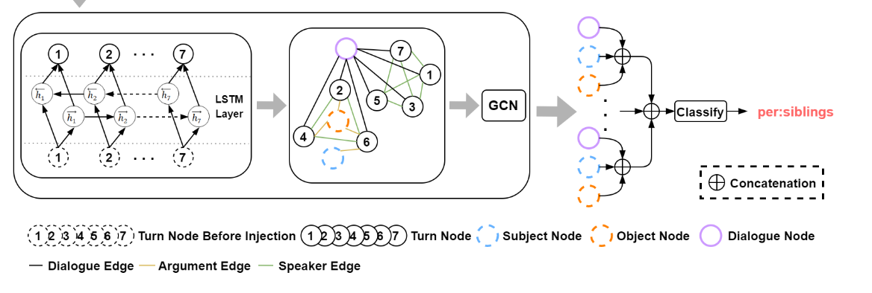
Turn-Speaker Edge
Document Node
Document-Turn Edge
Turn Node
Entity-Turn Edge
Entity Node
Graph
Speaker
Name
D
1
3
2
E1

Slide 17
D
E2
E1: Flowey
E2: speaker_2
aquaintance
1
3
2
E1
speaker_1 perspective
Turn 2
speaker_2_perspective
Turn 1
Turn 3
Cameraman
Turn 1
Turn 2
Turn 3
Ground Truth
Turn 1
Turn 2
Turn 3

Slide 18
PIPELINE_REGISTRY.register_pipeline(
"conversational-sequence-classification",
pipeline_class=ConversationalSequenceClassificationPipeline
)
speaker_tokenizer = SpeakerBertTokenizer.from_pretrained('bert-base-uncased')
model = TUCOREGCN_BertForSequenceClassification(TUCOREGCN_BertConfig.from_json_file("../models/BERT/tucoregcn_bert_mlc.json"))
model.cuda()
model.load_state_dict(torch.load("../TUCOREGCN_BERT_DialogRE/tucoregcn_pytorch_model.pt"))
model.cuda()
classifier = pipeline("conversational-sequence-classification", model=model, tokenizer=speaker_tokenizer, device="cuda:0", n_class=36, max_seq_length=512)
c = Conversation(
messages=[
Message("Speaker 1", "Howdy! I'm Flowey, Flowey the Flower!"),
Message("Speaker 2", "Hello Flowey. I'm your very best friend!"),
Message("Speaker 2", "You're new to the underground, aren'tcha?"),
],
speaker_relations=[
SpeakerRelation("Speaker 1", "Speaker 2")
]
)
labels, scores, logits = classifier(c).values()

Slide 19
"Speaker 1: 'Okay. Okay, daddy we'll see you tomorrow night. Okay bye-bye.'",
"Speaker 2: We?",
"Speaker 1: Are ah, having dinner with my Dad tomorrow night, I hope that's okay.",
"Speaker 2: Oh shoot, tomorrow's not so good, I'm supposed to um, fall off the Empire State building and land on a bicycle with no seat. Sorry.",
"Speaker 1: Ross, my father doesn't hate you.",
"Speaker 2: Please, he refers to me as 'wethead'.",
"Speaker 1: But honey he calls everybody by a nickname! Okay, look, I know, all right, just one dinner, please, just one night for me, please. I just want him to love you like I do."
"x": "Speaker 2",
"y": "wethead",
"r": ["per:alternate_names"],
"x": "Speaker 2",
"y": "honey",
"r": ["per:alternate_names"],
"x": "Speaker 2",
"y": "Speaker 1",
"r": ["per:girl/boyfriend"],
"x": "Speaker 2",
"y": "daddy",
"r": ["unanswerable"],
[]
"x": Entity 1,
"y": Entity 2,
"r": relation
"x": "Speaker 1",
"y": "Speaker 2",
"r": ["per:positive_impression", "per:girl/boyfriend"],
"x": "Speaker 1",
"y": "honey",
"r": ["unanswerable"]

Slide 20
I
love
coding
and
writing
Tokenize
“I love coding and writing”
Notes:
Note:
This figure aims to demonstrate the process of tokenization
If you want to change the gradient colors of this shape, you can simply click on the shape and then select “Fill color” (the bucket looking icon at the top).
This is a gradient color so you can customize however you want
Author: Elvis Saravia (ellfae@gmail.com)

Slide 21
ML Visuals
By dair.ai
https://github.com/dair-ai/ml-visuals
Notes:
IMPORTANT NOTE: Please don’t request editing permission if you do not plan to add anything to the slides. If you want to edit the slides for your own purposes, just make a copy of the slides.
ML Visuals is a new collaborative effort to help the machine learning community in improving science communication by using more professional, compelling and adequate visuals and figures. You are free to use the visuals in your presentations or blog posts. You don’t need to ask permission to use any of the visuals but it will be nice if you can provide credit to the designer/author (author information found in the slide notes).
This is a project made by the dair.ai community and maintained in this GitHub repo. Our community members will continue to add more common figures and basic elements in upcoming versions. Think of this as free and open artefacts and templates which you can freely and easily download, copy, distribute, reuse and customize to your own needs. I am maintaining this set of slides on a bi-weekly basis where I will regularly organize and keep the slides clean from spam or unfinished content.
Contributing: To add your own custom figures, simply add a new slide and reuse any of the basic visual components (remember to request edit permissions). We encourage authors/designers to add their visuals here and allow others to reuse them. Make sure to include your author information (in the notes section of the slide) so that others can provide the proper credit if they use the visuals elsewhere (e.g. blog/presentations). Add your name and email just in case someone has any questions related to the figures you added. Also, provide a short description of your visual to help the user understand what it is about and how they can use it. If you need "Edit" permission, just click on the "request edit access" option under the "view only" toolbar above or send me an email at ellfae@gmail.com. If you have editing rights, please make sure not to delete any of the work that other authors have added. You can try to improve it by creating a new slide and adding that improved version (that’s actually encouraged).
Downloading a figure from any of the slides is easy. Just click on File→Download→(choose your format).
If you need help with customizing a figure or have an idea of something that could be valuable to others, we can help. Just open an issue here and we will do our best to come up with the visual. Thanks.

Slide 22
Basic ML Visuals
Notes:
Note:
Basic components go here.

Slide 23
Notes:
Note:
This is a simple round rectangle that can represent some process, operation, or transformation
Author: Elvis Saravia (ellfae@gmail.com)

Slide 24
Notes:
Note:
This can be used to represent a vector. If you want to edit the distance between each element, you can “ungroup” the shapes and then modify the distance between the individual lines.
Author: Elvis Saravia (ellfae@gmail.com)

Slide 25
Notes:
Symbolizing an embedding

Slide 26
Notes:
Note:
Can represent a neuron or some arbitrary operation
Author: Elvis Saravia (ellfae@gmail.com)

Slide 27
Notes:
Note:
These visuals can represent a multi-directional array (3D) input, tensor, etc.
Author: Elvis Saravia (ellfae@gmail.com)

Slide 28
Softmax
Convolve
Sharpen
Notes:
Note:
These visuals could represent transformations (left) or operations (right)
The visuals on the right use the Math Equations Add on for Google Slides.
If you click on the equation you are able to modify it by:
Selecting Add Ons → Math Equations → Menu
While the equation is selected, click “Connect to Equation” on the “Math Equations UI”
Then change the properties like color, size, etc.
Author: Elvis Saravia (ellfae@gmail.com)

Slide 29
Softmax
Convolve
Sharpen
Notes:
Note:
These visuals could represent transformations (left) or operations (right)
The visuals on the right use the Math Equations Add on for Google Slides.
If you click on the equation you are able to modify it by:
Selecting Add Ons → Math Equations → Menu
While the equation is selected, click “Connect to Equation” on the “Math Equations UI”
Then change the properties like color, size, etc.
Author: Elvis Saravia (ellfae@gmail.com)
Log:
Added a dark theme version of the previous slide

Slide 30
Softmax
Linear
Add & Norm
Feed
Forward
Add & Norm
Add & Norm
Feed
Forward
Multi-Head
Attention
Add & Norm
Add & Norm
Multi-Head
Attention
Masked
Multi-Head
Attention
Positional
Encoding
Positional
Encoding
Input
Embedding
Output
Embedding
Inputs
Outputs(shifted right)
Notes:
Note:
Using the same visual components from before and a few new custom ones, I was able to come up with the Transformer architecture
This is a reproduction of the Transformer architecture figure presented in the work of Vaswani et al. 2017
You can further customize it however you want
Author: Elvis Saravia (ellfae@gmail.com)

Slide 31
Softmax
Linear
Add & Norm
Feed
Forward
Add & Norm
Add & Norm
Multi-Head
Attention
Feed
Forward
Add & Norm
Add & Norm
Masked
Multi-Head
Attention
Multi-Head
Attention
Positional
Encoding
Positional
Encoding
Input
Embedding
Output
Embedding
Inputs
Outputs (shifted right)
Notes:
Note:
Using the same visual components from before and a few new custom ones, I was able to come up with the Transformer architecture
This is a reproduction of the Transformer architecture figure presented in the work of Vaswani et al. 2017
You can further customize it however you want
Author: Elvis Saravia (ellfae@gmail.com)

Slide 32
I
love
coding
and
writing
Tokenize
“I love coding and writing”
Notes:
Note:
This figure aims to demonstrate the process of tokenization
If you want to change the gradient colors of this shape, you can simply click on the shape and then select “Fill color” (the bucket looking icon at the top).
This is a gradient color so you can customize however you want
Author: Elvis Saravia (ellfae@gmail.com)

Slide 33
Hidden Layers
Input Layer
a^{[2]}₁
a^{[3]}₁
Output Layer
a^{[2]}₂
a^{[3]}₂
a^{[4]}
Ŷ
X
a^{[2]}₃
a^{[3]}₃
a^{[1]}_{n}
a^{[2]}_{n}
a^{[3]}_{n}
X = A^{[0]}
A^{[1]}
A^{[2]}
A^{[3]}
A^{[4]}
Notes:
Created By @srvmshr
sourav@yahoo.com

Slide 34
Hidden Layers
Input Layer
a^{[1]}₁
a^{[2]}₁
a^{[3]}₁
Output Layer
a^{[1]}₂
a^{[2]}₂
a^{[3]}₂
a^{[4]}
Ŷ
X
a^{[1]}₃
a^{[2]}₃
a^{[3]}₃
a^{[1]}_{n}
a^{[2]}_{n}
a^{[3]}_{n}
X = A^{[0]}
A^{[4]}
A^{[1]}
A^{[2]}
A^{[3]}
Notes:
Original by @srvmshr
sourav@yahoo.com
Dark themed version by (Elvis Saravia - ellfae@gmail.com)

Slide 35
Hidden Layers
Input Layer
^{[1}a]₁
a^{[2]}₁
a^{[3]}₁
Output Layer
a^{[1]}₂
a^{[2]}₂
a^{[3]}₂
a^{[4]}
Ŷ
X
a^{[1]}₃
a^{[2]}₃
a^{[3]}₃
a^{[1]}_{n}
a^{[2]}_{n}
a^{[3]}_{n}
X = A^{[0]}
A^{[1]}
A^{[2]}
A^{[3]}
A^{[4]}
Notes:
Created By @srvmshr
sourav@yahoo.com

Slide 36
CONV operation
MxM
ReLU
+b1
+b1
MxMX2
+b2
+b2
NxNx3
MxM
ReLU
a^{[l-1]}
a^{[l]}
Notes:
Added by @srvmshr
Sourav @ yahoo.com

Slide 37
CONV operation
MxM
ReLU
+b1
+b1
MxMX2
+b2
+b2
NxNx3
MxM
ReLU
Notes:
Added by @srvmshr
Sourav @ yahoo.com

Slide 38
CONV operation
MxM
ReLU
+b1
+b1
MxMX2
+b2
+b2
NxNx3
MxM
ReLU
Notes:
Added by @srvmshr
Sourav @ yahoo.com

Slide 39
Abstract backgrounds
Notes:
Note:
You can add abstract backgrounds here

Slide 40
Notes:
Note:
You can change the gradient of each component
Author: Elvis Saravia

Slide 41
DAIR.AI
Notes:
Note:
This is the header I use for the dair.ai NLP Newsletter
You can change the gradient of each component
You can customize the background as well by right clicking and changing to another gradient or static color
Author: Elvis Saravia

Slide 42
Notes:
Note:
This is the header I use for the dair.ai NLP Newsletter
You can change the gradient of each component
Author: Elvis Saravia

Slide 43
Notes:
Note:
This is the header I use for the dair.ai NLP Newsletter
You can change the gradient of each component
Author: Elvis Saravia

Slide 44
Gradient Backgrounds
Notes:
Note:
Gradient background shows some inspirations and ideas for color themes that could be used for backgrounds
The examples used in this section are inspired by https://uigradients.com

Slide 48
Community Contributions
Notes:
Note:
You can add abstract backgrounds here

Slide 49
Striding in CONV
S=1
S=2
Notes:
Created by @srvmshr
Sourav @ yahoo.com

Slide 50
Notes:
Created by @srvmshr
Sourav @ yahoo.com

Slide 52
MaxPool Same s=1
Inception Module
5x5 Same
3x3 Same
NxNx192
1x1 Same
NxNx192
NxNx128
NxNx32
NxNx64
Notes:
Created by @srvmshr
Sourav @ yahoo.com

Slide 53
t-1
t
Retraining w/o expansion
Notes:
Note:
1 hidden layer neural network
Author: Elvis Saravia (ellfae@gmail.com)

Slide 54
No-Retraining w/ expansion
Partial Retraining w/ expansion
Notes:
Note:
1 hidden layer neural network
Author: Elvis Saravia (ellfae@gmail.com)

Slide 55
t-1
t
t-1
t
No-Retraining w/ expansion
Partial Retraining w/ expansion
Notes:
Note:
1 hidden layer neural network
Author: Elvis Saravia (ellfae@gmail.com)

Slide 56
t-1
t
t-1
t
t-1
t
Retraining expansion
No-Retraining expansion
Partial Retraining expansion
Notes:
Note:
1 hidden layer neural network
Author: Elvis Saravia (ellfae@gmail.com)

Slide 57
Size
Family?
X
Y
#bed
Walk?
PRICE ŷ
Basic Neuron Model
ZIP
School
How does NN work (Insprired from Coursera)
Wealth
Ŷ = 0
X
Logistic Regression
Ŷ = 1
Notes:
By @srvmshr
sourav@yahoo.com

Slide 58
Linear regression
ReLU(x)
$
$
Size
Size
Notes:
By @srvmshr
sourav@yahoo.com

Slide 59
Training
CONV
3
CONV
1
CONV
2
CONV
5
CONV
6
CONV
7
I
I1
CONV
4
128*128*1
128*128*1
Encoder
Decoder
Decoder
V1
V
ENcoder
128*128*1
128*128*1
Notes:
By @srvmshr
sourav@yahoo.com

Slide 60
Large NN
Med NN
η
Small NN
SVM,LR etc
Amount of Data
Why does Deep learning work?
Notes:
By @srvmshr
sourav@yahoo.com

Slide 61
Hidden
Input
Output
a^{[1]}₁
a^{[1]}₂
One hidden layer neural network
X
a^{[2]}
Ŷ
a^{[1]}₃
a^{[1]}₄
X = A^{[0]}
A^{[1]}
A^{[2]}
Notes:
By @srvmshr
sourav@yahoo.com

Slide 62
a^{[1]}₁
x_{[1]}
a^{[2]}
a^{[1]}₂
x_{[2]}
x_{[1]}
x_{[2]}
x_{[3]}
Neural network templates
Notes:
By @srvmshr
sourav@yahoo.com

Slide 63
a^{[1]}₁
x_{[1]}
a^{[2]}
a^{[1]}₂
x_{[2]}
x_{[1]}
x_{[2]}
x_{[3]}
Neural network templates
Notes:
By @srvmshr
sourav@yahoo.com

Slide 64
Train
Valid
Test
Underfitting
Good fit
Overfitting
x2
x2
x2
x1
x1
x1
Train-Dev-Test vs. Model fitting
Notes:
By @srvmshr
sourav@yahoo.com

Slide 65
x_{[1]}
x_{[2]}
a_{[L]}
DropOut
x_{[3]}
x2
r=1
x2
Normalization
x1
x1
Notes:
By @srvmshr
sourav@yahoo.com

Slide 66
J
w2
Early stopping
Err
w1
w1
w2
Before Normalization
Dev
Train
it.
J
w2
w1
w1
After Normalization
w2
Notes:
By @srvmshr
sourav@yahoo.com

Slide 67
x₁
x₂
w[L]
w[1]
w[2]
w[L-2]
w[L-1]
Deep neural networks
FN
TN
TP
FP
Understanding
Precision & Recall
Notes:
By @srvmshr
sourav@yahoo.com

Slide 68
Batch vs. Mini-batch
Gradient Descent
w2
w2
BGD
SGD
Batch
Gradient Descent vs. SGD
SGD
w1
w1
Notes:
By @srvmshr
sourav@yahoo.com

Slide 69
x_{[1]}
p_{[1]}
x_{[2]}
p_{[2]}
x_{[3]}
Softmax Prediction with 2 outputs
Notes:
By @srvmshr
sourav@yahoo.com

Slide 70
Miscellaneous

Slide 71
16
16+32
16
16
1
3
Convolution 3x3
Convolution 1x1
Dropout 0.1
16
Max Pooling 2x2
Skip connection
Dropout 0.2
Up Sampling 2x2
Block copied
Dropout 0.3
32
32
32+64
32
64
64
64+128
64
128
128
128+256
128
256
256
Notes:
By @avsthiago

Slide 72
Softmax
FC
Layer4
Layer1
Layer2
Layer3
FC
Layer3
Max-Pool
Input
Output
Conv3-32
Conv3-32
Conv3-32
Conv3-32
Max-Pool
Conv3-64
Max-Pool
Conv3-128
Max-Pool
Conv3-64
FC-512
Conv
Layer2
Max-Pool
Conv
Layer1
Input
Layer1
Layer2
Layer3
Layer4
Conv3-32
Output
Conv3-32
Conv3-32
Conv3-32
Max-Pool
Conv3-64
Max-Pool
Conv3-128
Max-Pool
Conv3-64
FC-512
Notes:
By @avsthiago

Slide 73
Filter concatenation
3x3 convolutions
5x5 convolutions
1x1 convolutions
1x1 convolutions
1x1 convolutions
1x1 convolutions
3x3 max pooling
Previous layer
Notes:
By @avsthiago

Slide 74
Previous layer
1x3 conv,
1 padding
1x3 conv,
1 padding
1x7 conv,
3 padding
1x3 conv,
1 padding
1x5 conv,
2 padding
1x3 conv,
1 padding
Filter concatenation

Slide 75
Avg-Pool
Auxiliary Classifier
Conv
FC
FC
Softmax
Inception
Input
Inception
Conv
Max-Pool
Conv
Max-Pool
Conv
Max-Pool
Inception
Inception
Max-Pool
Inception
Inception
Inception
Inception
Inception
Max-Pool
Avg-Pool
Conv
FC
Softmax
Avg-Pool
Auxiliary Classifier
Conv
FC
FC
Softmax
Input
ConvTranspose2d
Max-Pool
Conv
Max-Pool
Notes:
By @avsthiago

Slide 76
Filter concatenation
Filter concatenation
3x3 conv.
1x3 conv.
3x1 conv.
1x1 conv.
3x3 conv.
3x3 conv.
1x1 conv.
1x3 conv.
3x1 conv.
3x3 conv.
1x1 conv.
1x1 conv.
Pool
1x1 conv.
1x1 conv.
Pool
1x1 conv.
1x1 conv.
Previous layer
Previous layer
(a)
(b)
Notes:
By @avsthiago

Slide 77
Previous input
Previous input
x
x
F(x)
F(x)
Stacked layers
Stacked layers
x
identity
+
y=F(x)
y=F(x)+x
R1
R1
R2
R1
R1
R2
R3
R1
R2
R3
Notes:
By @avsthiago

Slide 78
Dense Block 1
Dense Block 2
Dense Block 3
Softmax
FC
Avg-Pool
Avg-Pool
Conv
Conv
Input
Avg-Pool
Conv
Transition layers
Notes:
By @avsthiago

Slide 79
h_{i+1}
Filter concatenation
h_{i+1}
add
add
Filter concatenation
3x3 max
3x3 conv
3x3 avg
identity
add
add
add
add
add
add
add
add
3x3 conv
identity
3x3 conv
5x5 conv
3x3 avg
identity
3x3 avg
3x3 avg
3x3 conv
5x5 conv
7x7 conv
5x5 conv
3x3 max
7x7 conv
3x3 avg
5x5 conv
h_{i}
h_{i}
...
...
h_{i-1}
h_{i-1}
(a)
(b)
Notes:
By @avsthiago

Slide 80
=
14*14
28*28
56*56
112*112
224*224
Notes:
By @avsthiago

Slide 81
Notes:
By @avsthiago
Dark-theme version of the previous (by Elvis Saravia)

Slide 82
Max(1,1,5,6) = 6
Y
1
1
2
4
5
6
7
8
6
8
3
2
1
0
Pooling performed with a 2x2 kernel and a stride of 2
3
4
1
2
3
4
X
Image Representation
Notes:
By @avsthiago

