Slide 1

Intro to Tableau
TA: Tanner Finken

Slide 2
AGENDA
What is Tableau
How does it work?
2017 Tennis Data Example
Display data, calculated fields, aggregates and joins
Exporting Results / Concluding Remarks

Slide 3
What is Tableau?
Data Visualization Software
Used for Data Analysis and many forms of Data Visualization​
Drag and Drop Interface for faster navigation

Slide 4

Similar Products
Power BI (Microsoft)
Others
All use software tools for
simple and effective
data cleaning and
visualization
Image from Tableau Presentation (slideshare.net)

Slide 5
How Does it work?

Slide 6
Types of Tableau
Tableau Prep - Data Cleaning Software
Tableau Desktop* – A downloadable application for Data Visualization (Free for Students)
Tableau Online – Analytics platform fully hosted in the cloud with the ability to publish dashboards and let anyone view them
Tableau Server – an online platform that allows you to host and manage Tableau data sources, workbooks, reports, and dashboards
Tableau Reader – Free software tool that allows you to view workbooks and visualizations made in Tableau Desktop or Public
Tableau Public – Free Visualization Software with Limitations (Visuals can only be published and not saved or exported locally)
*- Tableau Desktop is the one we will be learning about

Slide 7
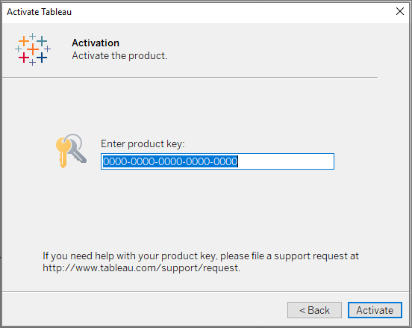
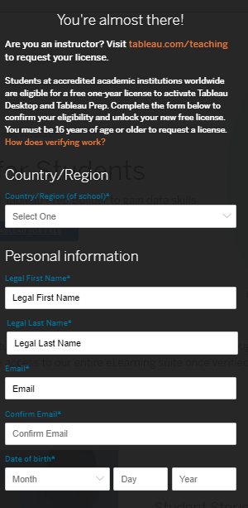
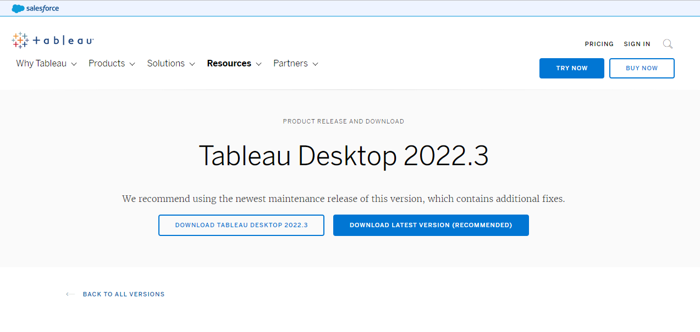
Tableau Desktop Download
Tableau Desktop (free for students for 1 year)
Fill out this form
Download Tableau Desktop here
Use the email code to verify, then register and begin using

Slide 8
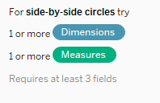
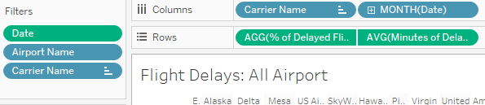
Data
Import your data from a variety of data sources (SQL, Oracle, SalesForce, JSON, CSV file, etc)
Data is assessed for type automatically and given default assumptions
Blue = Categorical or String Data types (Called Dimensions)
Green = Numeric Data (Called Measures)
These are just the defaults and can be changed as you are crafting your visual
Each visual tells you what it needs to be crafted

Slide 9
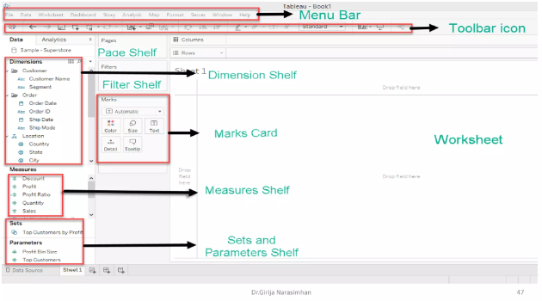
Format
Here is what the Tableau editor consists of
It is a lot, but each part has its own task
Type of Visual (Top Right)
Image from Visualization using Tableau (slideshare.net)

Slide 10
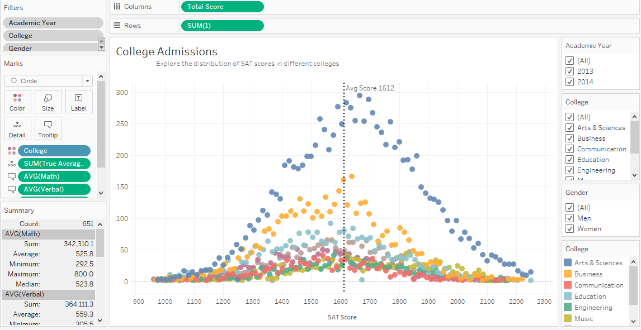
Goal
Visualize data quickly and be able to make multiple graphs into a dashboard to answer one or multiple questions

Slide 11
Example: 2017 Men’s tennis Data

Slide 12
Data
The data was found at the following website: ATP World Tour tennis data - Dataset - DataHub - Frictionless Data
In particular, we will be using the 2017 match_scores and match_stats data found here:
https://datahub.io/sports-data/atp-world-tour-tennis-data/r/match_scores_2017_unindexed.csv
And here:
https://datahub.io/sports-data/atp-world-tour-tennis-data/r/match_stats_2017_unindexed.csv
The easiest way is to just download them to your computer

Slide 13
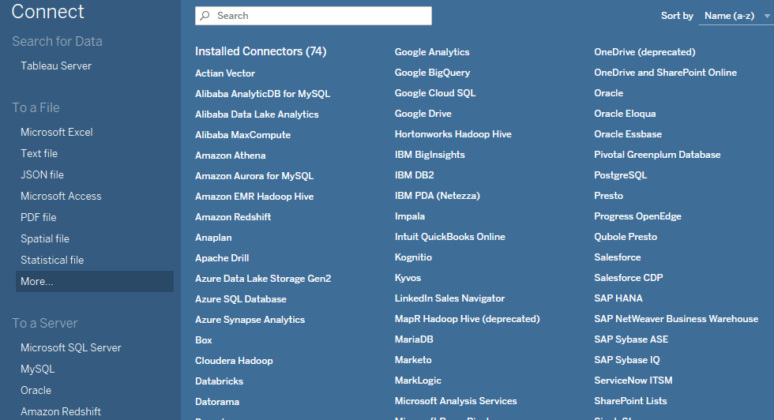
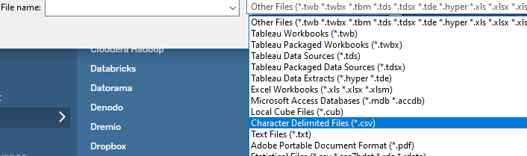
Starting the Project
Create a new workspace: File > New (Ctrl-N)
Connect to the data source: Data > New Data Source (Ctrl-D)
Under File Source, select more, then CSV file type and select one of the tennis match files.
Then under data source, add another connection and add the other CSV file
Finally, connect them together using Match Id

Slide 14
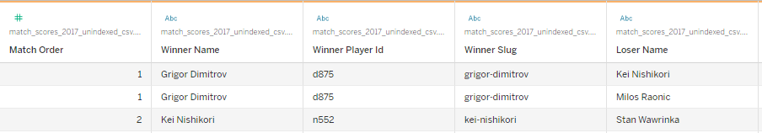
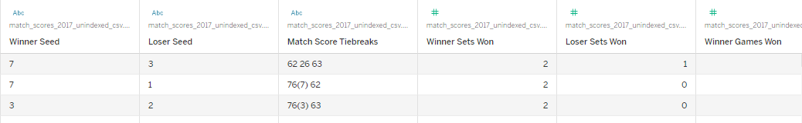
Viewing Data Attributes
First, we need to take a look at the data and see what we can visualize with the information we have.
Once the data is connected,
Under the Data Source tab at the bottom, we can see what attributes the data has

Slide 15
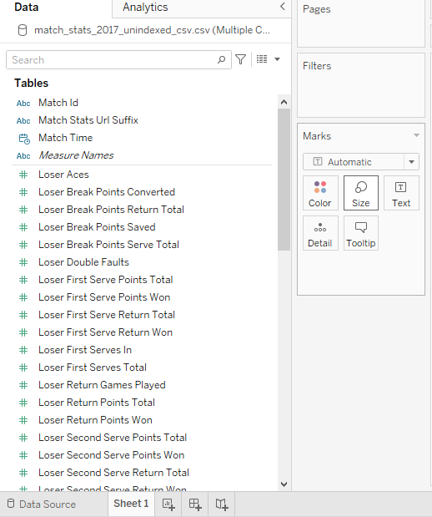
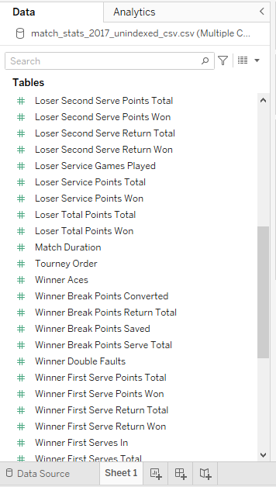
Viewing Data Attributes
The other way is to look under the data pane, while editing a sheet

Slide 16
Answering Questions:
Some questions we will try to answer:
Who won or lost the most matches in 2017?
What tournaments had the biggest number of upsets?
Does the return of serve affect the score of how badly someone loses?

Slide 17
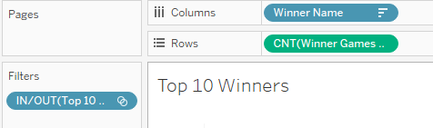
Who won or lost the most matches in 2017?:
Top 10 Players who won the most matches in 2017
Make a set of the top 10 Winners by right clicking on Winner Name, Create > Set
Change name to “Top 10 Winners”, then under the Top tab, we change it to top 10 by Winner Games (Count)
Simply drag Winner Name into the Column and then drag Count (change Aggregation type) of Winner Games Won into the Row
Then filter using the set we created

Slide 18
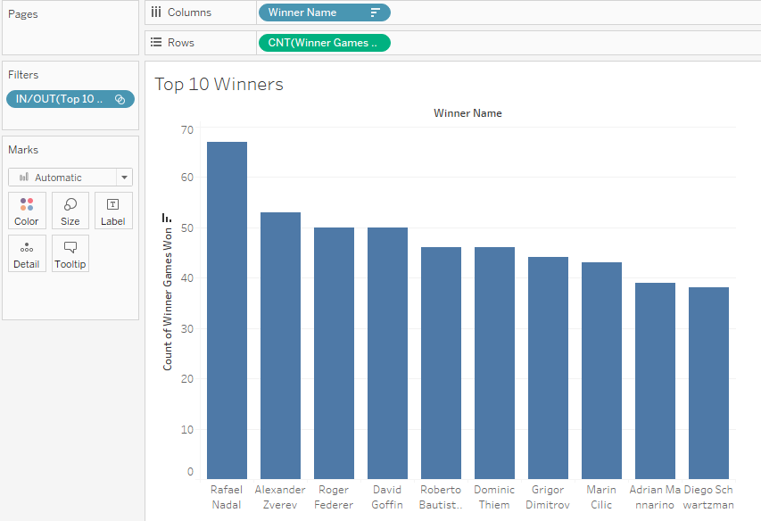
Who won or lost the most matches in 2017?:

Slide 19

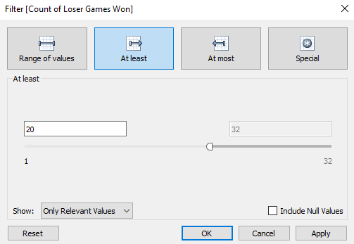
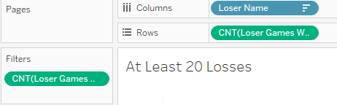
Who won or lost the most matches in 2017?:
Players who lost more than 20 matches in 2017
Create new sheet
Simply drag Loser Name into the Column and then drag Count (change Aggregation type) of Loser Games Won into the Row
Then filter based on the number of Loser Games Won, at least 20

Slide 20
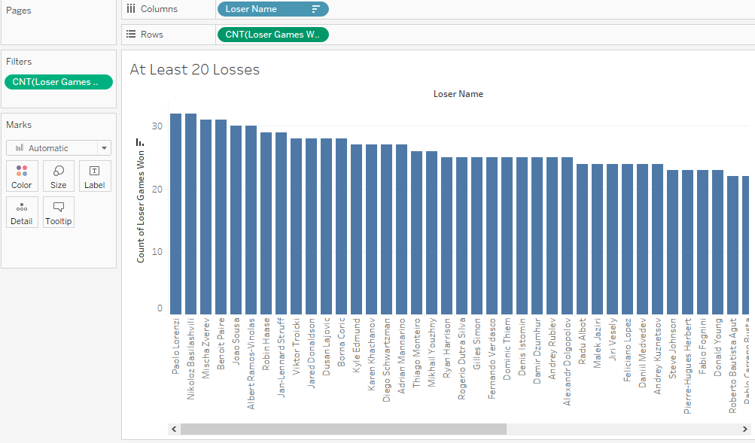
Who won or lost the most matches in 2017?:

Slide 21
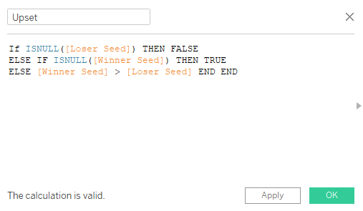
What tournaments had the biggest number of upsets?
Define an upset: when a lower seeded player beats a higher seed (Lower value of seed is better e.g. 1 is the best seed)
First, create a calculated field, seeing where upsets occur (Winner Seed > Loser Seed)
Then, we have to handle null values in the data, usually null means the player is unranked.
If a loser is unranked, it’s not an upset. If the winner is unranked, it is
So, we get the following formula:

Slide 22
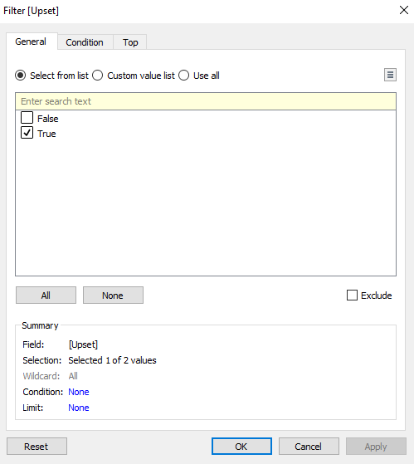
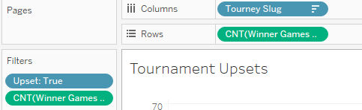
What tournaments had the biggest number of upsets?
Then, drag Tournament names to columns, and (Count) of Winner Games Won(Doesn’t matter what field)
Filter based on the newly created upset field, and by the count if you don’t want all tournaments

Slide 23
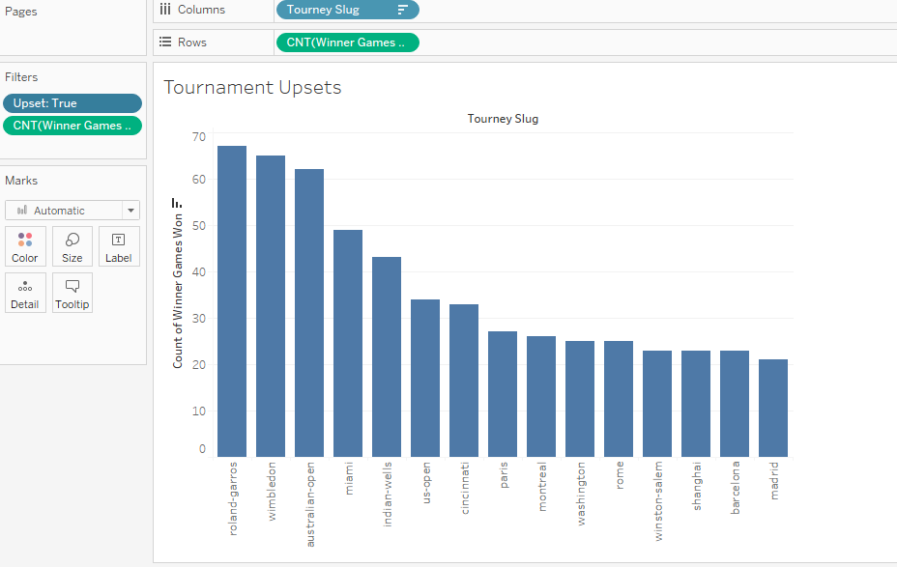
What tournaments had the biggest number of upsets?

Slide 24
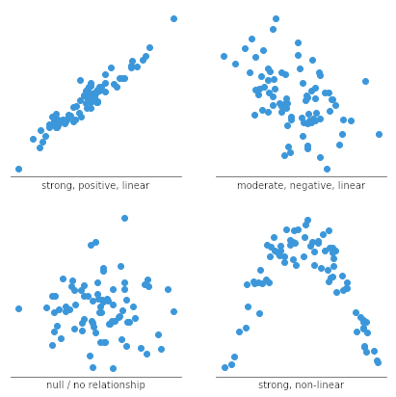
Does the return of serve affect the score of how badly someone loses?
Define how what we measure for return of serve:
In the data, we have loser return points won, loser first serve return won, and loser second serve return won. (All are values that should be converted to percentages by dividing by total)
Create those calculated fields: [Return won] / [Return total]
Then, measures of how badly someone loss can be how many games they were able to win, how long the match was played, or how many points they won.
So, we can visualize these using scatterplots

Slide 25
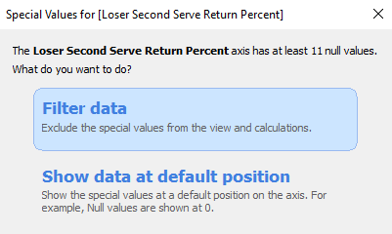
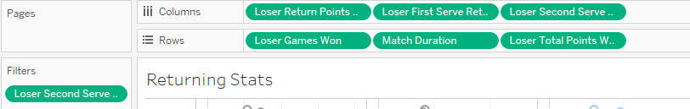
Does the return of serve affect the score of how badly someone loses?
Drag all the percentages we just calculated into columns
Then, drag the values we want to compare against into rows
And filter out any null values in the data

Slide 26
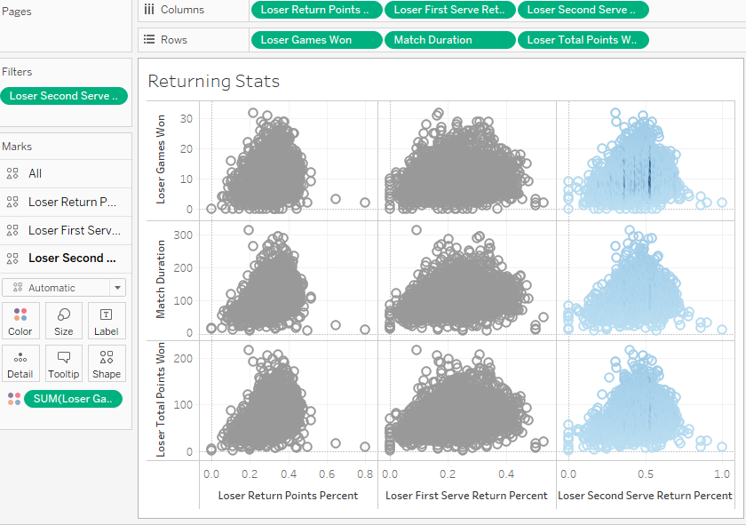
Does the return of serve affect the score of how badly someone loses?

Slide 27
Exporting Results/ Concluding Remarks

Slide 28
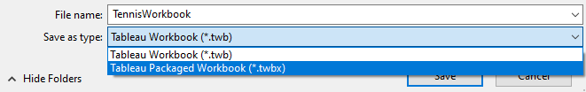
Saving your workbook
You can save your graphs for later editing as Tableau Workbook (.twb) or Tableau Packaged Workbook (.twbx)
The main difference is that the Packaged Workbook includes your data along with the graphs, so you can run it on another computer without needing access to the data.
While a Workbook is quicker to save and edit
Simply use File > Save As

Slide 29
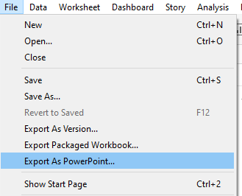
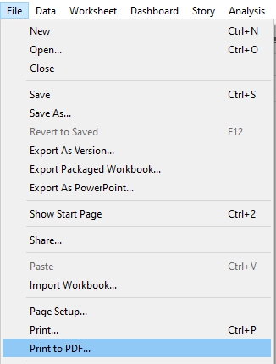
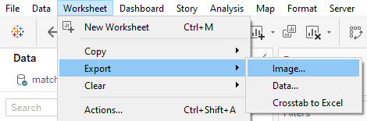
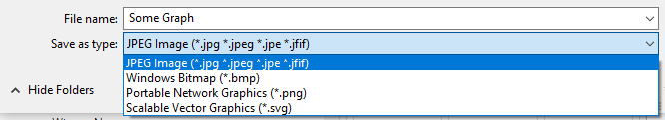
Export to Image or other formats
You can export your graphs to an image by using
Worksheet > Export > Image
Or you can download as a PowerPoint with
File > Export as PowerPoint
Or as a PDF
File > Print to PDF

Slide 30
Concluding Remarks
Tableau is a quick and effective data visualization tool, which can be used to quickly analyze and see data. The main drawbacks are taking time to learn how to use the tools that Tableau provides and getting used to the drag and drop style of building graphs. Creating a basic graph usually takes a lot less time than coding libraries such as D3 and Vega but can require more time with online tutorials to change small parts. Although not shown here, Tableau offers a wide variety of graphs that can be generated and is very useful for visualizing many types of data. Then, the visuals can be put into a dashboard for easy access in the same spot.

Slide 31
THANK YOU
Tanner Finken
finkent@arizona.edu

