Slide 1

Virtualised filenames – an alternative to docker.

Slide 2
Portable vs non-portable applications
Portable application | Non-portable application
If (Posix API avaialable or Win API avaialable) { Take user input; Process user input; Produce output; } | If (not on x86) goto fail; If (not on linux) goto fail; If (not on linux 3.4+) goto fail; If (libc is not glibc) goto fail; If (glibc is not version 2.21+) goto fail; If (/usr/bin/python not there) goto fail; If (/usr/bin/python --version is not exactly 2.7.10) goto fail; If (current executable's filepath is not in /usr/bin) goto fail; If (you're lucky enough that none of the above) { Take user input; Process user input; Produce output; }

Slide 3

I want this program installed & running by Monday

Slide 4
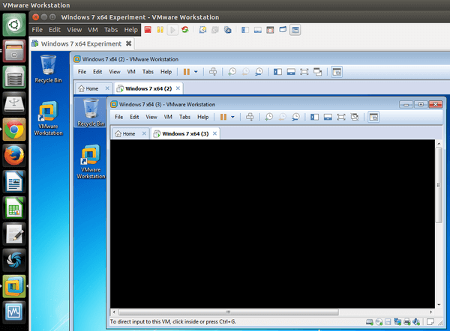

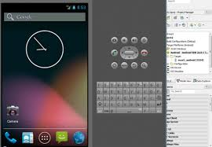
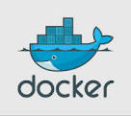
most unportable < least unportable
Buy new (possibly old) hardware | Emulate the architecture | Emulate the OS | Emulate fs, network stack and process tree.

Slide 5
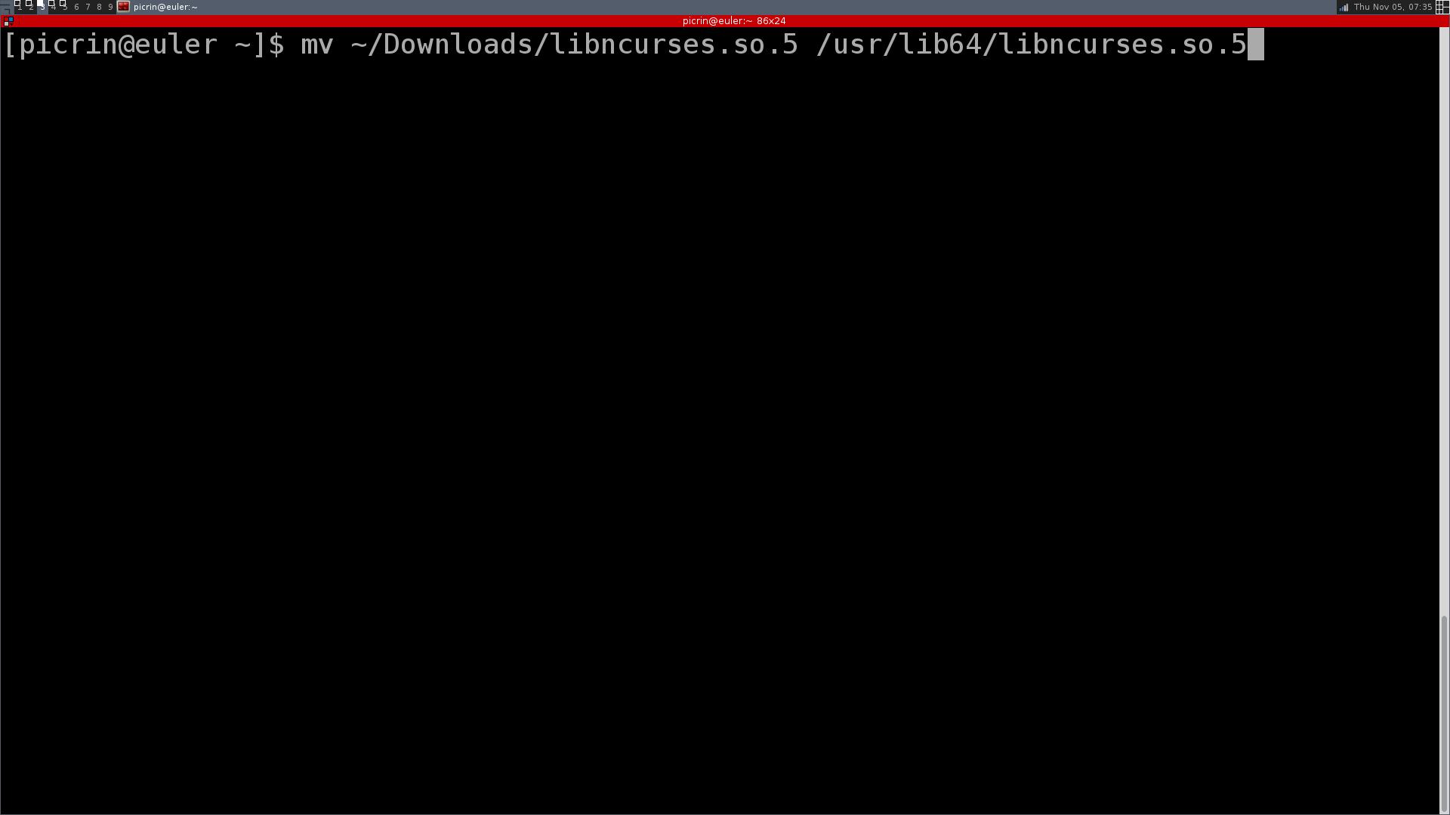
There is one more way...

Slide 6

Painful way

Slide 7
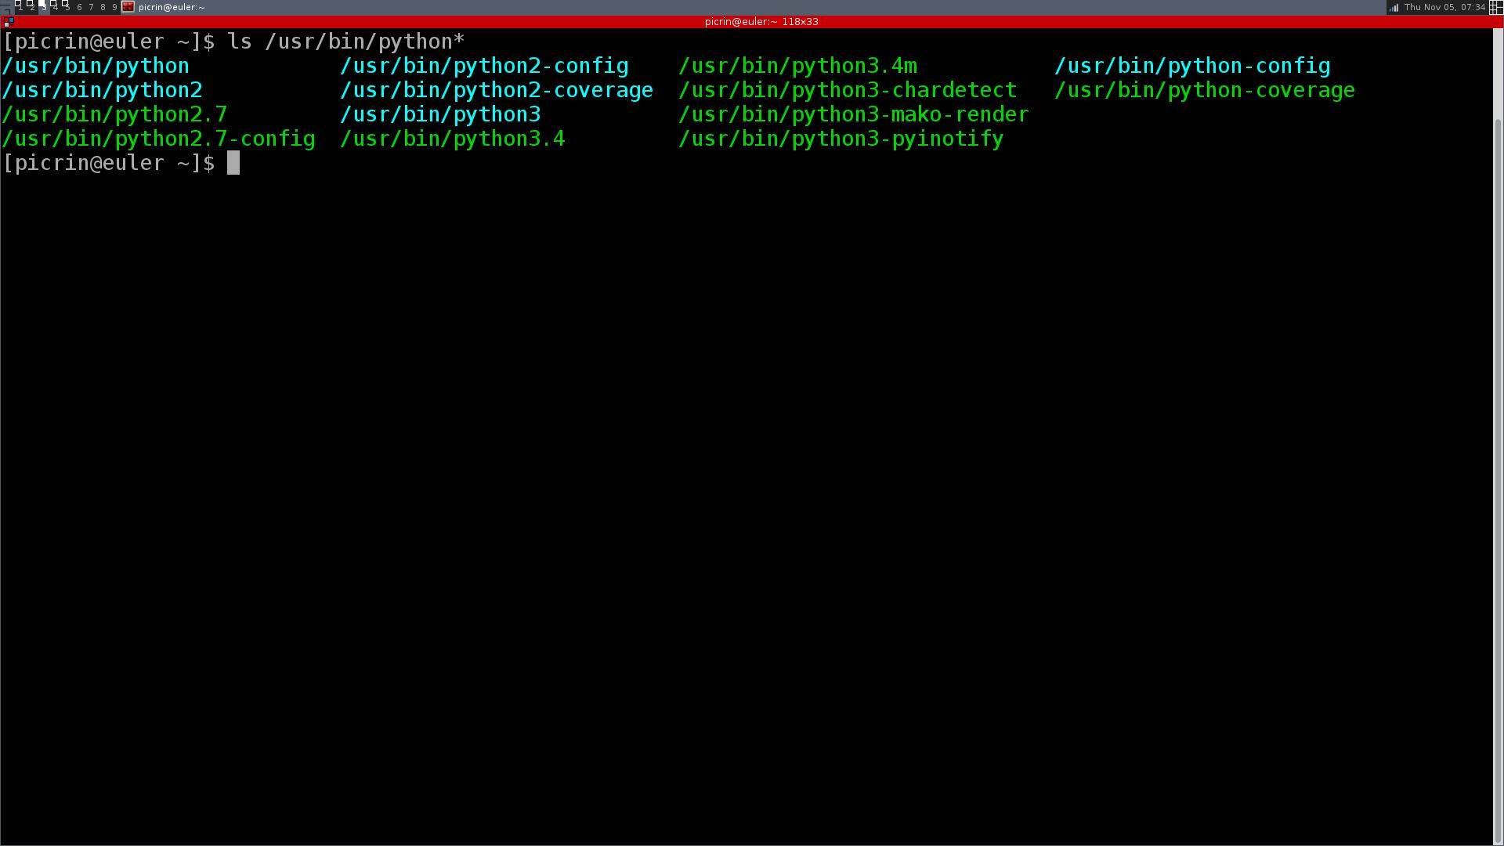
Rpm/dpkg to the rescue?

Slide 8
Not Really
python 2.6
python 2.7
conflict!
/usr/bin/python2
…
…
/usr/bin/python2
…
…

Slide 9
Hack into libc a new call vfn
A process makes a call vfn(“/usr/bin/python”, “/home/picrin/python2_5” ) | A process doesn't make the vfn call
From now on each call to open(), stat(), exec(), etc. will execute as normal, EXCEPT if path is /usr/bin/python, in which case they'll execute as if path was /home/picrin/python2_5 | each call to open(), stat(), exec(), etc. will execute as normal.
Each process can execute vfn multiple times, to virtualise as much (or as little) of the filesystem as it wishes. Each process inherits the vfn translation table from its parent process. | No process can alter vfn translations of any other process (security). You don't have to be root to alter your own process's vfn translation table (sensible). Nitty-gritty details-pitfalls, like executing vfn on files with open descriptors, etc. vfn translation table possibly has to be implemented inside kernel

Slide 10
vfn to the rescue!
rpm -ql python3
/usr/bin/pydoc3
/usr/bin/pydoc3.4
/usr/bin/python3
/usr/bin/python3.4
/usr/bin/python3.4m
/usr/bin/pyvenv
/usr/bin/pyvenv-3.4
rpm -ql python3 | xargs sha256sum
/usr/libvfn/8ff8790221fbf907c4c6e2db127664ec59f47e9bfb659252441900dbcc0dccaf /usr/bin/pydoc3
/usr/libvfn/8ff8790221fbf907c4c6e2db127664ec59f47e9bfb659252441900dbcc0dccaf /usr/bin/pydoc3.4
/usr/libvfn/4b78808d15be5bebfa7e0d11410d3bca84e370a196ec06d144ed214540b4060f /usr/bin/python3
/usr/libvfn/4b78808d15be5bebfa7e0d11410d3bca84e370a196ec06d144ed214540b4060f /usr/bin/python3.4
/usr/libvfn/4b78808d15be5bebfa7e0d11410d3bca84e370a196ec06d144ed214540b4060f /usr/bin/python3.4m
/usr/libvfn/9e64cc7d0101933c7288e1866f5a8d70ddef8a121308a4faa987c4c0c00a254c /usr/bin/pyvenv
/usr/libvfn/9e64cc7d0101933c7288e1866f5a8d70ddef8a121308a4faa987c4c0c00a254c /usr/bin/pyvenv-3.4

Slide 11

yeah!
Packaging becomes easy.
Dependency reuse becomes easy.
Software shipping becomes easy.
Containers become secure (no UID=0).
You no longer need UID=0 to install anything anyware.
Writing software is still hard ← focus there, portability is still a big bonus!

Slide 12

wait a minute
Need own kernel module to keep the vfn translation table, work out table inheritance, etc.
Need to hack EVERY libc call, which does a filesystem operation.
Some software STILL compiles against kernel headers, no way to do translation there.
There are multiple libc's to hack (glibc, bionic, bsd, etc.).
What about windows?

