Slide 1
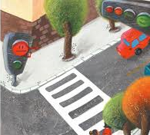
가상 신호등 프로젝트

Slide 2
알고리즘
빨강 LED켜기
보행자 빨강 신호등 점등
1초 기다림.
빨강LED끄기, 노랑LED켜기
보행자 빨강 신호등 꺼짐
1초 기다림
노랑LED끄기, 녹색 LED켜기
보행자 녹색 신호등 점등
0.7초 기다림
녹색LED끄기, 빨강 LED켜기
보행자 녹색 신호등 꺼짐

Slide 3
Source program
#include<wiringPi.h>
#include<stdio.h>
#define LED_R 0
#define LED_Y 2
#define LED_G 3
#define LED_PR 4
#define LED_PG 5
int main(void){
if(wiringPiSetup()== -1){
printf("setup wiringPi falled!");
return 1;
}

Slide 4
pinMode(LED_R, OUTPUT);
pinMode(LED_Y, OUTPUT);
pinMode(LED_G, OUTPUT);
pinMode(LED_PR, OUTPUT);
pinMode(LED_PG, OUTPUT);
while(1){
while(1){
digitalWrite(LED_R,HIGH);
digitalWrite(LED_Y,LOW);
digitalWrite(LED_G,LOW);
digitalWrite(LED_PR,HIGH);
digitalWrite(LED_PG,LOW);
printf("LED_R ON...\n");
delay(1000);

Slide 5
digitalWrite(LED_R,LOW);
digitalWrite(LED_Y,HIGH);
digitalWrite(LED_G,LOW);
digitalWrite(LED_PR,LOW);
digitalWrite(LED_PG,LOW);
printf("LED_Y ON...\n");
delay(700);
digitalWrite(LED_R,LOW);
digitalWrite(LED_Y,LOW);
digitalWrite(LED_G,HIGH);
digitalWrite(LED_PR,LOW);
digitalWrite(LED_PG,HIGH);
printf("LED_G ON...\n");
delay(1000);
digitalWrite(LED_R,LOW);
digitalWrite(LED_Y,LOW);
digitalWrite(LED_G,LOW);
digitalWrite(LED_PR,LOW);
digitalWrite(LED_PG,LOW);
delay(0);
return 0;
}

Slide 6
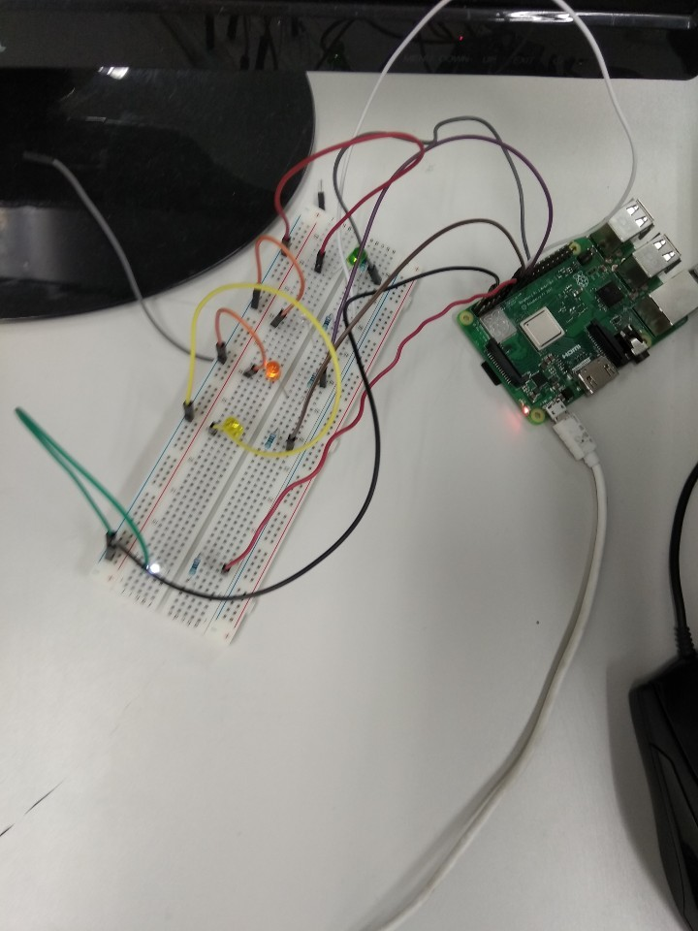
구동회로 (사진, 동영상)

