Slide 1
Ministry of Truth
Departmental Website

Slide 2
Outline
Fictional departmental website for the Ministry of Truth from George Orwell’s 1984
Provide citizens with up to date information
Allow party bureaucrats to easily edit official records to fit an ever changing

Slide 3
Main Features
Cleanly laid out navigation bar
Home
Services
About
Contact
Search bar
A list of popular “news” items
Featured article
Social media links
Links to “other ministries”
Optimized for desktop, tablet, and mobile

Slide 4
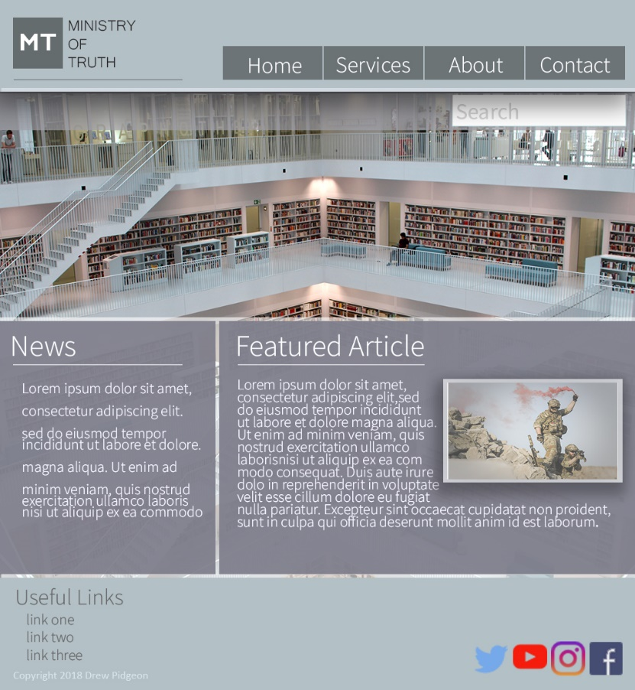
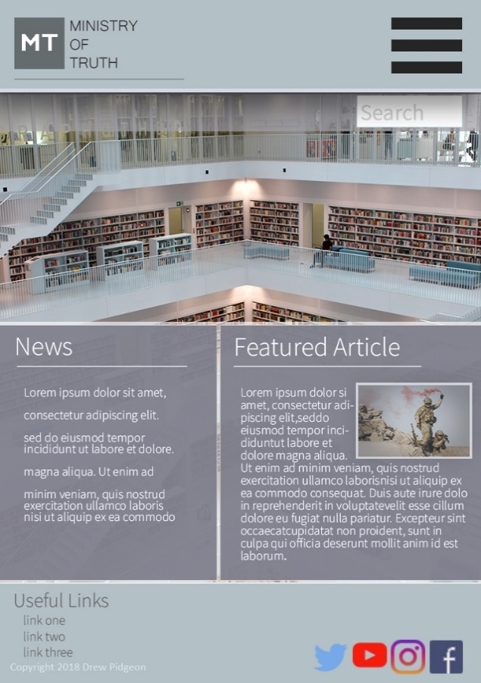
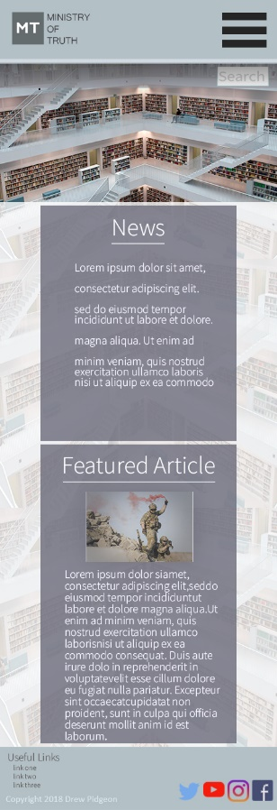
Mockups: Homepage
Desktop
Tablet
Mobile

Slide 5
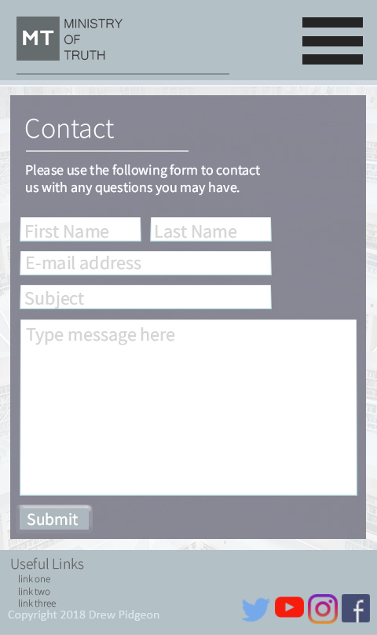
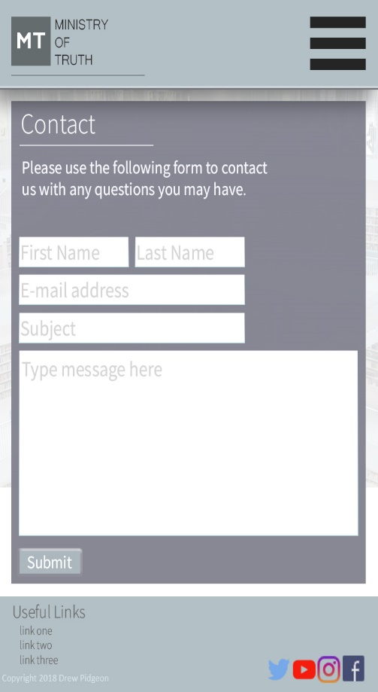
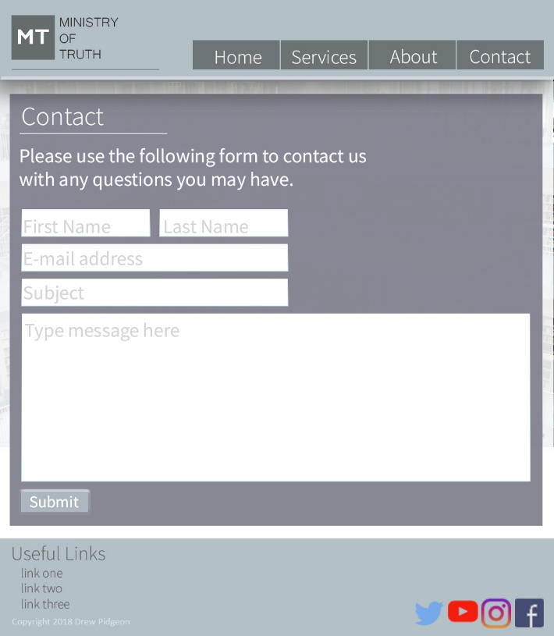
Mockups: Contact Page
Desktop
Tablet
Mobile

Slide 6
Website
https://pidg0015.github.io/final

Slide 7
Two Content Layout with Table
First bullet point here
Second bullet point here
Third bullet point here
Class | Group A | Group B
Class 1 | 82 | 95
Class 2 | 76 | 88
Class 3 | 84 | 90

Slide 8
Two Content Layout with SmartArt
Group A
Task 1
Task 2
Group B
Task 1
Task 2
Group C
Task 1
First bullet point here
Second bullet point here
Third bullet point here

Slide 9
Add a Slide Title - 1

Slide 10
Add a Slide Title - 2

Slide 11
Add a Slide Title - 3

Slide 13
Add a Slide Title - 4

Slide 14
Add a Slide Title - 5

