Slide 1

Notes:
[Sources]
README.md
frontend/app/assessment/page.tsx
frontend/app/results/page.tsx

Slide 2

Notes:
[Sources]
README.md
frontend/app/assessment/page.tsx
frontend/app/results/page.tsx

Slide 3
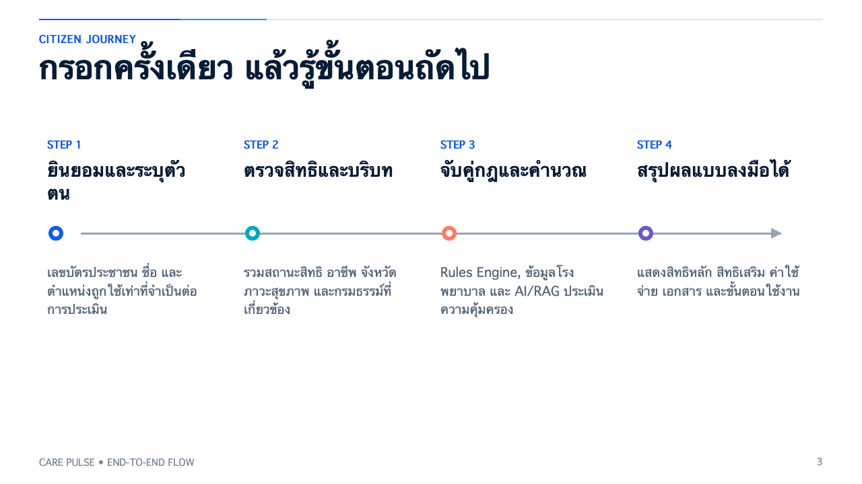
Notes:
[Sources]
frontend/app/assessment/page.tsx
frontend/app/results/page.tsx
frontend/lib/api.ts

Slide 4

Notes:
[Sources]
frontend/app/assessment/page.tsx
frontend/lib/types.ts
backend/app/services/ocr_document.py

Slide 5
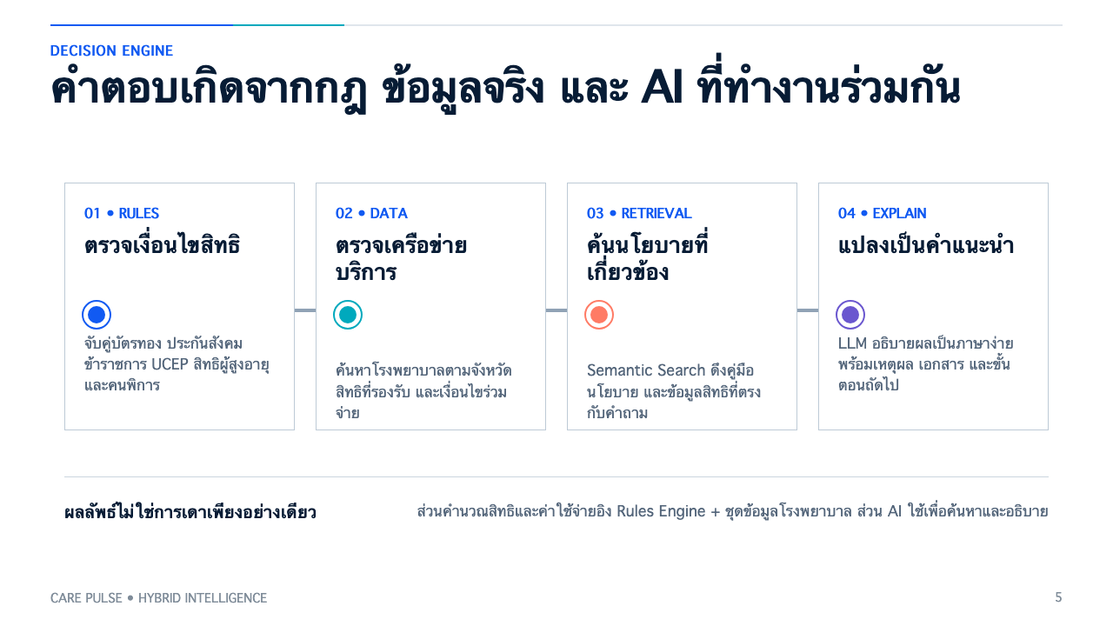
Notes:
[Sources]
backend/app/services/eligibility_engine.py
backend/app/services/cost_engine.py
backend/app/services/rag_service.py
backend/app/services/llm_service.py

Slide 6

Notes:
[Sources]
frontend/app/results/page.tsx
backend/app/services/eligibility_engine.py
backend/app/services/cost_engine.py

Slide 7

Notes:
[Sources]
backend/app/services/ocr_document.py
backend/app/services/rag_service.py
backend/app/services/llm_service.py
backend/app/services/pdpa_masking.py

Slide 8
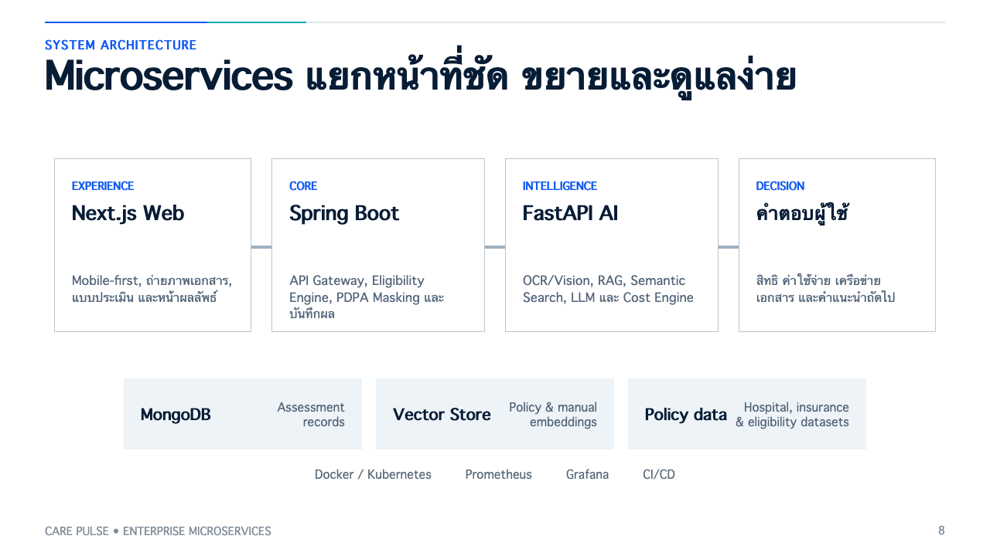
Notes:
[Sources]
README.md
docker-compose.yml
backend/app/main.py
springboot-service/pom.xml

Slide 9

Notes:
[Sources]
frontend/app/assessment/page.tsx
backend/app/services/pdpa_masking.py
backend/app/services/eligibility_engine.py
README.md

Slide 10

Notes:
[Sources]
README.md
frontend/app/assessment/page.tsx
frontend/app/results/page.tsx
Visual generated for this deck with OpenAI ImageGen; no external asset used.

Slide 11

Notes:
[Sources]
README.md
frontend/app/assessment/page.tsx
frontend/app/results/page.tsx
backend/app/services/eligibility_engine.py
backend/app/services/cost_engine.py
backend/app/services/rag_service.py

