Slide 1
OpenIOC
PRESENTED BY Sean Gillespie ⎪ August 19, 2014

Slide 2
Terminology
Tactics, Techniques, and Procedures (TTPs)
Intelligence – Information about threat actor tools and TTPs
Tool usage
Domains
File attributes
Evidence – The data in your collection systems
Indicator of Compromise (IOC) – matching evidence to intelligence
OpenIOC – An XML format for storing Indicators of Compromise

Slide 3
Overview
Low Value Use Cases
Storage and Transfer of Intelligence
List Matching Based Detection
High Value Use Cases
Rapid Scoping of Compromises
Sharing and Deployment of Operational TTPs
Required Tools and Concepts
The Power of OpenIOC
OpenIOC and You
PyIOCe
Anatomy of OpenIOC
Q&A

Slide 4
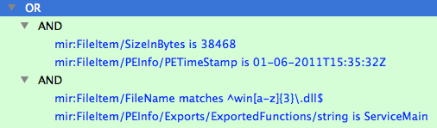
Storage and Transfer of Intelligence – Low Value
MD5 | 63d0…1bd7
Filename | winavg.dll
Size | 38468
Compile Time | 01-06-2011T15:35:32Z
Exports | ServiceMain
Sections | .text .data .idata .rsrc
Strings | Failed to open sockit
MD5 | a95c...d150
Filename | winssh.dll
Size | 38468
Compile Time | 01-06-2011T15:35:32Z
Exports | ServiceMain
Sections | .text .data .idata .rsrc
Strings | Failed to open sockit
MD5 | 831f…22ed
Filename | winzip.dll
Size | 54862
Compile Time | 05-24-2012T17:28:19Z
Exports | ServiceMain
Sections | .text .data .idata .rsrc
Strings | Failed to open sockit
MD5 | 323b...16f1
Filename | winhlp.dll
Size | 38468
Compile Time | 01-06-2011T15:35:32Z
Exports | ServiceMain
Sections | .text .data .idata .rsrc
Strings | Failed to open sockit
MD5 | 051b...f1ba
Filename | winrip.dll
Size | 24218
Compile Time | 07-14-2009T09:12:47Z
Exports | ServiceMain
Sections | .text .data .pinfo .rdata

Slide 5
List Matching Based Detection – Low Value
List maintenance
IOC quality
IOC ages
IOC duplication
Results are difficult to correlate to original intelligence
Wildly Inefficient
High false positive rate if IOCs aren’t extremely specific
High false negative rate if IOCs aren’t carefully crafted to detect variations
High true negative rate since most of what you are searching across does not match

Slide 6
Rapid Scoping of Compromises – High Value
Rapidly target specific aspects of a known compromise
Search for all executable files written to disk by ‘Bob’ in the last 30 days
Search for all instances of setup64.exe
Search for all registry entries containing \Oracle\
Search for MUICache/Prefetch evidence of setup.exe execution
Large result sets mitigated by Incident Responders having contextual knowledge of the current threat
Iterative process of refining IOCs and repeating searches

Slide 7
Sharing and Deployment of Operational TTPs – High Value
Operational IOCs are meant to describe forensically interesting sources of data or unique behaviors and attributes of malicious activity
Persistence mechanisms
Suspicious file attributes
Suspicious process attributes
Execution history locations
Recently opened documents locations
Browser history locations
Used for actively hunting interesting anomalies and rapidly processing forensic data
Serve as quick and functional references for training and consistency

Slide 8


Examples
Common Anti-Virus Evasion Technique
Common Lateral Movement Technique

Slide 9
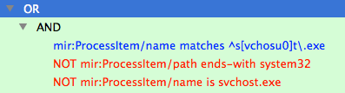
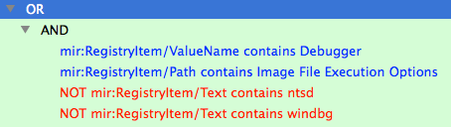
Examples
Common Default Hash Dumping Export
Common Malware Misspelling
Common Persistence Mechanism / Authentication Bypass Technique

Slide 10
Required Tools and Concepts
Editors – Tools to create and edit OpenIOC files
PyIOCe
Mandiant IOCe
Operational Systems – Systems that gather data
Splunk, Snort, GRR, MIR, Volatility, Yara
Parsers – Tools to turn OpenIOC files into operational inputs
MIR -> XPATH
GRR -> Flow inputs
Splunk -> Search
Snort -> Rules
Yara -> Sigs

Slide 11
The Power of OpenIOC
OpenIOC allows for simple intuitive descriptions of complex patterns
Indicator Logic – AND, OR
Term Conditions – is, contains, matches, starts-with, ends-with, greater-than, less-than
Term Modifiers– negate, case-sensitive
OpenIOC can be used for pivoting from known intelligence items
File info
File as a process
Registry values containing the filename
Execution history containing the filename (Prefetch/MUICache/Bit9)
Sharing TTP based OpenIOC files
Does not reveal confidential information
Does not aid attackers

Slide 12
The Power of OpenIOC
OpenIOCs are meant to be parsed to create inputs for operational systems
OpenIOC is best as a method for exchanging TTPs not intelligence
How to search for X with System Y not just what is X
There are better formats and methods for exchanging intelligence data
Global terms vs Operational System specific terms
Translation is complex and makes it easy to lose intended effects
Systems may have extreme variations in how they interpret and use terms

Slide 13
OpenIOC and You
Define your own terms
Terms can be used to describe anything an operational system is aware of
Specific data points
Flagged anomalies
Create term names that make sense for your operational system
Define your own parameters
Parameters can modify criteria or describe actions for operational systems
Create parameters that best reflect the capabilities of your operational system
Build your own parsers
It is up to you to decide what your system can do by combining custom terms and parameters

Slide 14
PyIOCe Key Features
Cross platform
Keyboard driven
Capable of working with OpenIOC 1.0 as well as 1.1
IOC cloning for rapid duplication for testing
Edit, import, and export of IndicatorTerm and Parameter lists to extend OpenIOCs for use with other operational systems
Term Maps to group terms with roughly equivalent content to assist in translating for other operational systems

Slide 15
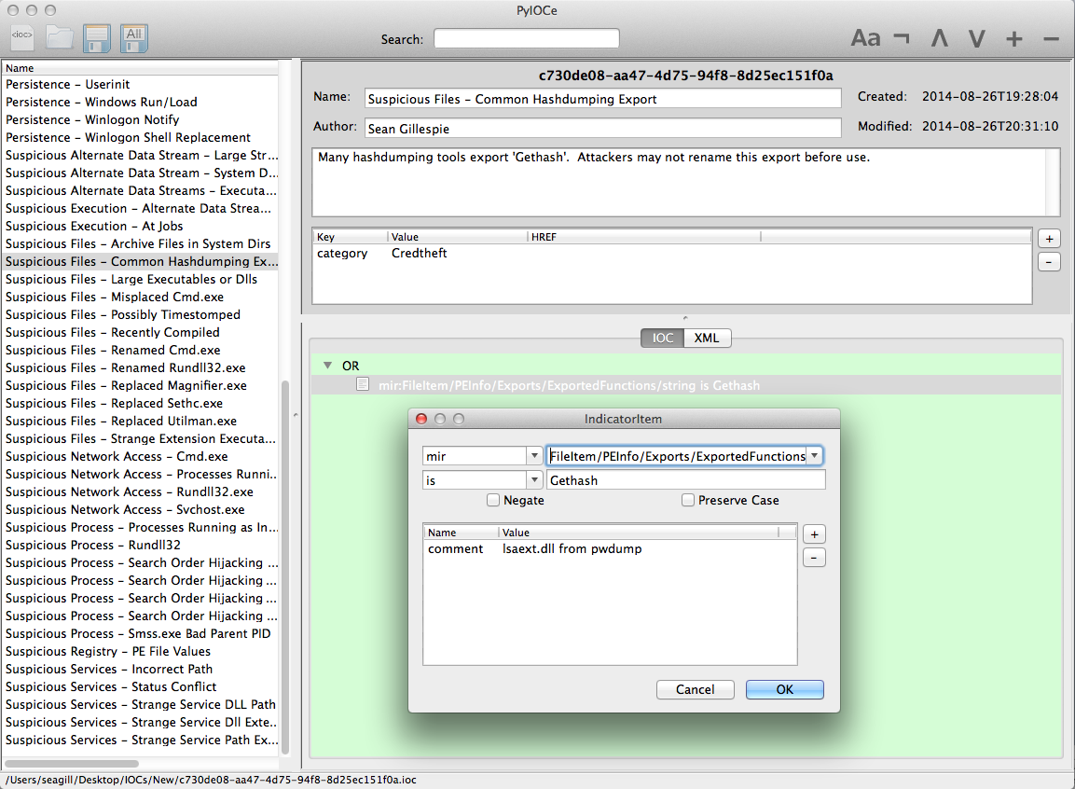
Anatomy of OpenIOC

Slide 16
Anatomy of OpenIOC
<OpenIOC xmlns:xsi="http://www.w3.org/2001/XMLSchema-instance" xmlns:xsd="http://www.w3.org/2001/XMLSchema" xmlns="http://openioc.org/schemas/OpenIOC_1.1" id="c730de08-aa47-4d75-94f8-8d25ec151f0a" last-modified="2014-08-26T19:49:18" published-date="0001-01-01T00:00:00">
<metadata>
<short_description>Suspicious Files - Common Hashdumping Export</short_description>
<description>Many hashdumping tools export 'Gethash'. Attackers may not rename this export before use.
</description>
<authored_by>Sean Gillespie</authored_by>
<authored_date>2014-08-26T19:28:04</authored_date>
<links>
<link rel="category">Credtheft</link>
</links>
</metadata>

Slide 17
Anatomy of OpenIOC
<criteria>
<Indicator id="9217c1ab-d389-454e-bf27-08ca1621c406" operator="OR">
<IndicatorItem preserve-case="false" negate="false" id="02b53389-3c51-4651-9449-962a468cb6b8” condition="is">
<Context document="FileItem" search="FileItem/PEInfo/Exports/ExportedFunctions/string" type="mir"/>
<Content type="string">Gethash</Content>
</IndicatorItem>
</Indicator>
</criteria>

Slide 18
Anatomy of OpenIOC
<parameters>
<param id="5315f26b-4b28-4472-bb36-a398e2bbe6c2" ref-id="02b53389-3c51-4651-9449-962a468cb6b8"
name="comment">
<value type="string">pwdump</value>
</param>
</parameters>
</OpenIOC>

Slide 19
Overview
Low Value Use Cases
Storage and Transfer of Intelligence
List Matching Based Detection
High Value Use Cases
Rapid Scoping of Compromises
Sharing and Deployment of Operational TTPs
Required Tools and Concepts
The Power of OpenIOC
OpenIOC and You
PyIOCe
Anatomy of OpenIOC
Q&A

Slide 20
Q&A

