Slide 1
Human Hunting
PRESENTED BY Sean Gillespie ⎪ April 20, 2015

Slide 2
Summary
General Automation & Tools
About the Adversary
Preparations for Hunting
Hunting Examples
Q&A

Slide 3
Automation is Great…
ID badge access using scanned & visual validation
Complex logistics and battlefield management
EMR patient validation for blood and meds
Critical factors include skilled humans making final decisions

Slide 4
...Except When It Isn’t
Air France 447
Asiana 214
2003 Northeast Blackout
F-22 dateline failure
Critical factors included over reliance on automation

Slide 5
A Tale of Two Systems
Airbus tends to engineer towards a pilot serving a machine
Boeing tends to engineer towards a machine serving a pilot
This fundamentally alters behavior of plane and pilot

Slide 6
Shall We Play A Game
We can build computers to compete with highly skilled Chess players
At substantial cost for the most successful systems
We can’t build computers to compete with highly skilled Go players
The more variables/branching the more humans outperform machines

Slide 7
And the Moral Is…
Automation is good at doing the heavy lifting to enhance capabilities
Repetitive tasks
Exact sorting/categorization
Accurate calculations
Large data sets
Automation is bad at replacing highly skilled humans
Pattern recognition
Data interpretation
Fuzzy sorting/categorization
Bluffing & misdirection

Slide 8
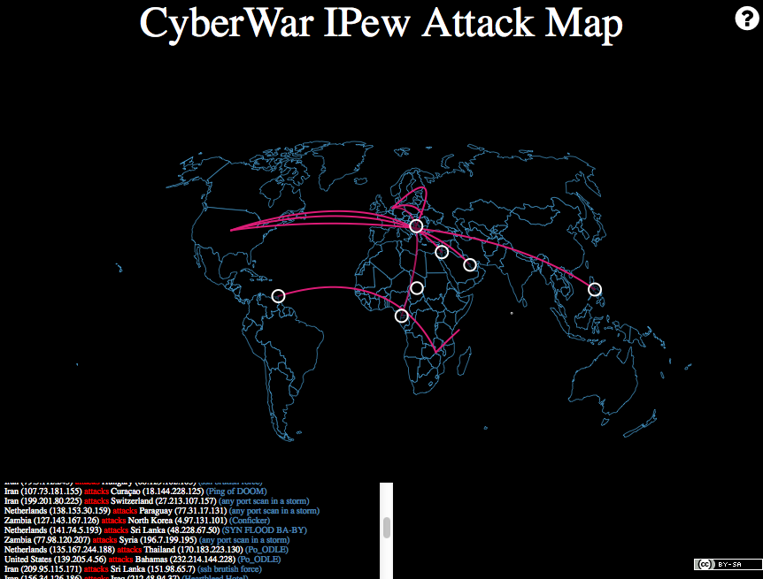
CyberWar

Slide 9
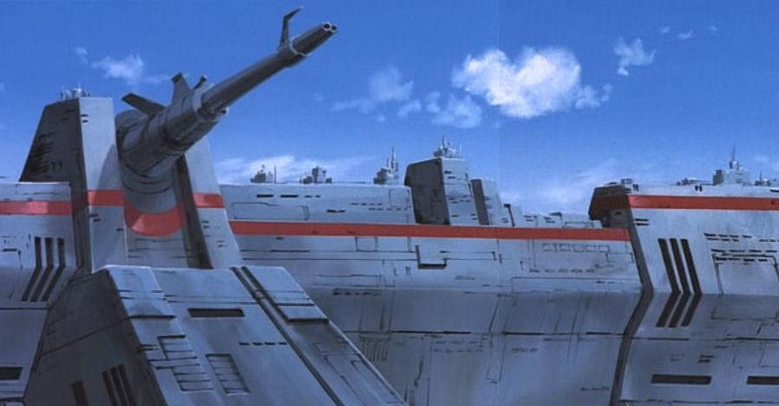
CyberBase

Slide 10
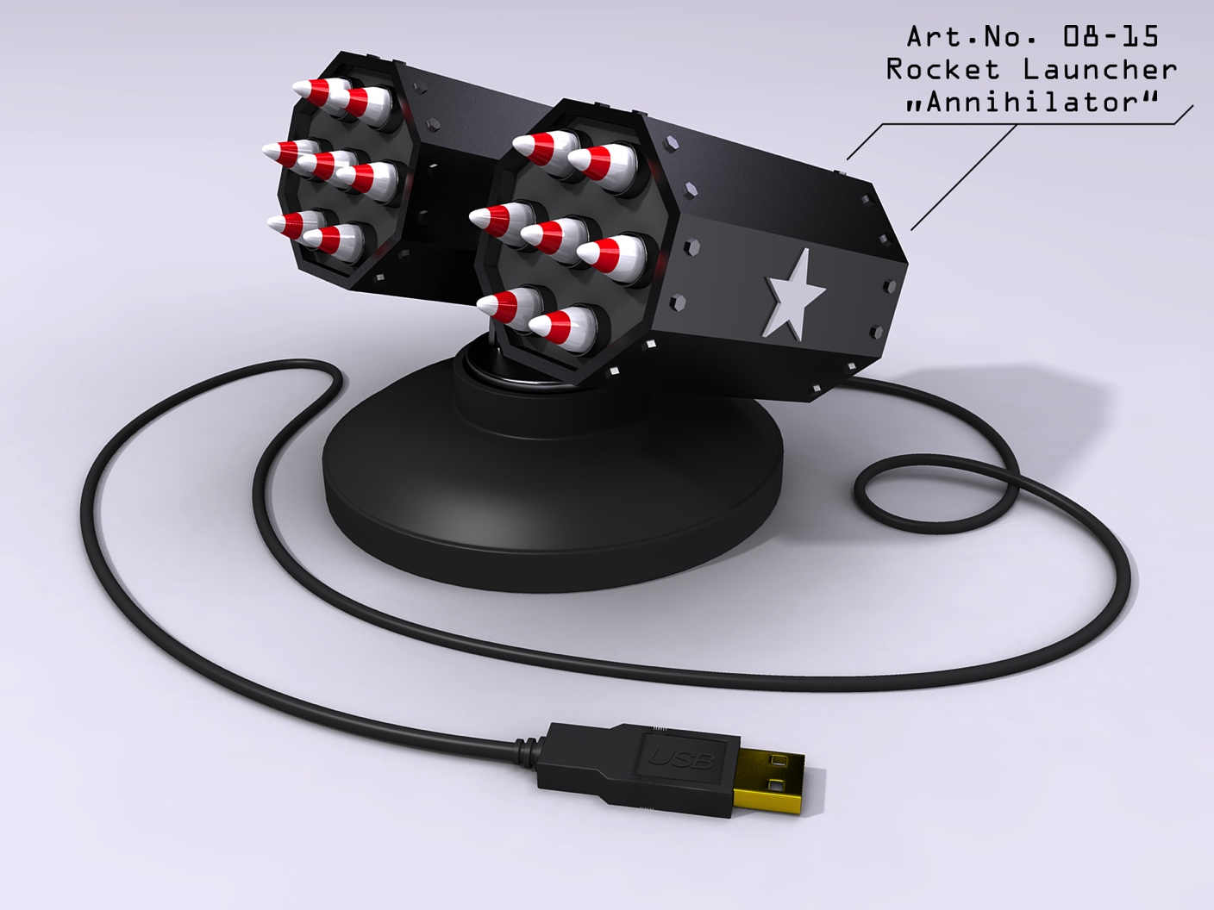
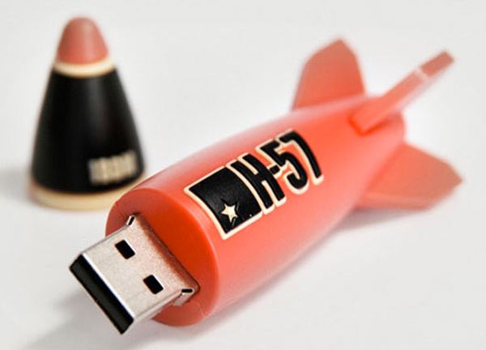
CyberMissiles
Remote Attacks
Local Attacks

Slide 11
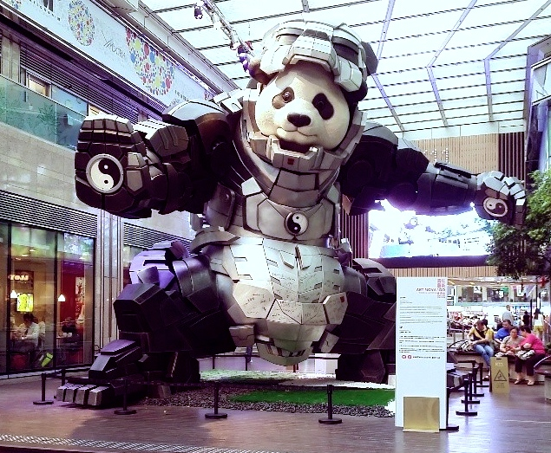
CyberEnemies
APT1

Slide 12
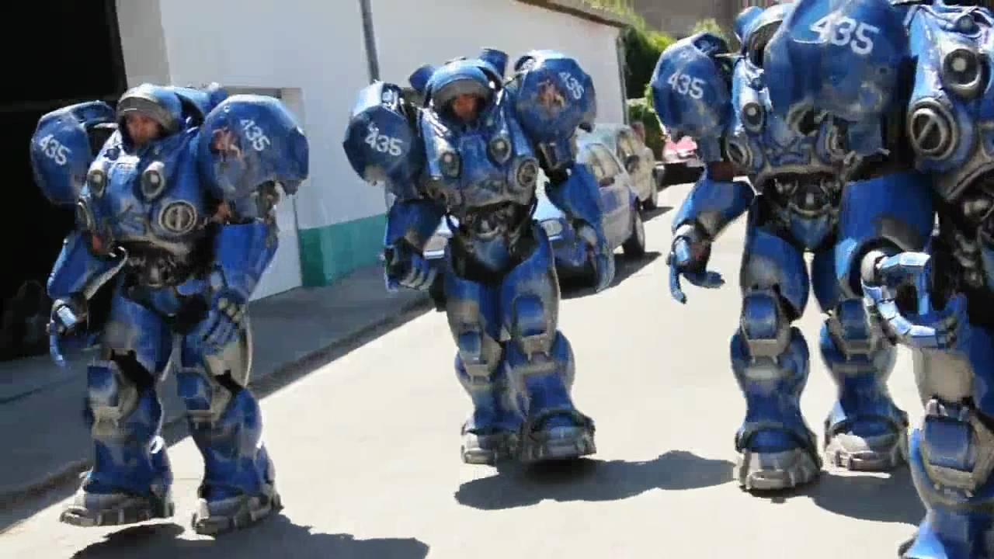
CyberWarriors
Data Marines

Slide 13
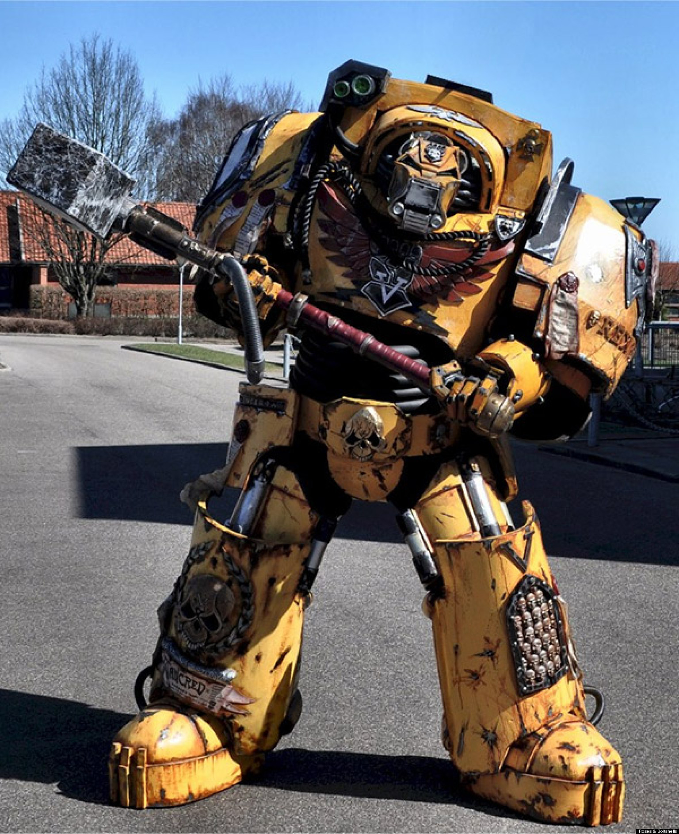
CyberWeapons
Ban Hammer

Slide 14

Automatic Real-time Detection Using Cloud Based Big Data Threat Intel Driven Machine Learning for Rapid Containment of Malicious Anomalies at Scale in Enterprise Networks
Heavy vendor focus on magic black boxes that replace humans
Very few with interfaces for analysts
Over reliance on automation to find evil

Slide 15
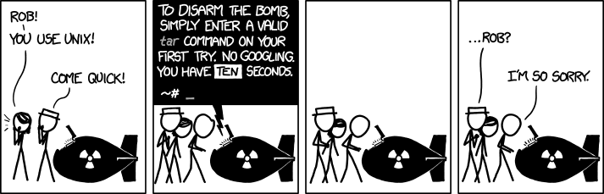
Do --You --Have --A --Flag?
Community builds a lot of excellent tools
Often overly complex usage with minimal documentation
Tools rarely scale well

Slide 16
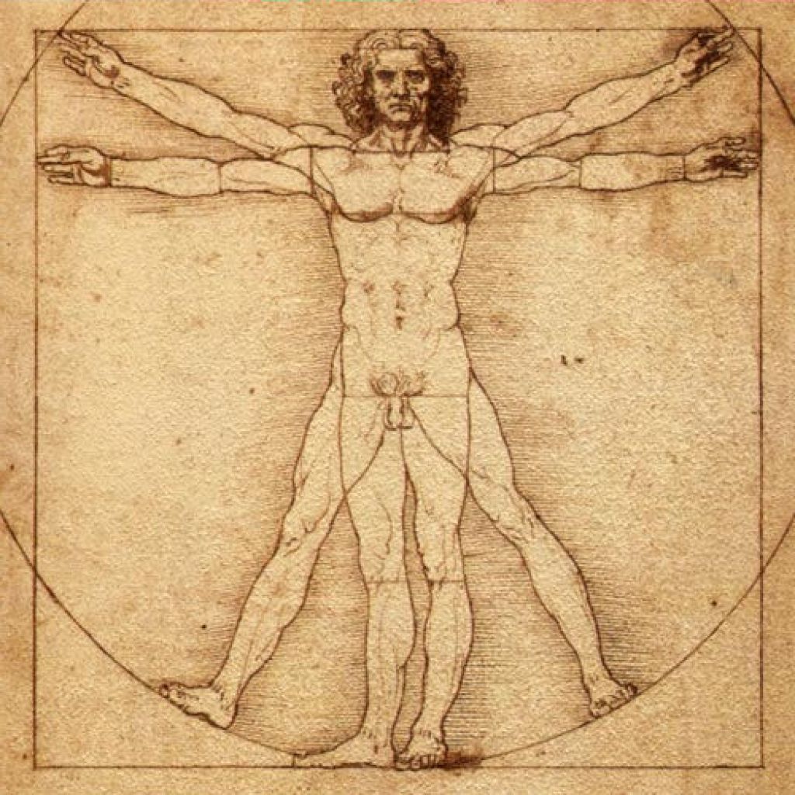
The Adversary – The Most Dangerous Game
Very creative
Very adaptive
Highly skilled
Highly focused

Slide 17

What You Need to Hunt
Collection Systems
Event logging
Host sensors & interrogation
Network sensors
Alert Management
Severity classification
Resolution status
Notes
Threat Research
Books & reports
Sandbox analysis
Threat Intel data
Host
Interrogate
Host
Sensors
Malware
Analysis
Alert
Mgmt
Network
Sensors
Central
Logging

Slide 18

Human Adversary – Human Defender
Alert validation
Effective response
Predict emerging threats

Slide 19
Collection Systems
Stream Capture
Captures state changes
Ongoing timeline of events
Good for investigations
Good for signatures/searches
Large volumes of data to handle
State Capture
Captures present state
Further historical reach of data
Good for discovery of new threats
Good for forensics
Gaps in timeline

Slide 20
Alert Management
Object Oriented Alerting
UIs should be tailored for data type
Relatively simple and intuitive
Allow searching & pivoting
Stacking similar data/alerts
Data tagging & reporting
Examples: Snorby & ePO (With proper dashboards)

Slide 21
Threat Research
Books
System operations
Forensics & malware
Analysis lab
Malware analysis
Protocols
Techniques
Threat Intelligence
Reports
Malware databases
Intel sharing/feeds
Red vs Blue practice

Slide 22

Host Interrogation With GRR & ForensicArtifacts
GRR Rapid Response is an incident response framework focused on remote live forensics.
https://github.com/google/grr
https://github.com/google/rekall
https://github.com/sleuthkit/sleuthkit
https://github.com/ForensicArtifacts/artifacts

Slide 23
Hunting with GRR
State capture type collection system
State machine based operation
Cross-platform
Scriptable
Server side parsing
Limited client side filtering

Slide 24
GRR Overview
Flow – The unit of work for GRR. Flows can call a sequence of client actions, processes results, perform server maintenance, or reporting tasks. Flows are written in python and stored on the server.
Hunts – Mechanism for running a Flow across a fleet of clients. When a client checks it will be evaluated against the criteria of the Hunt. Scheduling is determined by rules, client rate, client limit, and hunt expiration.
Artifact – Yaml defined “point of interest” for forensics. Examples include crontab files or Windows RunKeys.

Slide 25
Interesting or Common Flows
Interrogate
ArtifactCollectorFlow
FileFinder
RegistryFinder
AnalyzeClientMemory
MemoryCollector
Netstat
ListProcesses
LaunchBinary

Slide 26
Preparations & Process
Create an Artifact to collect your Live Response data from a host
Create Hunt with that Flow that only applies to an “LR” label
Create Hunts with hunting Flows
Validate Hunt results and apply “LR” label to any suspected hosts

Slide 27
What to Hunt
Process
Bad parents
Unique processes
Open connections
Registry
Persistence
Authentication manipulation
Services & Daemons
Wrong configuration
Unique services
Files
Obfuscated files
Suspicious placement
Scheduled Tasks & Cronjobs

Slide 28
What to Hunt
Threat Research
Think about evasion
Think about evidence
Generalize specific attacks into solid indicators for hunting

Slide 29
How to Hunt
Use generalized Artifacts
Bulk collection where possible
Filtered collection where impractical
Use Artifacts with parsers when available
Use API or console to extract results
Stacking & Filtering

Slide 30
The Hunt Begins
WindowsCommonFilePlacementAttacks
WindowsRunKeys
OSXLaunchDaemons

Slide 31
File Placement
name: WindowsCommonFilePlacementAttacks
doc: Common files associated with search order hijacking and other file placement attacks
collectors:
- collector_type: FILE
args:
path_list:
- '%%environ_systemdrive%%\program.exe’
- '%%environ_systemroot%%\System32\oci.dll’
- '%%environ_systemroot%%\ntshrui.dll'
- '%%environ_systemroot%%\System32\sysprep\cryptbase.dll’
… list truncated to use a visible font size
supported_os: [Windows]

Slide 32
Stacked Results
1 /C:/Windows/System32/oci.dll,1015808
1 /C:/Windows/System32/sysprep/CRYPTBASE.dll,81408
2 /C:/Windows/System32/Utilman.exe,785920
2 /C:/Windows/System32/sethc.exe,776192
7 /C:/Windows/System32/Utilman.exe,82432
7 /C:/Windows/System32/sethc.exe,270336
37 /C:/Windows/System32/Utilman.exe,81920
37 /C:/Windows/System32/sethc.exe,268288
5018 /C:/Windows/System32/Utilman.exe,1402880
5018 /C:/Windows/System32/sethc.exe,279040

Slide 33
Registry Keys
name: WindowsRunKeys
collectors:
collector_type: REGISTRY_KEY
args:
path_list:
- 'HKEY_USERS\%%users.sid%%\Software\Microsoft\Windows\CurrentVersion\Run\*’
- 'HKEY_LOCAL_MACHINE\Software\Microsoft\Windows\CurrentVersion\Run\*’
… list truncated to use a visible font size
labels: [Software]
supported_os: [Windows]

Slide 34
Stacked Results
1 C:\Users\aaaa\AppData\Local\Vidyo\Vidyo Desktop\VidyoDesktop.exe
1 C:\Users\bbbb\AppData\Local\Vidyo\Vidyo Desktop\VidyoDesktop.exe
1 C:\Users\cccc\AppData\Local\Vidyo\Vidyo Desktop\VidyoDesktop.exe
1 C:\Users\dddd\AppData\Local\Vidyo\Vidyo Desktop\VidyoDesktop.exe
1 C:\Users\eeee\AppData\Local\Vidyo\Vidyo Desktop\VidyoDesktop.exe
1 C:\Users\ffff\AppData\Local\Vidyo\Vidyo Desktop\VidyoDesktop.exe
1 C:\Users\gggg\AppData\Local\Vidyo\Vidyo Desktop\VidyoDesktop.exe
1 C:\Users\hhhh\AppData\Local\Vidyo\Vidyo Desktop\VidyoDesktop.exe
…

Slide 35
egrep "[A-Z]:\\\\[A-Za-z0-9]+:[A-Za-z0-9\.]+"
regsvr32 /s "C:\Temp:1A2A61B8.dat"
regsvr32 /s "C:\Temp:02357D83.dat"
aff4:/<CLIENT_ID>/registry/HKEY_USERS/<SID>/Software/Microsoft/Windows/CurrentVersion/Run/svchost

Slide 36
egrep “vb[se]”
wscript.exe //B "C:\Users\aaaa\AppData\Local\Temp\dopgglqblq..vbe”
wscript.exe //B "C:\Users\bbbb\AppData\Local\Temp\myphyoljsc..vbs”
wscript.exe //B "C:\Users\cccc\AppData\Local\Temp\fklxtwwwbv..vbs”
wscript.exe //B "C:\Users\dddd\AppData\Local\Temp\ozkvgpcbtp..vbs”
wscript.exe //B "C:\Users\eeee\AppData\Local\Temp\krqvsfjxld.vbs”
wscript.exe //B "C:\Users\ffff\AppData\Local\Temp\fyzbnaksvu..vbs”
wscript.exe //B "C:\Users\gggg\AppData\Local\Temp\gsiiwnbhjk.vbs”
aff4:/<CLIENT_ID>/registry/HKEY_USERS/<SID>/Software/Microsoft/Windows/CurrentVersion/Run/gsiiwnbhjk

Slide 37
File Content
name: OSXLaunchDaemons
doc: Mac OS X Launch Daemons files.
collectors:
- collector_type: FILE
args:
path_list:
- '/Library/LaunchDaemons/*'
- '/System/Library/LaunchDaemons/*'
- '%%users.homedir%%/Library/LaunchDaemons/*'
labels: [System]
supported_os: [Darwin]
urls: ['http://www.forensicswiki.org/wiki/Mac_OS_X']

Slide 38
Stacking & grep “apple”
1 /Library/LaunchDaemons/com.apple.globalupdate.plist
Program: /usr/bin/globalupdate
1 /Library/LaunchDaemons/com.apple.machook_damon.plist
Program: /usr/local/machook/machook
WatchPaths: /usr/local/machook/watch.sh

Slide 39
Stacking & grep “apple”
/usr/bin/globalupdate – Missing File
/usr/local/machook/watch.sh –
/usr/local/machook/machook – Wirelurker MD5
jobid=`ps -ef |grep machook |grep -v "grep" |wc -l`
if [ $jobid -eq 0 ];then
/usr/local/machook/machook &
fi
updateid=`ps -ef |grep globalupdate |grep -v "grep" |wc -l`
if [ $jobid -eq 0 ];then
/usr/bin/globalupdate &
fi

Slide 40
Coming Soon…ish
More parsers
Better searching based on file type/contents
Better filtering for Artifacts/Flows
Better tools for working with GRR data
Tagging
Filtering
Comments
History

Slide 41
Advanced Hunting
Process execution/AV logs fueling binary or LR capture
Beacon detection or network alerts trigger investigative Flows
Automatic delivery of acquired files to malware analysis

Slide 42
FIN
We need more automation that enhances human capabilities
We need more focus on hunting/alert validation skills
We need higher quality threat data and sharing
We need to stop looking for magic unicorns

Slide 43
Q&A @pidydx

