Slide 1
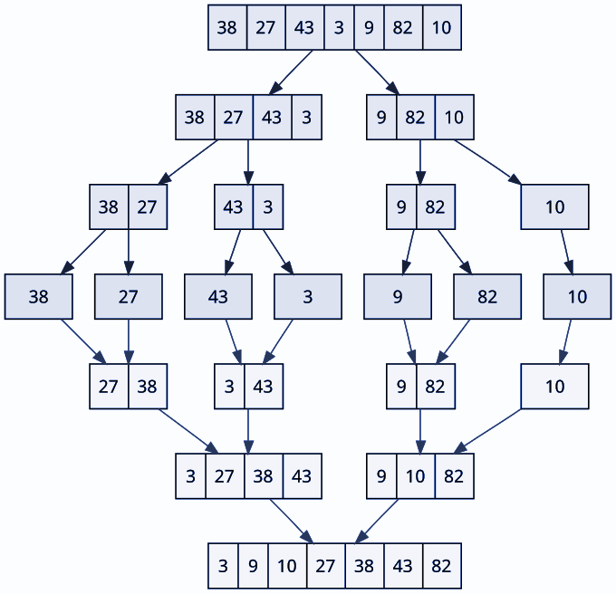
Divide and Conquer: Merge Sort
By: Pieter Alley and Juan Carlos Plate

Slide 2
Algorithm Overview
Divide and Conquer
About Merge Sort
Purpose
Break up the problem at hand into several subproblems
Solve each subproblem
Combine the solutions to reach the overall solution
Divide original input in halves until each sublist contains one element
Recursively sort each sublist
Combine the sorted sublist to get the solution
Merge sort is used to efficiently sort very large datasets.

Slide 3
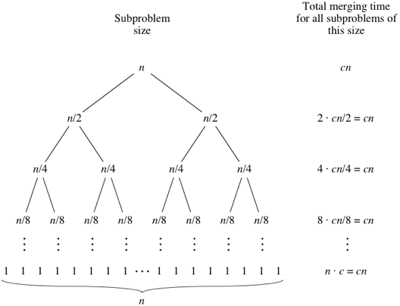
Recurrence Tree

Slide 4
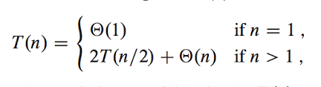
Recurrence Relation

Slide 5
Pseudo Code
MergeSort (Array(First..Last))
Begin
If Array contains only one element Then
Return Array
Else
Middle= ((Last + First)/2) rounded down to the nearest integer
LeftHalfArray = MergeSort(Array(First..Middle))
RightHalfArray = MergeSort(Array(Middle+1..Last))
ResultArray = Merge(LeftHalfArray, RightHalfArray)
Return ResultArray
End

Slide 6
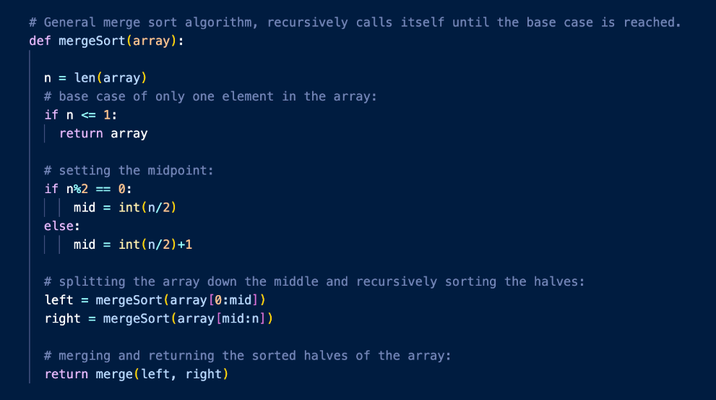
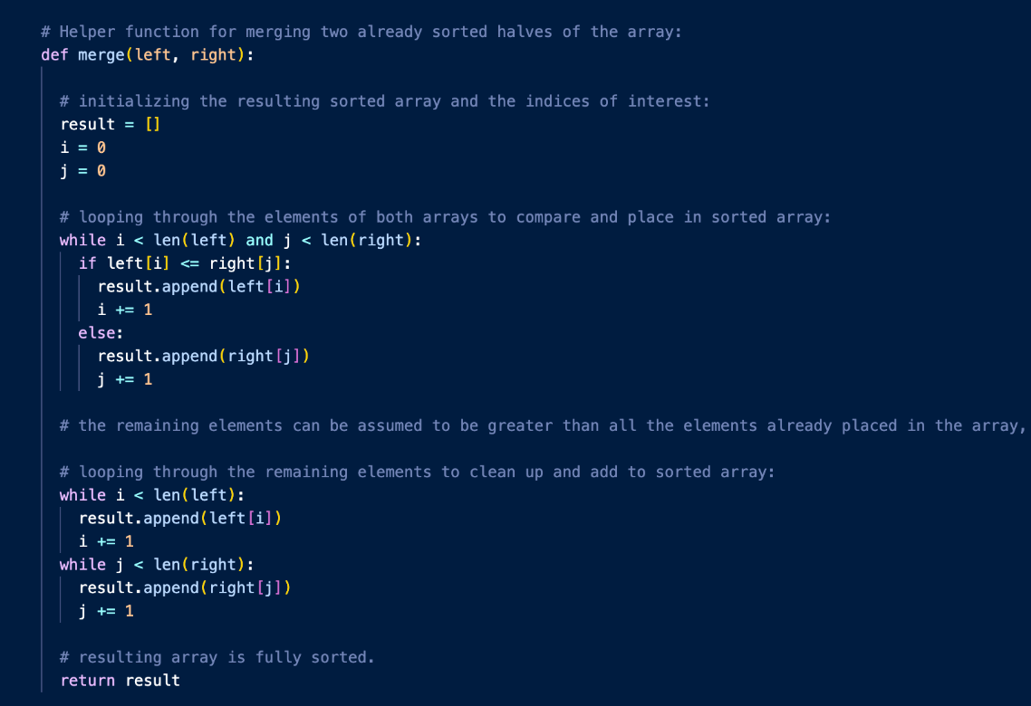
Merge Sort Implementation
Worst Case Example:
[5, 1, 7, 3, 6, 2, 8, 4]

Slide 7
Real-World Applications
Sorting Large Datasets
External Sorting
Inversion Counting
Sorting Linked List
Programming Language libraries

Slide 8
Timsort
Default built-in sorting algorithm for Python and Java.
Hybrid, stable-sorting algorithm, derived from merge sort and insertion sort
Implemented by Tim Peters in 2002 for use in the Python programming language
Iterates over the data collecting elements into runs and simultaneously putting those runs in a stack.
Whenever the runs on the top of the stack match a merge criterion, they are merged.

Slide 9
Implementation Details
Challenge 1
Challenge 2
The first challenge in merge sort is splitting the array into subproblems and sorting them recursively. In order to do this we split the array down the middle and recursively sort each half.
After we have sorted all of the subproblems we need to merge the solutions to get our final solution. We do this by comparing both the left and right subarrays until all elements are inserted.

Slide 10
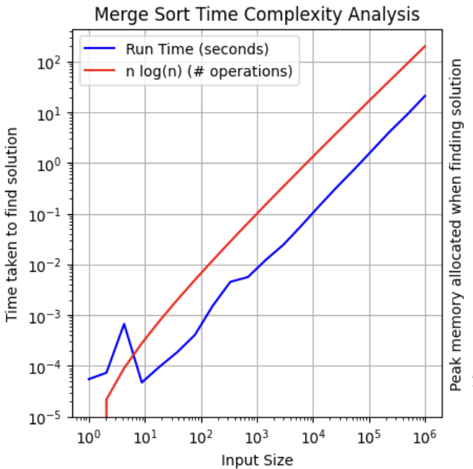
Performance Analysis
Running Time

Slide 11
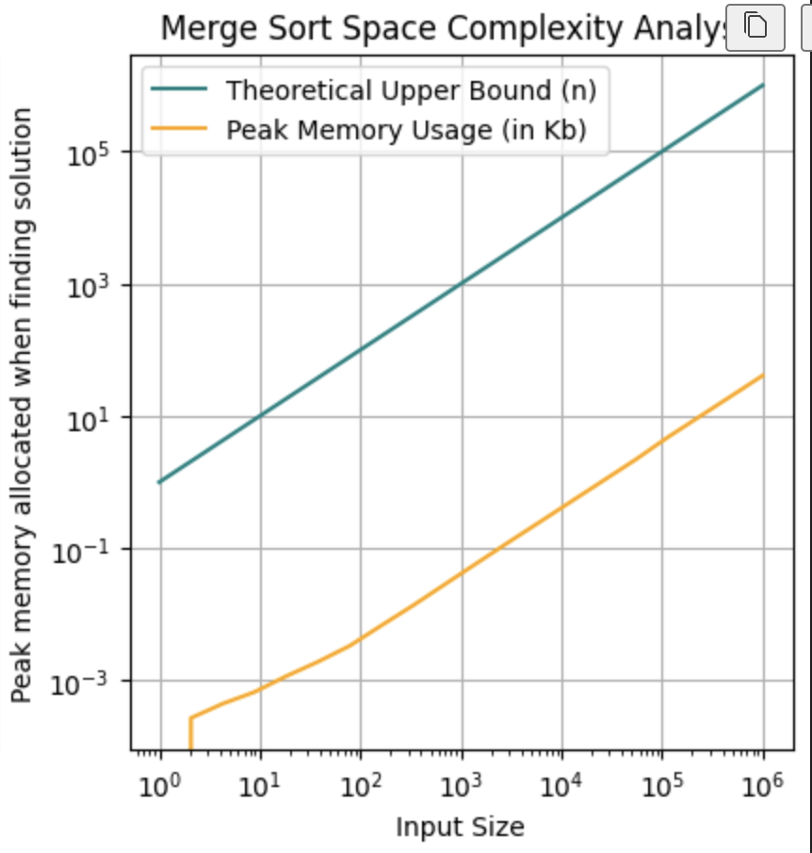
Performance Analysis
Memory Usage

Slide 12
Strengths
Limitations
Time complexity
Scalability
Memory Efficiency
Stable Sorting
Temporary Space
Recursive Nature
Not in-place

Slide 13
Improvements
We noticed that merge sort does not perform well for already sorted inputs
Algorithm still performs O(n logn) operations
Solution: Before anything check to see if input is sorted
Improves time complexity to O(n)

Slide 14
Conclusion
Merge sort is a divide-and-conquer algorithm
The divide-and-conquer structure guarantees that the time complexity will always be O(n log(n)) no matter what size input it takes.
Trade-offs:
Uses temporary space to sort subproblems
Recursive nature can make it unintuitive to new coders.
Guaranteed time complexity and scalability make for an extremely powerful tool for sorting and processing large data sets.

Slide 15
Thank You!

