Slide 1
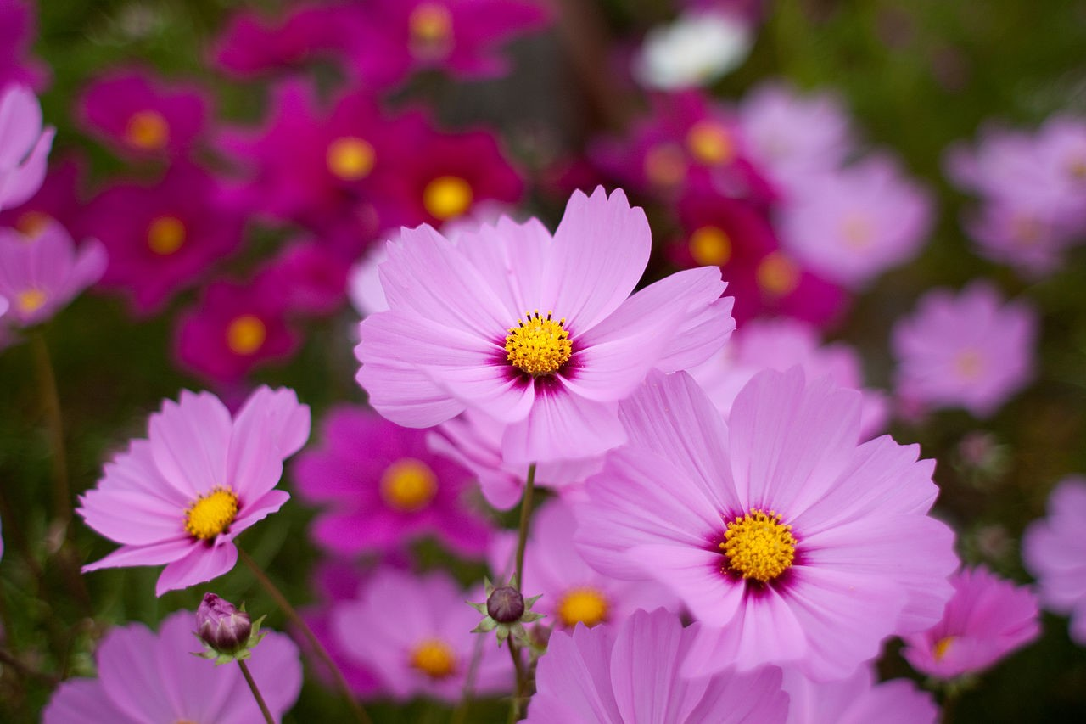




Quit to desktop
FlowerOS public_beta2
8:47 AM
App Store
Quiz Game
Preview
Rating

