Slide 1
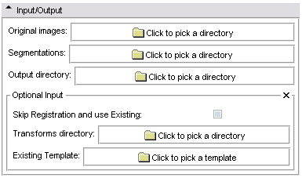
The directory containing
original images
The directory containing
segmentations
The output directory
Skip Registration Mode
The directory containing
existing transforms
The existing template

Slide 2
