Slide 1
Team 3 Movie Analysis
Naheem Olaniyan, Nishchint Upadhyaya, Pierce Nordeng, Rakhi Karki, Zachary Vincent

Slide 2
Business Problem
Analyze box office performance (total gross revenue) for the top hundred movies per year in the last two decades (1999-2018) in order to see what possible variables might have an impact on the box office performance of a movie.

Slide 3
Methodology
Data collection
Tableau
Excel/Access cleaning/pairing
Python/Jupyter for model

Slide 5
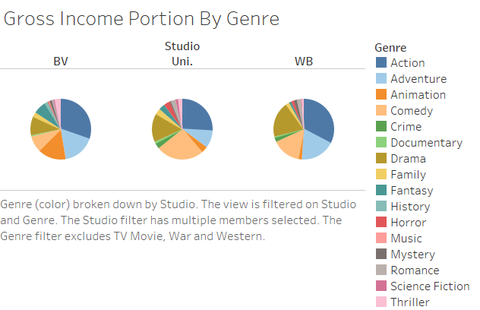
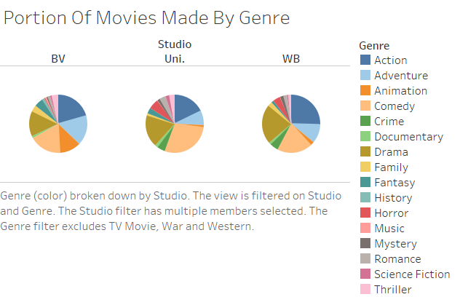

Slide 6
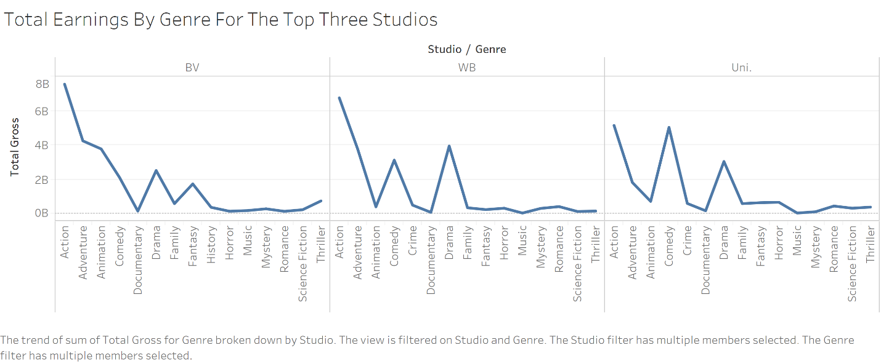

Slide 7
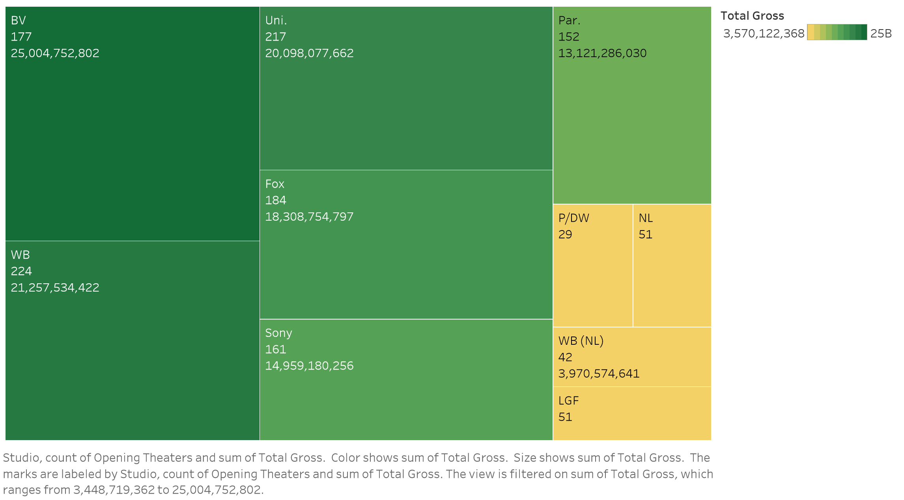
Studio Number of Movies and Total Gross

Slide 8
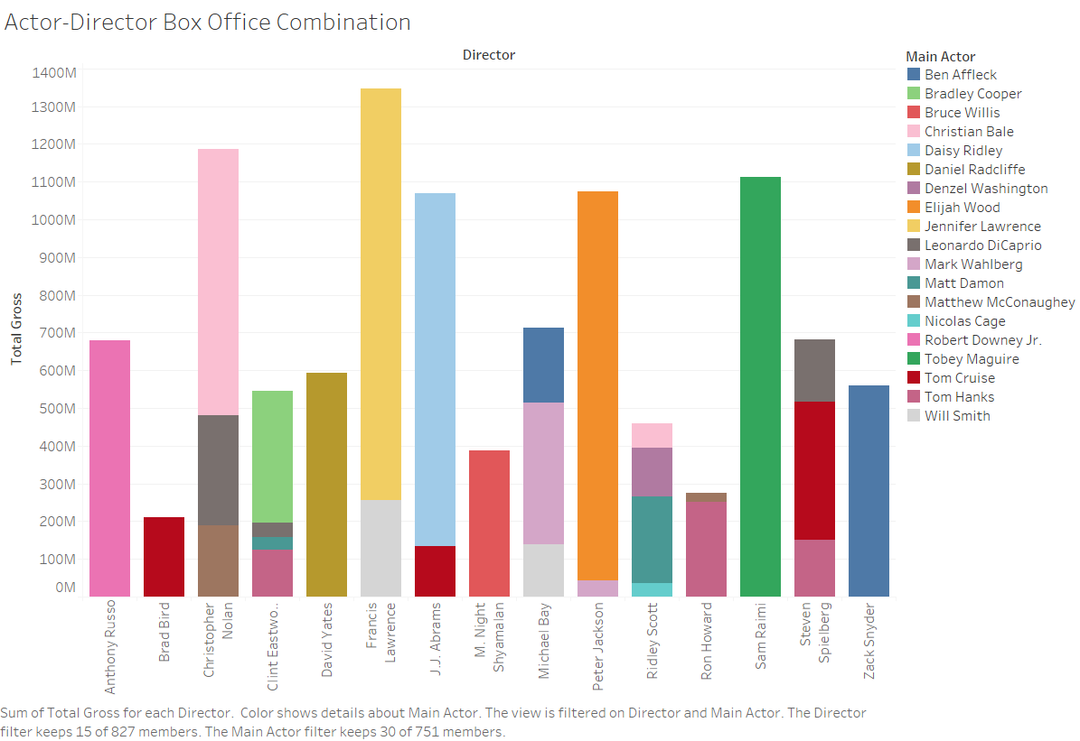
Actors may work well with a certain director.
There are combinations in this where they have worked together for different movies.
Examples
Studios can use this data when planning a new movie.

Slide 9
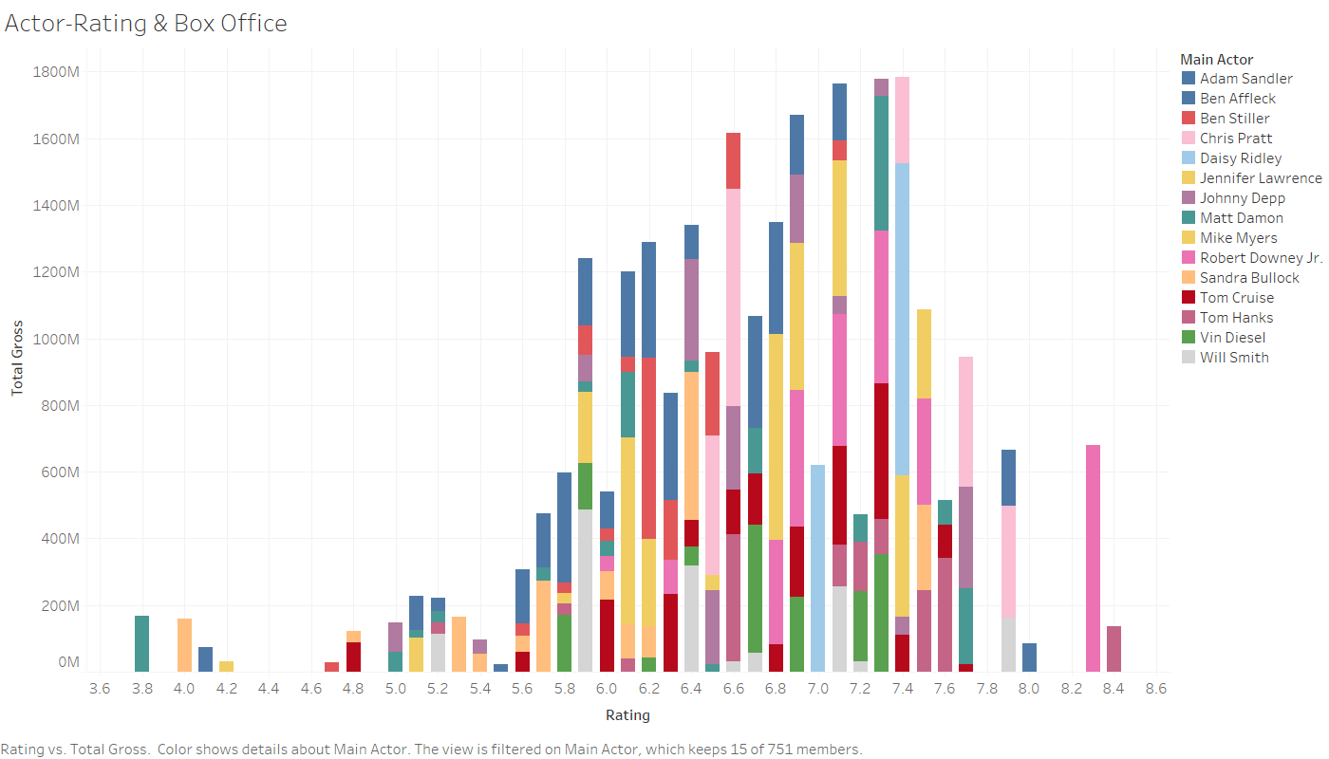
Low rating movies can also be a box office success
Chris Pratt and Will Smith are good examples in this visualization
These actors have a higher chance of making a movie a success.
Benefits Studios and Directors.

Slide 10
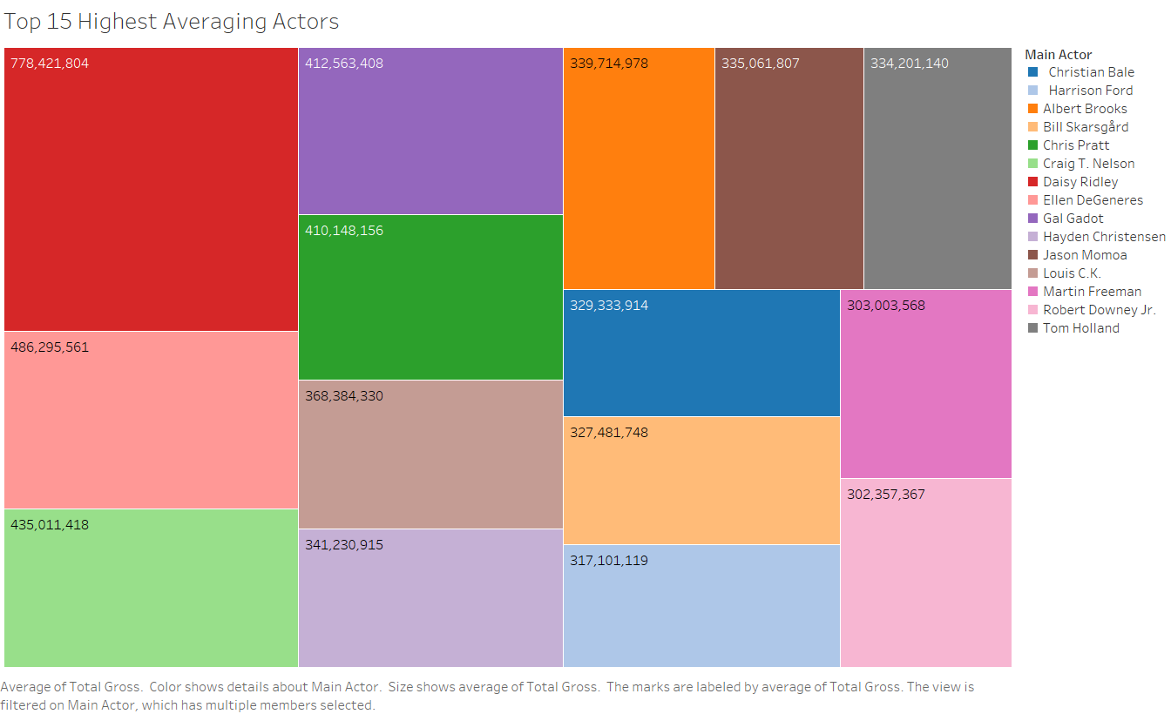
Highest Average Grossing Actors Of The Last 20 Years (1999-2018)
Daisey Ridley ($778,421,804)
Ellen DeGeneres ($486,295,561)
Craig T. Nelson ($435,011,418)
Gal Gadot ($412,563,408)
Chris Pratt ($410,148,156)

Slide 11
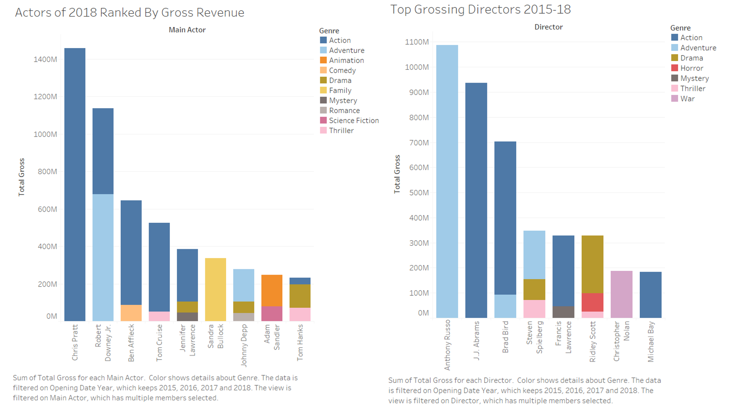

Slide 12
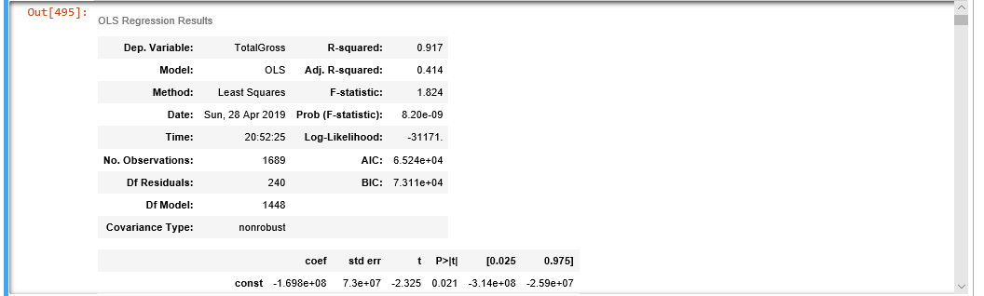
Logistic Regression
Variables used; Ratings,Release Month, Director,Actor,Genre,Studio
R Squared = 0.917
Adjusted R Squared = 0.414

Slide 13
Limitations
Limited access to reputable reviews
Unable to get information for some movies in dataset
Multiple genres/actors/directors for movies, had to choose the main one

Slide 14
Conclusion
There are a lot of factors that can determine the box-office success of a movie. Based on our dataset, these factors include the studio, actor, director, month of release and rating.
Therefore, the data that we collected can hugely benefit movie studios determine which actor-director combination can do a good job and generate the most revenue for a movie.
The data also benefits smaller theaters. Since they have fewer screens and have to decide what to show to maximize revenue.

