Slide 1
Call Detail Records for Human Mobility Studies
Taking Stock of the Situation in the “Always Connected Era”
Pierdomenico Fiadino (EURECAT, Spain)
Victor Ponce (Eurecat, Spain)
Juan Antonio Torrero (Orange Spain)
Marc Torrent (Eurecat, Spain)
Alessandro D’Alconzo (AIT, Austria)
Big-DAMA 2017, Los Angeles

Slide 2
What are CDR
CALL DETAIL RECORDS (CDRs)
CDRs are tickets to support operators’ billing procedure, summarizing a transaction, such as a call, text message or data connection.
Fields:
Types of recorded transaction:
User IDs (anonymized*)
calls (inbound and outbound)
Timestamp
SMS (inbound and outbound)
Cell info (ID, type, coordinates)
data connection (beginning of PDP context)
Action type
Others (routing, bill data, etc.)
*still, user metadata might be available (age, gender, post code, etc.)

Slide 3
CDRs and Human Mobility
Geo-localization of user actions
user A receives call at t₀
A
* The actual radio planning is in general more complex
(cell sectors, overlapping areas, umbrella cells, etc.)
cell #1
coverage area of cellular base stations*
cell #2
cell #4
cell #3
_{example of a transaction}
user_id | timestamp | action_type | cell_id | …
A | t₀ | inbound_call | 2 | …
user_id | age | gender | rate | address
A | 30 | M | MyRateTM | Rambla, BCN
cell_id | type | latitude | longitude | …
2 | micro | 40.9220 | 1.7612 | …
dimension (user-related metadata)
dimension (cell-related metadata)

Slide 4
CDRs and Human Mobility
Opportunities and Caveats
The localization of actions allows reconstructing human mobility
Support large-scale studies of aggregated behaviors
Wide range of applications (socio-economical studies, transport optimization)
Rich data (not only positions, but also demo-graphic data: gender, nationality..)
Rather high data availability (depending on operator’s exploitation strategies)
Rich literature (preliminary studies/proof of concepts, but no real-world use, yet)
Caveats:
Designed for different purposes (i.e., billing)
Variable space granularity (location accuracy, depending on cell towers)
(Historically) low time granularity (umber, frequency and uniformity of samples)

Slide 5
CDRs and Human Mobility
Time and Space granularity: actual mobility vs. perceived mobility
Location accuracy depends on cell position and radio planning
Actual user/handheld trajectory
Recorded actions (antenna position)
Usually not a big issue, depending on applications (urban radio planning is usually rather dense)
Perceived trajectory (from CDRs)
Main CDR limitation:
limited time granularity
User’s location only “visible” when an action occurs
Low time granularity = low accuracy in tracking users
Old literature shows that CDR are characterized by low time granularity. Is that changed?

Slide 6
OUR GOAL
Premise: past literature highlights the limited time granularity of CDRs
Question: has this changed?
Characterize the quality of
mobility information provided by CDRs
considering nowadays cellular usage patterns

Slide 7



Hard-facts and infrastructure
 | DS2014 | DS2016
Collection period | Q3-2014 | Q2-2016
Geographical area | Nation-wide (Spain)
Length | 31 days
# records/day | 350 million | 1.1 billion
# users/day | 9 million | 11 million
Data volume/day | 50GB (compressed) | 120GB (compressed)
6-nodes cluster (1 master, 5 workers)
48 CPUs, 192GB memory, 10TB storage
Hadoop Distributed File System (HDFS)
Apache HIVE (for ETL and pre-processing)
Apache Spark (for data analytics)

Slide 8
Cellular traffic type, from 2014 to 2016
Radical change in usage patterns: more data connection and “always on” apps
Data connection users: from ~50% in 2014 to ~85% in 2016
2G/3G/4G users generate more actions and more frequently

Slide 9
Increased action rate
# tickets | ds2014 | ds2016 | ∆
SMS/day | 0.5 | 0.1 | -0.4
CALLS/day | 1.8 | 2.5 | +0.7
DATA/day | 10.9 | 50.1 | +36.9
TOTAL/day | 13.2 | 52.7 | +39.5
Key observations:
SMS became marginal (replaced by instant messaging apps over 3G/4G)
Small increase of voice calls (increment of flat rates, restrained by VoIP)
Extremely high increase of data-related tickets (even considering data-users only)
Overall increase of average number of records per day per user: 50% of users generate at least 50 actions per day (only 10% did the same in 2014)

Slide 10
Data quality indicators
Definitions
DAYS OF ACTIVITY (DOV)
fraction of days in which a user generates actions over entire observation period
the higher the better
HOURLY ACTION RATE (HAR)
average number of action per hour
the higher the better
AVERAGE LAG TIME (ALT)
average gap between two consecutive actions
the lower the better
TOTAL INACTIVE TIME (TIT)
How long a user is idle (no recorded CDRs) over the observation period
the lower the better
ENTROPY (H)
measure of the uniformity of the distribution of actions over time
(i.e., how much users tend to be active for longer periods)
the higher the better (but not too much…)

Slide 11
Data quality indicators
Cumulative distributions across users: DS2014 vs DS2016
Overall improvements of all indicators from 2014 to 2016

Slide 12
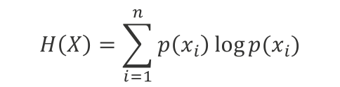
Data quality indicators
Comparting entropy of users in DS2014 and DS2016
Entropy: measure of uniformity of actions over time (it summarizes the other indicators
$$H\left(X\right)=\sum_{i=1}^{n}{p\left(x_{i}\right)\log{p(x_{i})}}$$
X = distribution of actions over time
n = number of time slots (e.g., 1-hour)
x_{i} = i-th time slot
p(x_{i}) = fraction of actions in x_{i}
Extreme cases:
H(X_{user a})=0 ➡ all actions in one time-bin
H(X_{user b})=1 ➡ constant number of actions
The higher the better: a more uniform behavior allows better tracking users’ position
However, H(X)=1 is a sign of non-human activity (e.g., IoT/m2m traffic, which has to be excluded)
As for all other indicators, ds2016 is better than ds2014 wrt. users’ entropies
Users in ds2016 tend to have higher entropy, which means better overall quality of perceived movements

Slide 13
Highly Active Users
Selecting user samples for human mobility studies
Higher activity degree (number and stability of action pattern)
Higher number of position samples (i.e., temporal granularity)
Perceived mobility is closer to actual mobility (less bias)
To reduce bias in mobility results, we only consider Highly Active Users (HAU)
Define HAU samples according to requirements
e.g. urban mobility studies requires higher time granularity than Nation-scale studies
Even with strict requirements, the HAU sample will be large and statistical relevant
users are in general more active and the usage of data connections is widespread
Thresholds from an operational study
Highly Active Users samples
Days Of Visibility (DOV)
DS2014
>=75%
7.5% (➡ 25% day only)
Hourly Action Rate (HAR)
ALL
conditions
DS2016
>=1
12.5% (➡ 38% day only)
Average Lag Time (ALT)
<=30m
Sample size rather large: up to 38% of entire user population in DS2016
Total Inactive Time (TIT)
<=75%
Entropy (H)
Statistical relevant samples: demographic (e.g., gender, age) statistical characteristics are preserved
0.7<>0.9

Slide 14
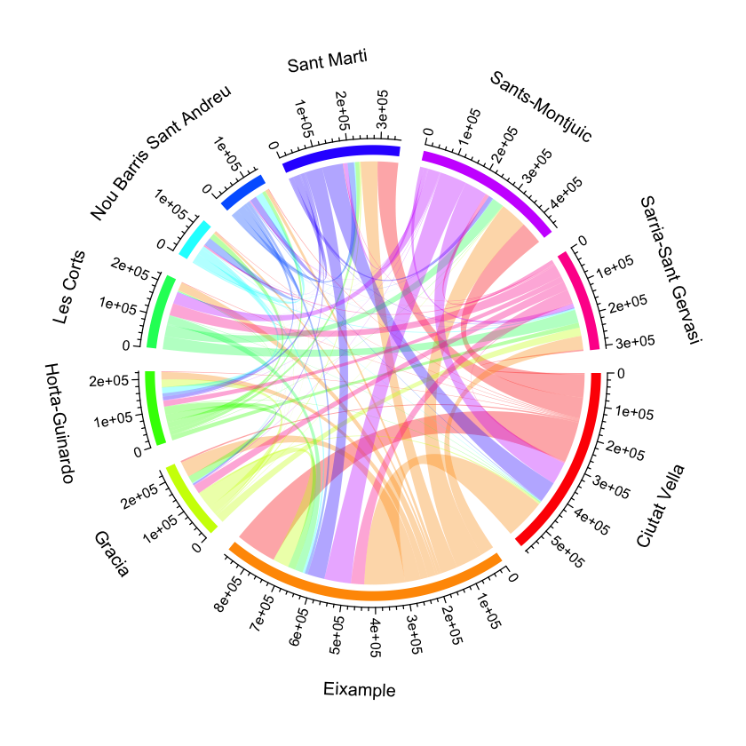
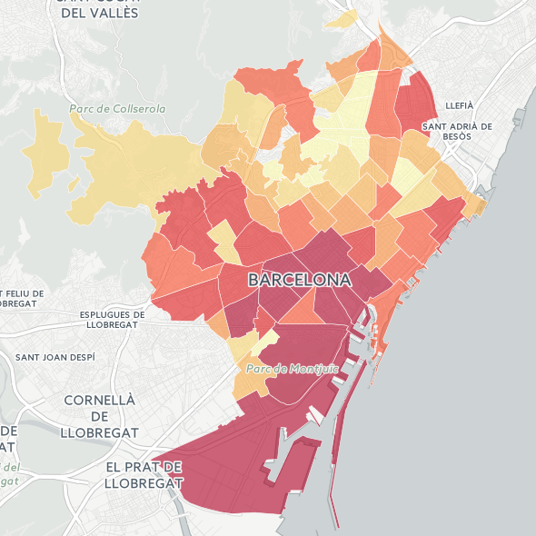
Applications
Experience from a commercial project (tourist mobility in Barcelona)
Heat maps: study concentrations of people per area
Transitions: between pairs of PoI, cities or neighborhoods
Human activity clustering: DBSCAN on weighted (by action count) tower locations
Note: all studies are based on HAU sample, in order to reduce the mobility bias introduced by inactivity of users (even for studying static behaviors…)

Slide 15
Conclusions
Longitudinal study of two Nation-wide CDR datasets from 2014 and 2016
collected in collaboration with major operator
Definition of indicators for describing quality of mobility information
focus on temporal granularity (number of actions per unit of time and uniformity of activity patterns)
Drastic change in the characteristics of CDR time-granularity over time
steep trend in the adoption of data connections and increase of recorded action frequency/stability
Interesting outlook for future exploitation of CDRs
CDR-based studies and products/commercial studies are gaining relevance

Slide 16

THANK YOU
Speaker: Alessandro D’Alconzo alessandro.dalconzo@ait.ac.at
Questions: Pierdomenico Fiadino pierdomenico.fiadino@eurecat.org

