Slide 1


Pierdomenico Fiadino
The Telecommunications Research Center Vienna (ftw.)
Challenging Entropy-based Anomaly Detection
and Diagnosis in Cellular Networks
fiadino@ftw.at
http://userver.ftw.at/~fiadino

Slide 2
MOTIVATION
111
Today’s Internet is characterized by increasing complexity
Multiple network types (WiFi, cellular, FTTH, etc.)
Large scale and highly distributed services (CDNs)
Sophisticated and highly dynamic traffic patterns
Frequent anomalies involving specific sub-populations of users
Are the traditional Anomaly Detection (AD) approaches still able to cope with this complex scenario?
We challenge the applicability of Entropy-based Anomaly Detection in typical modern day scenarios by comparing it with a more complex Distribution-based detector.
Challenging Entropy-based Anomaly Detection and Diagnosis Slide #2

Slide 3
REAL-WORLD USE CASES
111
RCATool framework evaluated for 6 months in 2014 on operational cellular network (DNS traffic)
Many paradigmatic use-cases (events) have been collected
?
DNS
server
?
device-specific push/cloud services
?
?
?
#DNS queries
#DNS queries
#DNS queries
requested hostnames (FQDN)
manufacturers
operative systems
RCATool: An Automatic Detection and Diagnosis Framework Slide #3

Slide 4
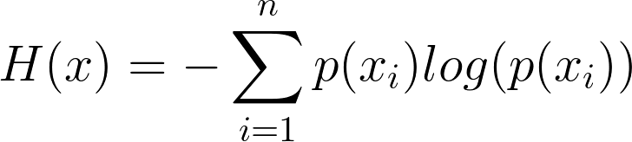
TWO ALTERNATIVE DETECTORS
111
Detector #1: Entropy-based
Represent entire distribution as Entropy
Entropies captures the dispersion of the corresponding probability distribution
A change in traffic patterns induces a change (spike/notch) in the entropy of the relevant traffic feature
111
H(current) = 0.42
Entropy
current distribution
2015-08-18 08:00
Challenging Entropy-based Anomaly Detection and Diagnosis Slide #4

Slide 5
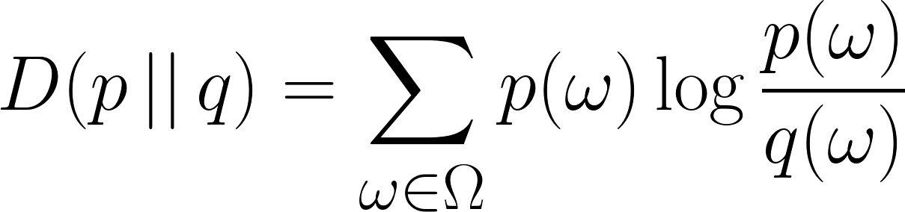
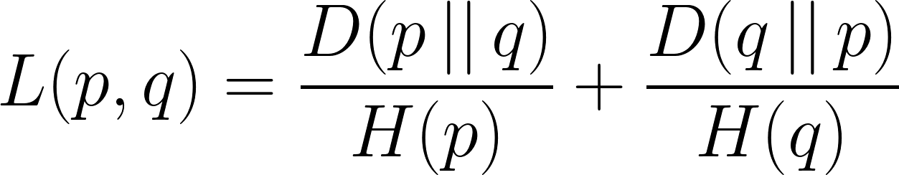
TWO ALTERNATIVE DETECTORS
111
Detector #2: Distribution-based
A more complex solution: consider whole empirical distribution of traffic features instead of just its entropy
Compute distance between distribution and a reference set of anomaly-free distributions (rapresenting normal behaviour)
111
Distribution distance metric
D(current) = 3
current distribution
Kullback-Leibler divergence
reference distribution
Entropy normalized KL metric
Challenging Entropy-based Anomaly Detection and Diagnosis Slide #5

Slide 6
REAL-WORLD USE CASES
111
 | Event #1 | Event #2
Start time | 9:00 | 12:00
Duration | 1 hour | 2 days
Devices | 10% | 5%
Back-off time | 5 seconds | 180 seconds
Manufacturer | Apple Inc. | Multiple (Samsung, HTC, ...)
O.S. | iOS 8.* | Android 4.*
Error flag | +5% time-outs | --
FQDN | OS-specific Top 3LD (push.apple.com) | OS-specific Top 3LD (mtalk.google.com)
Challenging Entropy-based Anomaly Detection and Diagnosis Slide #6

Slide 7
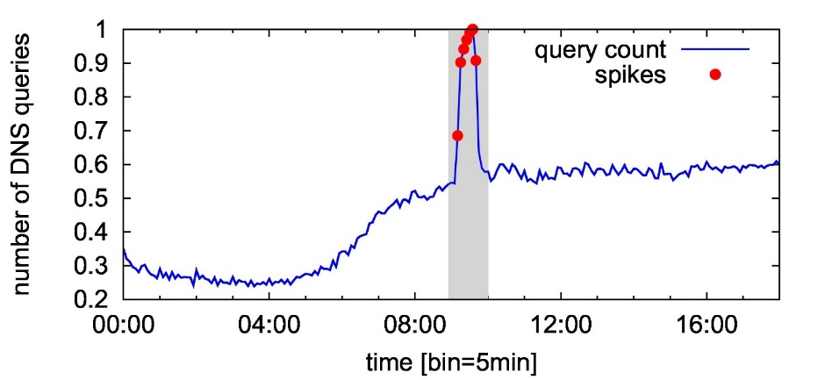
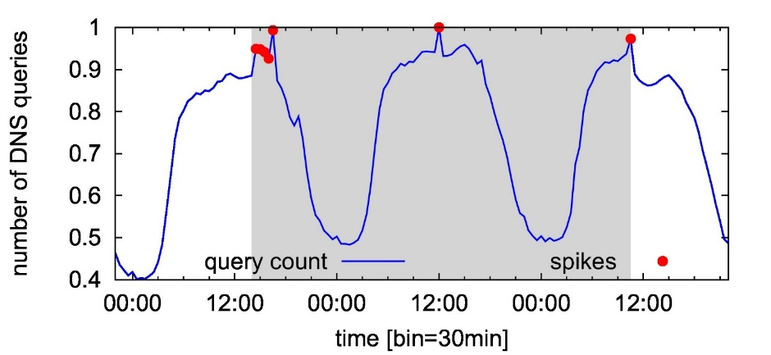
DNS TRAFFIC FEATURES
111
Anomalies usually visible by observing DNS traffic
Event #1 (Apple)
Event #2 (Android)
DSN traffic features considered
Device related: manufacturer and OS
Service related: requested hostnames (FQDN)
Network performance related: status code of DNS resolver
Challenging Entropy-based Anomaly Detection and Diagnosis Slide #7

Slide 8
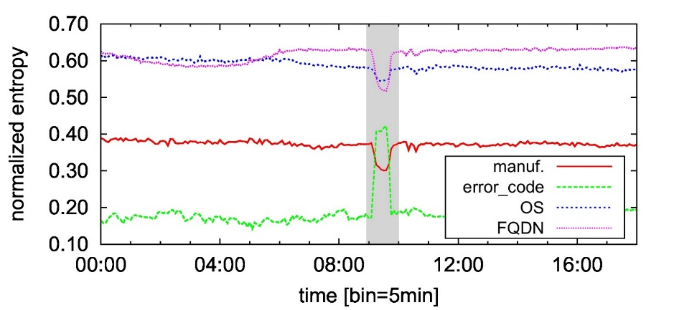
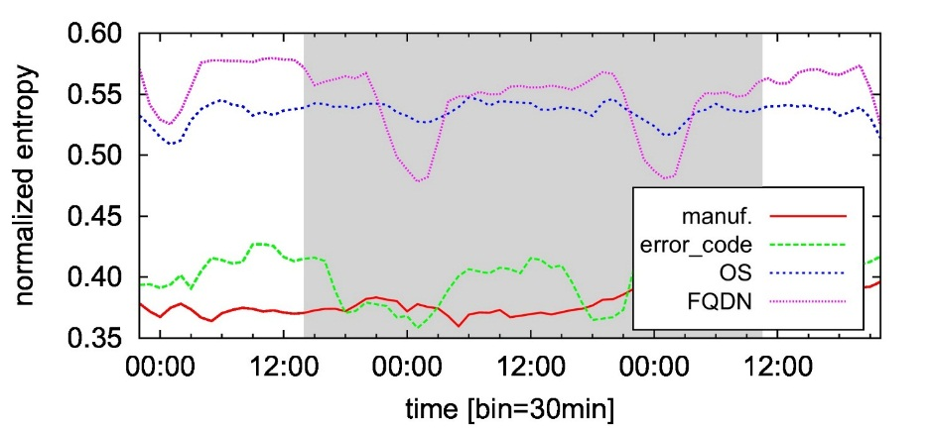
DETECTORS OUTPUT
111
Detector #1: Entropy-based
Event #1 (Apple)
Event #2 (Android)
Entropy of relevant features is clearly altered
Easily detected by algoriths such as EWMA
Entropy is not clearly visible
EWMA fails to detect the whole duration of the anomaly
Challenging Entropy-based Anomaly Detection and Diagnosis Slide #8

Slide 9
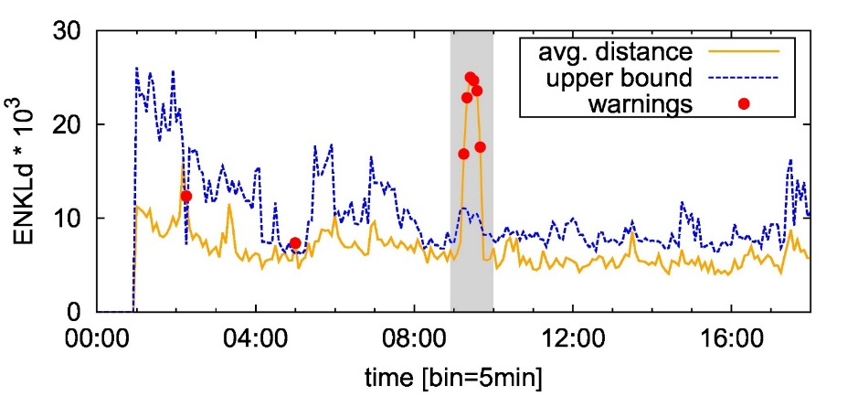
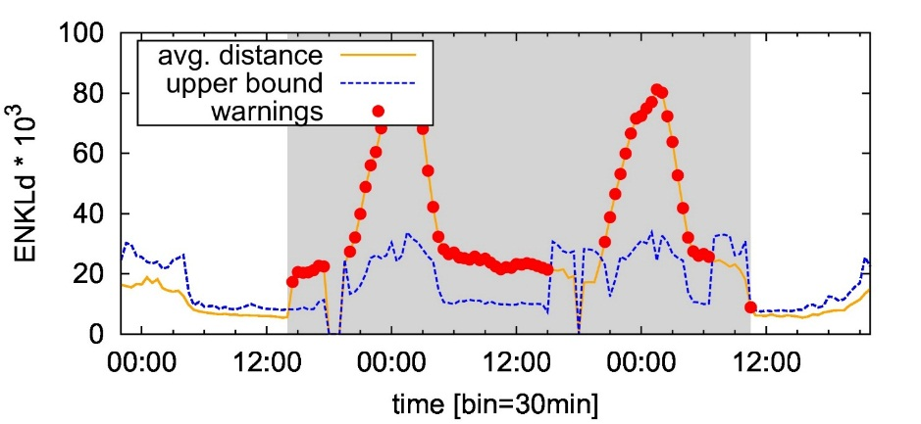
DETECTORS OUTPUT
111
Detector #2: Distribution-based
Event #1 (Apple)
Event #2 (Android)
Both event type exhibit a clear devergence from the normality reference
The whole duration of the anomaly is detected
Challenging Entropy-based Anomaly Detection and Diagnosis Slide #9

Slide 10
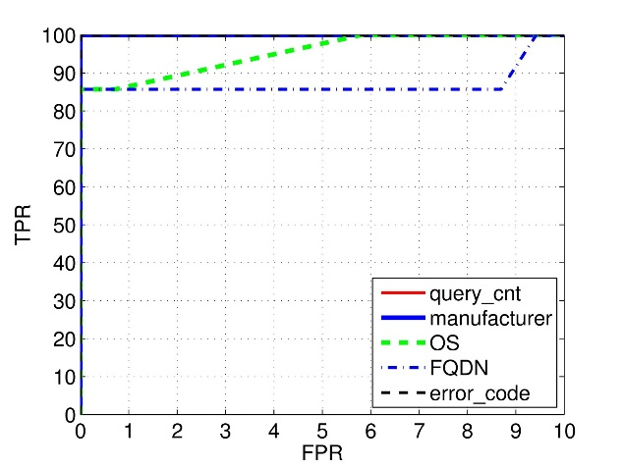
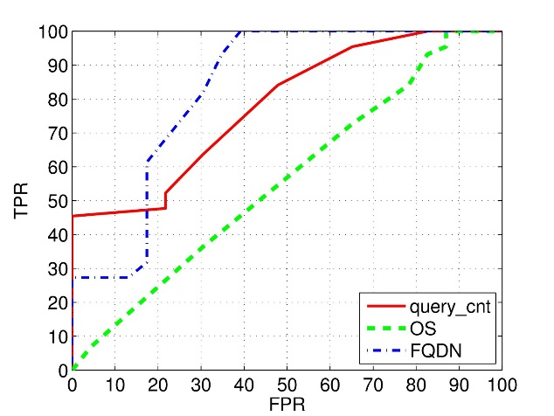
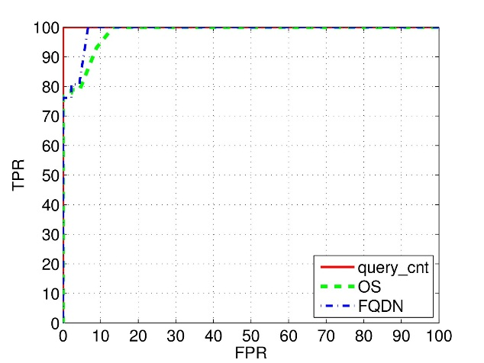
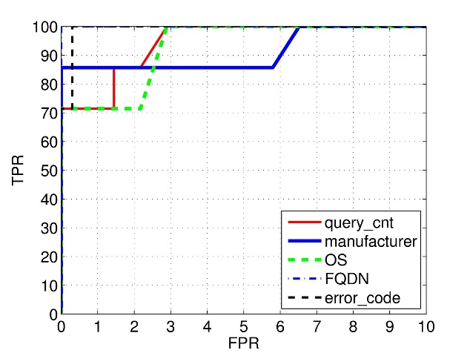
COMPARING PERFORMANCE
111
ROC Curves
Event Type #1
Event Type #2
Entropy-based
detector
Distribution-based
detector
RCATool: An Automatic Detection and Diagnosis Framework Slide #10

Slide 11
CONCLUSION
111
Entropy-based detectors are the most popular and largerly adopted, but they fail in coping with smaller-intensity – but still harmful – anomalies which are very common in modern-day networks
Challenging Entropy-based Anomaly Detection and Diagnosis Slide #11

Slide 12

Thank you for your attention ☺
Pierdomenico Fiadino
The Telecommunications Research Center of Vienna
http://userver.ftw.at/~fiadino
fiadino@ftw.at
http://www.ict-mplane.eu/

Slide 13
backup slides...

Slide 14
TRAFFIC FEATURE DISTRIBUTION
111
111
Distribution of DNS queries across device manufacturer
Devices affected by an anomaly induce a change in traffic feature distributions
Apple
Samsung
number of DNS queries
Huawei
HTC
LG
manufacturer
Challenging Entropy-based Anomaly Detection and Diagnosis Slide #14

Slide 15
TWO ALTERNATIVE DETECTORS
111
Detector #1: Entropy-based
Key idea: detect abrupt changes in time series of empirical entropy of certain traffic features (i.e., descriptors).
Entropies captures the dispersion of the corresponding probability distribution
A change in traffic patterns induces a change (spike/notch) in the entropy of the relevant traffic feature
Challenging Entropy-based Anomaly Detection and Diagnosis Slide #15

Slide 16
TWO ALTERNATIVE DETECTORS
111
Detector #2: Distribution-based
A more complex solution: consider whole empirical distribution of traffic features instead of just its entropy
Compute distance between distribution and a reference set of anomaly-free distributions (rapresenting normal behaviour)
Example of distance metric: normalized Kullback-Leibler
Kullback-Leibler divergence
Entropy normalized KL metric
Challenging Entropy-based Anomaly Detection and Diagnosis Slide #16

