Slide 1


Pierdomenico Fiadino
The Telecommunications Research Center Vienna (ftw.)
RCATool
A Framework for Detecting and Diagnosing Anomalies in Cellular Networks
fiadino@ftw.at
http://userver.ftw.at/~fiadino

Slide 2
MOTIVATION
111
Today’s Internet is characterized by increasing complexity
Multiple network types (WiFi, cellular, FTTH, etc.)
Large scale and highly distributed services (CDNs)
Sophisticated and highly dynamic traffic patterns
Frequent anomalies involving specific sub-populations of users
Application usage patterns (negatively) impacting cellular signaling
In such a complex scenario,
Anomaly Detection and Diagnosis
is still an open research topic
RCATool: a general framework for automatic detection and diagnosis of application- and device- specific anomalies
RCATool: An Automatic Detection and Diagnosis Framework Slide #2

Slide 3
PASSIVELY CAPTURED DATASET
111
Radio Access Network
internet
cellular network‘s core
passive probe
devices
Results in this paper are based on DNS traffic analysis. Other network traces types are under study.
network traces
RCATool
DBStream
RCATool: An Automatic Detection and Diagnosis Framework Slide #3

Slide 4
DIAGNOSIS FRAMEWORK
111
Network
Traces
(traffic features)
Symptomatic Signal Extraction
Change Detection Module
Diagnosis Module
Symptom query_cnt
Diagnostic manufacture
Diagnostic operative_sys
Diagnostic FQDN
Granularity 30 minutes
Warning_start 2015-02-14
Alarm_start 2015-02-14
alarm_end 2015-02-14
Warning_end 2015-02-14
Symptom query_cnt
Diagnostic manufacture
Diagnostic operative_sys
Diagnostic FQDN
Granularity 30 minutes
Warning_start 2015-02-14
Alarm_start 2015-02-14
alarm_end 2015-02-14
Warning_end 2015-02-14
Symptom query_cnt
Diagnostic manufacture
Diagnostic operative_sys
Diagnostic FQDN
Granularity 30 minutes
Warning_start 2015-02-14
Alarm_start 2015-02-14
alarm_end 2015-02-14
Warning_end 2015-02-14
Symptom query_cnt
Diagnostic manufacture
Diagnostic operative_sys
Diagnostic FQDN
Granularity 30 minutes
Warning_start 2015-02-14
Alarm_start 2015-02-14
alarm_end 2015-02-14
Warning_end 2015-02-14
Symptom query_cnt
Diagnostic manufacture
Diagnostic operative_sys
Diagnostic FQDN
Granularity 30 minutes
Warning_start 2015-02-14
Alarm_start 2015-02-14
alarm_end 2015-02-14
Warning_end 2015-02-14
Event Reports
Diagnostic
Signal Extraction
Change Detection Module
provide support in troubleshooting of anomalous events
passively collected
(e.g., from a mobile network core)
statistical content of diagnostic-symptomatic traffic features
probability distribution-based algorithm
State management and automatic signal correlation
KEY IDEA #1: distinguish between
symptomatic signals (notify presence of anomalous state) and
diagnostic signals (provide context)
KEY IDEA #2: observe significant changes in multiple traffic features
KEY IDEA #3: keep status of detected changes and coordinate output
RCATool: An Automatic Detection and Diagnosis Framework Slide #4

Slide 5
SIGNAL EXTRACTION
111
DNS-based signals
describe statistical content of traffic features
Initial tests: signals based on DNS traffic monitoring
Symptomatic Signals: probability distribution of number of users across query count (i.e., count how many users execute a given number of queries per each time-bin)
Diagnostic Signals: distribution of query count across DNS traffic features (e.g., list of device manufacturer, operating system, hostnames).
Apple
Samsung
number of DNS queries
Huawei
HTC
LG
manufacturer
RCATool: An Automatic Detection and Diagnosis Framework Slide #5

Slide 6
DETECTION MODULE
111
traces
signal extr.
change
detection
diagnosis
signal extr.
change
detection
Based on anomaly detection tool(s) from previous works, improved
Key module for the whole framework
Tested two alternative detection strategies*
* Spoiler alert: one doesn‘t (always) work
RCATool: An Automatic Detection and Diagnosis Framework Slide #6

Slide 7
TRAFFIC FEATURE DISTRIBUTION
111
111
Distribution of DNS queries across device manufacturer
Devices affected by an anomaly induce a change in traffic feature distributions
Apple
Samsung
number of DNS queries
Huawei
HTC
LG
manufacturers
RCATool: An Automatic Detection and Diagnosis Framework Slide #7

Slide 8
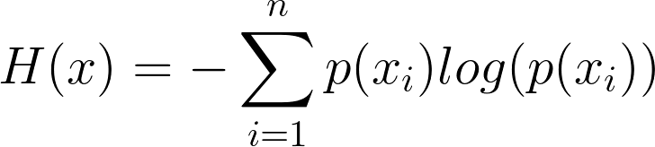
TWO ALTERNATIVE DETECTORS
111
Detector #1: Entropy-based
Represent entire distribution as Entropy
Entropies captures the dispersion of the corresponding probability distribution
A change in traffic patterns induces a change (spike/notch) in the entropy of the relevant traffic feature
111
H_{f}(t₀) = 0.42
Entropy
feature f distribution at t₀
2015-08-18 08:00
RCATool: An Automatic Detection and Diagnosis Framework Slide #8

Slide 9
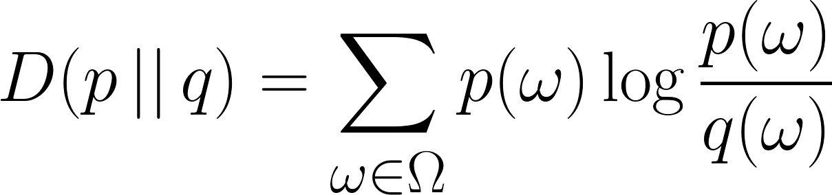
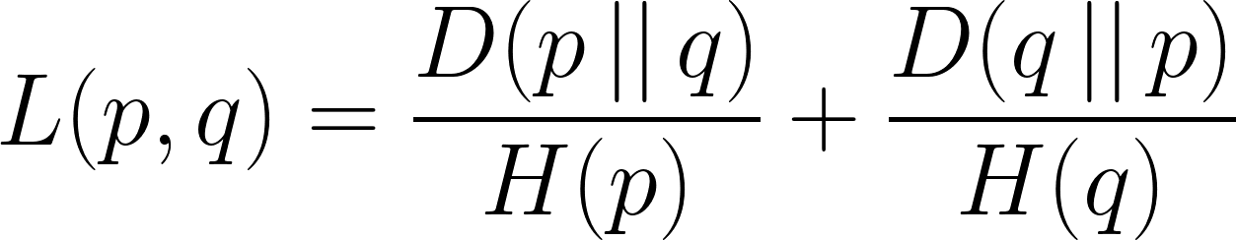
TWO ALTERNATIVE DETECTORS
111
Detector #2: Distribution-based
A more complex solution: consider whole empirical distribution of traffic features instead of just its entropy
Compute distance between distribution and a reference set of anomaly-free distributions (rapresenting normal behaviour)
111
Distribution distance metric
D_{f}(t_{i}) = 3
current distribution at t_{i}
Kullback-Leibler divergence
reference distribution r
Entropy normalized KL metric
RCATool: An Automatic Detection and Diagnosis Framework Slide #9

Slide 10
REAL-WORLD USE CASES
111
RCATool framework evaluated for 6 months in 2014 on operational cellular network (DNS traffic)
Many paradigmatic use-cases (events) have been collected
?
DNS
server
?
device-specific push/cloud services
?
?
?
#DNS queries
#DNS queries
#DNS queries
requested hostnames (FQDN)
manufacturers
operative systems
RCATool: An Automatic Detection and Diagnosis Framework Slide #10

Slide 11
SEMI-SYNTHETIC DATA GENERATION
111
RCATool framework evaluated for 6 months in 2014 on operational cellular network (DNS traffic)
Many paradigmatic use-cases (events) have been collected
still difficult to perform a complete evaluation...
Generate semi-synthetic background traffic
Over-impose synthetic anomalies
RCATool: An Automatic Detection and Diagnosis Framework Slide #11

Slide 12
SEMI-SYNTHETIC DATA GENERATION
111
Clean back-ground traffic:
Generation of semi-synthetic data derived from real traffic traces, preserving:
temporal dynamics (24-hours seasonality)
statistical characteristics
working days/Weekends differentiation
Synthetic anomalies superposition:
Inject additive anomalies in relevant signals:
Alter generated traffic distributions according to models of real-life anomalies
RCATool: An Automatic Detection and Diagnosis Framework Slide #12

Slide 13
REAL-WORLD USE CASES
111
 | Event #1 | Event #2
Start time | 9:00 | 12:00
Duration | 1 hour | 2 days
Devices | 10% | 5%
Back-off time | 5 seconds | 180 seconds
Manufacturer | Apple Inc. | Multiple (Samsung, HTC, ...)
O.S. | iOS 8.* | Android 4.*
Error flag | +5% time-outs | --
FQDN | OS-specific Top 3LD (push.apple.com) | OS-specific Top 3LD (mtalk.google.com)
RCATool: An Automatic Detection and Diagnosis Framework Slide #13

Slide 14
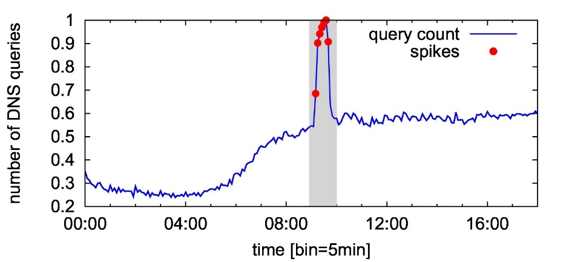
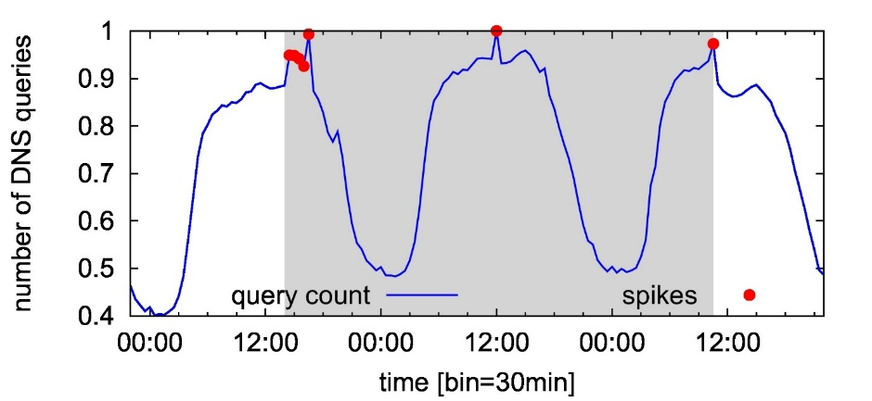
DNS TRAFFIC FEATURES
111
Anomalies usually visible by observing DNS traffic
Event #1 (Apple)
Event #2 (Android)
DSN traffic features considered
Device related: manufacturer and OS
Service related: requested hostnames (FQDN)
Network performance related: status code of DNS resolver
RCATool: An Automatic Detection and Diagnosis Framework Slide #14

Slide 15
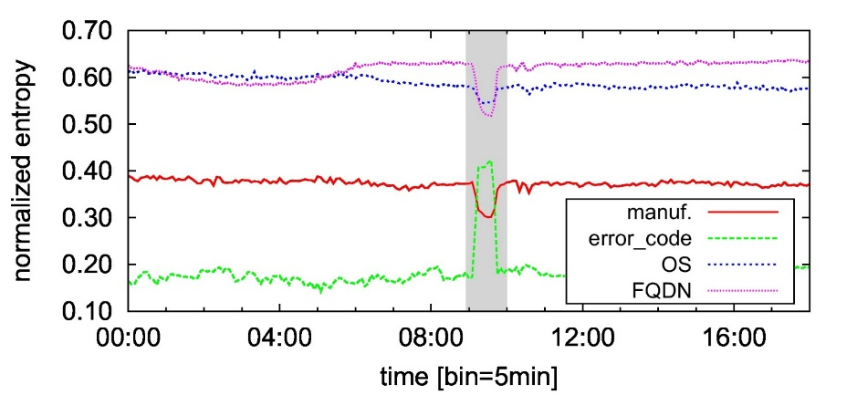
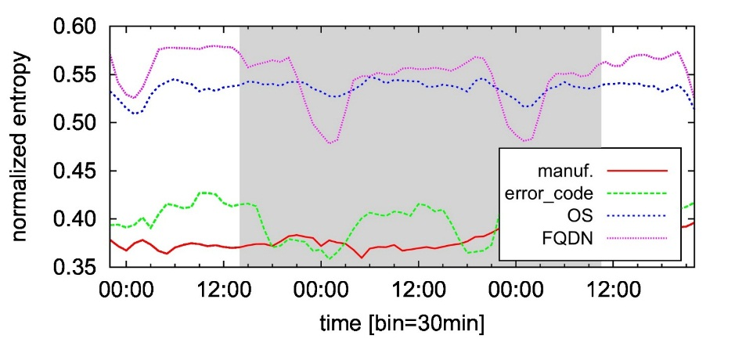
DETECTORS OUTPUT
111
Detector #1: Entropy-based
Event #1 (Apple)
Event #2 (Android)
Entropy of relevant features is clearly altered
Easily detected by algoriths such as EWMA
Entropy is not clearly visible
EWMA fails to detect the whole duration of the anomaly
RCATool: An Automatic Detection and Diagnosis Framework Slide #15

Slide 16
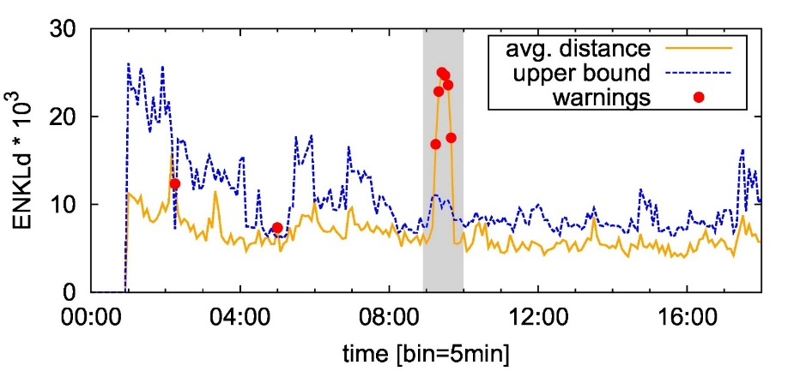
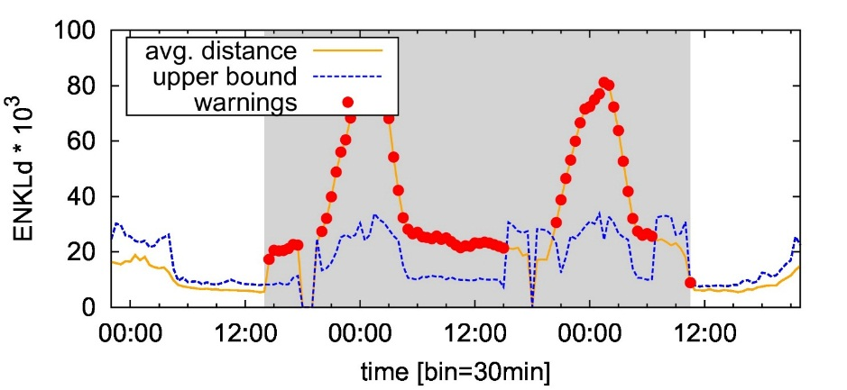
DETECTORS OUTPUT
111
Detector #2: Distribution-based
Event #1 (Apple)
Event #2 (Android)
Both event type exhibit a clear devergence from the normality reference
The whole duration of the anomaly is detected
RCATool: An Automatic Detection and Diagnosis Framework Slide #16

Slide 17
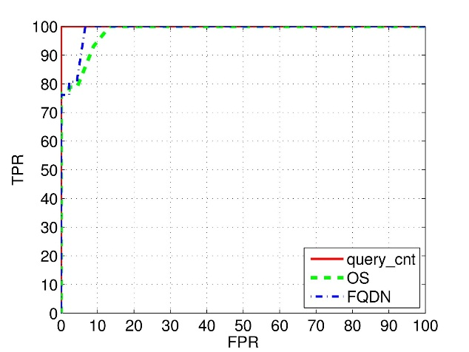
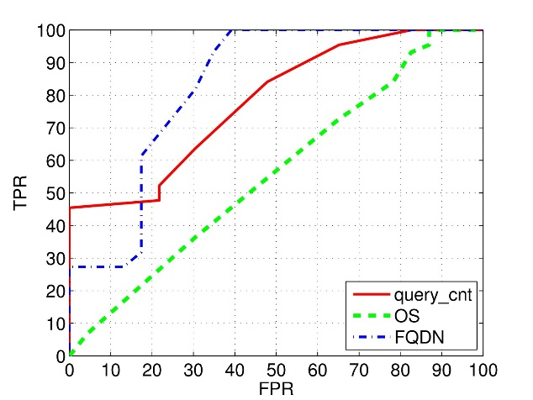
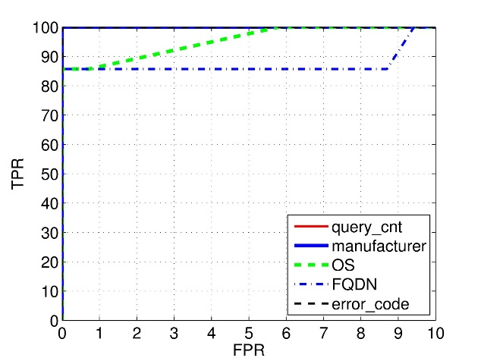
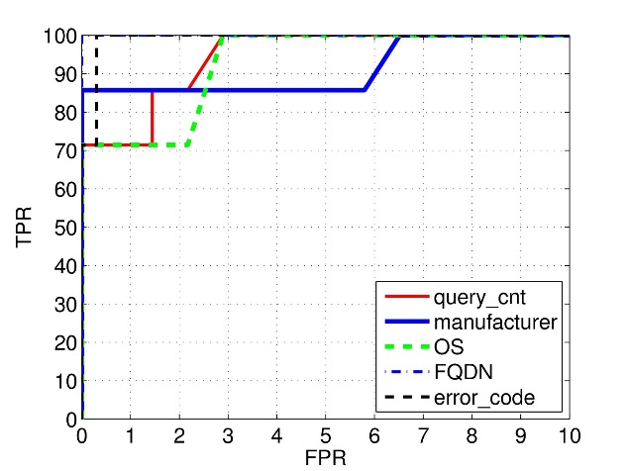
COMPARING PERFORMANCE
111
ROC Curves
Event Type #1
Event Type #2
Entropy-based
detector
Distribution-based
detector
RCATool: An Automatic Detection and Diagnosis Framework Slide #17

Slide 18
COMPARING PERFORMANCE
111
Entropy-based detectors are the most popular and largerly adopted, but they fail in coping with smaller-intensity – but still harmful – anomalies which are very common in modern-day networks
RCATool: An Automatic Detection and Diagnosis Framework Slide #18

Slide 19
DIAGNOSIS MODULE (ONGOING...)
111
diagnosis
Automatic Diagnosis Module
Keep state of the signal changes
Correlate the changes to produce a diagnosis
Change detection, from state-less to state-full: manage signal change notifications in a state-full fashion (manage change module flipping during long-term events).
Normal
f_{r} = 0
Warning
0 < f_{r} < th
Anomaly
f_{r} ≥ th
Signal-specific state machine
Change notifications are kept in a shift register. State transitions depend on fraction f_{r} of anomalous time-bins in the register
Signal change correlation: locate changes in the symptomatic signals, find correlated changes in diagnostic signals to unveil root cause. Manage event termination/mutation.
RCATool: An Automatic Detection and Diagnosis Framework Slide #19

Slide 20
EVENT REPORT
Event #123456 {Gran. 30 minutes}
-----------------------------------
Symptoms:
* query_cnt [10,+][1,-]
Correlated diagnostic signals:
* manufacturer [Samsung,+]
* operative_sys [Android 4.1.2,+]
* FQDN [youcloud.com,+]
Uncorrelated diagnostic signals:
* error code […]
* APN […]
-----------------------------------
Timestamps:
Warning_start 2015-02-14 13:00
Alarm_start 2015-02-14 13:30
Alarm_end 2015-02-16 11:00
Warning_end 2015-02-16 12:00
increase of users executing
1 query / 3 minuties
Samsung users running Android 4.1.2, resolving youcloud.com
APN independent, error code distribution is not impacted
for almost 2 days
RCATool: An Automatic Detection and Diagnosis Framework Slide #20

Slide 21
CONCLUSIONS
111as
1
Preliminary study on a framework for automatic and diagnosis of large scale Internet anomalies
Preliminary version is up and running in operational netowrk
2
Data generation: synthetic traffic distributions for designing and tuning the framework
Ongoing work: expand test-bed with other templates
3
Comparison of two alternative algorithms for the detector module
Ongoing work: improvements for the distribution-based algorithm
4
Preliminary diagnosis module for signal coordination and status management
Ongoing work: Machine-Learning approach
RCATool: An Automatic Detection and Diagnosis Framework Slide #21

Slide 22

Thank you for your attention ☺
Pierdomenico Fiadino
The Telecommunications Research Center of Vienna
http://userver.ftw.at/~fiadino
fiadino@ftw.at
http://www.ict-mplane.eu/

Slide 23
backup slides

Slide 24
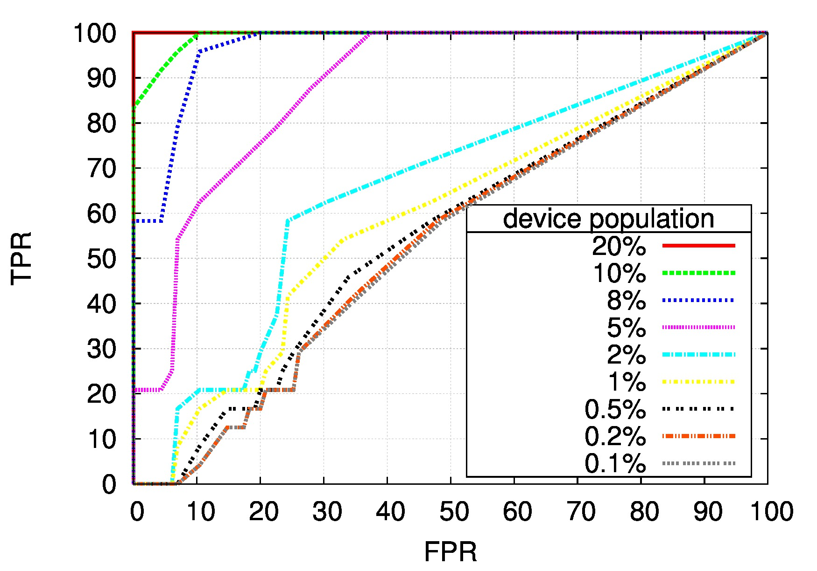
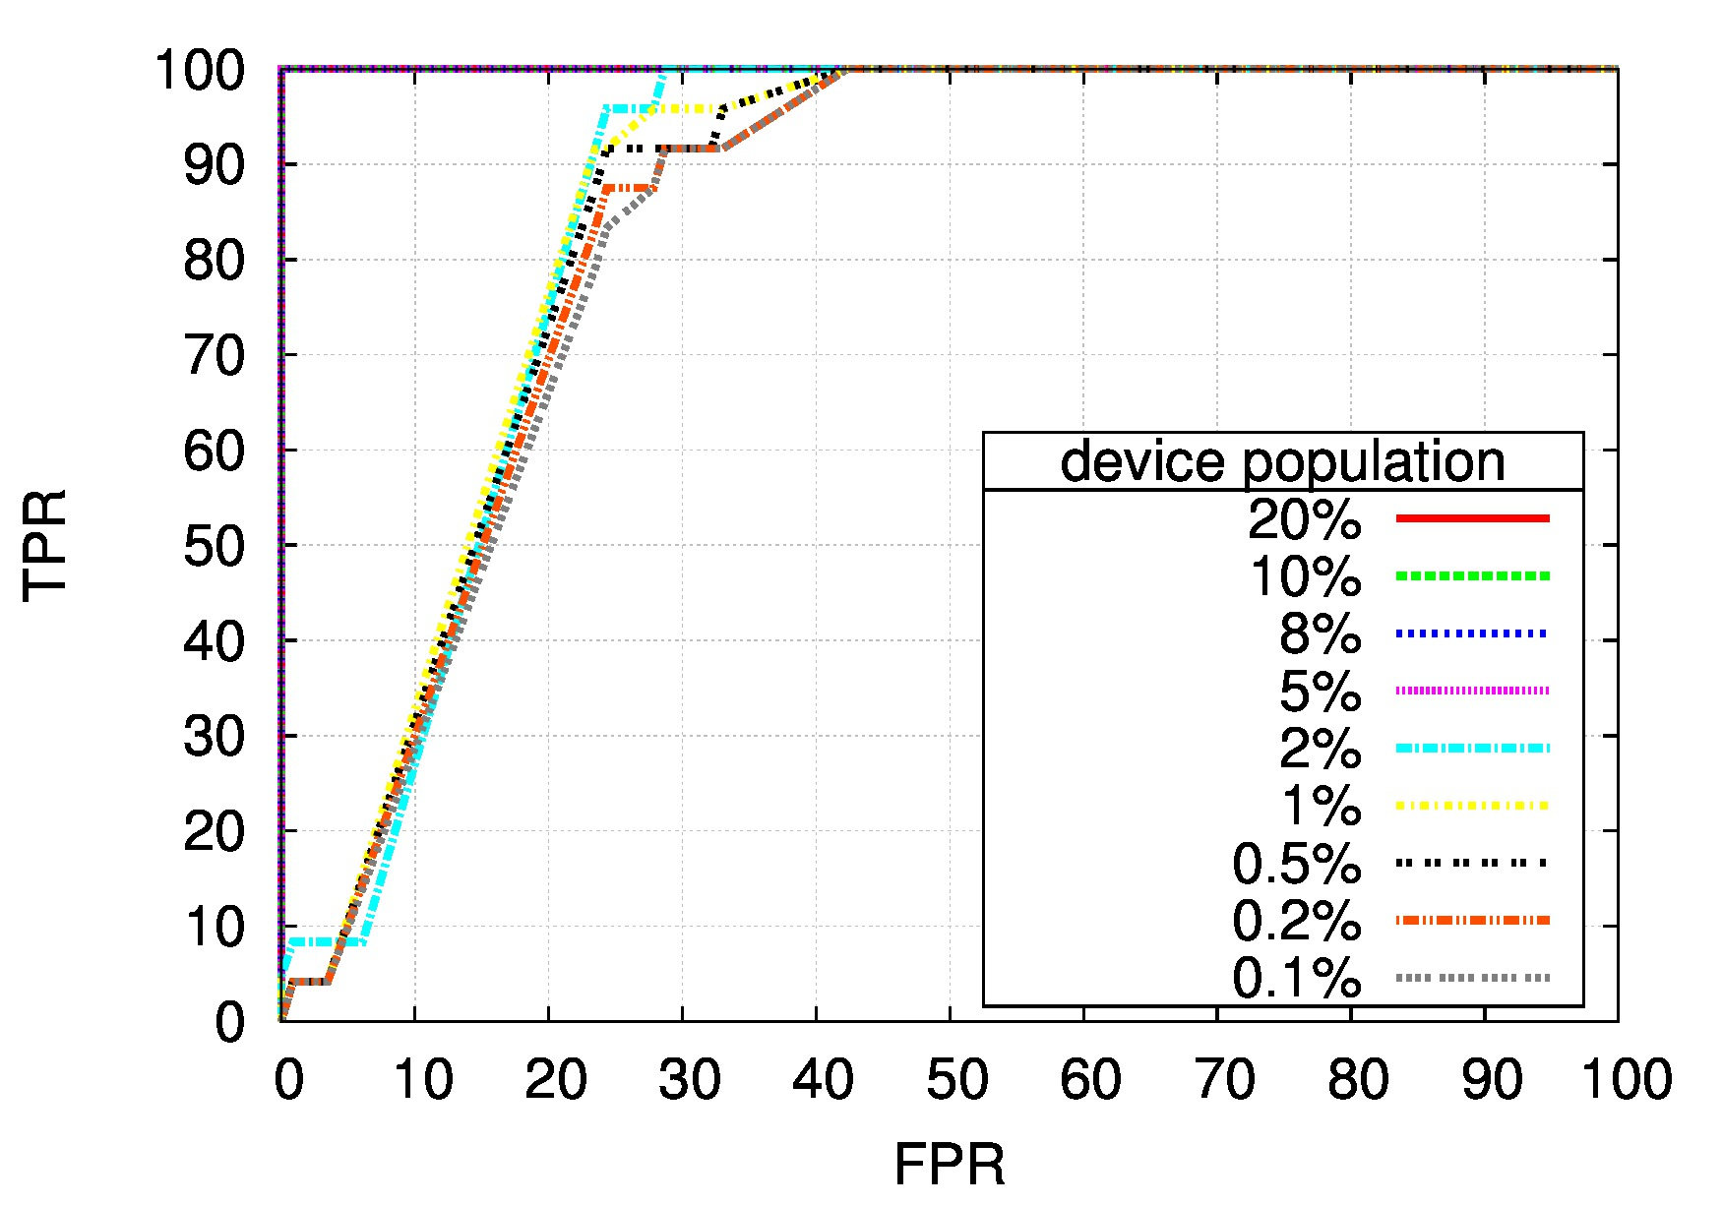
ANOMALY INTENSITY - PERFORMANCE
111
Entropy-based detector
Distrib-based detector
Challenging Entropy-based Anomaly Detection and Diagnosis Slide #24

Slide 25
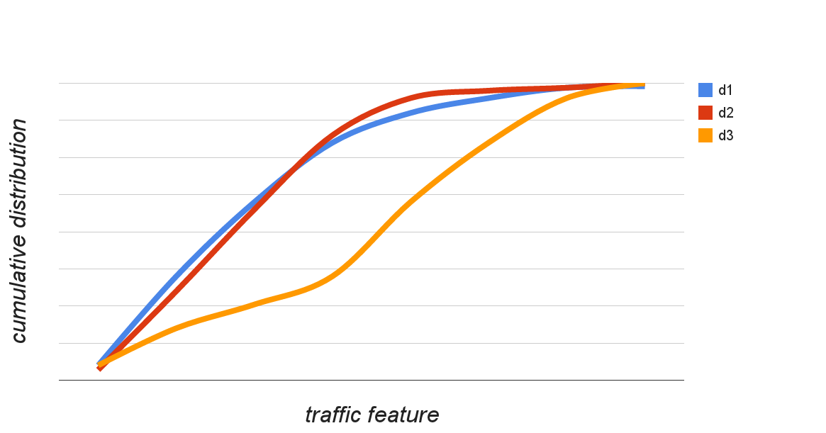
CHANGE DETECTION MODULE
111
Statistical Change Detection algorithm
Recognize macroscopic deviations in distributions
Algorithm consists of three phases for each iteration:
Self Adaptive Reference Set Identification: find normality reference from past distributions
Change test: use a normalized variant of the Kullback-Leibler divergence to decide if current distribution is compatible with the reference-set
Changing elements report: notify distribution elements that cause change (e.g., involved hostnames and operating systems)
CDF
x₁
x₂
x₃
feature
x₁ and x₂ are similar → KLd(x₁,x₂) is small
x₁ and x₃ are dissimilar → KLd(x₁,x₃) is large
Challenging Entropy-based Anomaly Detection and Diagnosis Slide #25

