Slide 1
2D Multiplayer Video Game
Authors :
Carl Levasseur,
Pierre Falez,
Benjamin Danglot.

Slide 2
Introduction
                Global description
                Technical description
                Demonstration
                Conclusion

Slide 3
Global description
A multi player game.
One goal : defeat the other team.
Got your own character.

Slide 4
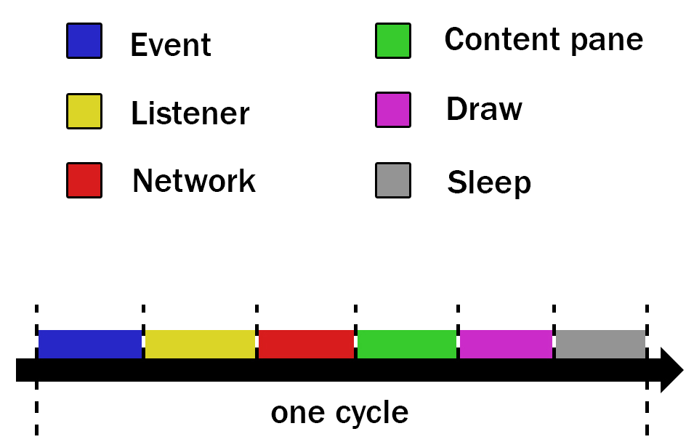
Technical description
Graphic User Interface

Slide 5
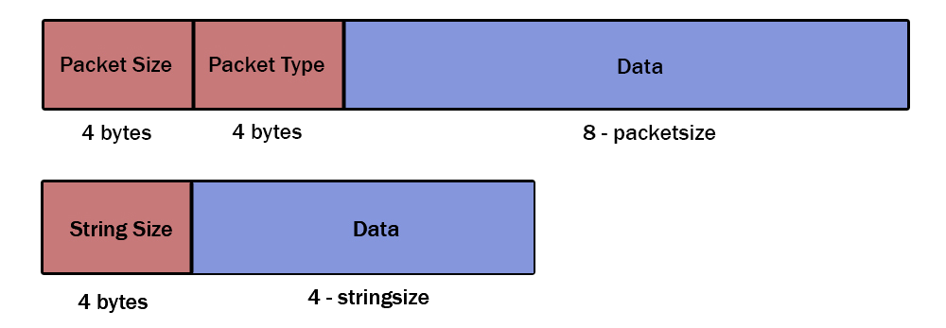
Technical description
Network

Slide 6
Demonstration

Slide 7
Conclusion
        Benefits.
        Overview.

