Slide 1
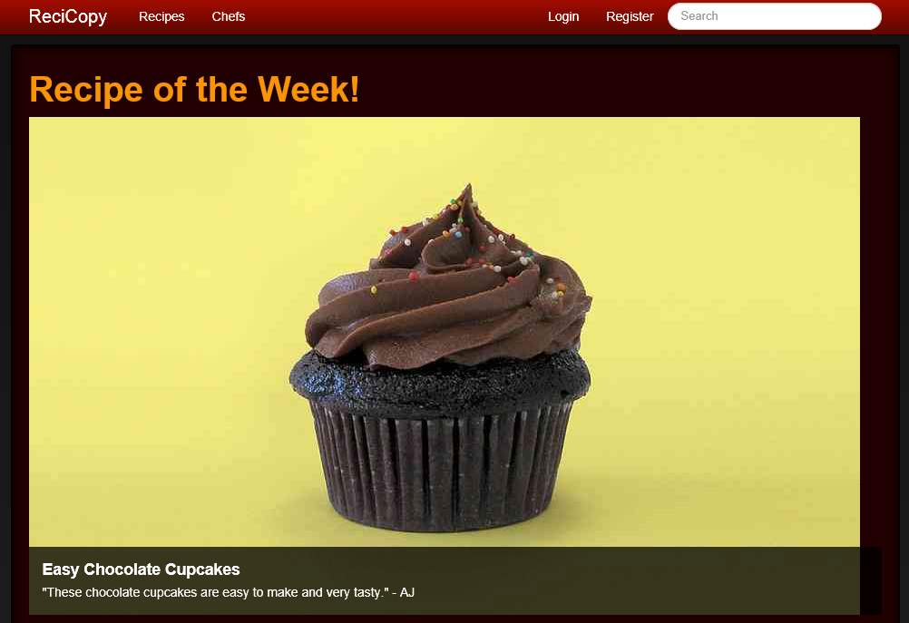

DANGLING POINTERS
RECICOPY
TEAM MEMBERS:
AJ Piergiovanni
Erik Sanders
{ INSERT LOGO /SCREENSHOTS / IMAGES HERE }

Slide 2


WHY RECICOPY?
ReciCopy is a social recipe site powered by SmartFile.
Based on real life recipe sharing
2013 SmartFile Platform Bake-Off

Slide 3




WHAT MAKES IT WORK?
MIT License
Heroku
GitHub
SmartFile
2013 SmartFile Platform Bake-Off

Slide 4
WHAT MAKES IT FAST?
SmartFile is used for all file storage and media serving purposes
ReciCopy uses the SmartFile service to store chef and recipe pictures in the cloud
The service is used to generate a permanent link to the pictures that can then be displayed to users
ReciCopy is extendable to use SmartFile to host any type of static content
2013 SmartFile Platform Bake-Off

Slide 5
WHAT MAKES IT COOL?
Cooking and recipe sharing happens the way it used to
People used to build up recipe collections through families and friends
Now, it’s become a much less sociable art
ReciCopy brings back the large recipe collection, but allows you to share with chefs all over the world
2013 SmartFile Platform Bake-Off

