Slide 1


Onedot Data Analysis
August 07, 2021
Remote Data Task
E-Commerce suppliers onboarding: Data integration
Analyst: Pier Luigi Segatto
Contact: pier.Segatto@gmail.com

Slide 2

Outline
Objective: Data Integration
Step 1: Pre-processing
Step 2: Normalization
Step 3: Integration
Conclusions

Slide 3
Objective
Improve the efficiency in onboarding new suppliers
Automate loading and pre-processing of suppliers data
Standardize input data (different formats, styles, attributes, etc…)
Integrate suppliers data into the e-commerce database
Suggest improvements and solve data-related issues

Slide 4
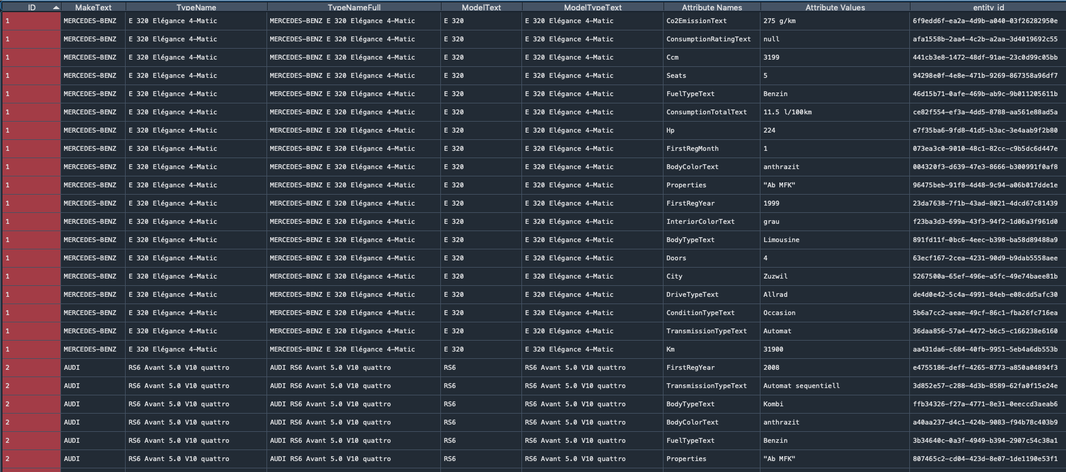
Step 1: Pre-processing
Suppliers database
# Entries = 21905
# Suppliers vehicles = 1153
# Attributes provided = 25 (19)
Pivoting the table to get the same granularity …

Slide 5
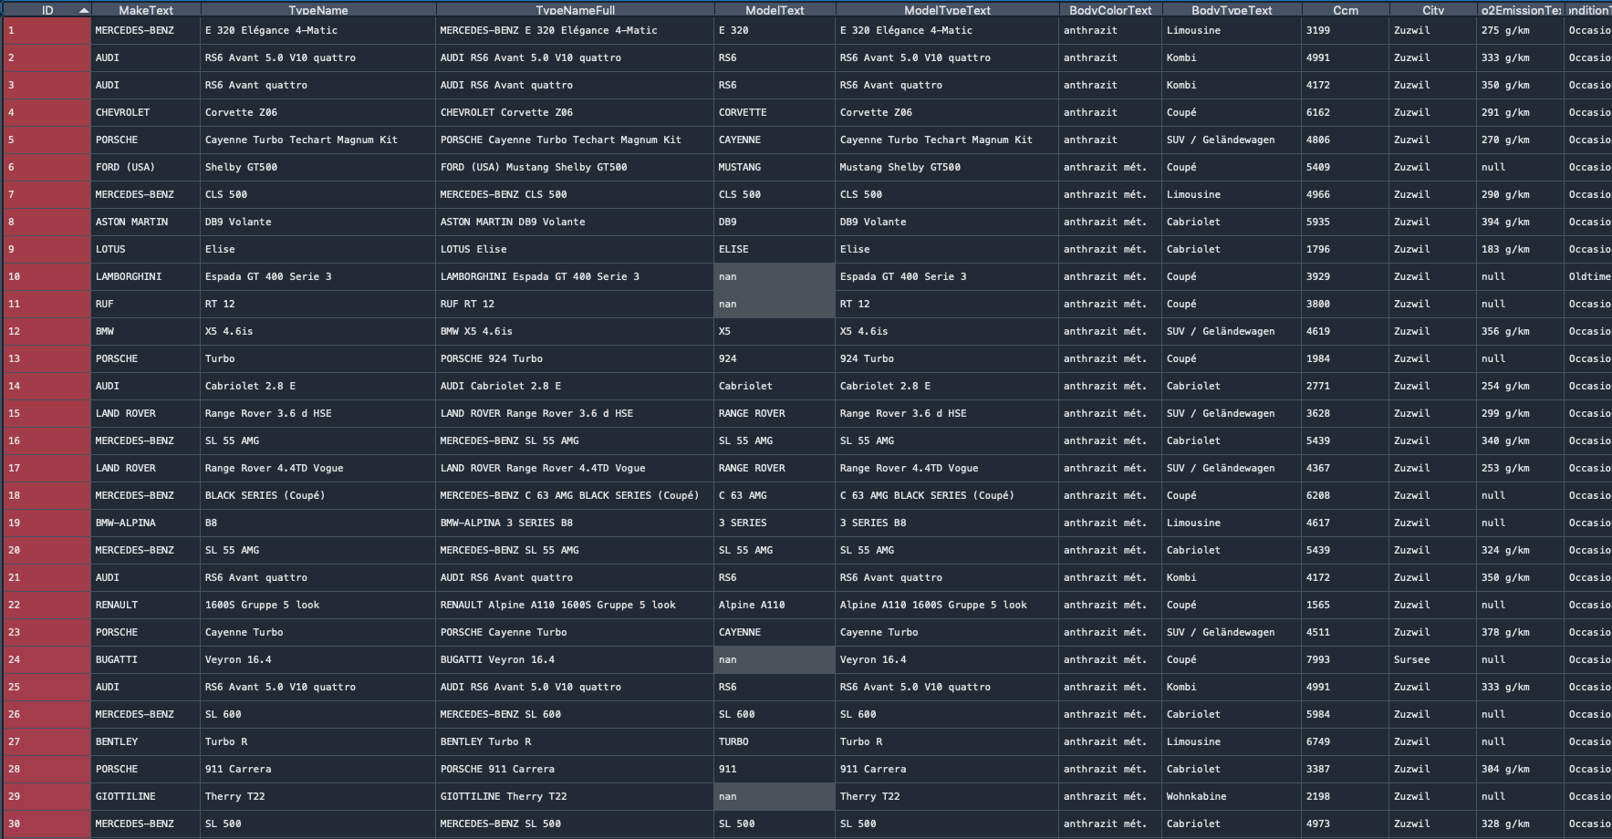
Step 1: Pre-processing
Pre-processed Suppliers database
Supplier database size (1153, 25)

Slide 6
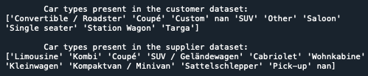
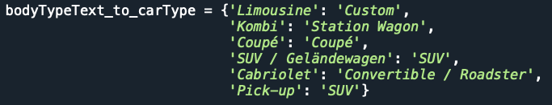

Step 2: Normalization
1) carType (BodyTypeText)
Problem: different language and different tags.
Final users could take advantage of a more detailed car dictionary.
Notes:
And here you can see the result in term of PAR and T.
The model has been able to extrapolate, starting from 12 timeseries of PAR and T and coupling the features info, the dynamics of PAR and T at whole network scale and this 1 y

Slide 7
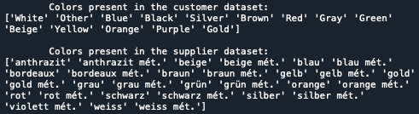
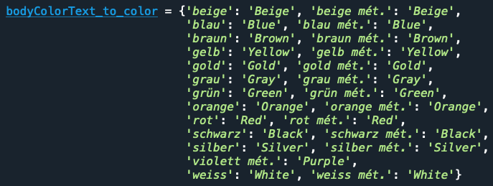
Step 2: Normalization
2) color (BodyColorText)
Problem: different language, more colors, met./not met. colors.
Final users could take advantage of a more detailed color dictionary.

Slide 8


Step 2: Normalization
3) condition (ConditionTypeText)
Problem: different tags.
In absence of more detailed information about the status of the cars:
If possible, request more details about the car status.

Slide 9
Step 2: Normalization
4) currency
Problem: information missing.
Given that all cars are coming from Switzerland, I assume the currency is CHF.
If possible, request price information to the suppliers. This would also help double checking the car status, getting the right currency, and filling the price on request attribute (see later).

Slide 10
Step 2: Normalization
5) drive
Problem: information missing.
Given that Swiss cars in the customer dataset can be found both RHD and LHD, I decided to not assume anything and to create a column filled with not a number values.
If possible, request drive information to the suppliers.

Slide 11

Step 2: Normalization
6) city (City)
7) country
All Swiss cities: filled column with “CH”.
8) make (MakeText)
Problem: upper cases.
To provide the same labels as in the e-commerce database I set in upper case all car make whose name is less than 4 chars.
Exceptions: Bmw-Alpina -> Alpina, Mclaren -> McLaren, Mini -> MINI, RUF -> Ruf.

Slide 12
Step 2: Normalization
9) manufacture_year (FirstRegYear)
10) mileage (Km)
11) mileage_unit (Km)
All provided mileages are in km. Manually filled this attribute with ‘kilometer’.
12) model (ModelText)
13) model_variant (ModelTypeText)
I propose to reorganize this attribute in the e-commerce database. This value is missing for ~25% of the cars and often there are leading chars to be removed.

Slide 13
Step 2: Normalization
14) price_on_request
Given that price info have not been provided I set this column to be filled with True (bool). If the price is not present it has to be requested.
If possible, I suggest to get more information about the car selling price.
15) type
Assuming that the e-commerce is selling only cars (the target dataset contains only cars), I tagged with 'Other' what is not a car in the supplier dataset (there is a bike and a truck).

Slide 14
Step 2: Normalization
16) zip
I associated to each of the 6 swiss cities present in the suppliers dataset, their canton.
Basel -> Basel-Stadt, Porrentrury -> Jura, Safenwil -> Aargau, Sursee -> Lucerne,
Zuzwil & St. Gallen -> St. Gallen.
~90% of the zip data is missing in the e-commerce database. Consider dropping this attribute.
17) manufacture_month (FirstRegMonth)
18) fuel_consumption_unit
I tagged with ‘l_km_consumption’ all entries where ConsumptionRatingText is ‘l/100km’.
I left a missing value where ConsumptionRatingText is ‘null’.

Slide 15
Step 3: Integration
Objective: Transform the supplier data with a specific data schema into a new dataset with target data schema.
Filter out the non required attributes.
I also merged (vertically) the supplier dataset with the e-commerce dataset to simulate a full integration with the web-app and to check for possible inconsistencies. No issues arose.
Size of the full database: (8405, 18) -> exported and available in output.xlsx with same cell formatting and autofilter capability as in the target dataset.

Slide 16
Conclusions
Data integration automatized
Consider getting from the suppliers information about the car status, drive, and selling price
Room to improve and complete the e-commerce database prior integration of the suppliers data
Next steps: data segmentation and optimization of the car categories displayed on the web-app.

Slide 17

Thank you for the attention

