Slide 1


Sunrise Upc
September 11, 2021
Telco Churn Task
Churn Rate Modeling:
Data analysis and model results
Data Scientist: Pier Luigi Segatto
Contact: pier.segatto@gmail.com

Slide 2

Outline
Part 1: Churn Likelihood
Part 2: Data Setup & Models
Part 3: Random Forest
Part 4: Conclusions

Slide 3
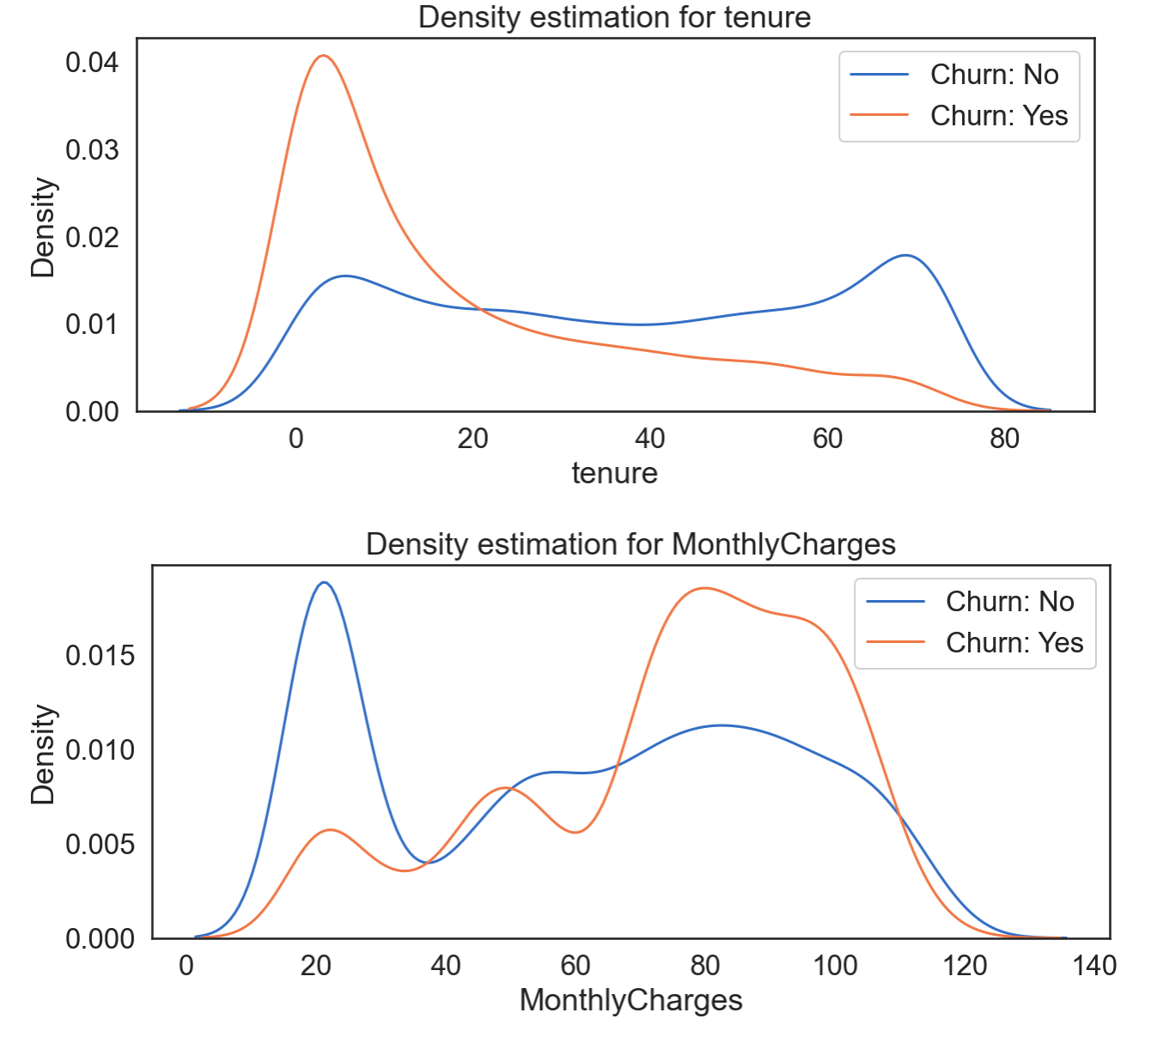
Churn Likelihood
Increased for customers who:
recently joined
pay high monthly charges

Slide 4
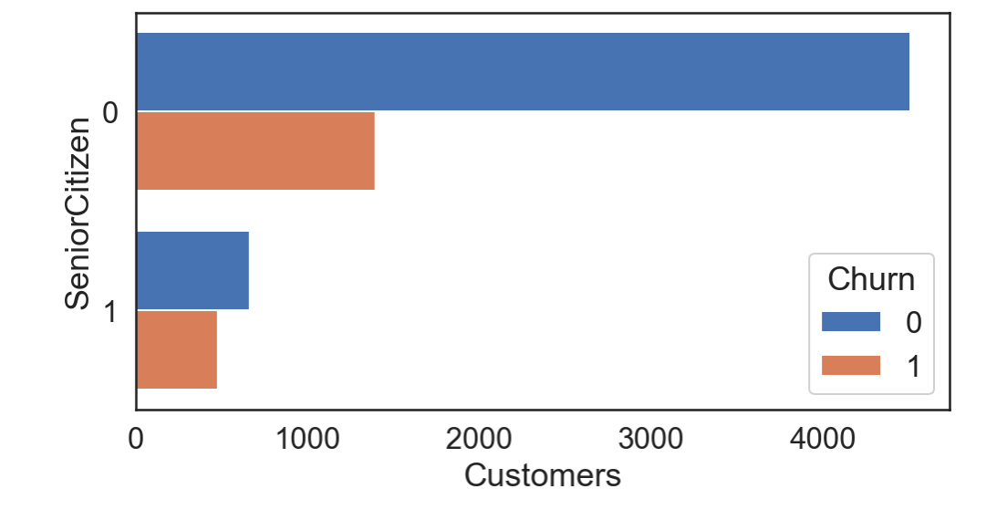
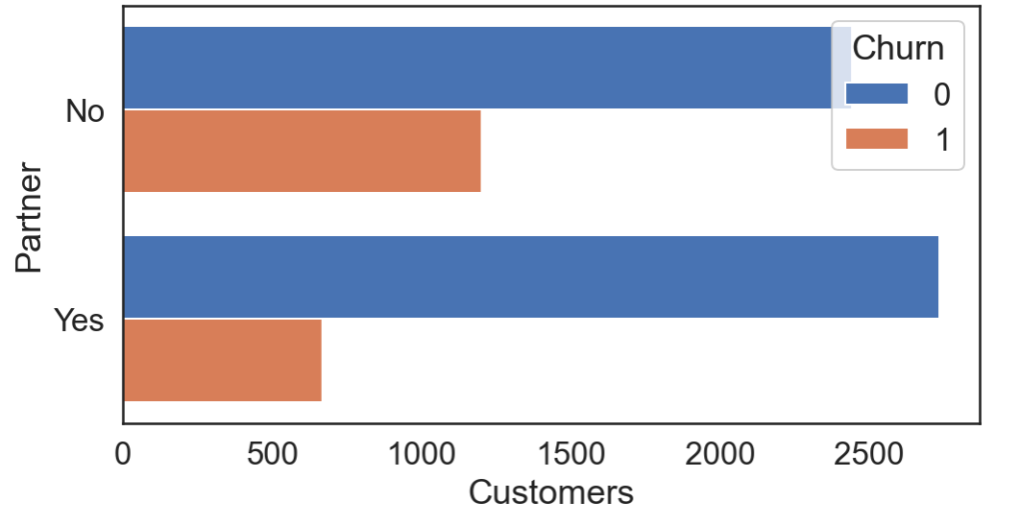
Churn Likelihood
Increased for customers who:
recently joined
pay high monthly charges
are over 65 years old
are living without partners

Slide 5
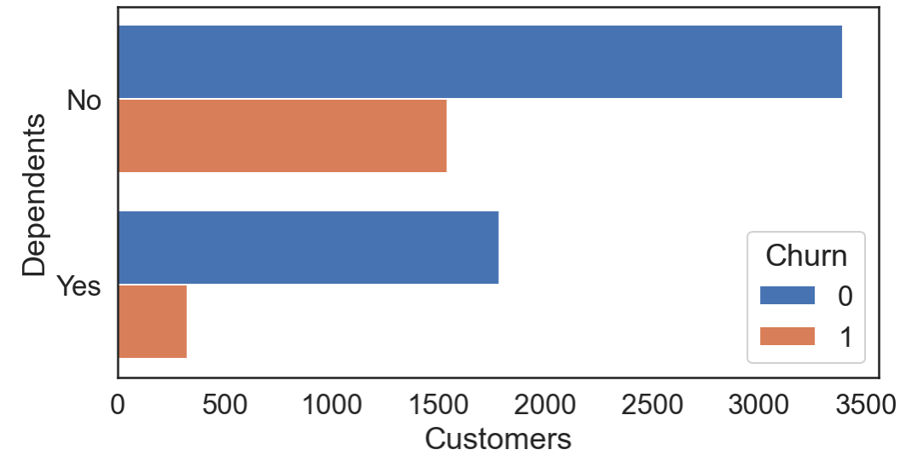
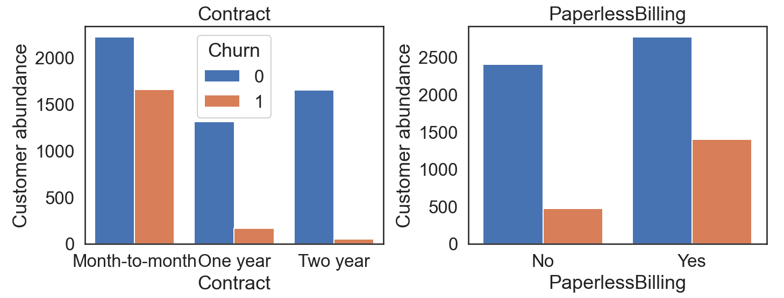
Churn Likelihood
Increased for customers who:
recently joined
pay high monthly charges
are over 65 years old
are living without partners
are living with dependents (children, parents, …)
have a short term contract
have a paperless billing

Slide 6
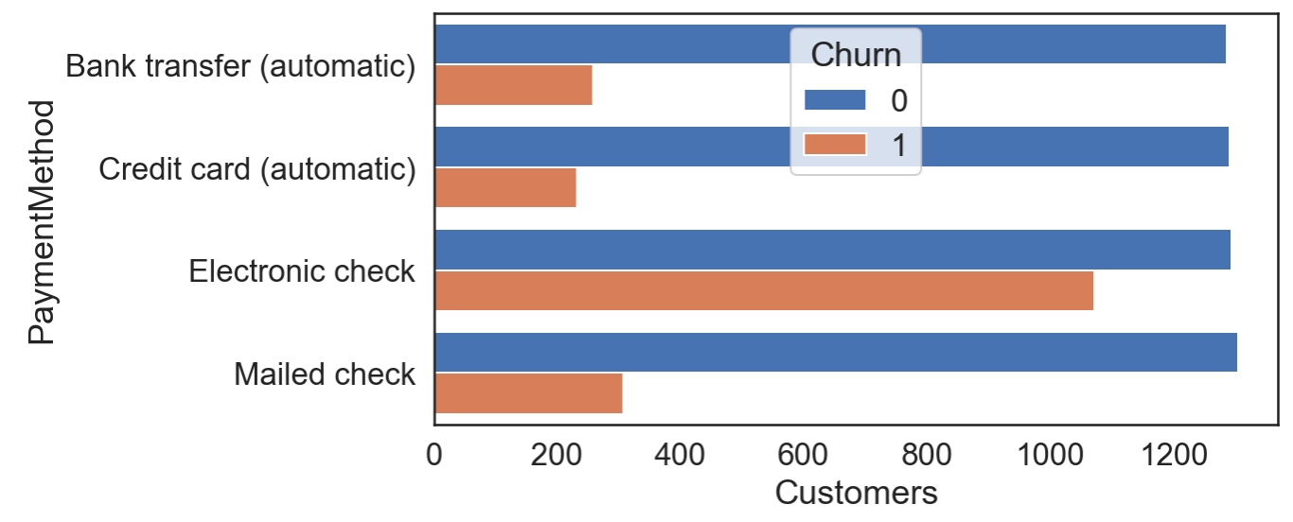
Churn Likelihood
Increased for customers who:
recently joined
pay high monthly charges
are over 65 years old
are living without partners
are living with dependents (children, parents, …)
have a short term contract
have a paperless billing
use an electronic check

Slide 7
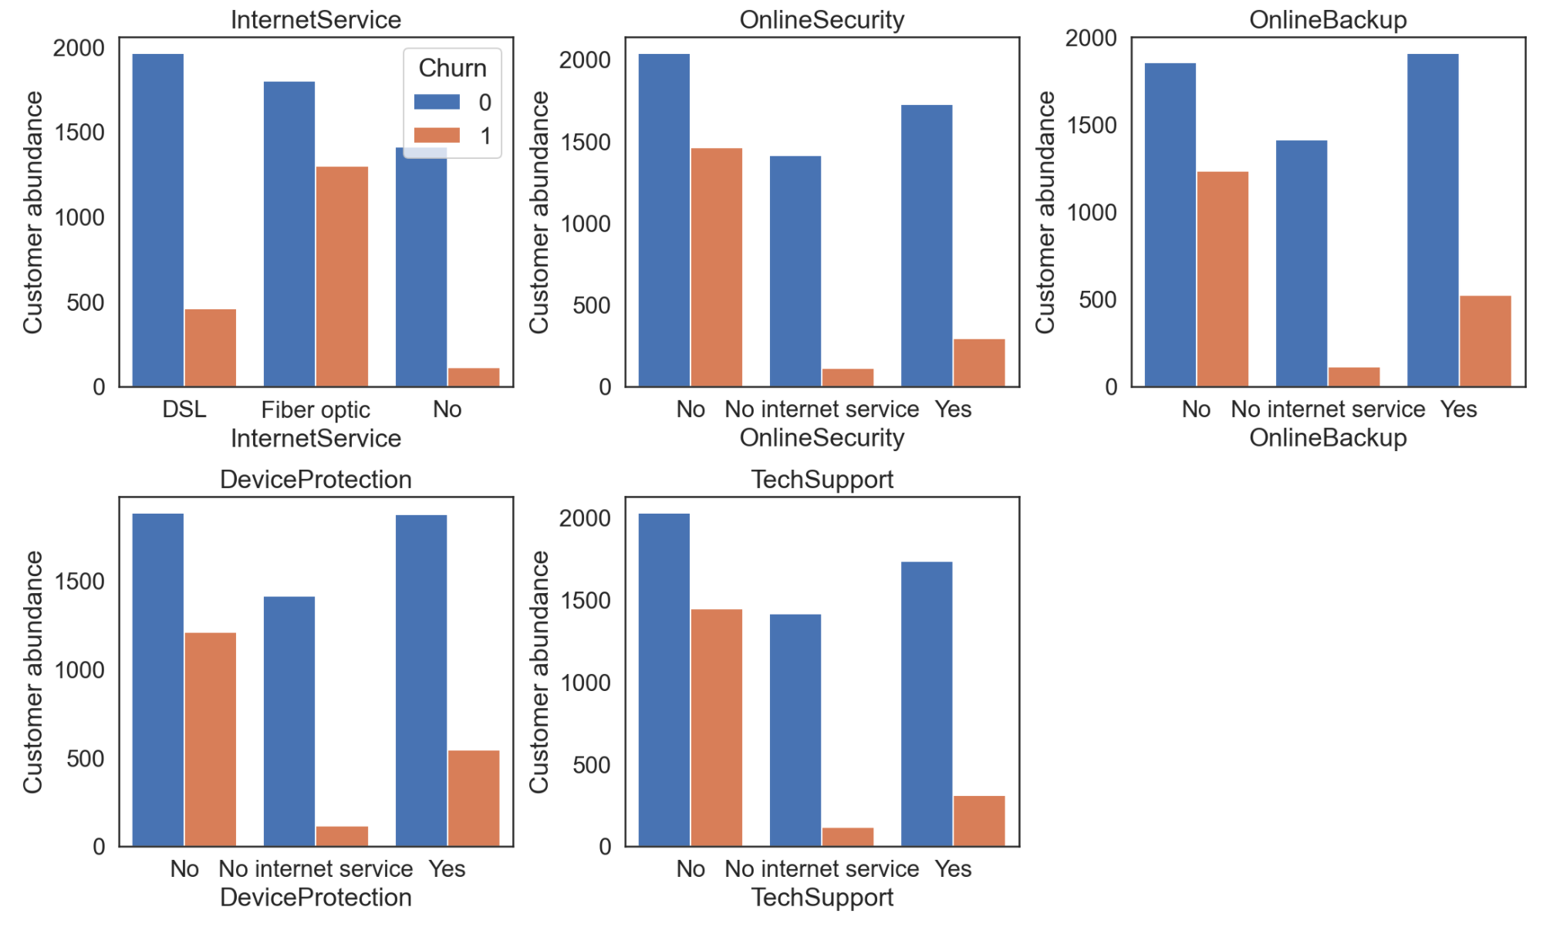
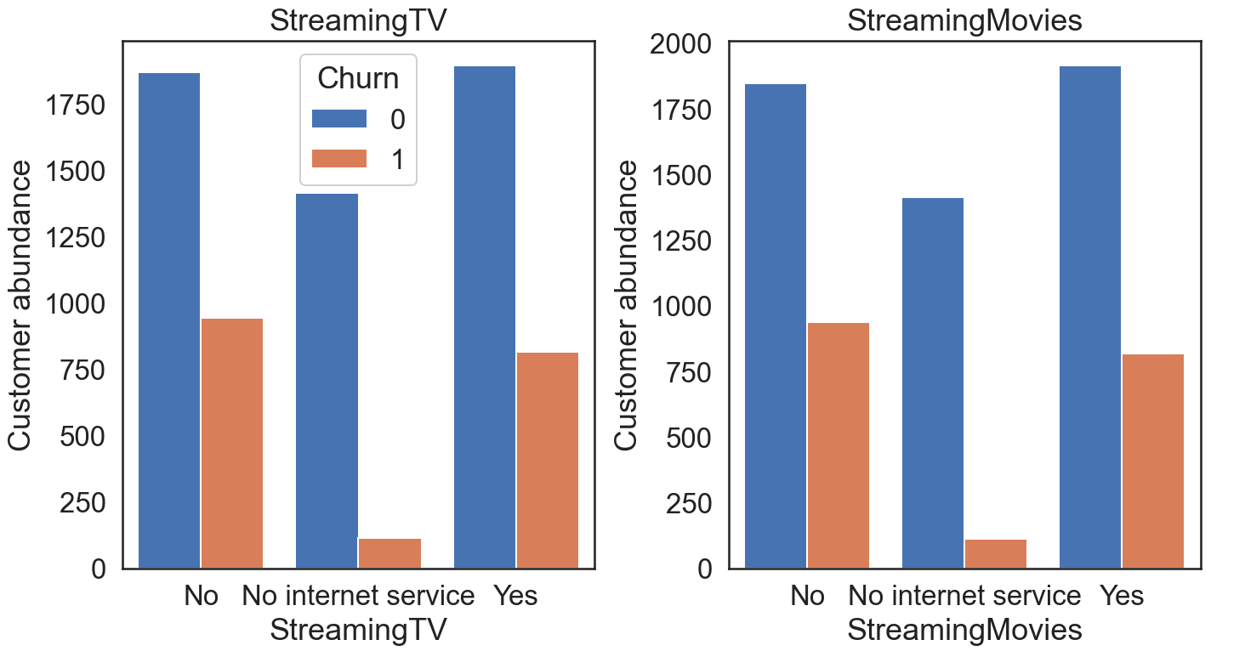
Churn Likelihood
Streaming service plays a minor role

Slide 8
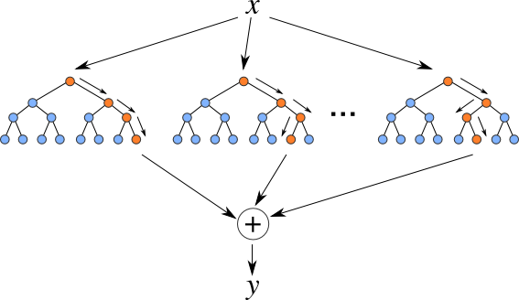
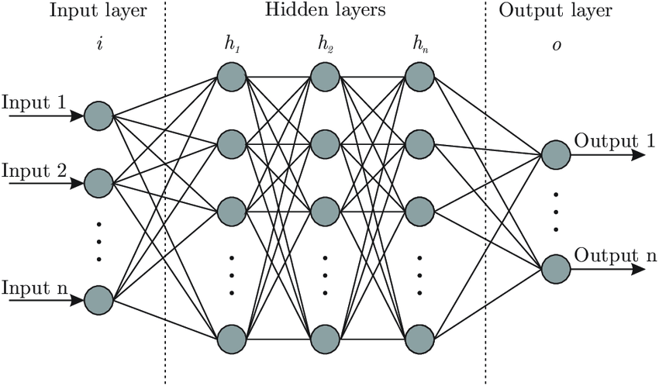
Data Setup & Models
Data resample (upsample of customers who churned)
Dropping of uninformative features
Features encoding
Train/Test split
Features normalization
 | Features | Labels
Train | (8278, 28) | (8278, )
Test | (2070, 28) | (2070, )
Total | (10348, 28) | (10348, )
(7043, 22)

Slide 9
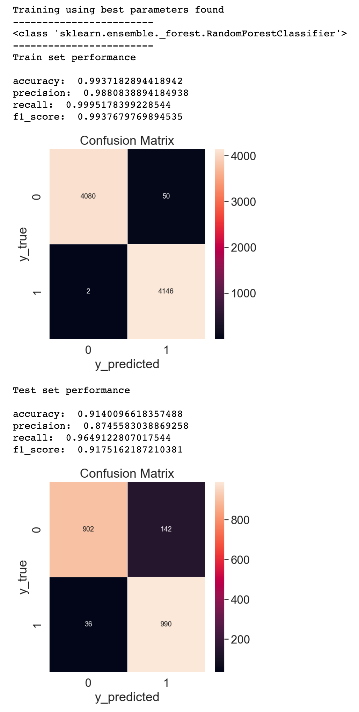
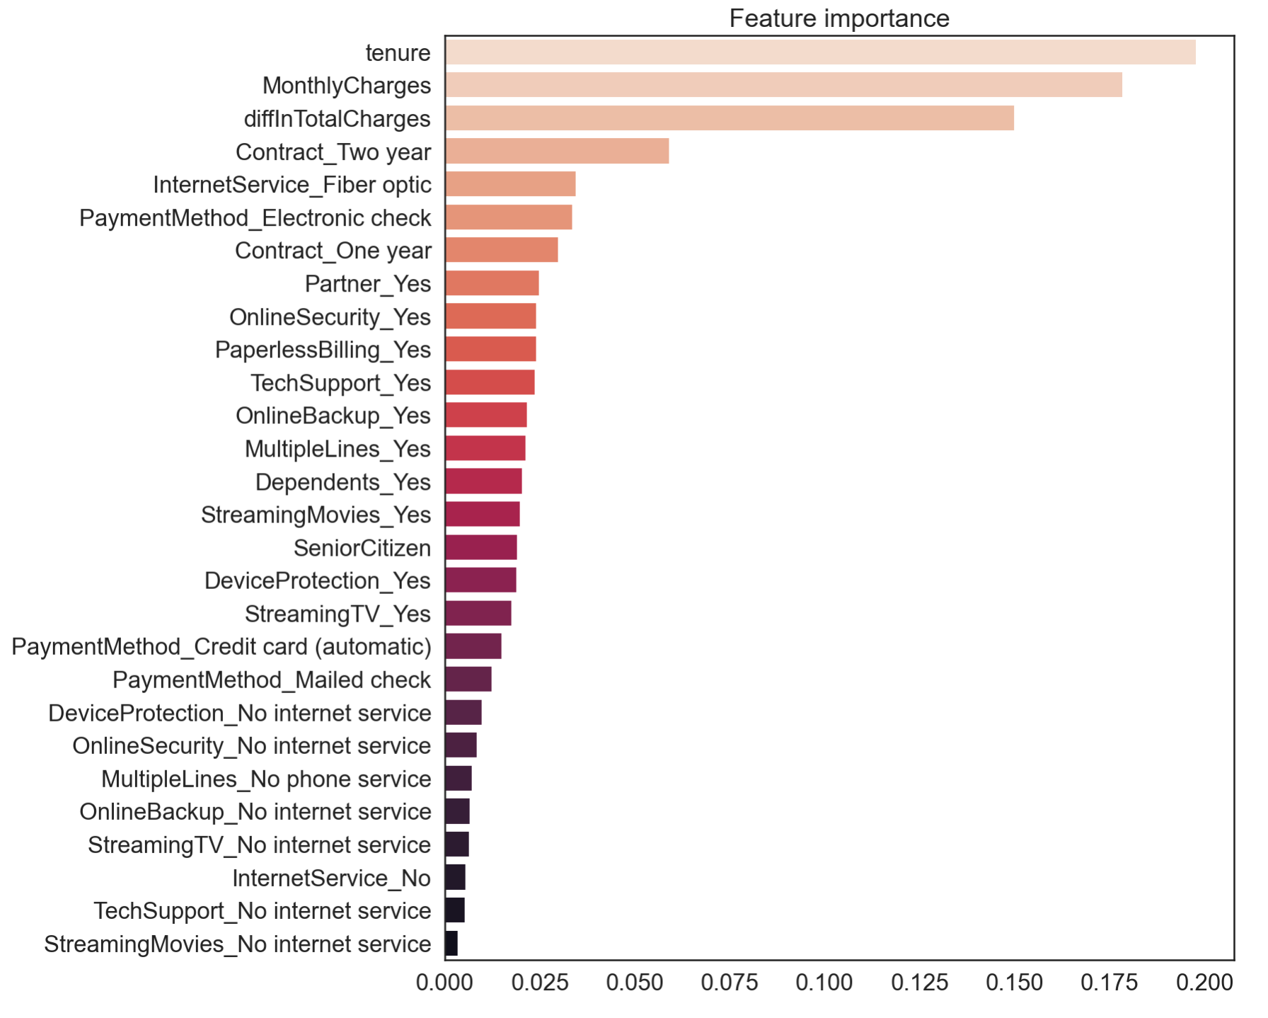
Random Forest
KPI: Recall TP / (TP+FN)
Optimized for:
Eestimators = 100
Max depth = 20
Split criterion = Entropy
Min samples for split = 2

Slide 10
Conclusions
Churn can be effectively predicted using our RF model
Test Model Recall : 96%
Feature importance confirmed our first exploratory analysis
Detected customers can be immediately targeted with aimed strategies:
Next month discounts
Longer term contracts
Push towards online security/ backup/ device protection/ tech support
Optic fiber service optimization:
Lower monthly price
Check quality

Slide 11

Thank you for the attention

