Slide 1

PhotoGlue
Instructions for use
Pierluigi Mansueto
University of Florence
Notes:
<numero>

Slide 2

PhotoGlue
Instructions for use
University of Florence
What is PhotoGlue for?
Program based on a MILP (Mixed Integer Linear Problem).
This MILP allows to create an arrangement of rectangular elements on a rectangular space, taking into account the aspect ratio of each element.
In the PhotoGlue context, these elements are photos: the photos are characterized by a width and a height and, consequently, by an aspect ratio.
The rectangular space is a background photo chosen by the user.
The PhotoGlue aim is the creation of collages from some selected photos.
2
Notes:
<numero>

Slide 3
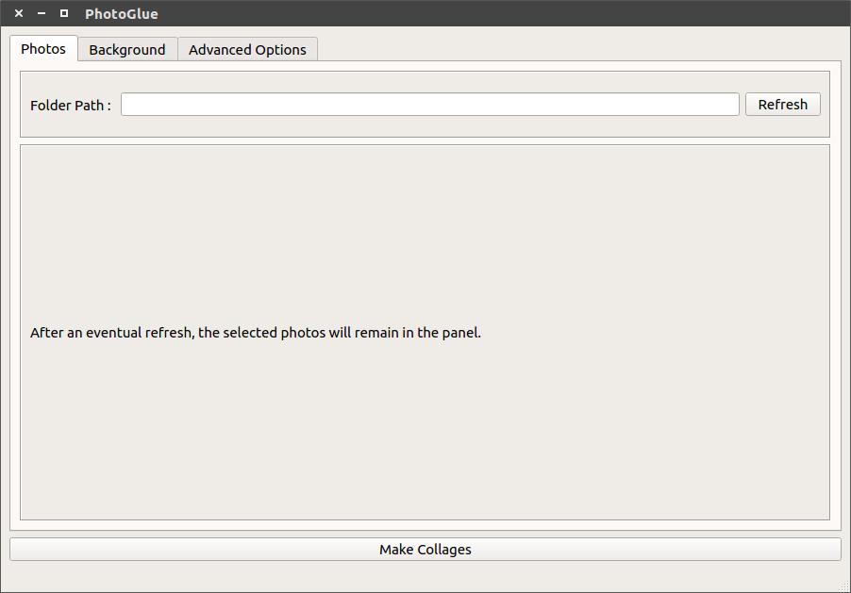
PhotoGlue
Instructions for use
University of Florence
The Photo Tab - 1
Insert the path to a folder which contains some photos (files supported: JPG, JPEG, PNG).
Press this button
after inserting a
valid folder path.
3
Notes:
<numero>

Slide 4
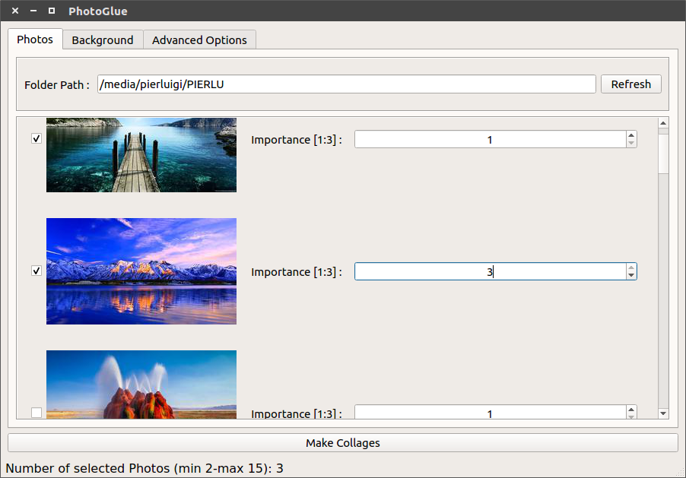
PhotoGlue
Instructions for use
University of Florence
The Photo Tab - 2
Select the
checkbox
of the photos
you want
in the collages.
Photo preview.
Choose the photo importance.
The greater the importance the greater
the scaling factor to apply at this photo will be.
Counter of
selected photos.
4
Notes:
<numero>

Slide 5
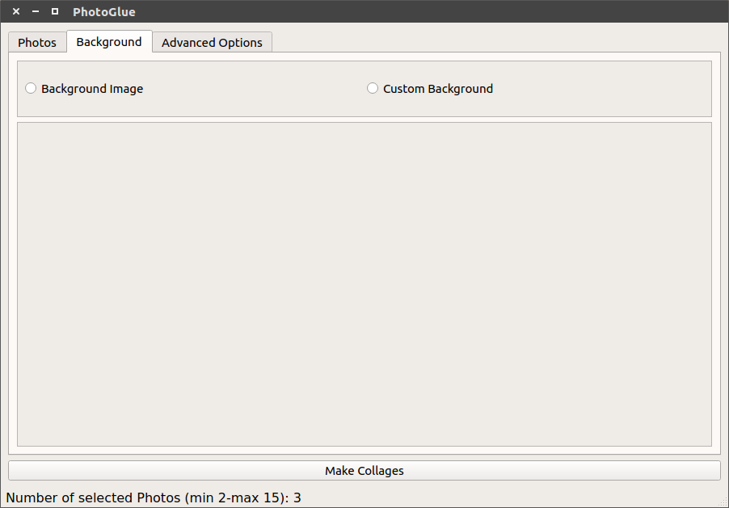
PhotoGlue
Instructions for use
University of Florence
The Background Tab - 1
Choose between a background image or a background in which you can choose colours, width and height.
5
Notes:
<numero>

Slide 6
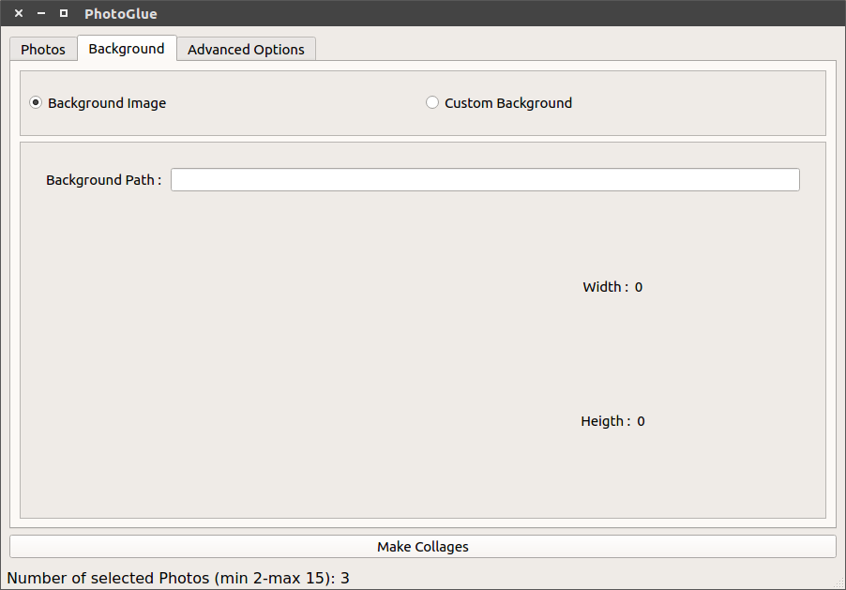
PhotoGlue
Instructions for use
University of Florence
The Background Tab - 2
Insert a path to a photo which will constitute the background of the collages.
6
Notes:
<numero>

Slide 7
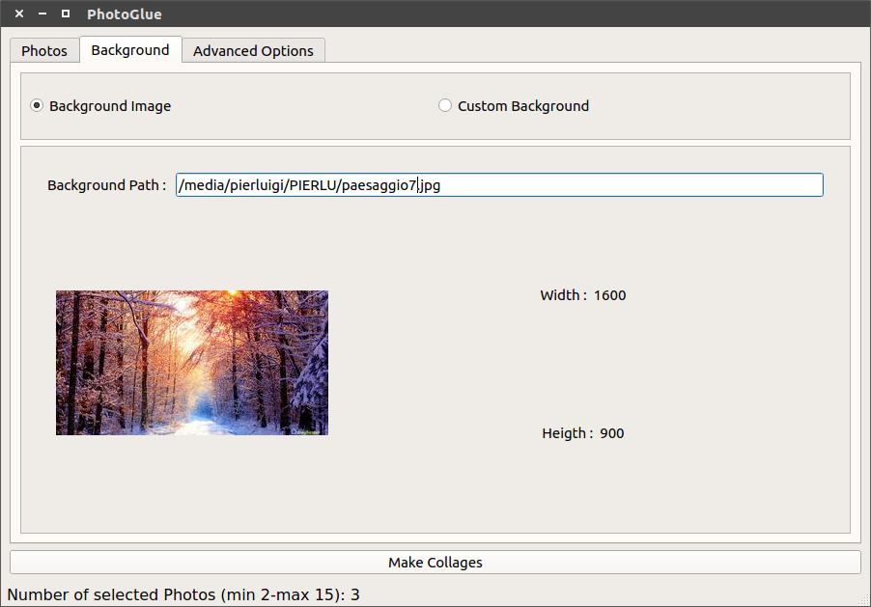
PhotoGlue
Instructions for use
University of Florence
The Background Tab - 3
After entering a valid photo path, a photo preview, the width and the height of the photo will compare.
Photo preview.
7
Notes:
<numero>

Slide 8
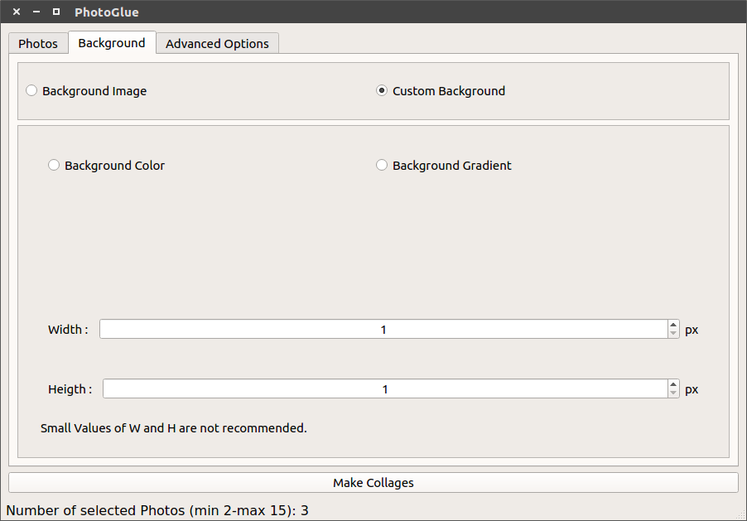
PhotoGlue
Instructions for use
University of Florence
The Background Tab - 4
Choose between a background characterized by one colour or another one characterized by a linear interpolation between two colours.
8
Notes:
<numero>

Slide 9
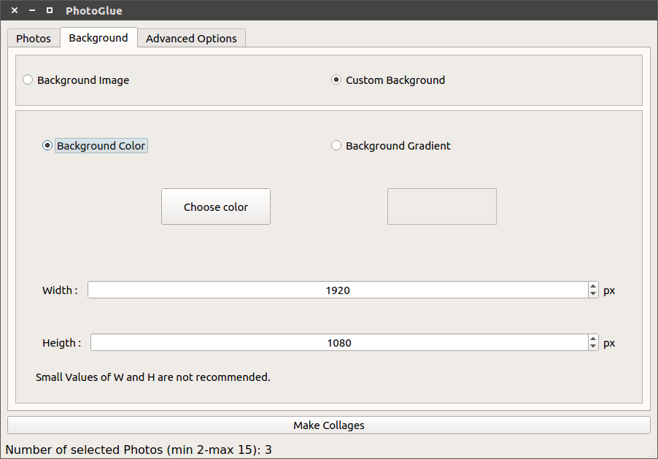
PhotoGlue
Instructions for use
University of Florence
The Background Tab - 5
The background area must be big enough to contain the smallest representation of each photo.
9
Notes:
<numero>

Slide 10
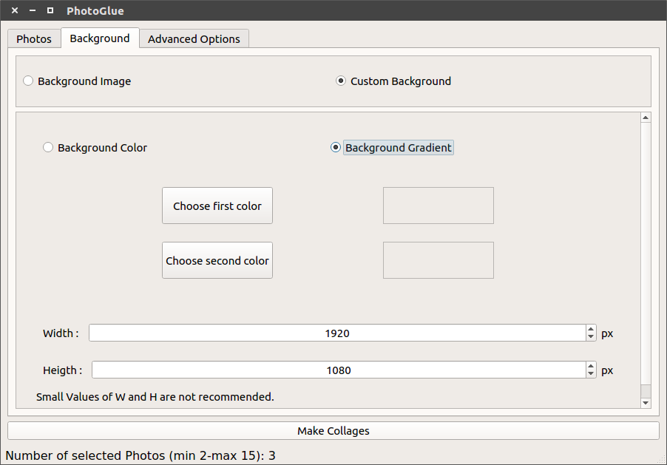
PhotoGlue
Instructions for use
University of Florence
The Background Tab - 6
Linear interpolation between these colours.
10
Notes:
<numero>

Slide 11
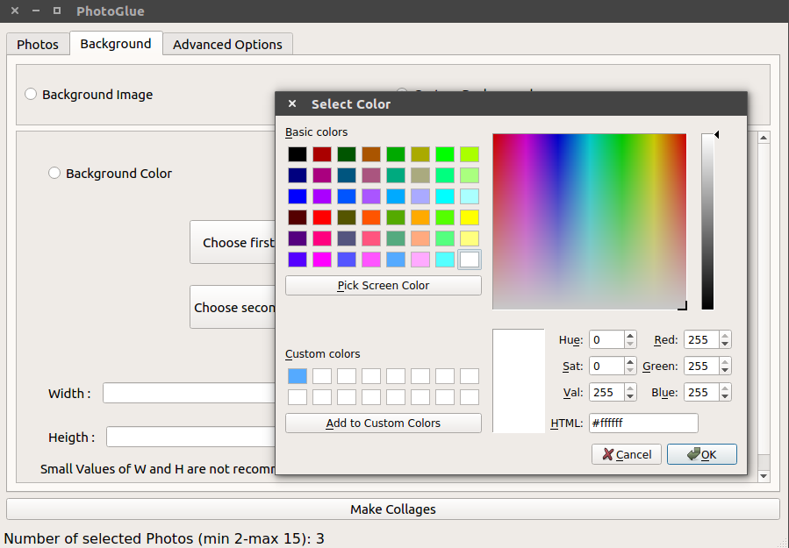
PhotoGlue
Instructions for use
University of Florence
The Background Tab - 7
You can choose also a particular shade of a colour.
You can choose basic colours.
Save your favourite colours.
11
Notes:
<numero>

Slide 12
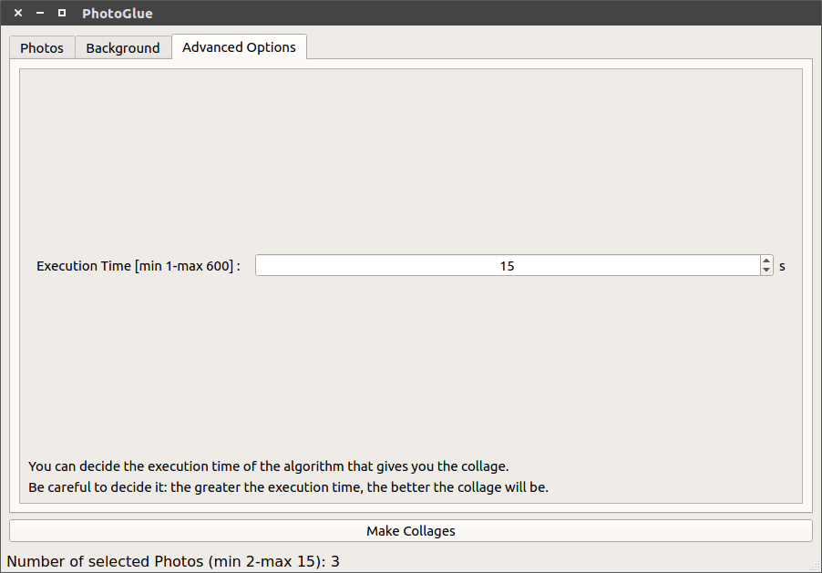
PhotoGlue
Instructions for use
University of Florence
The Advanced Options Tab
12
Notes:
<numero>

Slide 13
PhotoGlue
Instructions for use
University of Florence
Are you ready? Let’s make a collage!
Press the button.
13
Notes:
<numero>

Slide 14
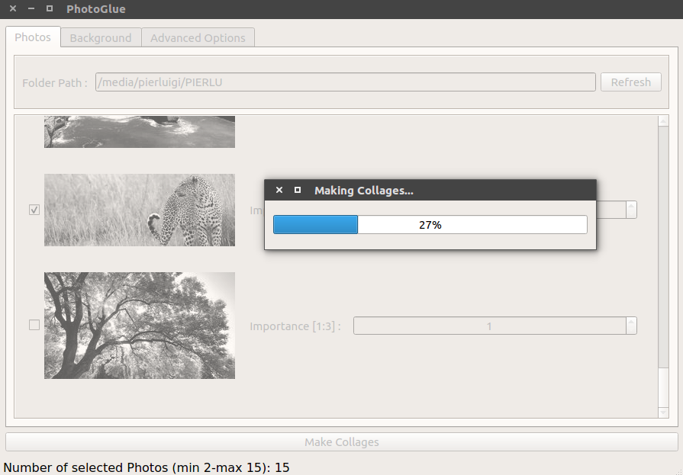
PhotoGlue
Instructions for use
University of Florence
Are you ready? Let’s make a collage!
14
Notes:
<numero>

Slide 15
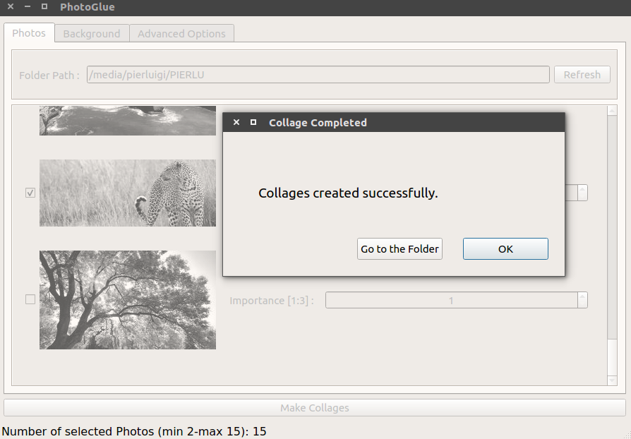
PhotoGlue
Instructions for use
University of Florence
Are you ready? Let’s make a collage!
You can go to the folder to see your new collages. The maximum number of created collages is 5 (as the maximum number of solutions of the optimization algorithm execution).
When you want, you can create some new collages with other photos.
15
Notes:
<numero>

Slide 16
PhotoGlue
Instructions for use
University of Florence
Pay attention
In the MILP, the bottom-left corner is considered as the origin both of the elements and of the background area.
On the contrary in PhotoGlue, the top-left corner is considered.
However this does not involve big distortions on the results of the optimization algorithm execution.
16
Notes:
<numero>

Slide 17
Thank you for the attention
Pierluigi Mansueto
University of Florence
Notes:
<numero>

