Slide 1
Design Patterns
at least the ones I find most useful

Slide 2

Why Design Patterns?
Known solutions to common problems…
…let’s not reinvent the wheel ☺
We are already using patterns…
…it’s all about common sense ☺
Patterns may confirm (or correct) our design…
…useful to double-check our assumptions ☺
Patterns should be adapted to the problem…
…not the other way around!

Slide 3
State
FSM
+ handleEvent()
INIT
currentState
play
pause
State
PLAY
PAUSE
play
+ handleEvent()
stop
stop
STOP
InitState
PlayState
+ handleEvent()
+ handleEvent()
The Strategy pattern is similar…

Slide 4
State
DEMO

Slide 5
Composite
Compose objects into tree structures…
…and treat “branches” and “leaves” identically!
Picture
Picture
Line
Rectangle
Text
Line
Rectangle

Slide 6
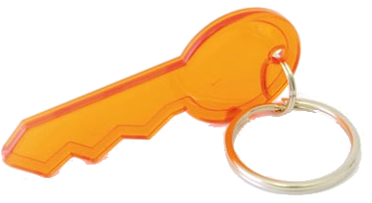
Composite
Abstract class that represents both primitives and their containers
graphics
Graphic Object
+ draw()
Text
Line
Rectangle
Picture
+ draw()
+ draw()
+ draw()
+ draw()
+ add()
+ remove()

Slide 7
Composite
operation()
children
Component
+ operation()
Node
Node
Node
Leaf
Leaf
Node
+ operation()
+ operation()
Leaf
Leaf
Leaf
for each c in children:
c.operation()

Slide 8
Composite
DEMO

Slide 9
Double Dispatch
<<abstract>> Event
sysEvt.handle();
usrEvt.handle();
sysEvt.toString();
usrEvt.toString();
+ handle() + toString()
SystemEvent
UserEvent
+ handle() + toString()
+ handle() + toString()
Receiver type
Request name
Single Dispatch

Slide 10
Double Dispatch
<<abstract>> Event
<<abstract>> Handler
+ process(Handler)
+ handle(SystemEvent) + handle(UserEvent)
SystemEvent
UserEvent
+ process(Handler)
+ process(Handler)
DefaultHandler
DumpHandler
…
…
DumpHandler.handle(this)
Receiver type 2
Request name
Receiver type 1
SystemEvent.toString()

Slide 11
Visitor
<<abstract>> Element
<<abstract>> Visitor
+ accept(Visitor)
+ visit(Concrete_A)
+ visit(Concrete_B)
Concrete_A
Concrete_B
Visitor_One
Visitor_Two
+ accept(Visitor)
+ accept(Visitor)
+ visit(Concrete_A)
+ visit(Concrete_B)
+ visit(Concrete_A)
+ visit(Concrete_B)
accept(Visitor_One)
v.visit(this)
a.method()

Slide 12
Visitor
+ PROS
Great to traverse hierarchies and accumulate state ☺
Adding new operations is easy…
…just add a new Visitor ☺
- CONS
Adding a new Concrete Element is hard…
…must implement all abstract methods ☹
May break incapsulation of Elements ☹

Slide 13
Visitor + Composite
Visitor
Component
+ visit(Node)
+ visit(Leaf)
+ accept(Visitor)
CountVisitor
XmlVisitor
Leaf
Node
+ visit(Node)
+ visit(Leaf)
+ visit(Node)
+ visit(Leaf)
+ accept(Visitor)
+ accept(Visitor)
<node id=“1”>
Nodes Leaves
1
<node id=“2”>
1 0
2
A
<leaf id=“A”/>
2 0
</node> <node id=“3”>
2 1
3
B
<leaf id=“B”/>
3 1
</node> <leaf id=“C”/>
</node>
3 2
C
3 3

Slide 14
Visitor + Composite
DEMO

Slide 15
Example
Collect data
Multiple sources
(System, Network, Player…)
Send reports
Many output formats (text, JSON, XML, …)
Perception
Cross-platform (Linux, OSX, PS3…)

Slide 16

Example
Collect data
Linux
Linux
System
OSX
Networking
OSX
PS3
PS3
Linux
Player
OSX
PS3

Slide 17
Example
Collect data
Abstract Factory
Network Collector
System Collector
+ createSystemCollector() + createNetworkCollctor() + createPlayerCollector()
Linux Network Collector
Linux System Collector
Linux Factory
+ createSystemCollector() + createNetworkCollctor() + createPlayerCollector()
Abstract Factory

Slide 18
Example
Collect data
…data?
Hierarchy
Handled uniformly (e.g. dump())
System:
CPU: Intel Atom
Mem: 2 GB
Network:
lo:
ip: 127.0.0.1
mac: 00:00:00:00:00
eth0:
ip: 10.2.2.35
mac: d4:9a:20:d6:8f:d2
Player:
video: H.264
audio: AC3
buffering:
time: 0:20:41 data: 241 bytes
Component
+ accept(Visitor)
Leaf
Node
+ accept(Visitor)
+ accept(Visitor)

Slide 19
Example
Send reports
Visitor
+ visit(Node)
+ visit(Leaf)
Component
JsonVisitor
XmlVisitor
+ accept(Visitor)
+ visit(Node)
+ visit(Leaf)
+ visit(Node)
+ visit(Leaf)
Leaf
Node
+ accept(Visitor)
+ accept(Visitor)

Slide 20
Example
<< create >>
Network Collector
Abstract Factory
<< use >>
+ createSystemCollector() + createNetworkCollctor() + createPlayerCollector()
<< create >>
Linux Network Collector
OSX Network Collector
PS3 Network Collector
Linux Factory
System Collector
<< use >>
+ createSystemCollector() + createNetworkCollctor() + createPlayerCollector()
Linux System Collector
OSX System Collector
PS3 System Collector
…more classes here…
Component
Visitor
<< visit >>
+ accept(Visitor)
+ visit(Node)
+ visit(Leaf)
Leaf
Node
JsonVisitor
XmlVisitor
+ accept(Visitor)
+ accept(Visitor)
+ visit(Node)
+ visit(Leaf)
+ visit(Node)
+ visit(Leaf)

Slide 21
Example
Abstract Factory
<< populate >>
Composite
Visitor
<< visit >>
Design patterns are not just common practices…
…they also define a common language ☺

Slide 22
Example
DEMO

Slide 23
Communications
Simplistic Approach
it’s better to avoid this ;-)
System
Log
User
UI
Not scalable
Logic + Communication code (replicated!)
Each sender needs to know its receivers
Can’t easily change the interfaces of Log and UI

Slide 24
Communications
Mediator
System
Log
Not very dynamic
Mediator
User
UI
The Mediator concentrates and coordinates communications (hub-like)
Senders don’t need to know their receivers ☺
Many-to-many → One-to-many ☺
The Mediator needs to know the receives’ type in advance ☹
Centralizes control: monolithic, can be hard to maintain ☹

Slide 25
Communications
Observer
UI
Model
Observer
system.attach(this);
void update(Model m) {
m.getState();
}
System
Log
User
UI
Model
The Observer distributes communications
More dynamic than Mediator ☺
Models must maintain list of Observers ☹
Observers need to know their Models ☹
void onStateChanged() {
foreach obs in observers {
obs.update(this);
}
}

Slide 26
Communications
Event Notifier
Publisher
Subscriber
System
Event Service
Log
User
UI
Centralized: Publishers and Subscribers don’t know each other.
Subscribers only know about events…
…and register their own policies/filters
Dynamic: Elements can be added/removed without hassle.

Slide 27
Communications
Mediator
Simplistic Approach
System
Log
System
Log
Mediator
User
UI
User
UI
Observer
Event Notifier
Subject
Observer
Publisher
Subscriber
System
Log
System
Event Service
Log
User
UI
User
UI

Slide 28
Event Notifier
Event Notifier
Subscriber
subscribe
+ subscribe(EventType, Subscriber, Filter) + unsubscribe(EventType, Subscriber, Filter) + publish(Event)
+ notify(Event)
Event Type
Filter
notify
Event
apply
Event
publish
Event
It’s possible to add at runtime:
Publishers
Subscribers
Event types
Filter
Publisher
+ apply(Event)
We took the best from Mediator and Observer,
without their disadvantages ☺

Slide 29
Event Notifier
DEMO

Slide 30
Active Object
Client
Future
Decouple method invocation from method execution.
Future
Scheduler
Proxy
Servant
Method Request
Activation List
Future
Result
Same thread as Client
Separate thread

Slide 31
Active Object
Consider priorities and multiple CPUs
Opportunities for optimization…
Scheduler
Thread spawning / pooling
Proxy
Servant
Method Request
Activation List
Future
Result
Liabilities…
Execution order != invocation order
→ Difficult to debug

Slide 32
Active Object
DEMO

Slide 33
Half-Sync/Half-Async
Asynchronous programming is generally more efficient
Services
Interrupts
Callbacks
Synchronous programming is generally easier
Usually less complex
Explicit time constraints
Of course we want the best of both worlds ;-)

Slide 34
Half-Sync/Half-Async
Decompose the services of our system into two layers…
SYNC
queuing
ASYNC
…and add a queuing layer between them.

Slide 35
Half-Sync/Half-Async
Long high-level services (e.g. DB queries, file transfers) in separate threads
SYNC
queuing
Communication between layers
ASYNC
Short low-level services (e.g. interrupt handlers)

Slide 36
Half-Sync/Half-Async
External event source
Async service
Queue
Sync service
notification
Do any required work
read
message
“Input available”
message
Actual processing
notification
Available for new work
read
message

Slide 37
Half-Sync/Half-Async
Many things to think of…
Identify candidate services for sync/async
Sync: Threading model? Thread safety…
Async: Interrupts? Completion events?
Queuing: Buffering? Serialization?
Inter-layer communication?
Sockets? Callbacks?
Demultiplexing and notification strategy?
Monitor Object
Active Object

Slide 38

Anti-patterns
Know your enemy
Known wrong solutions to common problems
public class EventHandler {
public void handle (SystemEvent e) {
saveSystemState(e);
}
}
public class BackupEventHandler extends EventHandler {
public void handle(SystemEvent e) {
super.handle(e);
startBackup(e);
}
}
Call Super

Slide 39
Anti-patterns
Fixed using a Template method:
public class EventHandler {
public void handle (SystemEvent e) {
saveSystemState(e);
doHandle(e);
}
protected void doHandle(SystemEvent e) {}
}
public class BackupEventHandler extends EventHandler {
protected void doHandle(SystemEvent e) {
startBackup(e);
}
}

Slide 40

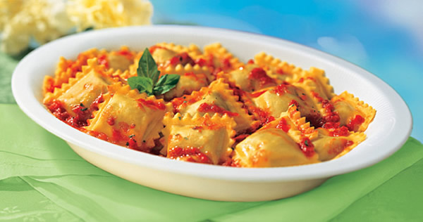
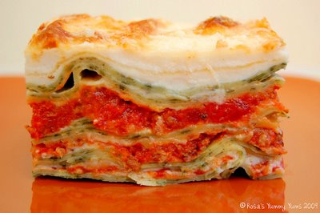
Anti-patterns
God Object
Knows too much
Does too much
Ravioli Code
Small loosely-coupled components
Results from overzealous separation
Lasagna Code
“muddy” layers…
…overly encapsulated

Slide 41
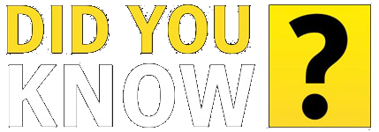
Anti-patterns
Test-Driven Development
Tests drive the implementation, towards the fulfilment of requirements.
…BUT…
Tester-Driven Development
Requirements driven by bug reports or test results

Slide 42
So what’s the point?
Design Patterns are useful tools
If used properly, they help designing elegant software
They can’t be applied everywhere! Belief in universal applicability is an anti-pattern (Golden Hammer, Silver Bullet)
They also define a common language
A class called “Observer” should be self-describing
There’s a lot of them
Many different areas, scopes and languages (idioms)
Creational, Structural, Behavioural, Architectural, …
Have fun! ☺

Slide 43
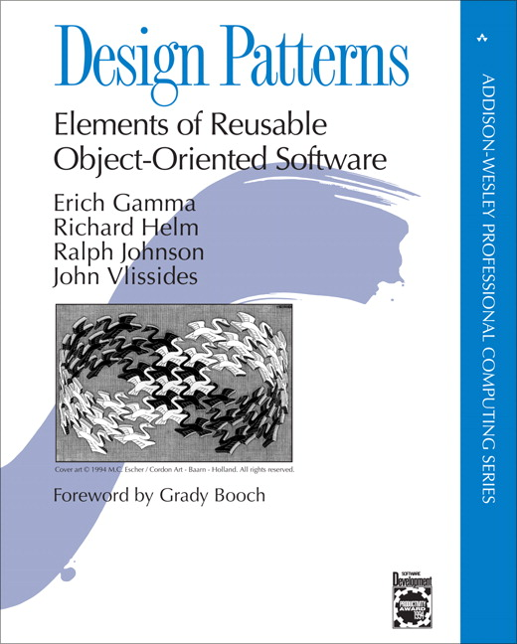
References
The "Gang of Four” (GoF)
Erich Gamma, Richard Helm,
Ralph Johnson, John Vlissides
Vince Huston’s page http://www.vincehuston.org/dp/

Slide 44
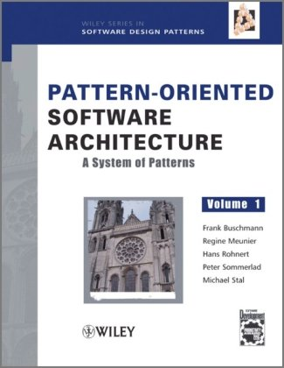

References
POSA
Vol. 1 – 2 (3 – 4)
Patterns for Concurrent and Networked Objects
A System of Patterns

Slide 45

Thank you
…any questions?

