Slide 1
From the G_dm identification to the final LFR, and why the G_dm-W2 controller goes unstable on the setup
W2 pipeline review · 80 Hz disturbance rejection · November 2026
Notes:
Two parts: the new way the uncertain LFT model is built (from the grey-box G_dm identification to the final LFR used by the IQC synthesis), and the analysis of the instability observed on the setup with the G_dm-W2 controller at 0 kg.

Slide 2
Pipeline: from measured FRFs to a robust controller
1
2
3
4
5
Multimodel FRF
G_dm grey-box
Residual G_LTI
Weight W2
LFR + IQC
One sine sweep per added mass (0, 2.1, 5.9, 7.6 kg), etfe on a fine grid
Mass-dependent 2nd-order part, one mass per OP, common c and k
G_LTI,i = G_i / G_dm,i on the synthesis grid, nominal = mean
Pointwise bound of the relative error of the residuals
G = G_dm(m0 - dm) · G_LTI · (1 + W2 Δ), robust synthesis
Scripts: a_MultimodelFRFID → b_LFT2ndorderID (steps 2-5) → c_IQCcontrolSynW2 → d_ExperimentalResults
Notes:
The identification of G_dm is unchanged. What is new is everything after it: the residual LTI part is computed on the synthesis grid, W2 is the pointwise bound of the residual relative error (no rational fit), and the LFR combines the real mass parameter and the LTI uncertainty.

Slide 3
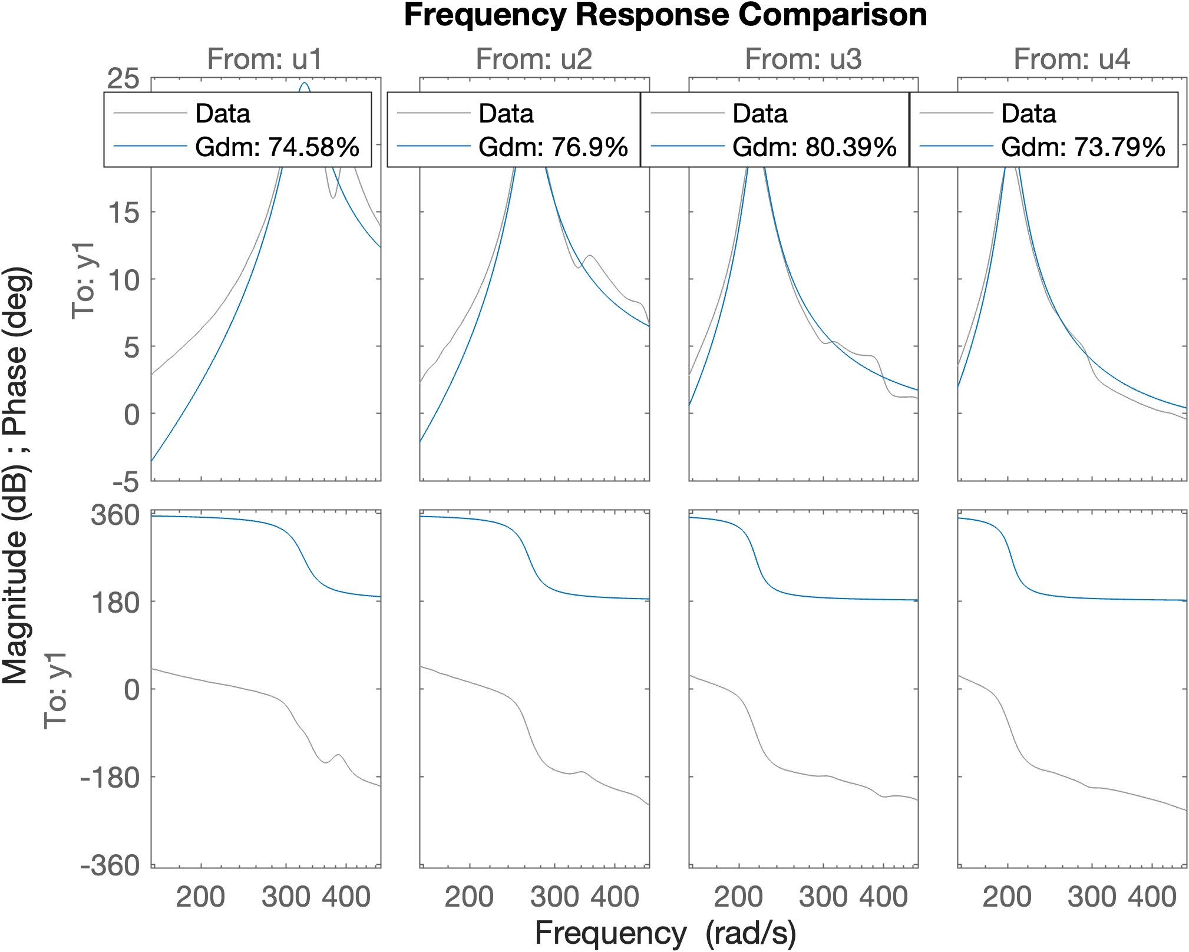
Step 2: G_dm captures the mass-dependent resonance
G_dm,i(s) = s² / (m_i s² + c s + k)
Fit on 25-75 Hz, one mass per operating point, common c and k
Tustin discretisation: the LFT in dm is then exact in discrete time
OP | m_i | resonance
0 kg | 0.449 | 52.4 Hz
2.1 kg | 0.684 | 42.4 Hz
5.9 kg | 1.028 | 34.6 Hz
7.6 kg | 1.164 | 32.5 Hz
m0 = 0.806 (centre), dm_bound = 0.358 (half-width): dm = ±0.358 covers all four masses
Notes:
c = 19.4, k = 48 606. m0 and dm_bound are the centre and half-width of the identified interval, not the mean, so the lightest mass (0 kg) sits exactly on the edge |dm| = dm_bound.

Slide 4
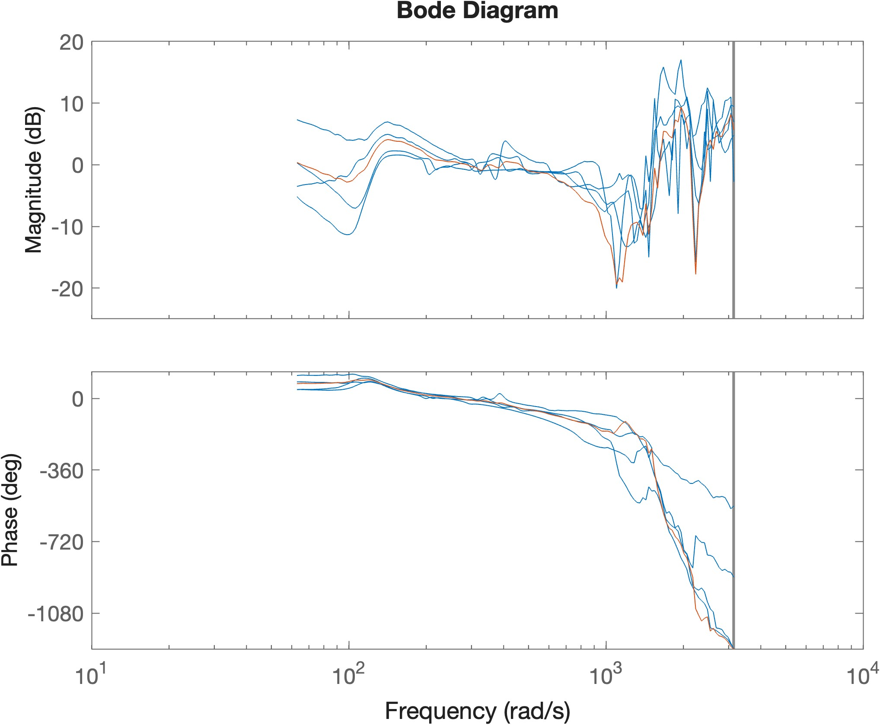
Step 3: what G_dm does not explain is the residual LTI part
G_LTI,i = G_i / G_dm,i, computed directly on the synthesis grid
Nominal G_LTI = mean of the four residuals (red)
Below 150 Hz the residuals nearly coincide: the mass effect is in G_dm
Above 150 Hz: structural modes that move between operating points, this is where the residual spread is large
Notes:
Synthesis grid: 300 points, log 10-20 Hz then linear (about 1.8 Hz spacing) up to Nyquist, with one point exactly at the disturbance frequency.

Slide 5
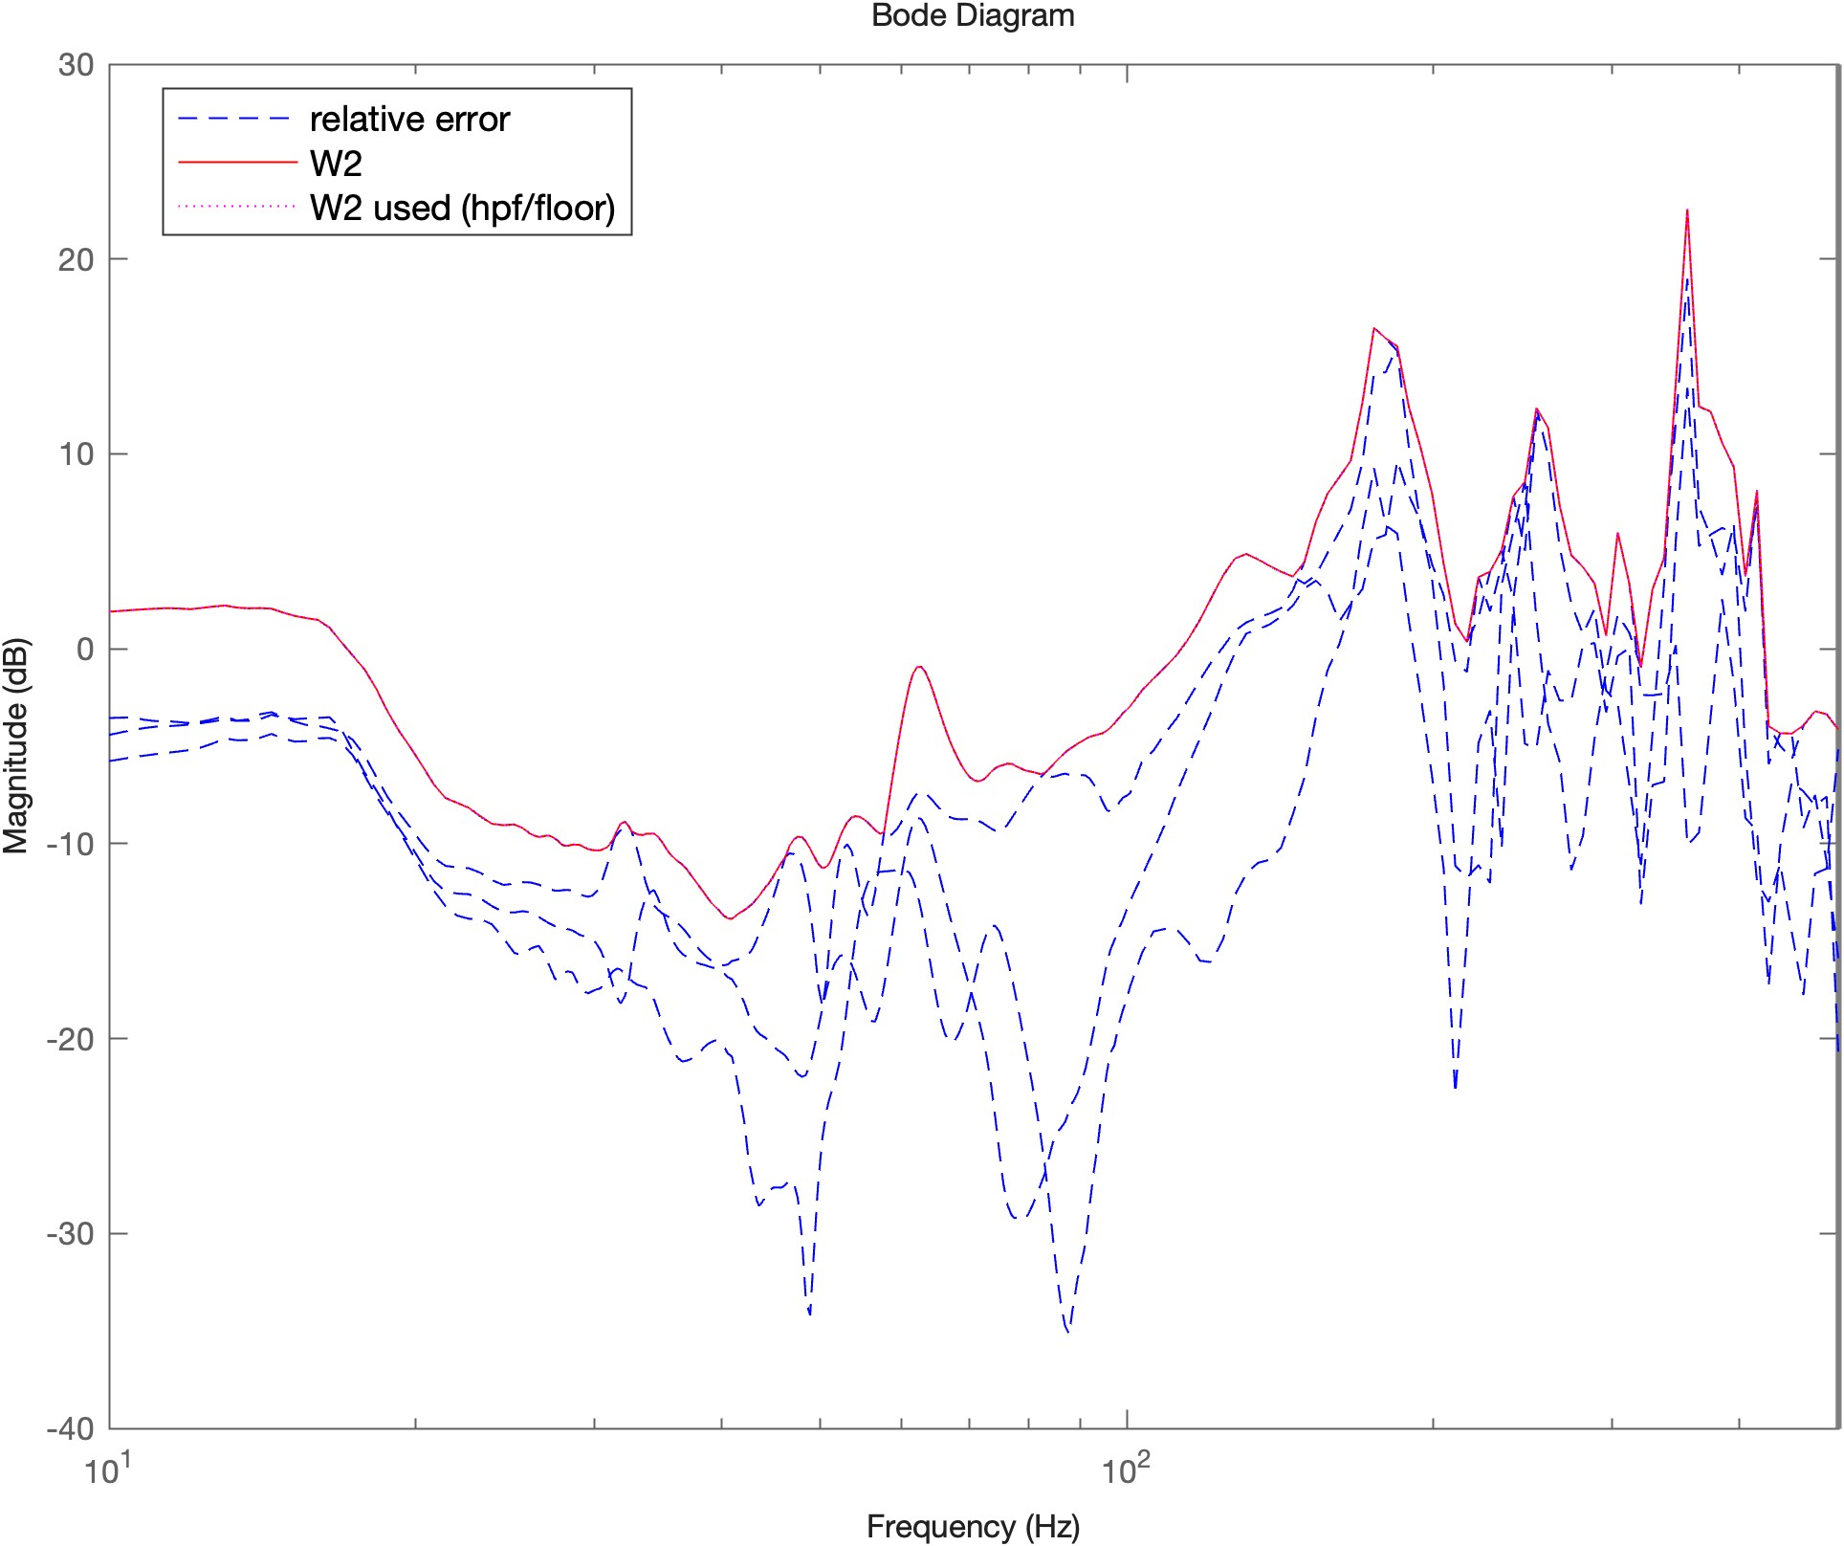
Step 4: W2 bounds the relative error of the residuals
|W2(jω)| = max_i |(G_LTI,i - G_LTI) / G_LTI|
Pointwise optimal bound (ucover W1opt), no rational fit
No high-pass filter, no floor: it covers exactly the measured spread
Small below 150 Hz (< -5 dB around 80 Hz), up to +22 dB at the high-frequency modes
Fine linear grid above 20 Hz so the narrow modes are sampled
Notes:
A consequence for later: around 80 Hz the four plants agree, so W2 is small there. The synthesis therefore assumes almost no uncertainty exactly where the controller puts its sharp resonance.

Slide 6
Step 5: the final LFR and what the synthesis certifies
G(dm, Δ) = G_dm(m0 - dm) · G_LTI · (1 + W2 Δ)
Δ: LTI uncertainty
dm: real parameter
Synthesis (c)
1×1 dynamic, ||Δ||∞ ≤ 1
Weighted by W2
Multiplier diag(1, -1)
|dm| ≤ η (mass units)
Multiplier [η²D, E; E*, -D]
D(ω), E(ω) optimised
1: robust stability at η0
2: min ||W1 S|| s.t. robust stab.
3: max η by bisection, alternate
Certificate: if the final η ≥ dm_bound = 0.358, the loop is robustly stable for all masses and all residuals inside W2 (on the grid)
Notes:
The certificate holds for the loop K × G with the plant inside the set. It assumes that the controller implemented on the setup is exactly the designed K: the second part of this review shows that this assumption is what fails.

Slide 7
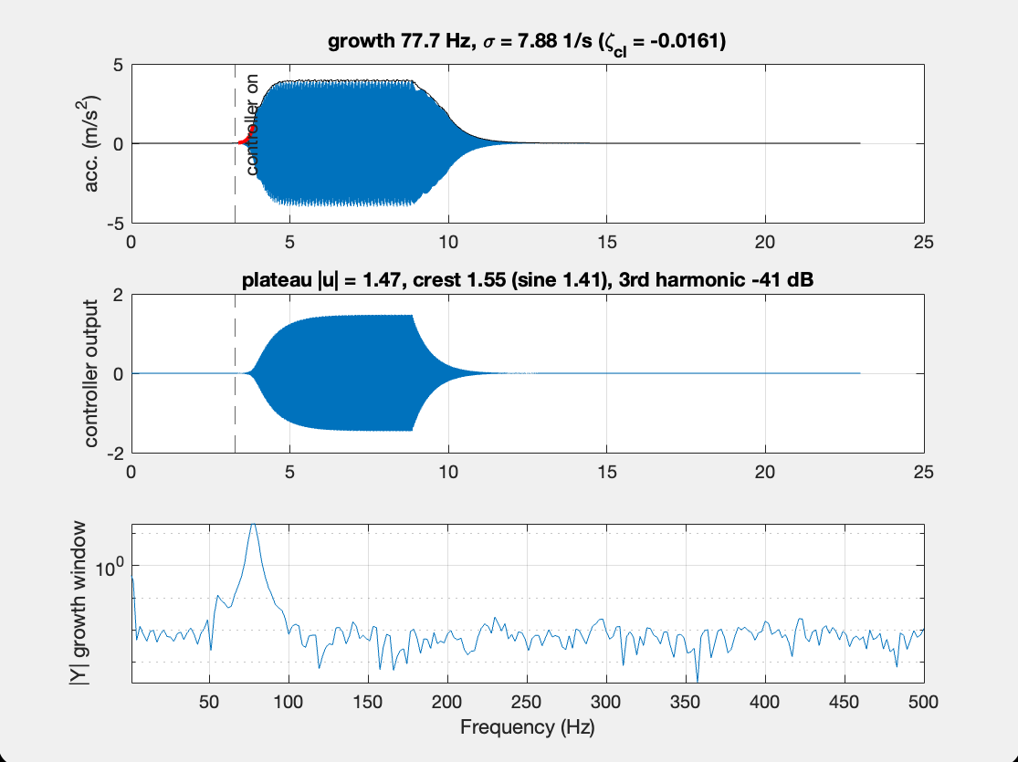
On the setup, K_chosen goes unstable at 0 kg
77.7 Hz
frequency of the growing oscillation
σ = +7.9 1/s
growth rate: closed-loop damping -0.016 (unstable)
No disturbance: it starts from noise when the controller is switched on
Controller output is a clean sine (crest 1.55, 3rd harmonic -41 dB): not clipped
The level is limited on the measurement side (≈ ±4 m/s²)
Notes:
Recording gfrf0_k_final_..._hyb_..._etaf0.60. Analysed with utils.instability in d_ExperimentalResults. After the controller is switched off, the ring-down at 79.9 Hz with damping 0.003 is the controller's own 80 Hz pole pair (79.9 Hz, damping 0.0034).

Slide 8
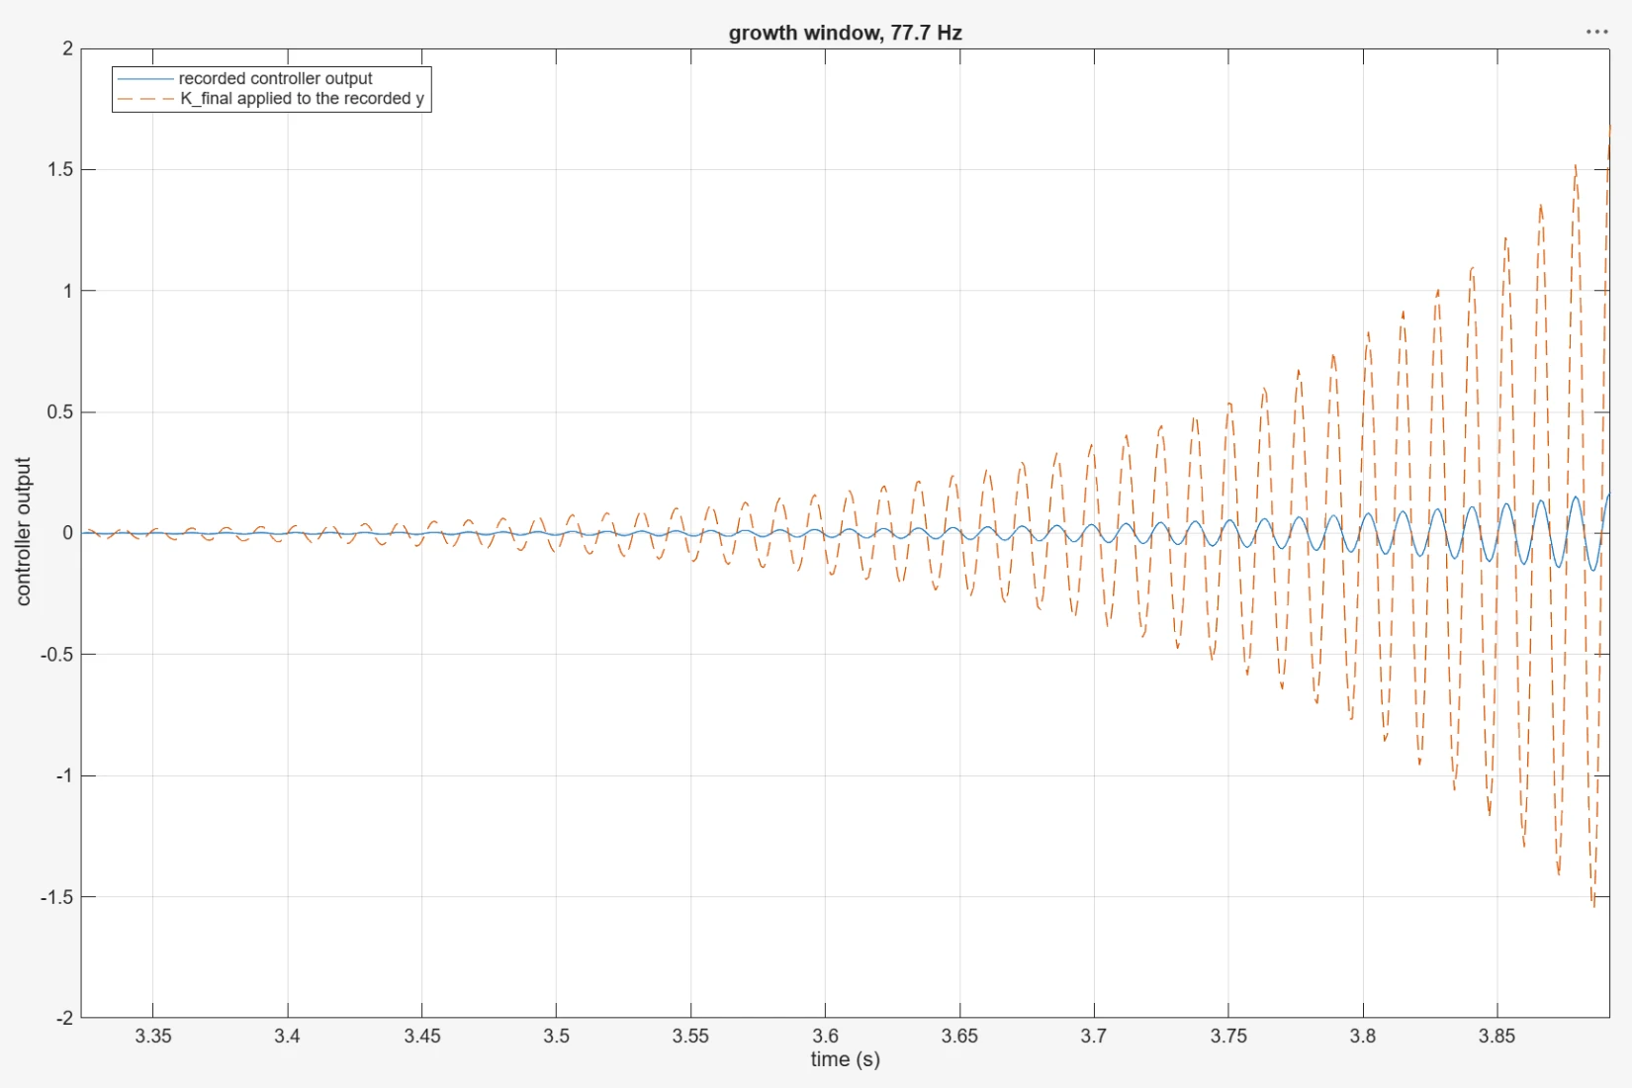
The controller that runs is not K_final
-20.3 dB
gain: ≈ 1/9.81, acceleration in g instead of m/s²?
-28.0°
phase: exactly 1 sample (1 ms) at 77.7 Hz
Measured at 77.7 Hz: recorded u/y vs designed -K_final
The plant path (controller output → acceleration) matches the identification within 1 dB and 3°
So the difference is inside the control model, not in the plant
Recorded controller output (blue) vs K_final applied offline to the recorded acceleration (dashed)
Notes:
Implemented controller ≈ 0.097 · z^-1 · K_final. The delay appears between two logged signals, so it is a block in the model (unit delay, rate transition, task boundary), not hardware latency, which is already inside the identified FRF.

Slide 9
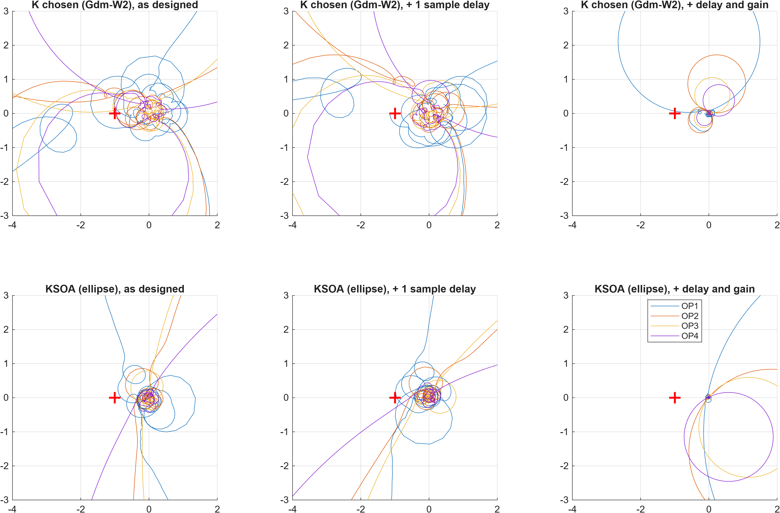
Delay and gain push K_chosen's 80 Hz loop around -1
K_chosen
With delay and gain, the 0 kg loop (OP1, blue) becomes a large circle that passes right next to -1: the instability seen at 77.7 Hz
KSOA
Same delay and gain: every operating point moves away from -1 (circles in the right half-plane), so it stays stable on the setup
Top: K_chosen (G_dm-W2). Bottom: KSOA (ellipse). Columns: as designed, + 1 sample, + delay and gain 1/9.81. Red cross: -1
Notes:
This is why neither the identified FRFs nor the robustness certificate showed the problem: both assume that the designed controller is the one running. W2 is also small around 80 Hz, so the design had no reason to keep that circle away from -1.

Slide 10
Next steps
1
Fix the implementation
2
Or design for the setup
Controller input in m/s² (after the g → m/s² conversion) and no extra sample in the controller path
Synthesis plant G_design = gain · z^-1 · G, so every controller accounts for both
3
Check before testing
4
Then re-run the experiments
Nyquist / min |1+L| with the implemented loop must predict K_chosen unstable and KSOA stable
Sine and sweep at all masses with d_ExperimentalResults, 80 Hz G_dm-W2 vs ellipse, and 50 Hz
Notes:
First confirm on the real-time model which signal the controller block reads and whether there is a unit delay or rate transition before it.

