Slide 1

MSC IN COMPUTATIONAL COGNITIVE SCIENCE
Brain Imaging – Methods and Applications
Module: Electroencephalography (EEG)
Lecture 10
Reading the mind?
Decoding and applications
Pierpaolo Croce
A.Y. 2026-2027

Slide 2
LECTURE 10
Today: from brain signals to predictions
Encoding vs decoding: two directions of inference.
1
MVPA: linear classifiers, cross-validation, overfitting, metrics.
2
Interpreting classifiers: weights vs patterns (Haufe et al., 2014).
3
Time-resolved decoding and temporal generalisation.
4
Applications: BCI, clinical EEG, EEG–fMRI; course wrap-up.
5
Brain Imaging · EEG · Lecture 10 · Decoding and applications
2
Notes:
Main references: Grootswagers, Wardle & Carlson (2017) J Cogn Neurosci 29:677 (decoding dynamic brain patterns from EEG/MEG); King & Dehaene (2014) Trends Cogn Sci 18:203; Haufe et al. (2014) NeuroImage 87:96; Wolpaw & Wolpaw (2012) Brain–Computer Interfaces.

Slide 3
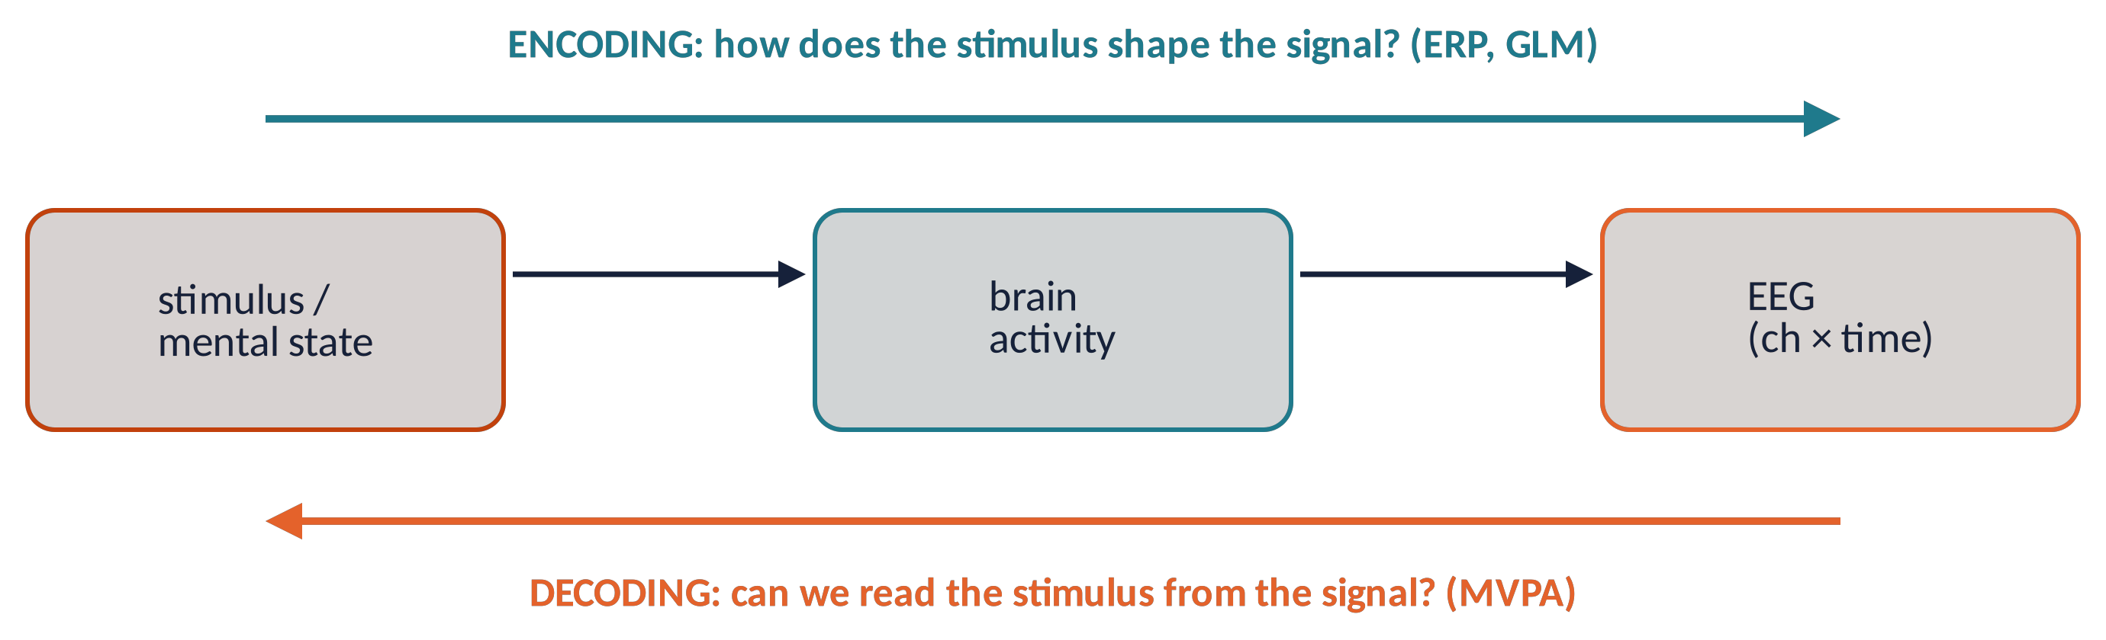
TWO DIRECTIONS
Encoding and decoding
1
Univariate (ERP): one channel at a time → multiple comparisons, choice of electrodes.
2
Multivariate (MVPA): uses the whole pattern; detects distributed, weak, individual-specific effects.
3
Question changes: from "where/when is the effect?" to "is information present?"
Metaphor a sommelier does not measure one molecule: the pattern of many tells the wine.
Brain Imaging · EEG · Lecture 10 · Decoding and applications
3
Notes:
Naselaris et al. (2011) NeuroImage 56:400 (encoding and decoding in fMRI); Haynes & Rees (2006) Nat Rev Neurosci 7:523. ERPs/GLMs are encoding models: they predict the signal from conditions. MVPA decodes conditions from multichannel patterns: more sensitive to distributed effects, no need to choose channels a priori.

Slide 4
01
Multivariate pattern analysis
4

Slide 5
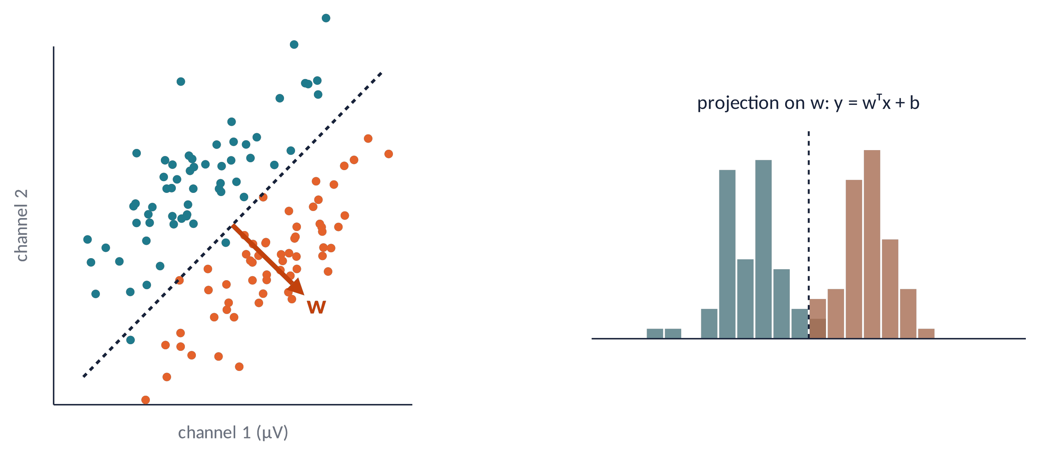
MVPA (1)
A linear classifier
Each trial = a point in channel space (x = amplitudes at time t).
A linear classifier finds a hyperplane separating the classes.
LDA with shrinkage (regularised covariance) is a robust default for EEG (Blankertz et al., 2011).
Also: SVM, logistic regression — similar performance.
w = Σ⁻¹ (μ₁ − μ₀) ŷ = sign(wᵀx + b)
Brain Imaging · EEG · Lecture 10 · Decoding and applications
5
Notes:
LDA with shrinkage (Ledoit–Wolf) is a strong default for EEG (Blankertz et al., 2011 NeuroImage 56:814; Grootswagers et al., 2017). SVM and logistic regression give similar results. Features: amplitudes of all channels at a time point (or a short window).

Slide 6
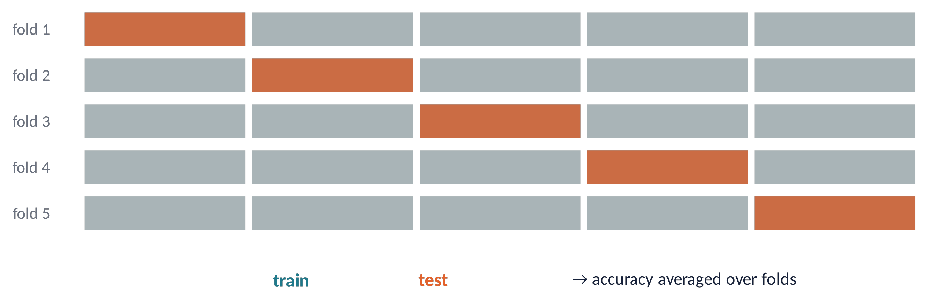
MVPA (2)
Training, testing, cross-validation
1
Test data must be never seen during training.
2
k-fold: split into k parts, train on k−1, test on the left-out, rotate, average.
3
⚠ Leakage: any step using labels or all data (feature selection, normalisation) inside the folds.
4
Small samples → large error bars (Varoquaux et al., 2017).
Brain Imaging · EEG · Lecture 10 · Decoding and applications
6
Notes:
Never test on training data. k-fold CV (k = 5–10), stratified; preprocessing steps fitted on the data (e.g., PCA, scaling, ICA selection based on labels) must be done inside the folds to avoid leakage (Varoquaux et al., 2017 NeuroImage 145:166 — cross-validation failure: small sample sizes lead to large error bars).

Slide 7
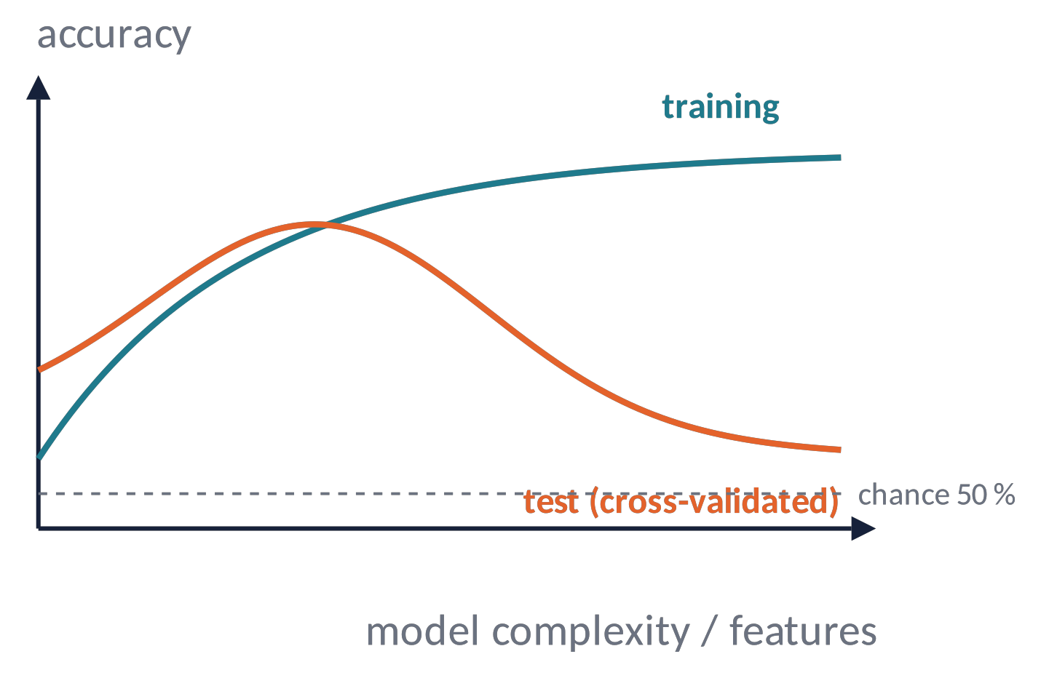
MVPA (3)
Overfitting and the curse of dimensionality
Many features, few trials → the model memorises noise: training accuracy ≈ 100 %, test ≈ chance.
Remedies: regularisation, fewer features (per time point), more trials, pseudo-trials.
Only cross-validated accuracy counts.
Metaphor a student who memorises the answers of last year's exam fails a new one.
Brain Imaging · EEG · Lecture 10 · Decoding and applications
7
Notes:
With 64 channels × 100 time points = 6400 features and 100 trials, any classifier can fit noise perfectly. Remedies: regularisation (shrinkage, L2), fewer features (time-resolved decoding, averaging windows, PCA), more trials, pseudo-trials (averaging small groups of trials; Grootswagers et al., 2017).

Slide 8
02
Evaluating and interpreting
8

Slide 9
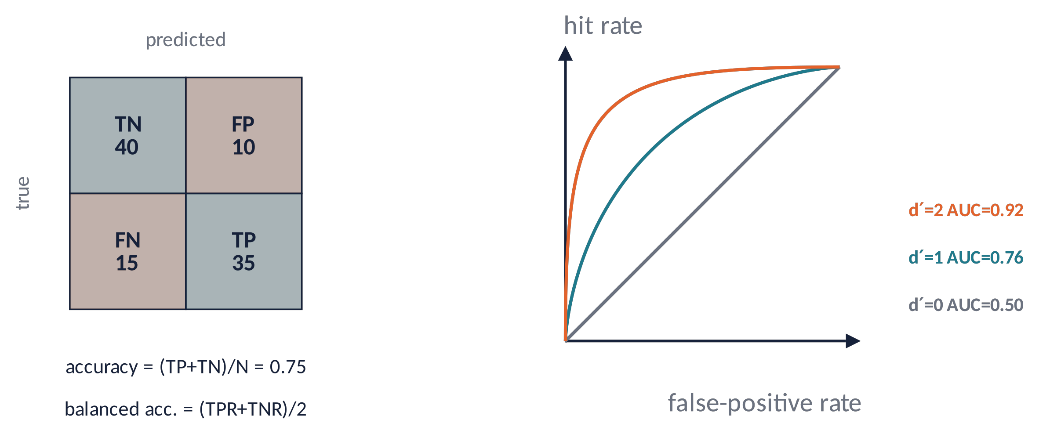
EVALUATION (1)
Performance metrics and chance level
Confusion matrix → accuracy; balanced accuracy if classes are unbalanced.
d′ and AUC: threshold-free sensitivity (signal detection theory).
⚠ Chance ≠ 50 % with few trials: use label permutation (Combrisson & Jerbi, 2015).
Brain Imaging · EEG · Lecture 10 · Decoding and applications
9
Notes:
Balanced accuracy for unbalanced classes; d' = z(hit) − z(FA); AUC is threshold-free. Chance is not exactly 50 % with few trials: test significance by label permutation (Combrisson & Jerbi, 2015 J Neurosci Methods 250:126) and at group level by t-tests against chance or prevalence inference (Allefeld et al., 2016).

Slide 10
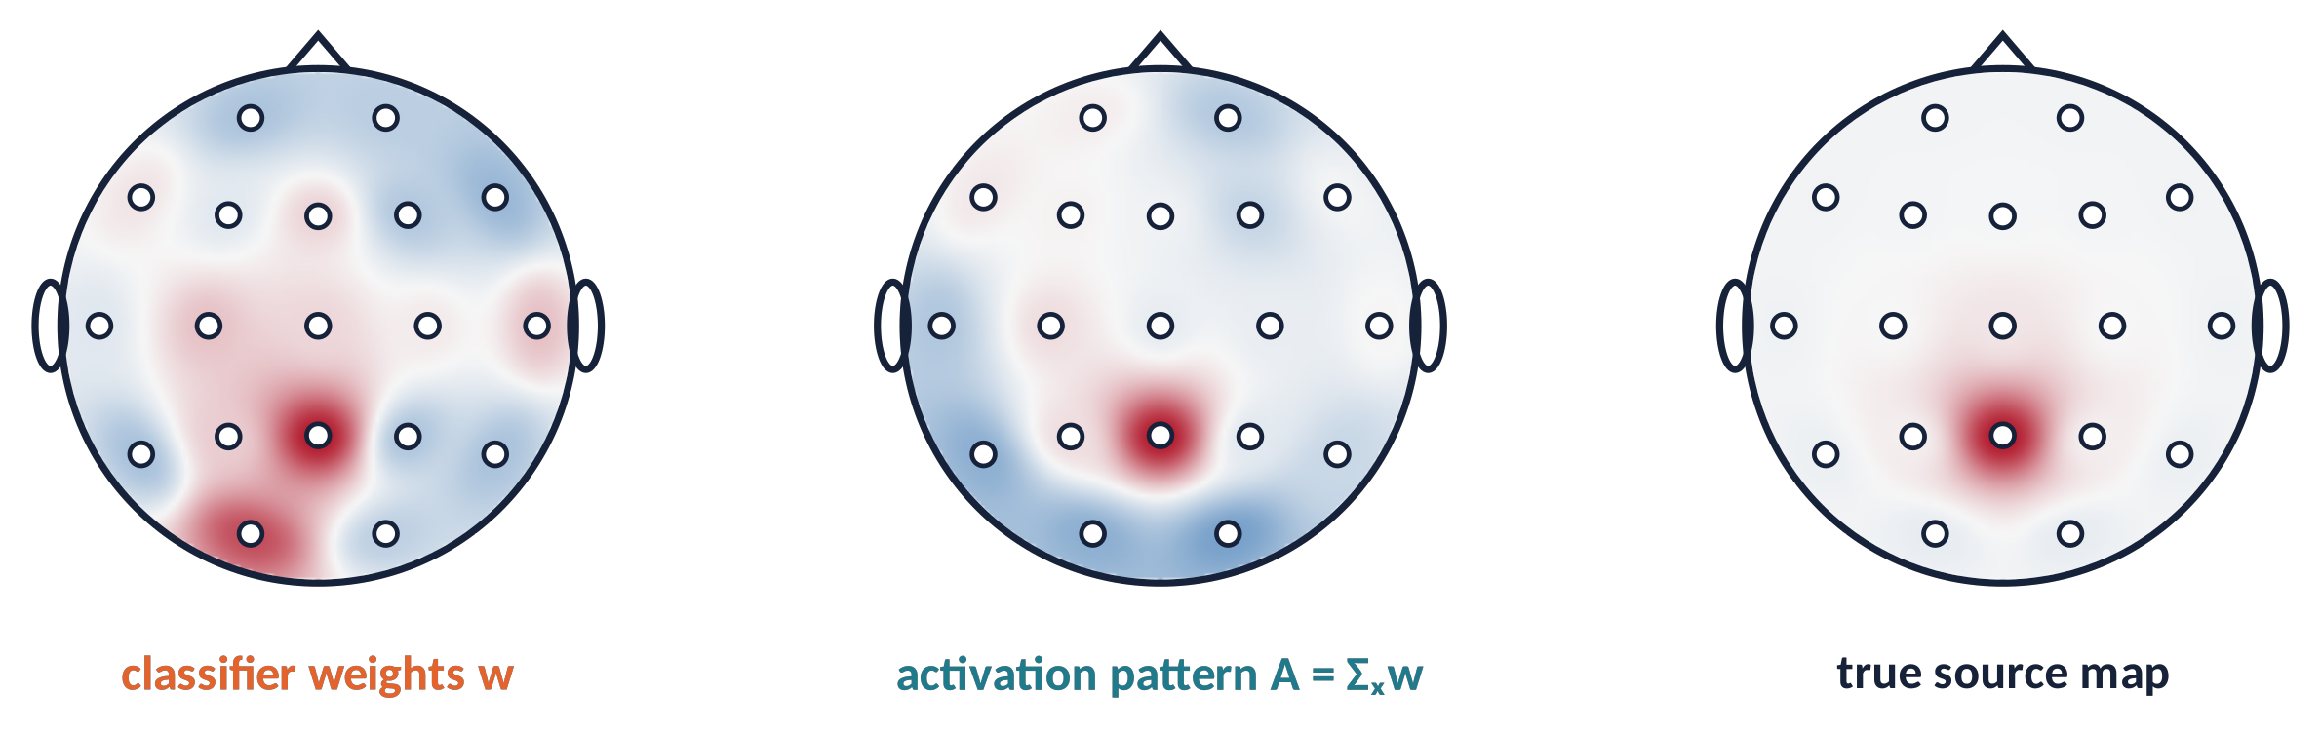
EVALUATION (2)
Weights are not patterns
A = Σ_{x} · W · Σ_{ŝ}⁻¹
Weights (backward model) also cancel noise: a large weight can sit on a channel without signal.
Transform them into activation patterns (forward model) before interpreting topographies (Haufe et al., 2014).
Brain Imaging · EEG · Lecture 10 · Decoding and applications
10
Notes:
Haufe et al. (2014) NeuroImage 87:96. A backward model's weights W combine signal and noise suppression: a channel with large weight may carry no signal (it cancels noise). The forward-model activation pattern A = Σ_x W Σ_ŝ⁻¹ is interpretable as the spatial pattern of the signal of interest.

Slide 11
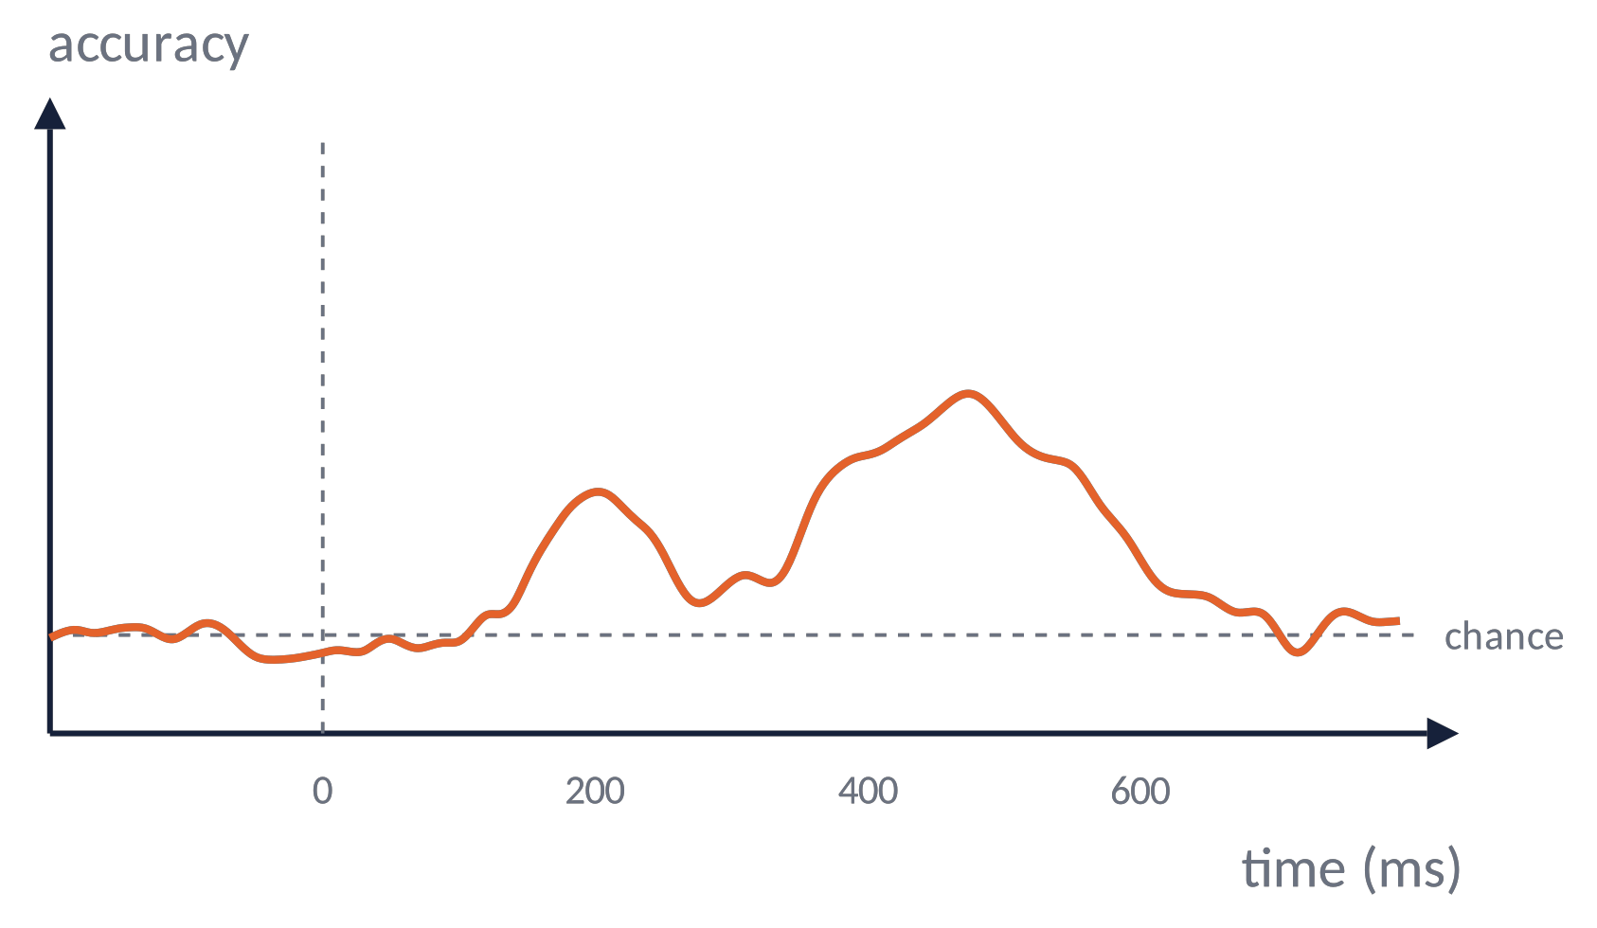
TIME-RESOLVED DECODING (1)
When does the brain know?
Repeat the classification at every time point (features = channels).
The accuracy curve shows when information is present, with ms resolution.
Group statistics: accuracy vs chance with cluster-based permutation.
⚠ High-pass filters can shift the apparent onset (Van Driel et al., 2021).
Brain Imaging · EEG · Lecture 10 · Decoding and applications
11
Notes:
Train and test a classifier independently at each time point (Grootswagers et al., 2017). Above-chance clusters are tested with cluster-based permutation across subjects. The onset of decodability indicates when information becomes available — but beware filter-induced smearing (Van Driel et al., 2021 J Neurosci Methods).

Slide 12
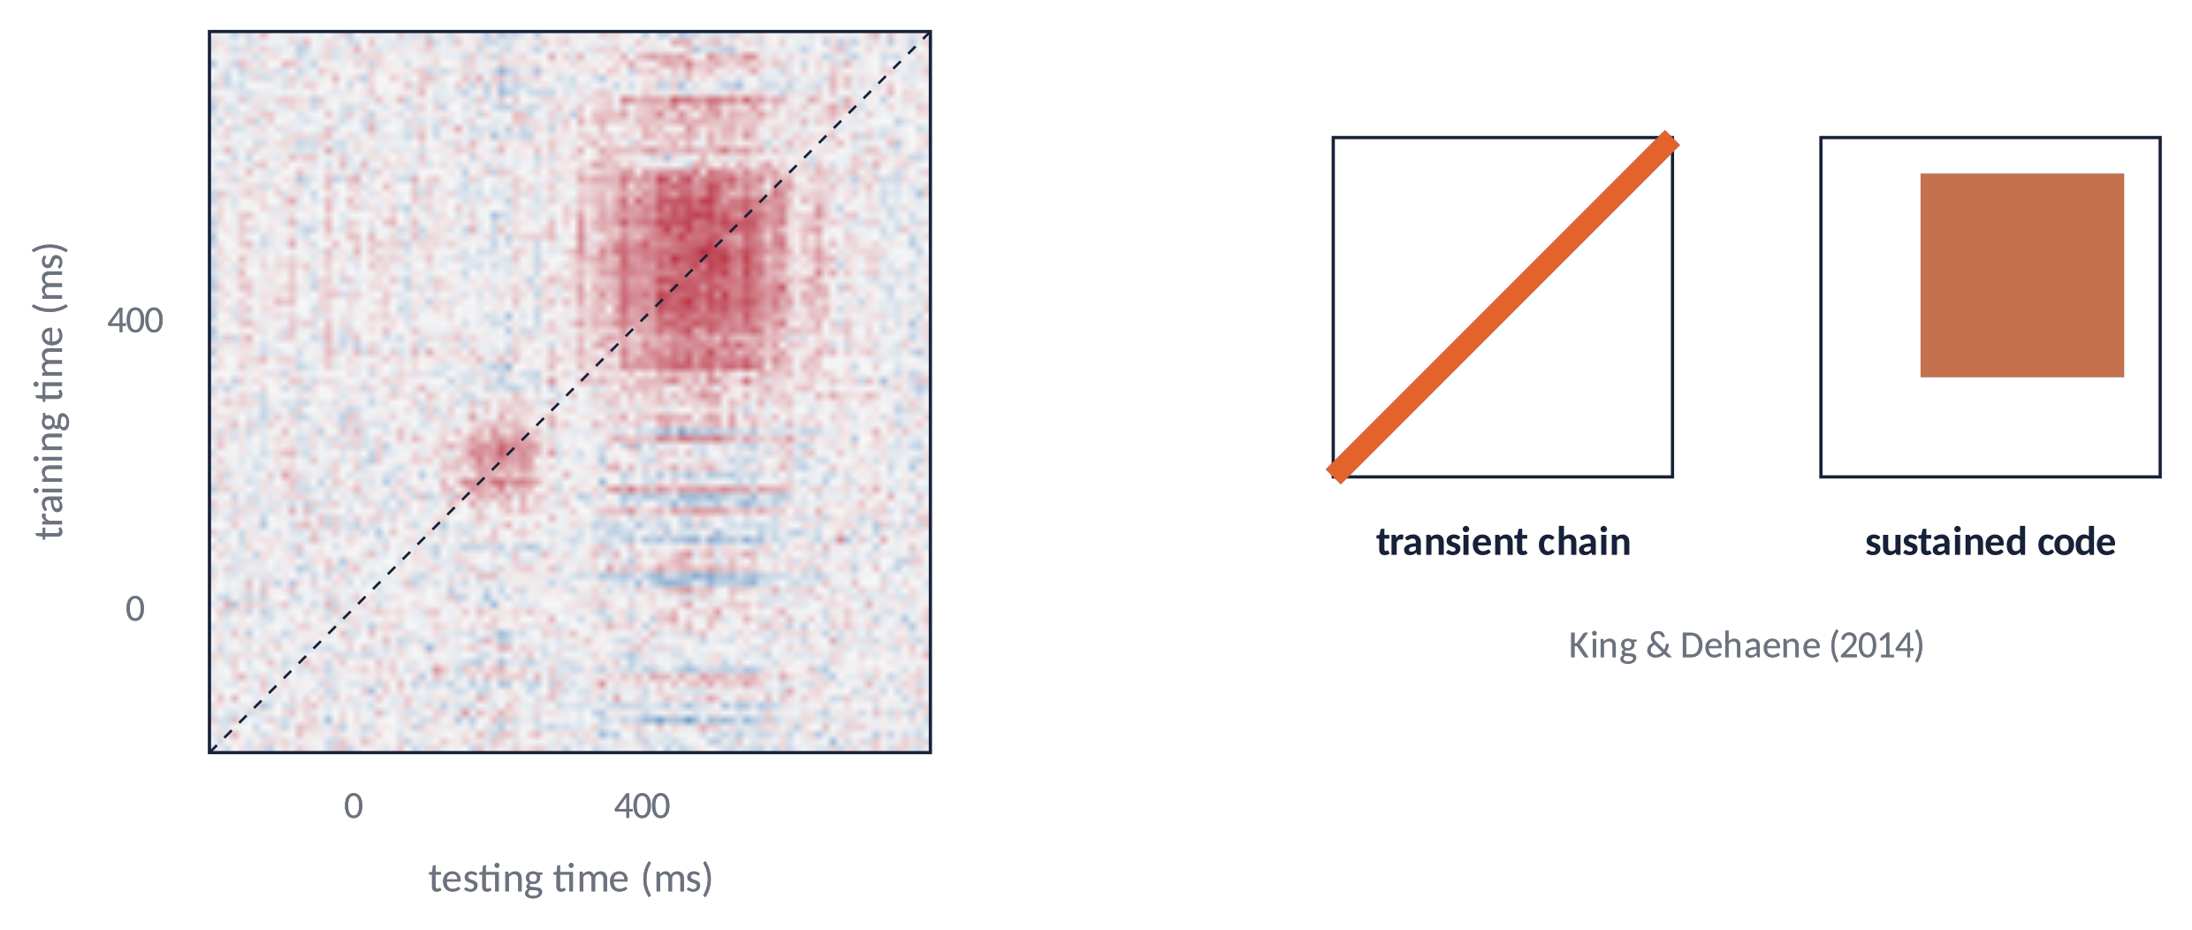
TIME-RESOLVED DECODING (2)
Temporal generalisation
Train at time t, test at every t′ → a time × time matrix (King & Dehaene, 2014).
Diagonal = a chain of transient codes; square = a sustained code.
Our simulation: an early transient (~200 ms) and a sustained late code (350–600 ms).
Brain Imaging · EEG · Lecture 10 · Decoding and applications
12
Notes:
King & Dehaene (2014) Trends Cogn Sci 18:203 — train at t, test at t'. A diagonal pattern indicates a chain of transient codes; a square indicates a sustained code; off-diagonal below-chance indicates reversal. Example with N2pc/visual search: Fahrenfort et al. (2017) J Cogn Neurosci.

Slide 13
03
Applications
13

Slide 14
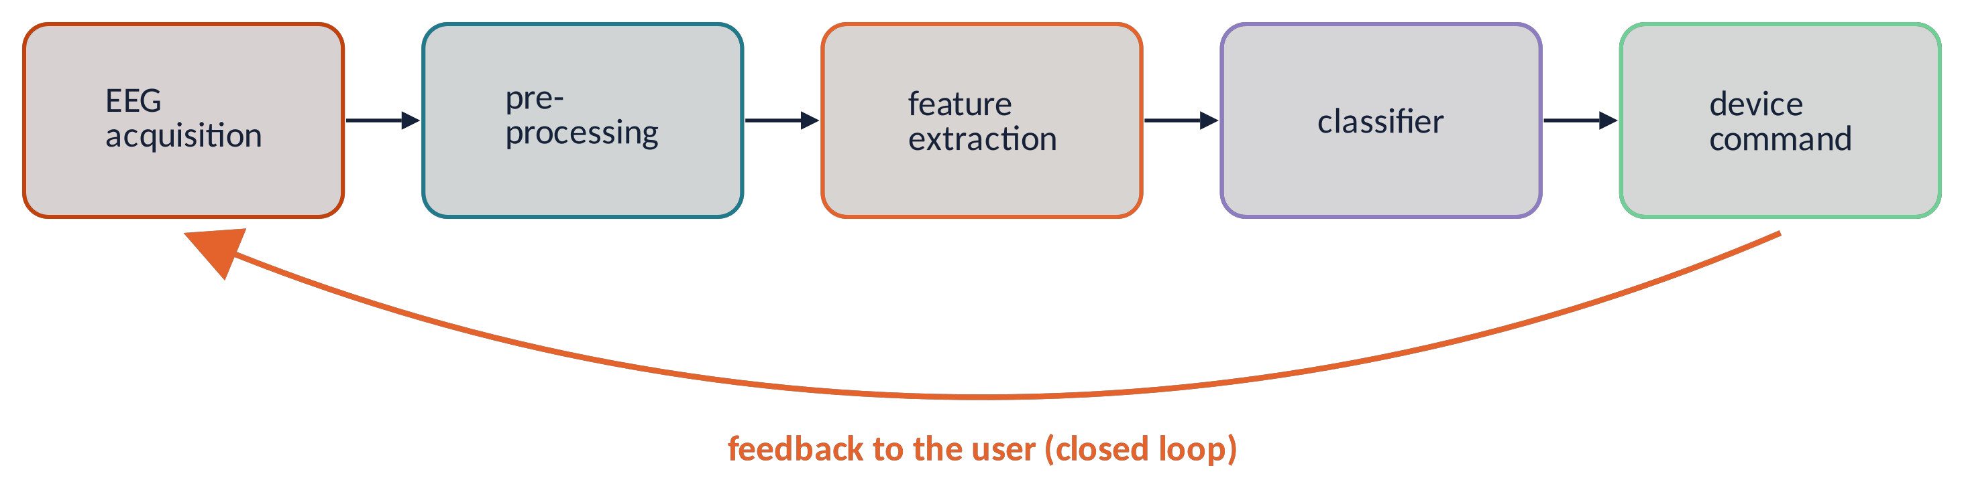
APPLICATIONS (1)
Brain–computer interfaces
P300 speller
rare flashes of the attended row/column evoke a P3 (Farwell & Donchin, 1988).
SSVEP
targets flicker at different frequencies; the attended one dominates the spectrum.
Motor imagery
imagining a hand movement → contralateral mu/beta ERD (Pfurtscheller & Neuper, 2001).
Uses
communication in ALS/locked-in, stroke rehabilitation, neurofeedback.
Brain Imaging · EEG · Lecture 10 · Decoding and applications
14
Notes:
Wolpaw et al. (2002) Clin Neurophysiol 113:767; Lotte et al. (2018) J Neural Eng 15:031005 (review of classification algorithms). Paradigms: P300 speller (Farwell & Donchin, 1988), SSVEP, motor imagery (mu/beta ERD; Pfurtscheller & Neuper, 2001). Applications: communication in ALS/locked-in, neurorehabilitation after stroke (Ang et al., 2015), neurofeedback.

Slide 15
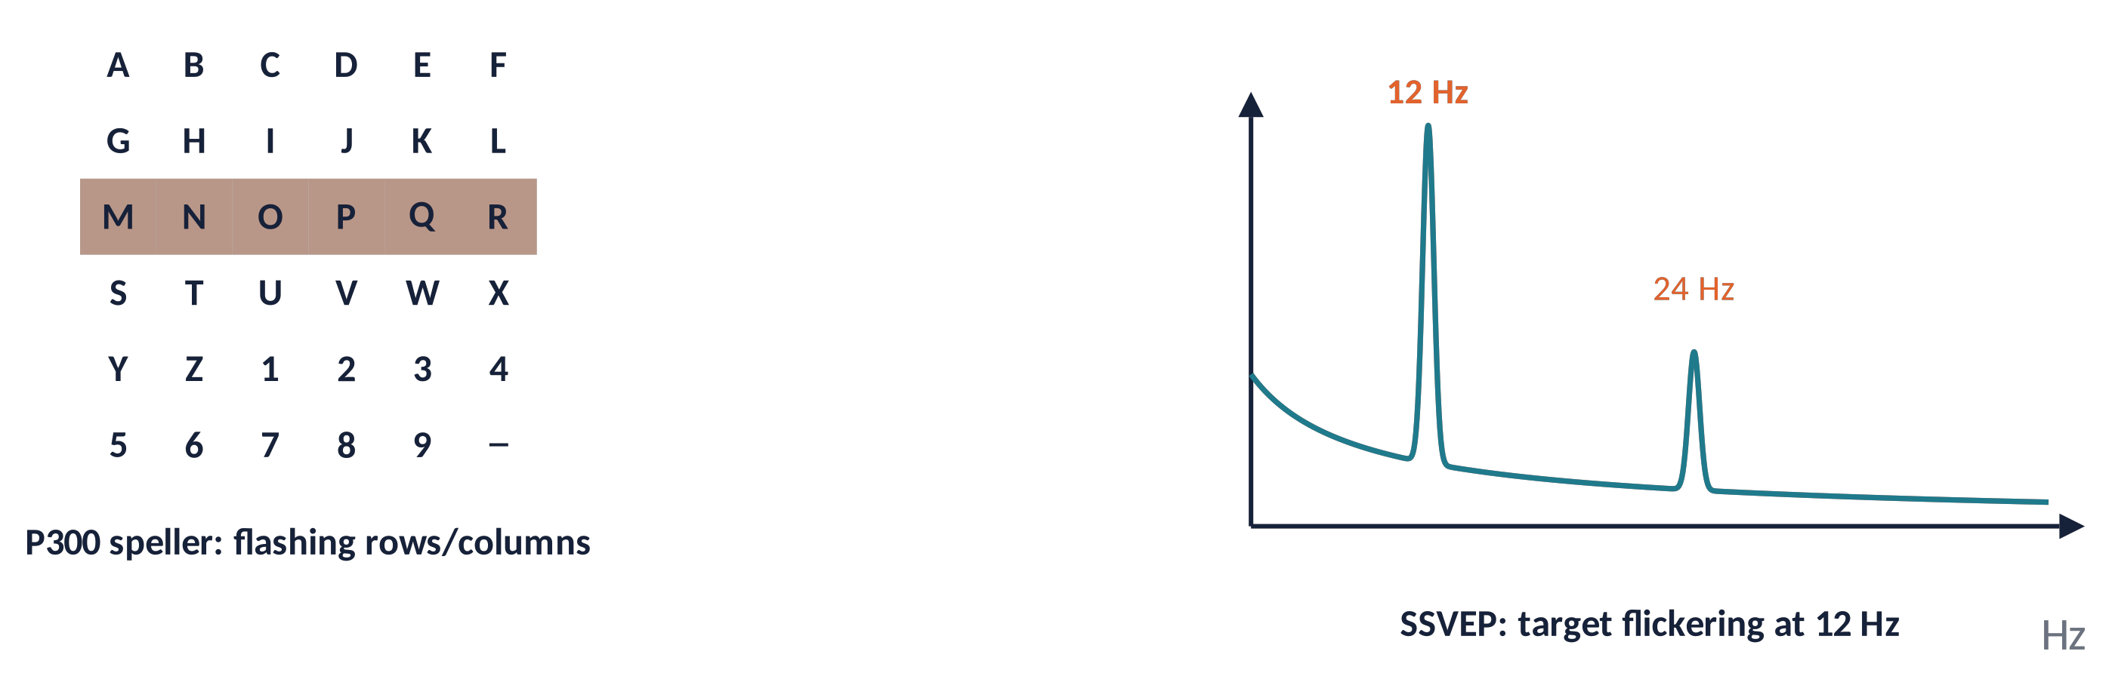
APPLICATIONS (2)
P300 speller and SSVEP
1
P300: classify target vs non-target ERPs (LDA); average several repetitions for reliability.
2
SSVEP: detect the flicker frequency and its harmonics (e.g. CCA); fast, little training.
3
Performance: information transfer rate (bits/min) = accuracy × classes × speed.
Brain Imaging · EEG · Lecture 10 · Decoding and applications
15
Notes:
Information transfer rate (bits/min) combines accuracy, number of classes and speed (Wolpaw et al., 2002). SSVEP detection with canonical correlation analysis (Lin et al., 2006 IEEE TBME). Dry-electrode and wearable systems enable out-of-lab use but with lower SNR.

Slide 16
APPLICATIONS (3)
Clinical EEG
Epilepsy
spikes, seizures, presurgical source imaging (Brodbeck et al., 2011).
Sleep
stages, apnoea, automatic scoring with machine learning.
Consciousness
coma and disorders of consciousness: covert command following detected by decoding (Claassen et al., 2019).
Anaesthesia & dementia
depth-of-anaesthesia monitors; slowing of rhythms in dementia.
EEG is cheap, portable, bedside and millisecond-precise: ideal for monitoring and screening.
Brain Imaging · EEG · Lecture 10 · Decoding and applications
16
Notes:
Epilepsy: interictal epileptiform discharges, seizure detection, presurgical ESI (Mégevand & Seeck, 2018; Brodbeck et al., 2011 Brain 134:2887). Sleep: AASM scoring. Disorders of consciousness: EEG markers and covert command following (Claassen et al., 2019 NEJM 380:2497). Anaesthesia depth monitoring. Dementia: slowing of rhythms. Brain death: electrocerebral silence.

Slide 17
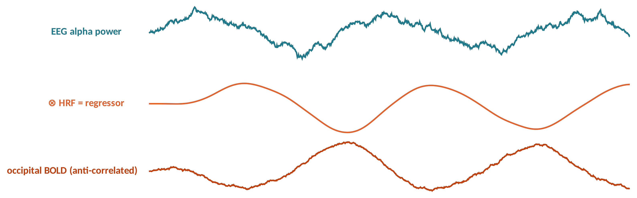
APPLICATIONS (4)
Multimodal imaging: EEG–fMRI
EEG = when (ms); fMRI = where (mm): complementary.
EEG-informed fMRI: EEG features ⊗ HRF as GLM regressors (e.g. alpha ↔ negative occipital BOLD; Goldman et al., 2002; Laufs et al., 2003).
Challenges: gradient and ballistocardiogram artifacts (Allen et al., 1998, 2000).
Also: EEG + TMS (causal probing), EEG + eye tracking, EEG + fNIRS.
Brain Imaging · EEG · Lecture 10 · Decoding and applications
17
Notes:
Goldman et al. (2002) NeuroReport 13:2487 and Laufs et al. (2003) PNAS 100:11053: alpha power anticorrelated with occipital/parietal BOLD. Artifacts in the scanner: gradient (template subtraction, Allen et al., 2000) and ballistocardiogram (Allen et al., 1998). Integration approaches: EEG-informed fMRI, fMRI-informed source imaging, symmetric fusion (Huster et al., 2012 J Neurosci 32:6053). Microstate–BOLD: Lecture 8.

Slide 18
04
In practice and wrap-up
18

Slide 19
IN MATLAB
Time-resolved decoding with cross-validation
X = cat(3, A.data, B.data); X = permute(X, [3 1 2]); % trials x channels x time
y = [zeros(size(A.data,3),1); ones(size(B.data,3),1)];
cv = cvpartition(y, 'KFold', 5); nT = size(X,3); acc = zeros(1,nT);
for t = 1:nT
Xt = X(:,:,t); c = 0;
for k = 1:cv.NumTestSets
tr = training(cv,k); te = test(cv,k);
mdl = fitcdiscr(Xt(tr,:), y(tr), 'DiscrimType','linear', 'Gamma',0.2); % shrinkage LDA
c = c + sum(predict(mdl, Xt(te,:)) == y(te));
end
acc(t) = c / numel(y);
end
w = mdl.Coeffs(1,2).Linear; % weights (last time point)
Apat = cov(Xt) * w; % activation pattern (Haufe 2014)
plot(A.times, acc); yline(0.5, '--'); xlabel('time (ms)'); ylabel('accuracy');
% chance: repeat with y(randperm(numel(y))) 1000 times -> null distribution
Brain Imaging · EEG · Lecture 10 · Decoding and applications
19
Notes:
Plain MATLAB (Statistics and Machine Learning Toolbox: fitcdiscr, cvpartition). Alternatives: MVPA-Light (Treder, 2020 Front Neurosci 14:289), CoSMoMVPA (Oosterhof et al., 2016), ADAM toolbox (Fahrenfort et al., 2018). Remember: equal trial numbers per class, shrinkage, permutation test for chance.

Slide 20
ETHICS
Neural data are personal data
Decoding reads information, not "thoughts": accuracy is limited and task-specific.
1
EEG is health/biometric data (GDPR): consent, anonymisation, secure sharing.
2
Consumer neurotech raises questions of mental privacy and cognitive liberty (Ienca & Andorno, 2017; Yuste et al., 2017).
3
Report limits honestly: avoid hype in communication.
4
Brain Imaging · EEG · Lecture 10 · Decoding and applications
20
Notes:
Ienca & Andorno (2017) Life Sci Soc Policy 13:5 (towards new human rights: cognitive liberty, mental privacy); Yuste et al. (2017) Nature 551:159 (four ethical priorities for neurotechnologies and AI); GDPR: EEG is health/biometric data. Consumer EEG devices and data sharing.

Slide 21
COURSE WRAP-UP
Ten lectures in one slide
1 · History & what EEG measures
6 · Spectra & time-frequency
2 · Cellular bases
7 · ERPs
3 · From neurons to scalp
8 · Spatial analysis & microstates
4 · Recording
9 · Sources & connectivity
5 · Preprocessing & ICA
10 · Decoding & applications
Physics → recording → cleaning → time, frequency, space → sources and networks → prediction.
Brain Imaging · EEG · Lecture 10 · Decoding and applications
21
Notes:
A map of the course to review for the exam.

Slide 22
CHECK YOUR UNDERSTANDING
Three questions
You select the 10 most discriminative channels on all data, then cross-validate: 95 %. What went wrong?
1
Your classifier has a large weight at Fp1. Does Fp1 carry the effect?
2
The temporal generalisation matrix is a thin diagonal. What does it mean?
3
Brain Imaging · EEG · Lecture 10 · Decoding and applications
22
Notes:
(1) Overfitting/leakage: features selected on all data; accuracy must be cross-validated with selection inside folds. (2) Weights ≠ patterns: compute A = Σ_x w. (3) Diagonal → transient chain; square → sustained representation.

Slide 23
TAKE-HOME MESSAGES
Take-home messages
Decoding asks "is the information there, and when?" using whole patterns.
1
Cross-validate, regularise, avoid leakage; test chance by permutation.
2
Interpret patterns, not weights (Haufe et al., 2014).
3
Temporal generalisation reveals the dynamics of codes.
4
EEG powers BCIs, clinical monitoring, multimodal imaging — with ethical care.
5
Brain Imaging · EEG · Lecture 10 · Decoding and applications
23

Slide 24
SUGGESTED READING
Suggested reading
Grootswagers T., Wardle S.G., Carlson T.A. (2017) Decoding dynamic brain patterns from evoked responses: a tutorial on MVPA applied to time series neuroimaging data. J Cogn Neurosci 29:677–697.
King J.-R., Dehaene S. (2014) Characterizing the dynamics of mental representations: the temporal generalization method. Trends Cogn Sci 18:203–210.
Haufe S. et al. (2014) On the interpretation of weight vectors of linear models in multivariate neuroimaging. NeuroImage 87:96–110.
Blankertz B. et al. (2011) Single-trial analysis and classification of ERP components — a tutorial. NeuroImage 56:814–825.
Varoquaux G. et al. (2017) Assessing and tuning brain decoders: cross-validation, caveats, and guidelines. NeuroImage 145:166–179.
Combrisson E., Jerbi K. (2015) Exceeding chance level by chance. J Neurosci Methods 250:126–136.
Wolpaw J.R. et al. (2002) Brain–computer interfaces for communication and control. Clin Neurophysiol 113:767–791.
Lotte F. et al. (2018) A review of classification algorithms for EEG-based brain–computer interfaces: a 10 year update. J Neural Eng 15:031005.
Laufs H. et al. (2003) EEG-correlated fMRI of human alpha activity. NeuroImage 19:1463–1476.
Claassen J. et al. (2019) Detection of brain activation in unresponsive patients with acute brain injury. N Engl J Med 380:2497–2505.
Treder M.S. (2020) MVPA-Light: a classification and regression toolbox for multi-dimensional data. Front Neurosci 14:289.
Yuste R. et al. (2017) Four ethical priorities for neurotechnologies and AI. Nature 551:159–163.
Brain Imaging · EEG · Lecture 10 · Decoding and applications
24

